Slide 1
Defining ODEs in COPASI (or SBML) that are not chemical reactions
Jim Sluka CC3D Workshop 17 Aug. 2, 2017

Slide 2
You want to model a set of ODE’s but …
The system isn’t a set of reactions
The concept of “reactant” and “product” doesn’t really apply
For example, you have an ODE that contains variables x, y and z and the ODE for z is;
$$\frac{dz}{dt}=x∙z −y$$
This equation really can’t be interpreted using a “reactant” and “product” formalism

Slide 3
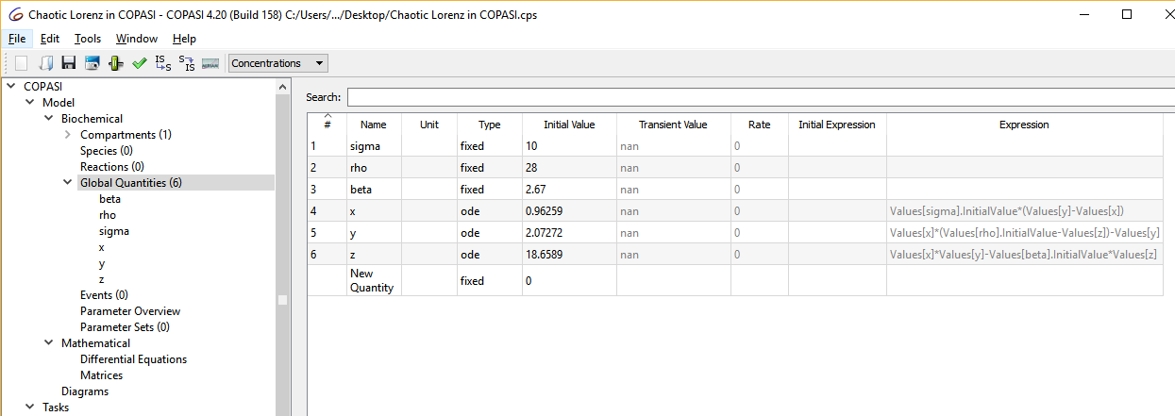
In COPASI (and SBML)
You can assign Global Quantities as a fixed value, as an assignment (calculated from other values) or as an ODE

Slide 4
Step 1:
In the Global Quantities table click New Quantity and enter a name

Slide 5
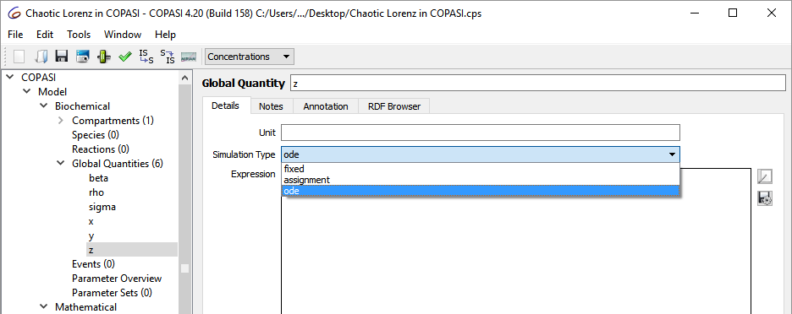
Step 2:
Double click the line in the Global Quantities table to open the edit page for your new variable
Select from the Simulation Type dropdown ode

Slide 6
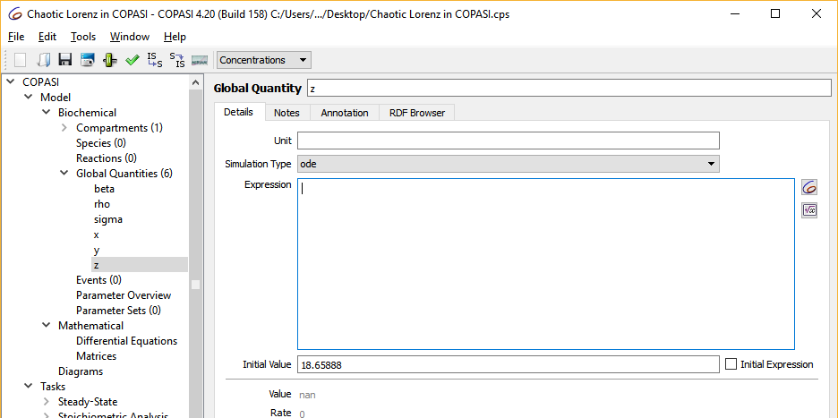
Step 3:
Click in the Expression box, which will allow you to enter an equation and also activates the COPASI button

Slide 7
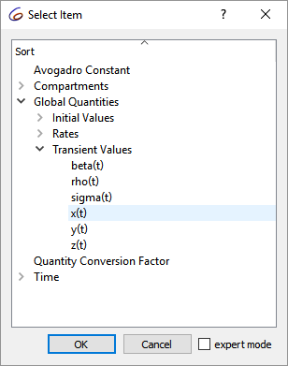
Step 4:
Using a combination of math symbols, functions, (see http://copasi.org/Support/User_Manual/Model_Creation/User_Defined_Functions/ for a list of math functions) and COPASI variables create your ODE.
While editing the equation the box will be pink if COPASI cannot parse the equation. It will turn blue if COPASI can parse the equation.
Use the enter key or click the “commit” button to finish the equation.

Slide 8
Step 5:
You can check your equations by going to COPASI’s Mathematical and Differential Equations tab
The ODE assigned to the variable z.

Slide 9
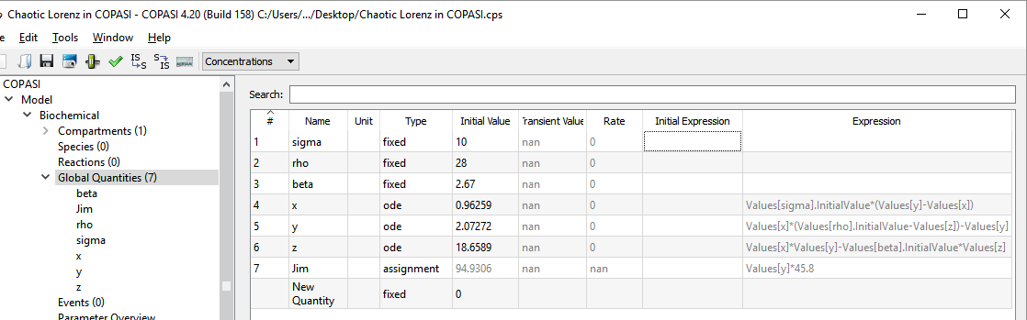
Step 6:
You can create variables, ODEs, assignments etc.

Slide 10
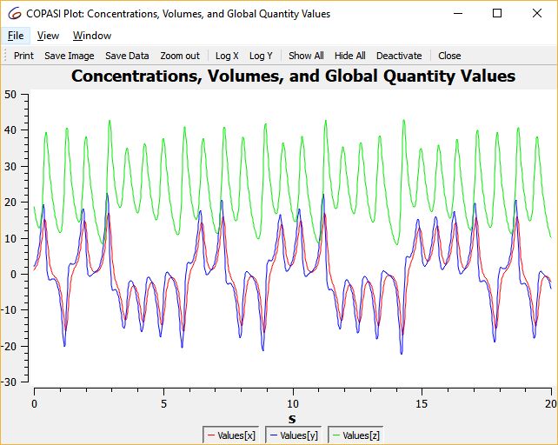
Step 7:
The system of ODEs can now be run or analyzed using the standard COPASI tools.
For example, a time course for the set of ODEs (bottom left) in the file “ Chaotic Lorenz in COPASI.cps“ produces the graph below right. (sigma σ, beta β and rho ρ are constants, x, y and z are variables defined by ODEs)
Math
In COPASI

