Slide 1
Intro to CC3D Day 2 CPM/GGH basics, cell sort, plots
James A. Glazier
Biocomplexity Institute
Indiana University
Bloomington, IN 47405
USA
Julio Belmonte
EMBL
Heidelberg
Germany
Bloomington IN, US
Tuesday, August 1st, 2017
Support: NIGMS-R01GM076692, [NIGMS-R01GM077138], NIH-U01-GM111243, NIGMS-R01 GM122424, [Falk Medical Research Trust], IUCRG, [NSF], [US EPA], EMBL-Marie Curie Interdisciplinary Postdoctoral Fellowship

Slide 2
Many Ways to Model Cells in Tissues
Rule-based:
Cellular Automata
Generic Agent Based Models
Physics Based:
Center Models
Subcellular Element Models
Viscoelastic Models
Vertex Models
Immersed Boundary Models
Cellular Potts Model/
Glazier-Graner-Hogeweg Model

Slide 3
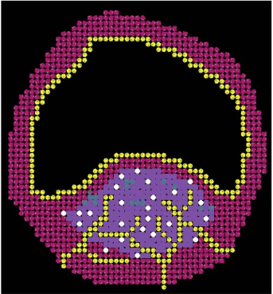
Many Ways to Model Cells in Tissues
Rule-based:
Cellular Automata
Generic Agent Based Models
Physics Based:
Center Models
Subcellular Element Models
Viscoelastic Models
Vertex Models
Immersed Boundary Models
Cellular Potts Model/
Glazier-Graner-Hogeweg Model
Agent-Based Model of Atherosclerotic Plaque Progression, Peirce-Cottler et al

Slide 4
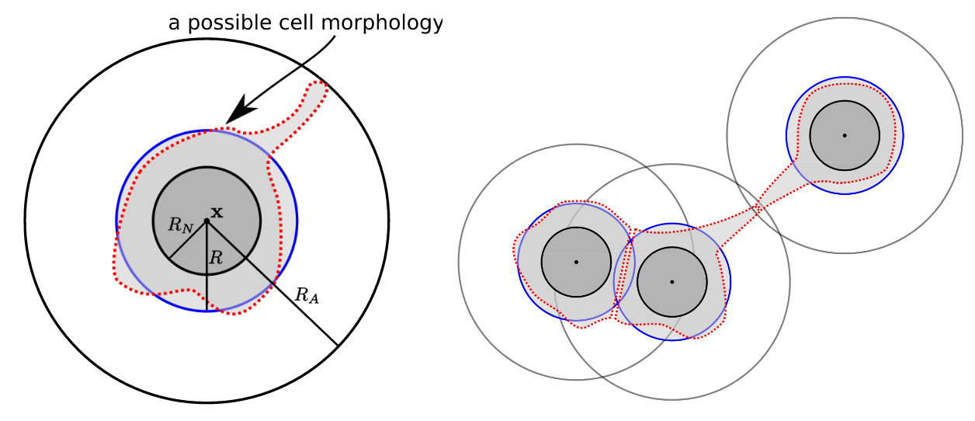
Many Ways to Model Cells in Tissues
Rule-based:
Cellular Automata
Generic Agent Based Models
Physics Based:
Center Models
Subcellular Element Models
Viscoelastic Models
Vertex Models
Immersed Boundary Models
Cellular Potts Model/
Glazier-Graner-Hogeweg Model

Slide 5
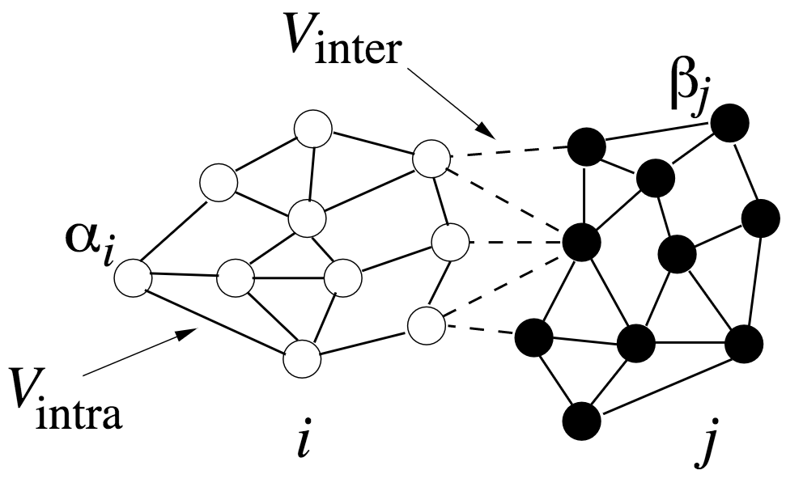
Many Ways to Model Cells in Tissues
Rule-based:
Cellular Automata
Generic Agent Based Models
Physics Based:
Center Models
Subcellular Element Models
Viscoelastic Models
Vertex Models
Immersed Boundary Models
Cellular Potts Model/
Glazier-Graner-Hogeweg Model

Slide 6
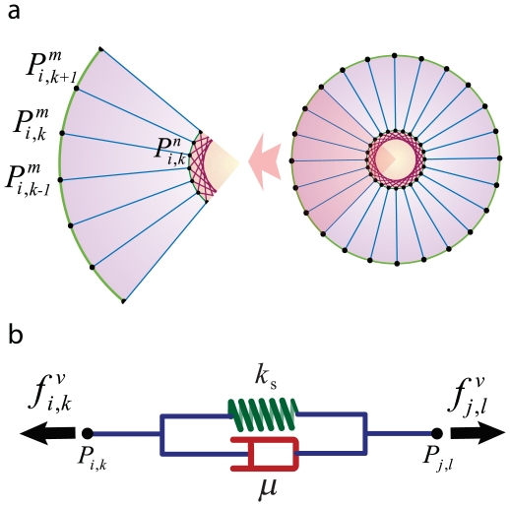
Many Ways to Model Cells in Tissues
Rule-based:
Cellular Automata
Generic Agent Based Models
Physics Based:
Center Models
Subcellular Element Models
Viscoelastic Models
Vertex Models
Immersed Boundary Models
Cellular Potts Model/
Glazier-Graner-Hogeweg Model

Slide 7
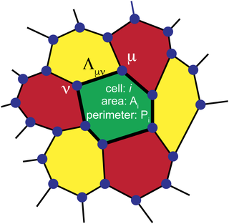
Many Ways to Model Cells in Tissues
Rule-based:
Cellular Automata
Generic Agent Based Models
Physics Based:
Center Models
Subcellular Element Models
Viscoelastic Models
Vertex Models
Immersed Boundary Models
Cellular Potts Model/
Glazier-Graner-Hogeweg Model

Slide 8
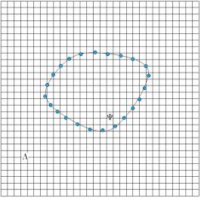
Many Ways to Model Cells in Tissues
Rule-based:
Cellular Automata
Generic Agent Based Models
Physics Based:
Center Models
Subcellular Element Models
Viscoelastic Models
Vertex Models
Immersed Boundary Models
Cellular Potts Model/
Glazier-Graner-Hogeweg Model

Slide 9
Many Ways to Model Cells in Tissues
Rule-based:
Cellular Automata
Generic Agent Based Models
Physics Based:
Center Models
Subcellular Element Models
Viscoelastic Models
Vertex Models
Immersed Boundary Models
Cellular Potts Model/
Glazier-Graner-Hogeweg Model

Slide 10
A Place to Read about Virtual-Tissue Models
http://link.springer.com/book/10.1007%2F978-3-7643-8123-3

Slide 11
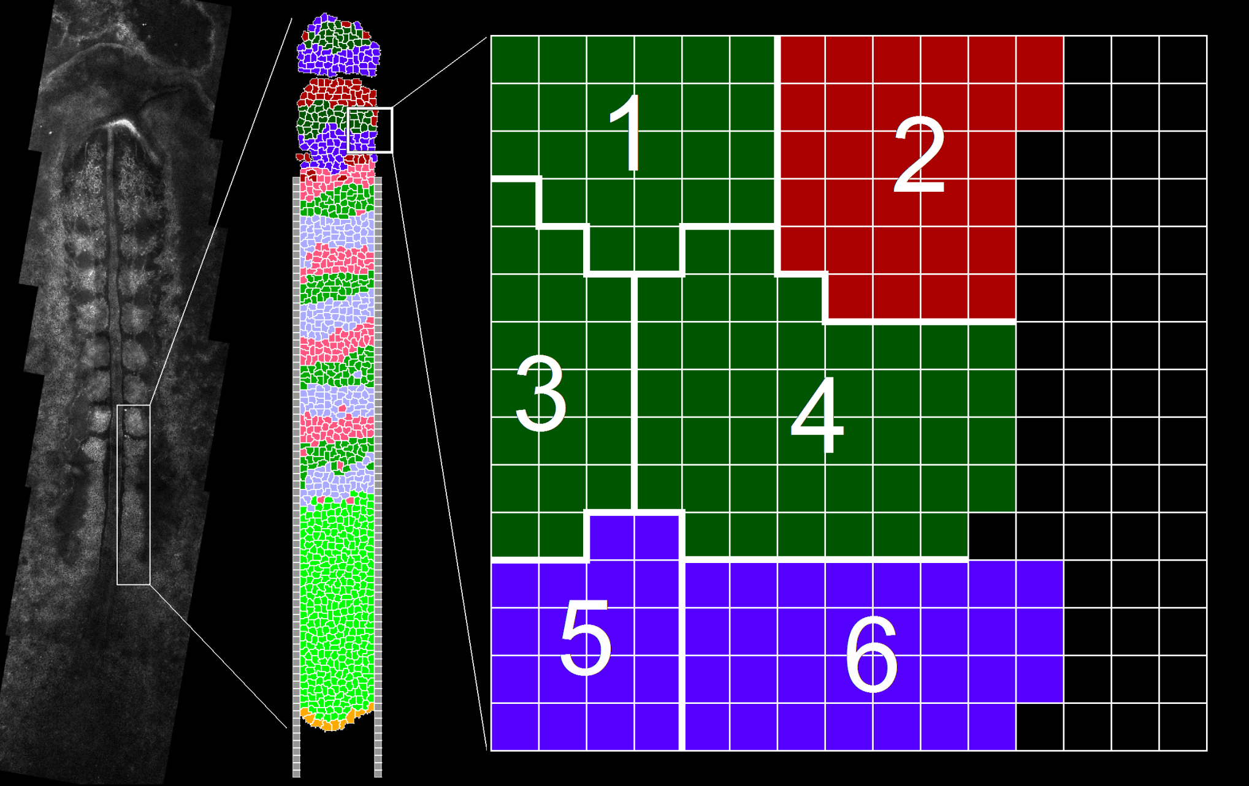
One Way to Describe Cells and their Behaviors:The GGH Model
Developed in 1991-1993 in collaboration with Francois Graner in the Laboratory of Prof. Yasuji Sawada, RIEC, Tohoku University

Slide 12
From Ising Model to GGH Model Via Potts Model and Cellular Potts Model
Ising Model→
Potts Model→
Cellular Potts Model→
GGH Model
A series of increases of complexity in:
Elements at a Lattice Site
Coupling to Additional Mechanisms
Effective Energy
Update Rules
Update Acceptance Function

Slide 13
Background – Ising Model
1st neighbors
 |  |  | X
4th neighbors
 |  |  | X

Slide 14
Background – Ising Model
Algorithm:
1) Randomly select a site i
2) Select a neighboring site j
If state (color) different:
3) Calculate current energy of site j and if j = i
4) Calculate change in energy ΔE and accept change (flip) according to:
3)
 |  |  | j
 |  |  |  | i
1) and 2)
E_{initial}
 |  |  | j
 |  |  |  | i
4)
 |  |  | j
 |  |  |  | i
P(ΔE)
 |  |  | j
 |  |  |  | i
E_{changed}

Slide 15
Potts Model Basics
An extension of the Ising Model to Q states,
The states interact with each other via a coupling of strength J and to an external magnetic field B.
Q =3
Q =5

Slide 16
Potts Model Application - Foams
Q = Initial number of bubbles
All bubbles interact with the same energy J

Slide 17
Coarsening is the Same in 3D
Gilberto Thomas

Slide 18
From Potts to GGH
Doesn’t Look Much Like Biological Cells, but does have the Key Concept of Surface-Energy-Based Evolution.
Now build a model with key biological mechanisms:
Cell Volume
Cell Adhesion
Cell Movement in Response to External Cues (Chemotaxis, Haptotaxis)
Cell Growth
Cell Division
Spontaneous Cell Movement
Cell Exertion of Forces
Changes in Cell Surface Properties

Slide 19
GGH Concepts
Objects: Generalized Cells, Fields, Links, Networks
Generalized Cells:
Properties: Volume, Polarity, Surface Area, Inertia, Density, Viscosity, Elasticity, Plasticity, Substructure, Adjacency
Behaviors: Motility, Growth, Division, Death
Interactions: Adhesion, Chemotaxis, Differentiation, Secretion, Absorption
Fields:
Properties: Concentration, Diffusion Constants, Decay Constants
Behaviors: Diffusion, Decay,
Interactions: Reaction, Secretion, Absorption, Advection
Links:
Properties: Length, Target Length, Elastic Modulus, Yield Strain, Target Angles, Bending Moduli
Behaviors: Creation, Destruction, Change of Target Length
Interactions: Exert Forces on Cells, Pulled on By Cells
Networks:
Properties: Values
Behaviors: ODEs, Stochastic Evolution
Interactions: Activation, Inhibition, Reaction, Decay

Slide 20
Generalized Cells
Each Cell has a unique integer Index, σ and consists of all sites on the Cell Lattice containing that Index.
The number of Cell Lattice Sites with Index σ is the Cell’s Volume, V.
The number of Lattice Sites with Index σ and, which are next to a Site with a Different Index σ ’ is the Cell’s Surface Area, S.
Each cell also has a Type, τ.
Types, τ
Medium
Type 1 (green)
Type 2 (red)
Type 1 (purple)
Cell index (σ) = 4
Cell type (τ) = green
Cell volume (V) = 44
Cell surface (S) = 26

Slide 21
Cell Dynamics in CC3D
Biological cells rearrange due to the cytoskeleton-driven extension and retraction of cell membranes (including pseudopods, filopodia and lamellipodia)
These movements are quasi-random and generate forces, which act on the cell causing it to move
The GGH dynamics caricatures this biological process and recognizes that movement at the cell scale is perfectly damped
It tries randomly (a Monte Carlo method) to extend and retract cell boundaries one pixel at a time in a series of Pixel (Voxel) Copy Attempts
These movements depend on the Effective Energy of the Cell Lattice
They are selected so that the configuration of Objects in the Cell Lattice evolves to minimize the Effective Energy (satisfy all the constraints in the specified behaviors, etc..)

Slide 22
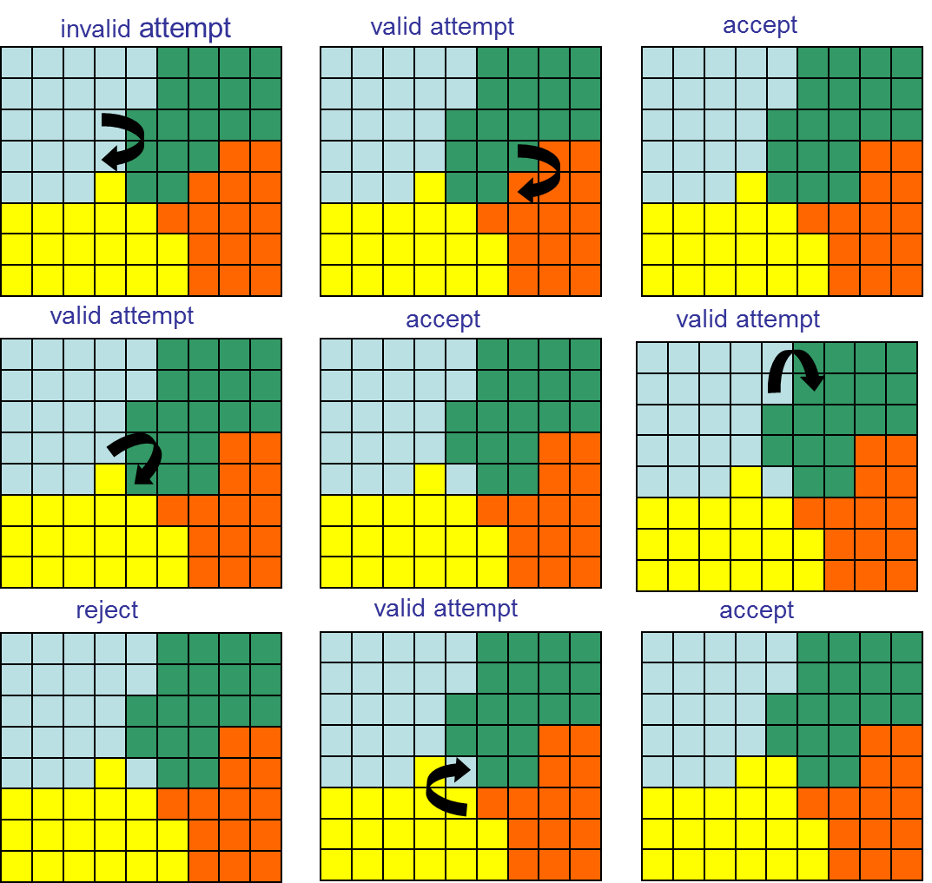
Cell Dynamics in CC3D
Pixel (Voxel) Copy Attempts
The specific algorithm is Modified Metropolis Dynamics:
1 ) Evaluate the Current Effective Energy
2) Pick a Source voxel in the Cell Lattice at random
3) Pick a neighboring Target voxel to the first voxel at random
4) Copy the Source voxel to the Target and evaluate the change in Effective Energy

Slide 23
Cell Dynamics in CC3D
Types, τ
Medium
Type 1 (green)
Type 2 (red)

Slide 24
Constraints
A Constraint is a very convenient method for implementing behaviors via an Effective Energy.
In general, an elastic Constraint has the form:
λ is the Constraint Strength and f the Constraint Function. The bigger λ, the smaller the deviations of the behavior of the system from the target.
Because of the Dynamic Behavior of Metropolis Algorithm ANY behavior can be implemented this way.

Slide 25
Volume Constraints
Most Cells have defined volumes.
i.e. the cell obeys the ideal gas law.

Slide 26
Volume Constraints
Most Cells have defined volumes.
i.e. the cell obeys the ideal gas law.
Easy way to implement Cell Growth:

Slide 27
Volume Constraints
Most Cells have defined volumes.
i.e. the cell obeys the ideal gas law.
Easy way to implement Cell Growth:
And Cell Death:
The rate of cell disappearance
proportional to

Slide 28
Other Constraints
Surface constraint
Length constraint
Cell-Cell Elastic (spring) constraint

Slide 30
CompuCell3D file structure
XML script
Main Python script
Steppables script
Selection of predefined
objects and functions
List of additional,
user-defined functions
User-defined functions

Slide 31
CompuCell3D programs
Tweddit++
CC3D Player
Custom text editor for
CompuCell3D
Program to run
CompuCell3D models

Slide 32
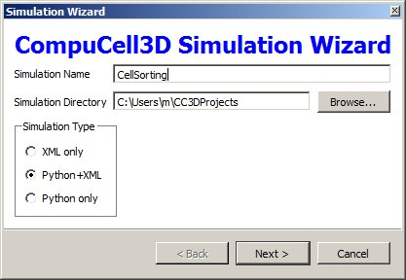
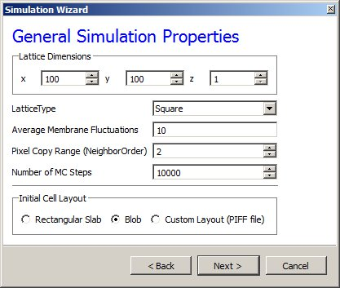
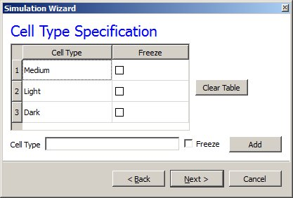
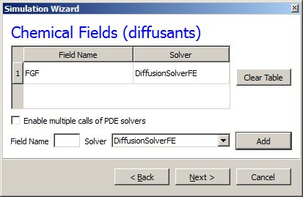
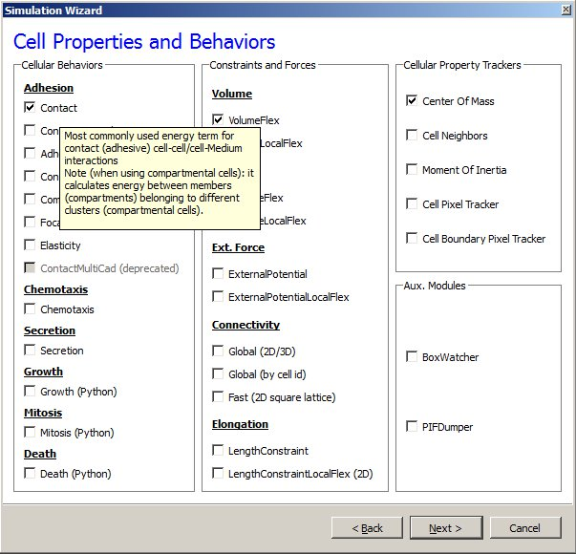
Building a simple model in 60 seconds using CompuCell3D and Twedit++

Slide 33
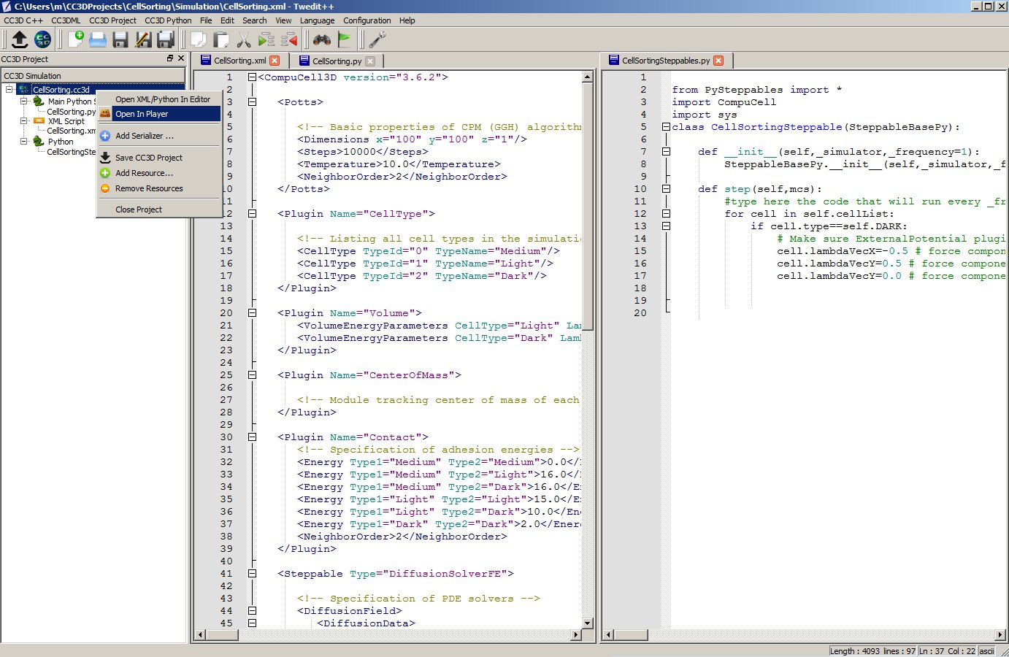
Building a simple model in 60 seconds using CompuCell3D and Twedit++

Slide 34
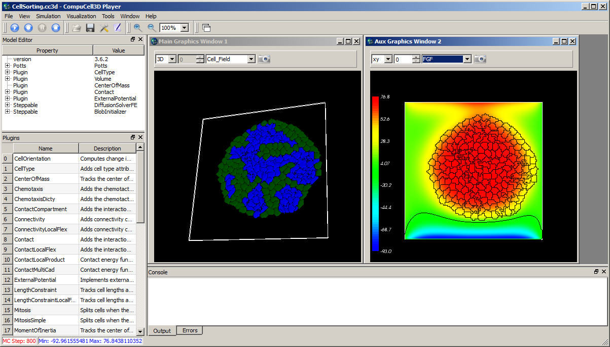
Building a simple model in 60 seconds using CompuCell3D and Twedit++

Slide 35
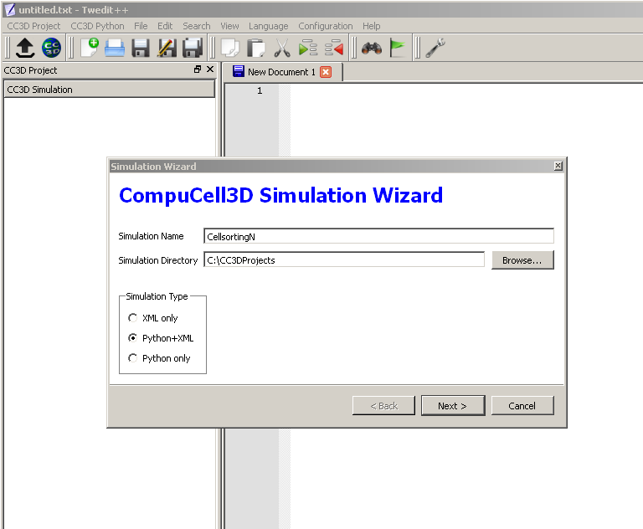
Creating a Model with Twedit++
Launch Twedit++
From CC3D Project menu select New Simulation Wizard…
Type name of the simulation [No spaces] and choose language which will describe it
NOTICE: by default the simulation will be stored in
C:\CC3DProjects\
Recommend putting on your desktop
We will do this twice, once with XML only and Once with Python Only

Slide 36
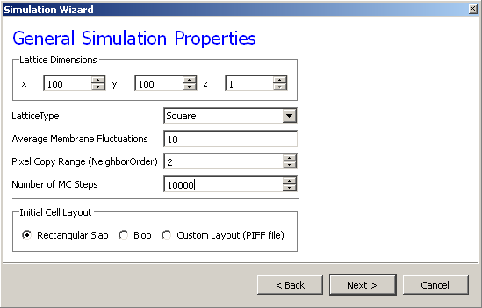
Creating a Model with Twedit++
Specify lattice size, lattice type (square/hexagonal), neighbor range
Twedit++ also requests some other info we haven’t discussed yet—leave these as defaults and hit next

Slide 37
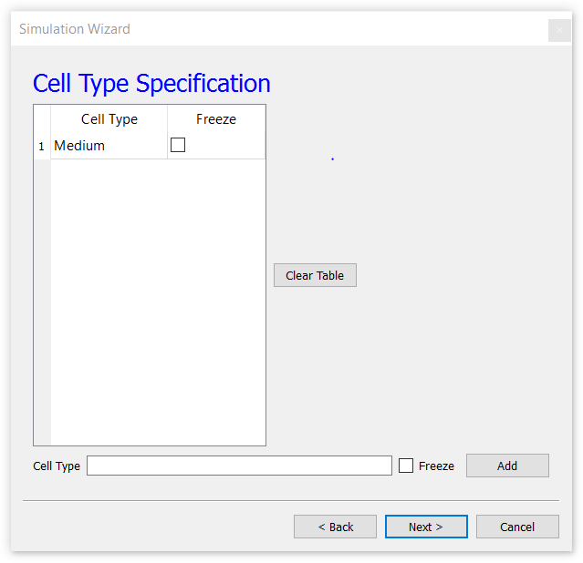
Creating a Model with Twedit++
Twedit++ assumes we want to put some cells in our universe and will ask you to add them.

Slide 38
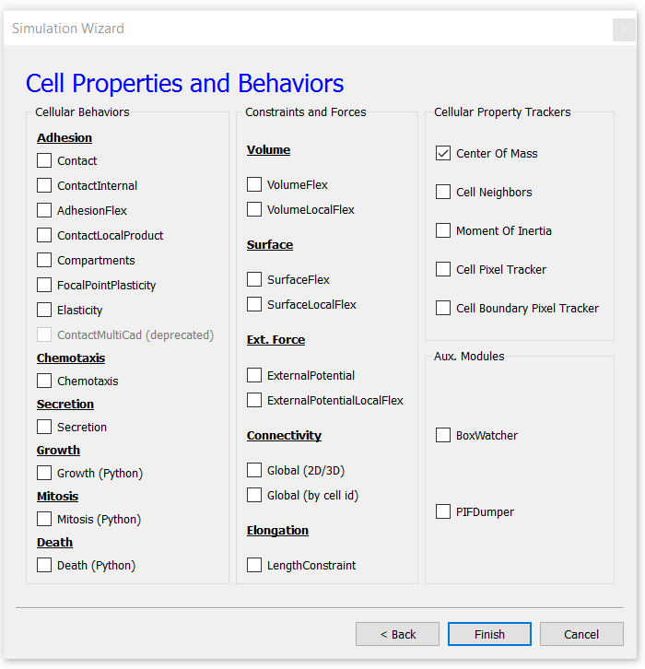
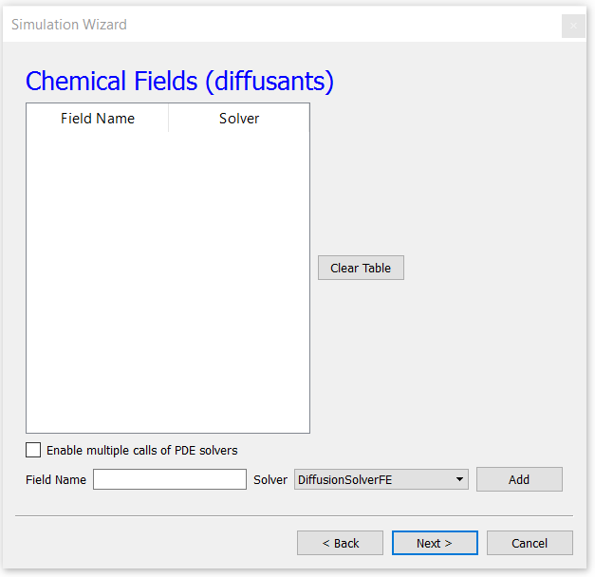
Creating a Model with Twedit++
Twedit++ Assumes we want to put some other types of objects in our universe
And that we want to assign properties to them

Slide 39
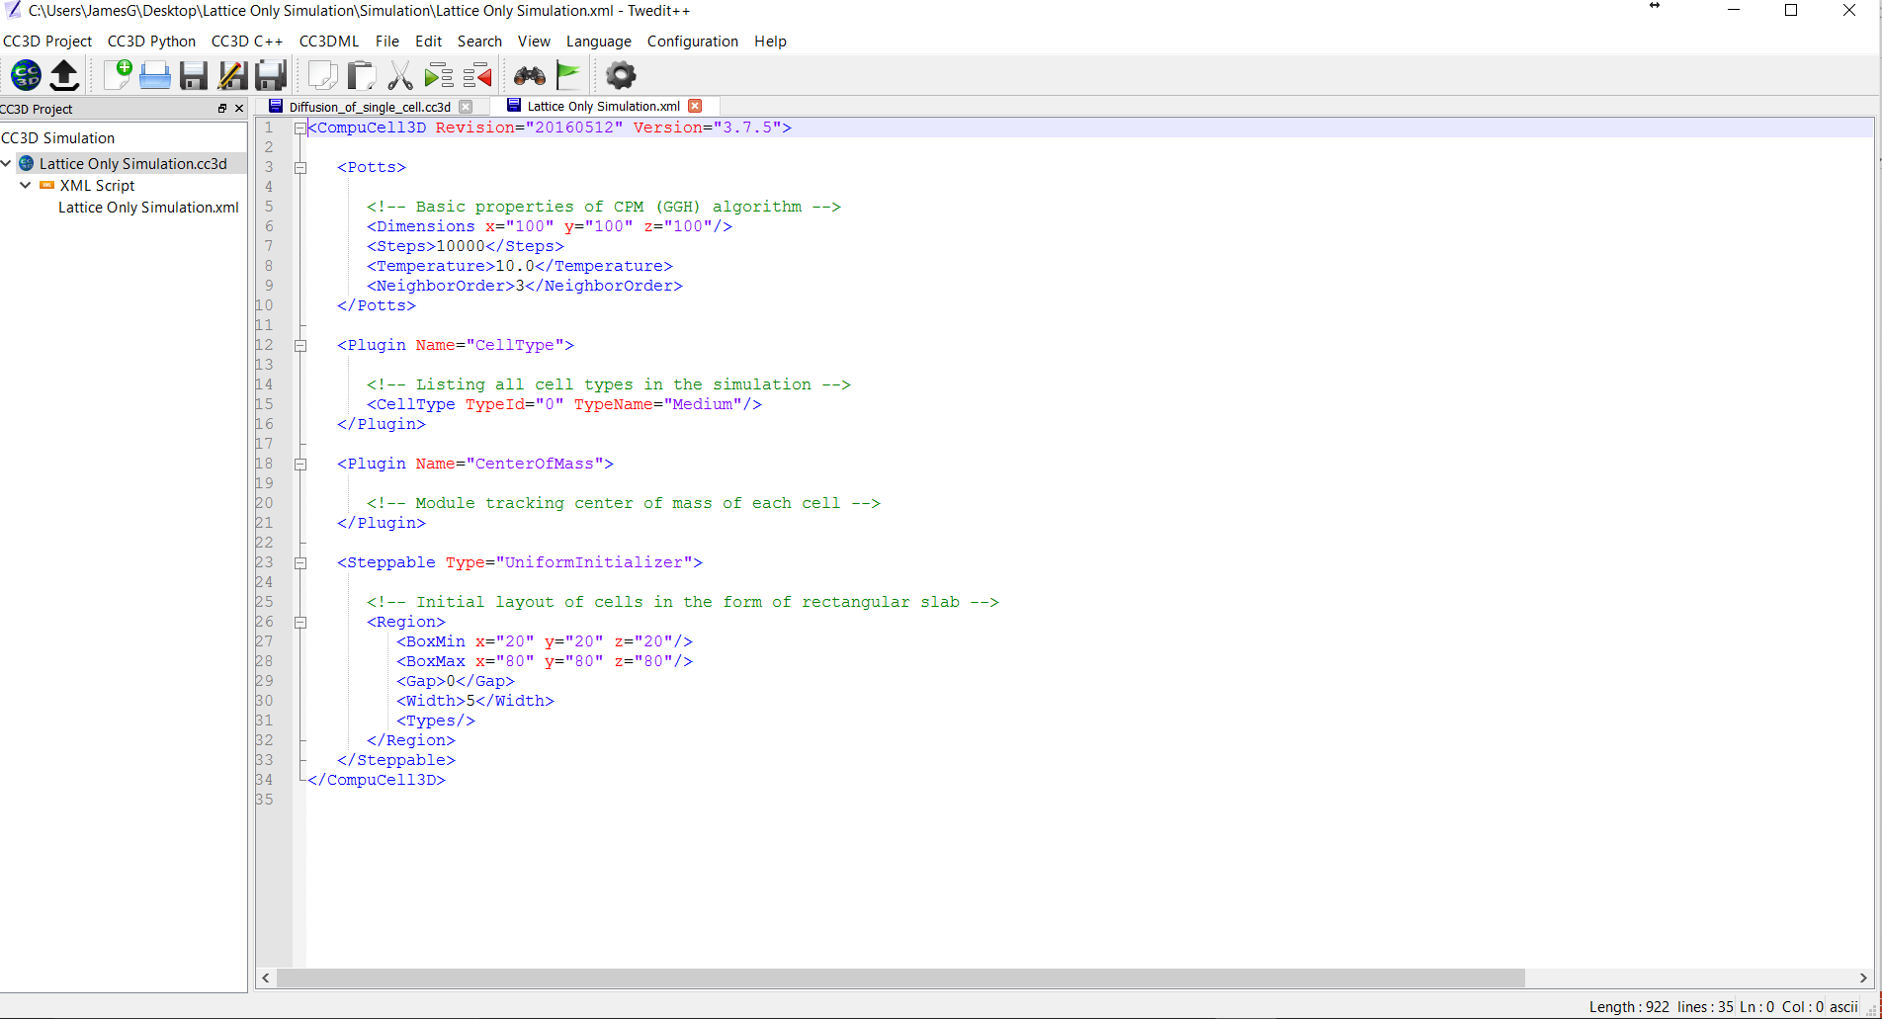
Creating a Universe with Twedit++
Your Twedit++ screen should look like this
Double click on Lattice Only Simulation in Left Menu
You should see the following

Slide 40
Creating a Model with Twedit++
Lines 1-10 and 34 specify the basic properties of your model
<CompuCell3D Revision="20160512" Version="3.7.5">
<Potts>
<!-- Basic properties of CPM (GGH) algorithm -->
<Dimensions x="100" y="100" z="100"/>
<Steps>10000</Steps>
<Temperature>10.0</Temperature>
<NeighborOrder>1</NeighborOrder>
</Potts>
</CompuCell3D>

Slide 41
Creating a Model with Twedit++
Initial and Boundary Conditions
If we want our Model lattice to be periodic in one or more directions, in XML we add the lines
<Boundary_x>Periodic</Boundary_x>
<Boundary_y>Periodic</Boundary_y>
<Boundary_z>Periodic</Boundary_z>
-------------------------------
<Potts>
<!-- Basic properties of CPM (GGH) algorithm -->
<Dimensions x="100" y="100" z="100"/>
<Steps>1000000</Steps>
<Temperature>10.0</Temperature>
<NeighborOrder>1</NeighborOrder>
<Boundary_y>Periodic</Boundary_y>
<Boundary_x>Periodic</Boundary_x>
<Boundary_z>Periodic</Boundary_z>
</Potts>

Slide 42
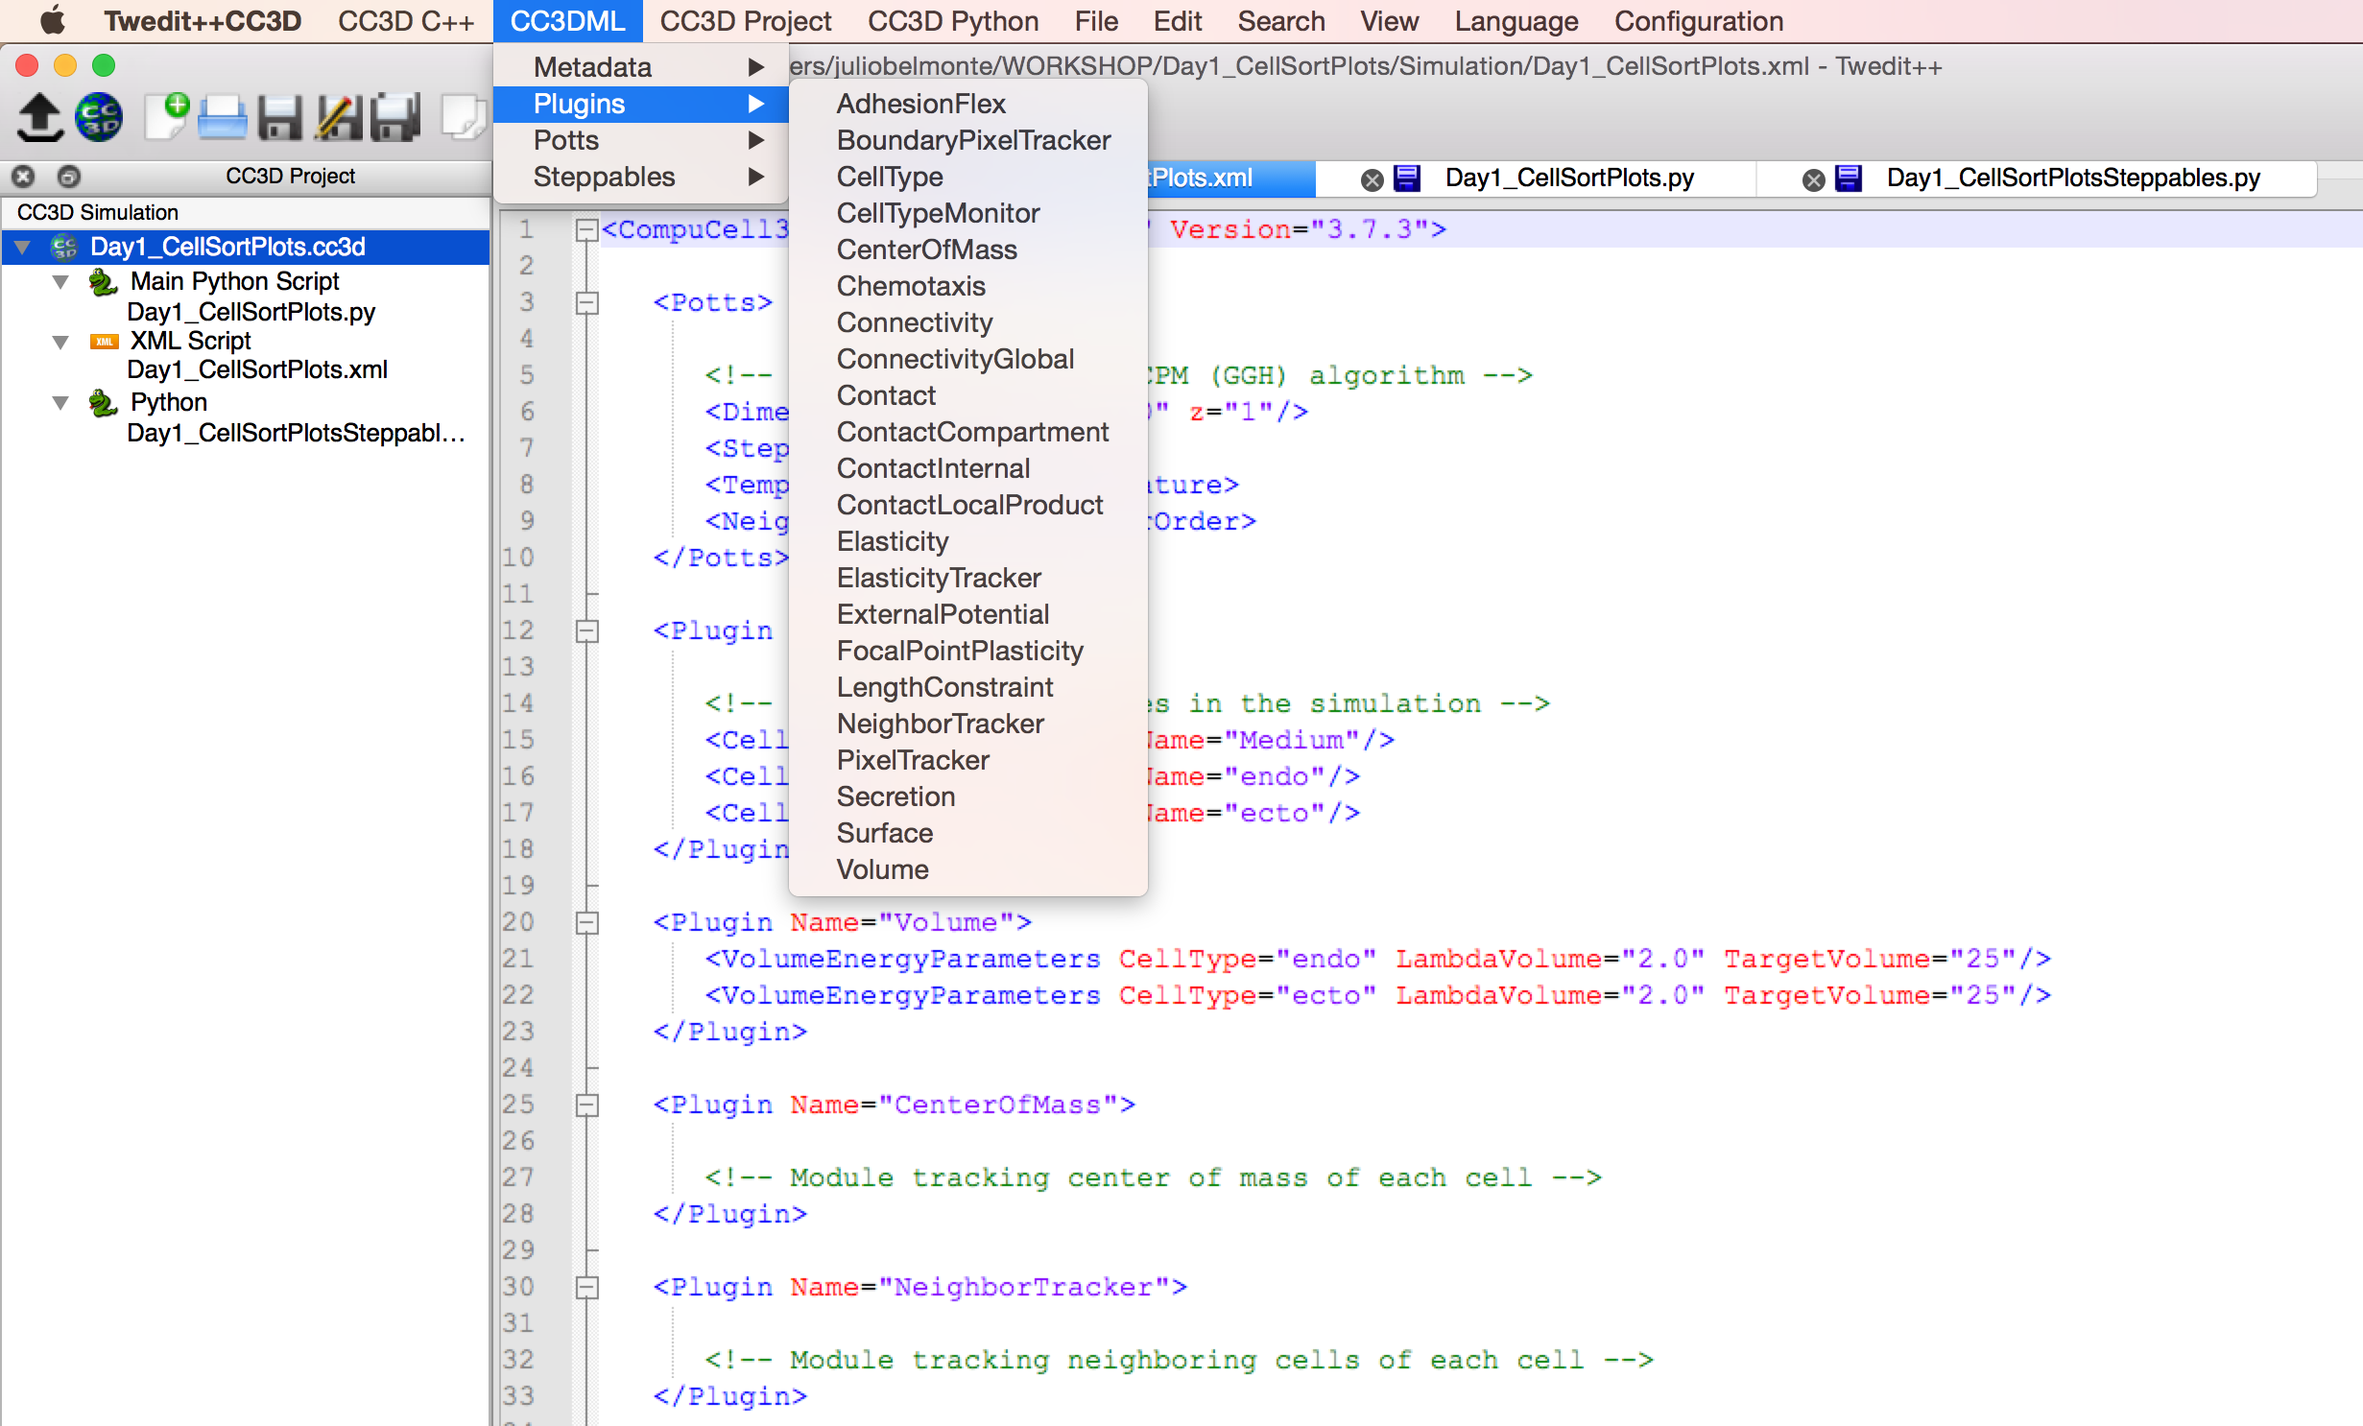
Creating a Model with Twedit++
Tweditt++ gives you the option to select desired pre-defined function (plugins) from the menu and add them to your simulation

Slide 43
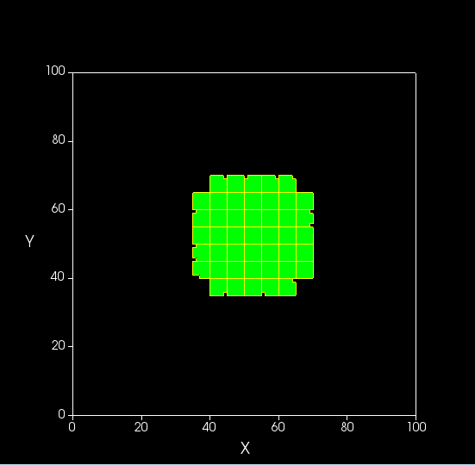
Live Example
Creating a simulation of an homogenous cell culture

Slide 44
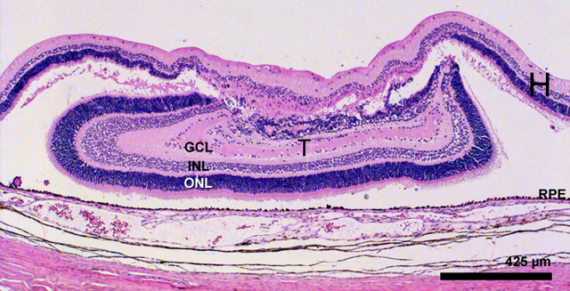
Cell Sorting During Development— Biological Observations
How do different cell types form ordered layered structures in developing embryos? Cells reorganize during early development, then maintain spatial relationships
Study in vitro by making random aggregates of two embryonic cell types and see how they behave.

Slide 45
Cell Sorting During Development— Biological Observations

Slide 46
Cell Sorting—A Simple Model Biological Observations
In a randomly mixed aggregate of two embryonic cell types, cells of the same type form clusters, which gradually merge together until one cell type forms a sphere in the center of the aggregate, with the other type surrounding it.
We call this phenomenon cell sorting and say that the outer cell type engulfs the inner cell type.
Mixtures of the same pairs of cell types consistently put the same type to the center.
If cell type A engulfs cell type B,
and cell type B engulfs cell type C,
then cell type A engulfs cell type C.
Inhibiting cell movement prevents cell sorting.

Slide 47
Cell Sorting—Define Initial Hypotheses
Steinberg’s Differential Adhesion Hypothesis:
Cell types have a consistent hierarchy of adhesion energies when they come into contact with their own and other cell types.
The cell’s adhesivity depends on the number and type of cell adhesion molecules in its membrane.
Cells fluctuate randomly within an aggregate.
Cells don’t grow or change their properties during sorting
Less adhesive cell types engulf more adhesive cell types.
Alternative hypotheses assume:
differential contractility in cell membranes,
differential mobility of cell types,
that cells send out a diffusible chemical signal which attracts other cells of the same type by chemotaxis, and
cells send out filopodia that directly pull on cells of their own type

Slide 48
Cell Sorting
Object | Properties | Property Type
Universe | X-extent | Parameter
 | Y-extent | Parameter
Cells | Position | Variable
 | Mass | Parameter
 | Volume | Parameter
 | Surface tension | Parameter
Medium | Volume | Variable
Object | Type
Cell | Endoderm
 | Mesoderm
Medium | Medium

Slide 49
Cell Sorting
Behavior | Participant Object | Properties
Movement | Cells | Random movement
Interaction | Participant Objects | Properties | Property Type
Separation | Cell 1 | Volume exclusion | Variable
 | Cell 2 adjacent to Cell 1
Cell-Cell Adhesion | Cell 1 | Adhesion Strength | Variable
 | Cell 2 adjacent to Cell 1
Cell-ECM Adhesion | Cell 1 | Adhesion Strength | Variable
 | External medium

Slide 50
Cell Sorting
Object | Property | Position | Arrangement
Universe | X-extent | -
 | Y-extent | -
Endoderm | number | Cluster 1 | random
Ectoderm | number | Cluster 1 | random

Slide 51
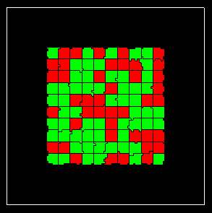
Live Example 2
Creating a simulation of two cell types randomly mixed

Slide 52
Cell Sorting—Execute Simulation
Additional Final Patterns for different J hierarchies
Initial Condition—Random Mixture
Incomplete Cell Sorting with Cell Types with identical behaviors and homotypic interface favored over heterotypic —
Cell Mixing with Cell Types with identical behaviors and heterotypic interface favored over homotypic—
Inverse Cell Sorting with Dark Cells more cohesive but preferring Medium contact compared to Light Cells—
Cell Dispersal, with Cells preferring to contact Medium rather than each other—

Slide 53
Cell Sorting—Compare Sorting Kinetics in Experiment and Simulation

Slide 54
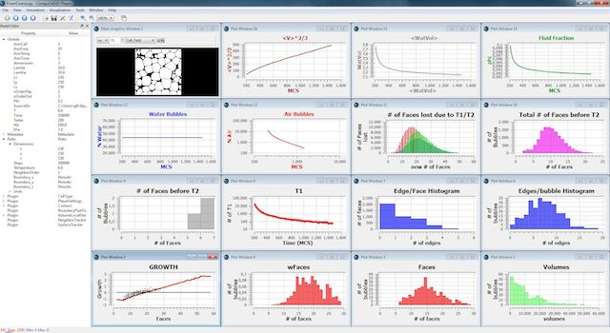
CompuCell3D – Scientific Plots

Slide 55
Scientific Plots are specified in Python
XML script
Main Python script
Steppables script
Selection of predefined
objects and functions
List of additional,
user-defined functions
User-defined functions

Slide 56
CC3D Python Steppables overview
XML script
Main script
Steppables

Slide 57
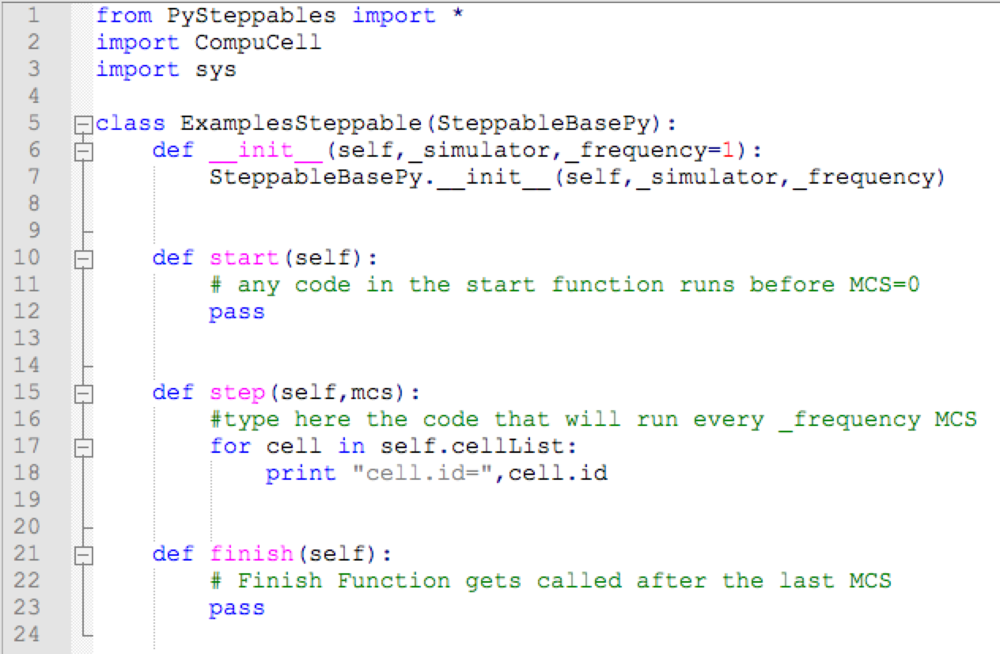
CC3D Python Steppables overview
XML script
Main script
Steppables

Slide 58
CompuCell3D Time Slicing
Change voxel copy attempt
During pixel copy “blue” pixel (newCell) replaces “yellow” pixel (oldCell)
100x100x1 square lattice = 10000 lattice sites (pixels)
MCS 1
MCS 2
MCS 3
10000 pixel-copy attempts
10000 pixel-copy attempts
10000 pixel-copy attempts
Run
Steppables
start
Run
Steppables
Run
Steppables
Run
Steppables
finish

Slide 59
Creating Scientific Plots using Twedit++
Twedit++ Provides a host of predefined Code Blocks for Python, CC3DML and C++ model specification in the pull-down menus
We will use the pull-down menu to generate plots
These code snippets are very helpful, but will still require some hand editing and possibly reading of manuals to do exactly what we want

Slide 60
Creating Scientific Plots using Twedit++
To create a dynamic plot, we first create and configure a plot window in the Python Steppable start function, then add the points we wish to plot in the step function
To create the plot window position your cursor in the start function (line 10)
Select the pull-down menu
Then select the “Scientific Plots” option and click on “1. Setup (start fcn)”

Slide 61
Creating Scientific Plots using Twedit++
You should see the following code block
Replace title= 'DATA_SERIES_1 and DATA_SERIES_2‘ with a sensible title like title=‘Cell Volume and Surface’
In self.pW.addPlot('DATA_SERIES_1',_style='Dots',_color='red',_size=5)
Rename 'DATA_SERIES_1‘ to something more descriptive like ‘Volume’
In self.pW.addPlot('DATA_SERIES_2',_style='Steps',_size=1)
Rename 'DATA_SERIES_2‘ to something more descriptive like ‘Surface’
For the moment, we will leave the plot styles alone in these two lines (we will change them later)

Slide 62
Creating Scientific Plots using Twedit++
In the code block
We can add additional data sets to the plot window by repeating the addPlot command with the name of the data series
self.pW.addPlot('DATA_SERIES_3',_style='Steps',_size=3)

Slide 63
Creating Scientific Plots using Twedit++
In the code block
pW is actually a variable containing the reference to the Plot window
We can create additional plot windows by repeating the addNewPlotWindow command but with a different variable reference, e.g. pW2
We then need to remember to use the reference in future commands related to this window
self.pW2.addPlot('DATA_SERIES_1',_style='Dots',_color='red',_size=5)

Slide 64
Creating Scientific Plots using Twedit++
To display data in the plot window
Position your cursor in the step function below the line
print "cell.id=",cell.id (line 19)
Select the pull-down menu
Then select the “Scientific Plots” option and click on “2. Add data points (step fnc)”
Your code block will look like this:
Could use the print "cell.id=",cell.id to print out more information about cells

Slide 65
Creating Scientific Plots using Twedit++
Could use the print "cell.id=",cell.id to print out more information about cells
Or cell.volume, for example
Horizontal axis
Vertical axis

Slide 66
Live Example 3
Add Plots to a CC3D simulation

Slide 67
Cell Sorting—In class exercises
Find a set of surface energies with both cell-Medium contact energies equal that lead to normal sorting (dark cells on the inside engulfed by light cells). What is the relationship among your energies?
Change the cell-Medium contact energies so that the sorting is reversed (light cells on the outside). How do the revised cell-Medium contact energies compare to each other and to the cell-cell contact energies?
Start from the normal sorting case (1). Change the Light-Dark contact energy to achieve incomplete cell sorting. What is the relationship between the Light-Dark, Light-Light and Dark-Dark contact energies in this case?
Start from the normal sorting case (1). Adjust your energies so that the cells form a single cluster with checkerboard configuration. What is the relationship among your energies?
Start from the normal sorting case (1). Adjust your energies so that the cells form two completely separate clusters surrounded by medium. What is the relationship among your energies?
Start from the normal sorting case (1). Adjust your energies so that the cells disperse in the medium. What is the relationship among your energies?
Start from the normal sorting case (1). Adjust your energies so that the once cell type forms cluster and the other cell type disperses in the medium.

