Slide 1
Intro to CC3D Day 6 Cell Compartments and Links
James A. Glazier
Biocomplexity Institute
Indiana University
Bloomington, IN 47405
USA
Julio Belmonte
EMBL
Heidelberg
Germany
Bloomington IN, US
Tuesday, August 1st, 2017
Support: NIGMS-R01GM076692, [NIGMS-R01GM077138], NIH-U01-GM111243, NIGMS-R01 GM122424, [Falk Medical Research Trust], IUCRG, [NSF], [US EPA], EMBL-Marie Curie Interdisciplinary Postdoctoral Fellowship

Slide 2
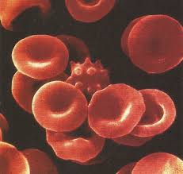
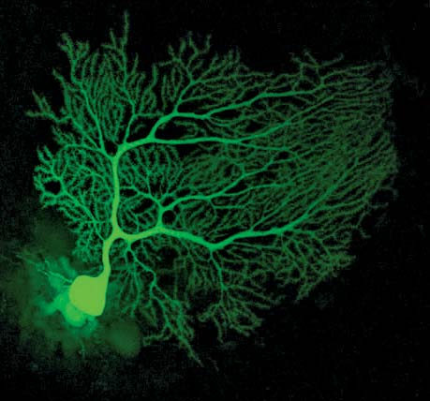
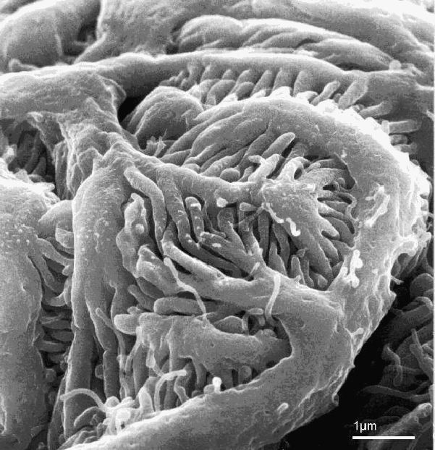
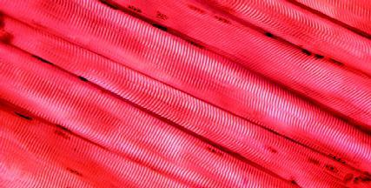
Cell Shapes
Describing the shapes of cells is surprisingly difficult
Cell shapes are extremely diverse, ranging from the relatively simple usually smooth red blood cell (erythrocyte)
to the extreme number of long branches of some neurons (Purkinje cells)
to the complex local interdigitations of podocytes in the kidney
to the long columnar multinuclear myofibers (muscle cells formed from the fusion of many separate precursor myoblast cells)
Initially will neglect these complex shapes and follow biologists in classifying cells by considering a few basic shape categories
$$7μ$$
22$μ$
1$μ$
20$μ$

Slide 3
Tissue Organization
Most tissues have one of two basic architectures:
mesenchyme (three-dimensional textures)
epithelia (sheets)
Occasionally tissues assume structures intermediate between mesenchymal and epithelial organizations
Muscle and neural tissue in the brain also have specialized architectures
While a metazoan organism like a person or a zebrafish and most of the organs they contain seem intrinsically 3 dimensional, most of the function and complexity of organs and animals comes from epithelia, bent, rolled, branched, layered,… into a variety of space-filling forms

Slide 4
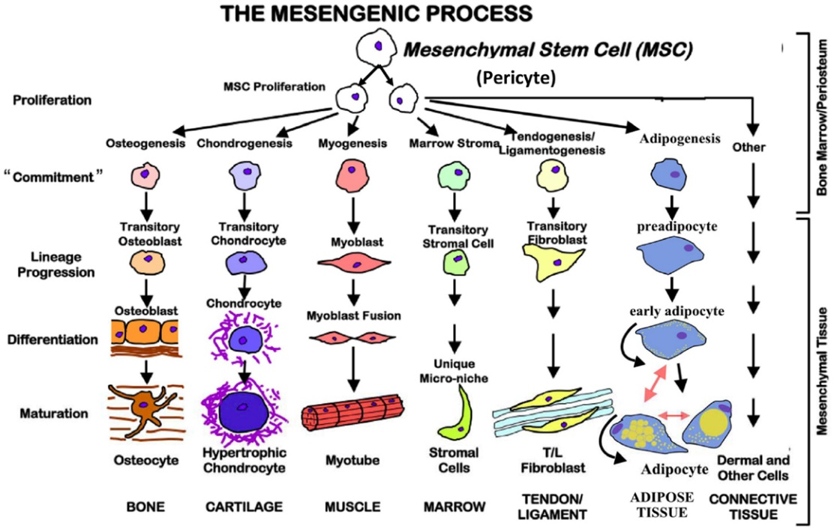
Cell Classifications: Epithelial vs Mesenchymal
Mesenchymal cells are any cells that don’t naturally form sheets
May be polarized (neurons)
Generally weakly adhering to each other
Often found in three-dimensional connective tissue (e.g. neurons, leukocytes,…)
Cells of the same type can differ in the degree to which they have particular mesenchymal or epithelial properties
Cells with intermediate properties between epithelial and mesenchymal are sometimes called epithelioid

Slide 5
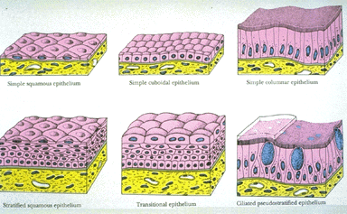
Tissue Organization: Epithelia
Cells form continuous more-or-less two-dimensional monolayer sheets (one sheet in simple epithelia, two or more stacked sheets in stratified epithelia)
Epithelia always have a well-defined top (apical) surface and bottom (basal) surface
Neighboring cells in a layer adhere strongly to each other. The connections between cells are so tight they form a molecular barrier
At the basal surface, the sheet attaches to an ECM basement membrane (a mechanically strong quasi-two dimensional meshwork of fibrous molecules to which the cells adhere strongly)
Often a layer of connective tissue underlays the basal surface
Often the apical surface faces a fluid-filled space

Slide 6
Cell Classifications: Epithelial Cell Shape
Depending on shape, epithelial cells are characterized as:
Squamous—flat, height much less than diameter
Cuboidal—height and diameter roughly equal
Columnar—height substantially greater than diameter
diameter
height

Slide 7
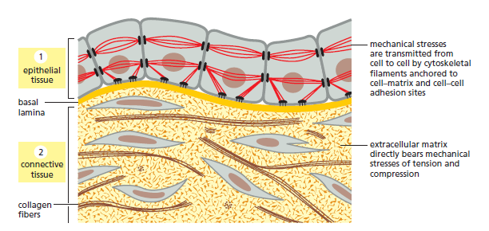
Tissue Organization: Epithelia
In many epithelia, the fibrous cytoskeleton of the cell connects from cell to cell in the plane of the sheet, providing great tensile strength

Slide 8
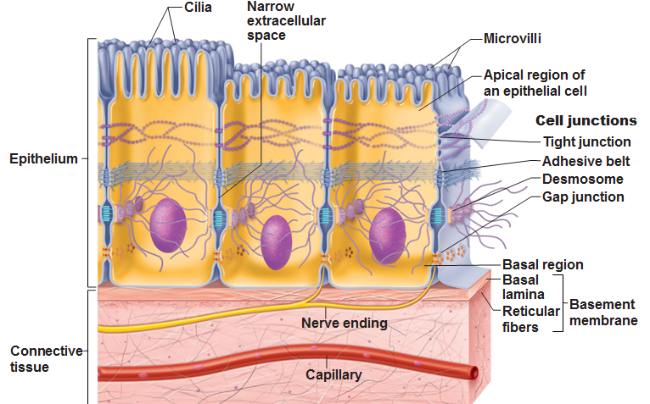
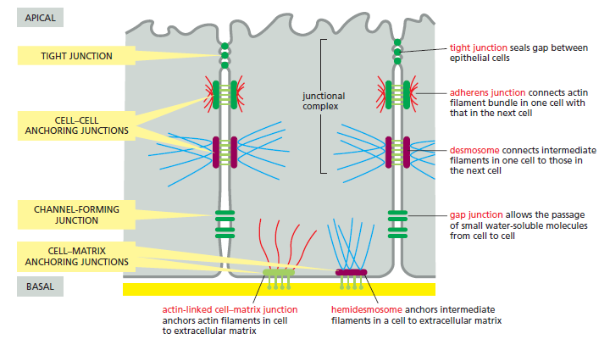
Cell Classifications: Epithelial vs Mesenchymal
Characterizes the propensity of the cell to form sheets (epithelia)
Epithelial cells are typically polarized, with apical, lateral and basolateral domains
Lateral domains have special molecular structures for adhering to epithelial cells of specific types and molecular machines to create and apply tension forces to form tightly assembled epithelial sheets and to transmit force across sheets
Apical surfaces are often non-adhesive to allow them to face fluid environments and have special structures for absorbing or secreting material
Basolateral or Basal surfaces stick weakly to other cells but strongly to extracellular matrix

Slide 9
Verbal Model of Epithelium
Object is a Cell
Properties:
Position
Volume
Objects
Properties
Interactions

Slide 10
Verbal Model of Epithelium
Cell is Polarized
Properties
Polarity (as Flag)
Degree of Polarization
(e.g. aspect ratio of height
to diameter)
Orientation of Polarization
Apical
Lateral
Objects
Properties
Interactions
Basal

Slide 11
Verbal Model of Epithelium
A Cell is Polar is Epithelial
Apical
Lateral
Objects
Properties
Interactions
Basal

Slide 12
Verbal Model of Epithelium
A Cell is Polar is Epithelial
Has Basal, Lateral and
Apical Surfaces
Properties:
Position
Area
Apical
Lateral
Objects
Properties
Interactions
Basal

Slide 13
Verbal Model of Epithelium
A Cell is Polar is Epithelial
Has Basal, Lateral and
Apical Surfaces
Lateral Surface Adheres to
other cells Lateral Surfaces
Properties:
Strength of Adhesion
Apical
Lateral
Objects
Properties
Interactions
Basal

Slide 14
Verbal Model of Epithelium
A Cell is Polar is Epithelial
Has Basal, Lateral and
Apical Surfaces
Adheres to Cells via Lateral
Surfaces
Adheres to ECM via Basal
Surface
Properties:
Strength of Adhesion
ECM is an Elastic Solid is a Basement Membrane
Properties
Position
Length
Apical
Lateral
Objects
Properties
Interactions
Basal
ECM

Slide 15
Verbal Model of Epithelium
A Cell is Polar is Epithelial
Has Basal, Lateral and
Apical Surfaces
Adheres to Cells via Lateral
Surfaces
Adheres to ECM to
Basement Membrane via
Basal Surface
ECM is an Elastic Solid is a Basement Membrane
Medium is a Fluid
Adheres to Cells
Properties
Cell-Medium Contact Energy
Apical
Medium
Lateral
Objects
Properties
Interactions
Basal
ECM

Slide 16
Verbal Model of Epithelium
Initial Condition is an ECM at the Basal Side, Medium at the Apical Side and a row of laterally-contacting cells
Objects
Properties
Interactions

Slide 17
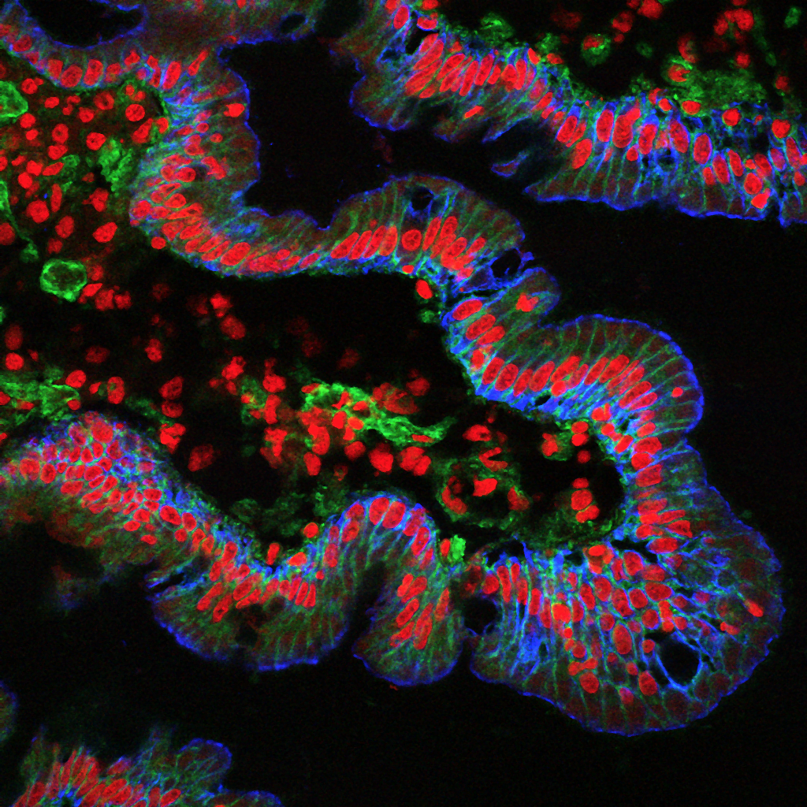
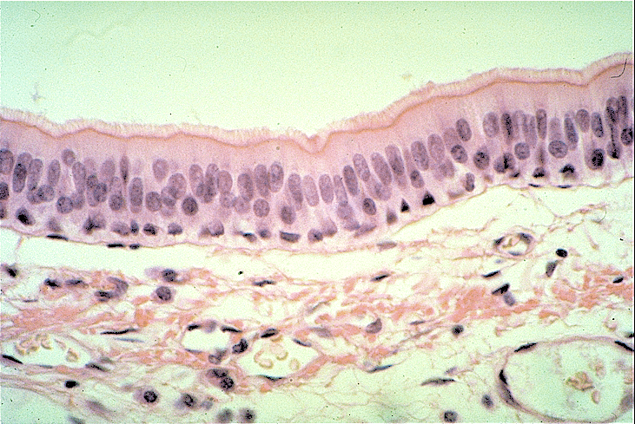
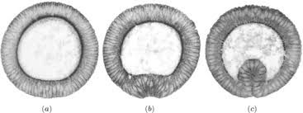
Epithelium

