Slide 1
Intro to CC3D Day 3 Cell growth, Division, CC3D/SBML
James A. Glazier
Biocomplexity Institute
Indiana University
Bloomington, IN 47405
USA
Julio Belmonte
EMBL
Heidelberg
Germany
Bloomington IN, US
Tuesday, August 1st, 2017
Support: NIGMS-R01GM076692, [NIGMS-R01GM077138], NIH-U01-GM111243, NIGMS-R01 GM122424, [Falk Medical Research Trust], IUCRG, [NSF], [US EPA], EMBL-Marie Curie Interdisciplinary Postdoctoral Fellowship

Slide 2
CPM modeling Scope
Cellular behaviors:
Location
Volume
Shape
Movement
Adhesion
Mitosis
Death
Differentiation
Polarization
Etc…

Slide 3
Subcellular modelling
Biochemical Kinetics:
Cell-Cycle
Circadian rhythms
Cardiac rhythms
cAMP oscillations
Delta-Notch patterning
WNT pathway
FGF pathway
Etc…

Slide 4
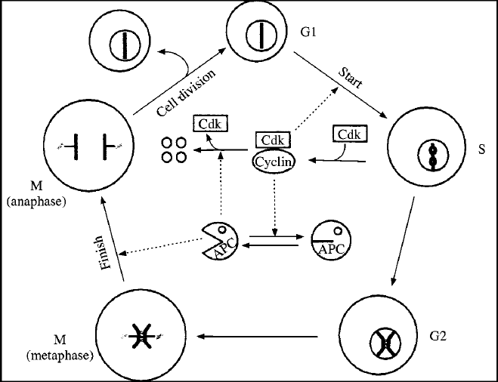
Subcellular modelling
Biochemical Kinetics:
Cell-Cycle
Circadian rhythms
Cardiac rhythms
cAMP oscillations
Delta-Notch patterning
WNT pathway
FGF pathway
Etc…

Slide 5
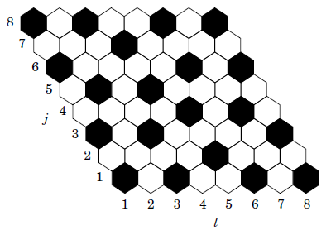
Subcellular modelling
Biochemical Kinetics:
Cell-Cycle
Circadian rhythms
Cardiac rhythms
cAMP oscillations
Delta-Notch patterning
WNT pathway
FGF pathway
Etc…

Slide 6
Multiscale model - Somitogenesis

Slide 7
How to add this into CompuCell?
Just another Python class!
Too slow

Slide 8
How to add this into CompuCell?
Just another Python class!
Too slow
C++ file to be wrapped into Python
Too complicated

Slide 9
How to add this into CompuCell?
Just another Python class!
Too slow
C++ file to be wrapped into Python
Too complicated
Import SBML

Slide 10
SBML – Systems Biology Markup Language
Not a software!
Machine-readable format for representing subcellular models
Standard for storage and exchange of models
Implementation agnostic

Slide 11
SBML
How does it work?
Developer software (SBW/Jarnac)
SBML
Simulation software (CompuCell3D)

Slide 12
SBML
Initial conditions:
Parameters:

Slide 13
SBML
<?xml version="1.0" encoding="UTF-8"?>
<sbml xmlns = "http://www.sbml.org/sbml/level2" level = "2" version = "1">
<model id = "cell">
<listOfCompartments>
<compartment id = "compartment" size = "1"/>
</listOfCompartments>
<listOfSpecies>
<species id = "S1" boundaryCondition = "false" initialConcentration = “5.0" compartment = "compartment"/>
<species id = "S2" boundaryCondition = "false" initialConcentration = “0.0" compartment = "compartment"/>
</listOfSpecies>
<listOfParameters>
<parameter id = "k1" value = "0.1"/>
</listOfParameters>
<listOfReactions>
<reaction id = "_J1" reversible = "false">
<listOfReactants>
<speciesReference species = "S1" stoichiometry = "1"/>
</listOfReactants>
<listOfProducts>
<speciesReference species = "S2" stoichiometry = “2"/>
</listOfProducts>
<kineticLaw>
<math xmlns = "http://www.w3.org/1998/Math/MathML">
<apply>
<times/>
<ci>
k1
</ci>
<ci>
S1
</ci>
</apply>
</math>
</kineticLaw>
</reaction>
</listOfReactions>
</model>
</sbml>

Slide 14
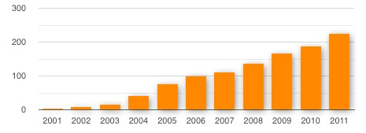
SBML
Total number of known SBML-compatible software packages each year :

Slide 15
How to write SBML?
Bio-Spice
Large collection of tools, integrated via a "Dashboard." Free download (BSD), various platforms.
Teranode
Suite of tools for model management, design, and simulation. (Linux/Mac/Windows) Commercial (30-day trial available).
SBW
Systems Biology Workbench.
Check http://sbml.org/SBML_Software_Guide

Slide 16
Integration with CC3D
Reaction kinetic models can be easily added in CC3D when in SBML format.
Once loaded, the model is converted into a set of ODEs and is solved by the smblSolver library inside CC3D.

Slide 17
CC3D+SBML
CC3D:
SBML
Degradation
E2
Activator
E1
S
E3
Metabolism
Gene Regulation
Protein Regulation

Slide 18
CC3D+SBML
CC3D cells:
SBML
Degradation
E2
Activator
E1
S
E3
Metabolism
Gene Regulation
Protein Regulation

Slide 19
Integration with CC3D – 1 cell
CC3D:
SBML
Degradation
E2
Activator
E1
S
E3
Metabolism
Gene Regulation
Protein Regulation

Slide 20
Integration with CC3D – cell type
CC3D:
SBML
Degradation
E2
Activator
E1
S
E3
Metabolism
Gene Regulation
Protein Regulation

Slide 21
Integration with CC3D – External (PBPK)
CC3D:
SBML
Degradation
E2
Activator
E1
S
E3
Metabolism
Gene Regulation
Protein Regulation

Slide 22
class <someClass>(SteppableBasePy):
def __init__(self,_simulator,_frequency):
SteppableBasePy.__init__(self,_simulator,_frequency)
def start(self):
# Define a SBML model
Path = <ModelPath> # Path where the model is stored
Name = <ModelName> # Name of the model
Step = <timeStep> # Time step of integration
# Add SBML model to a cell
self.addSBMLToCellIds(_modelFile=Path,_modelName=Name,_ids=[<cellIds>],_stepSize=Step)
self.addSBMLToCell(_modelFile=Path,_modelName=Name,_cell=<cell>,_stepSize=Step)
# Add SBML model to cell types
self.addSBMLToCellTypes(_modelFile=Path,_modelName=Name,_types=[<Types>],_stepSize=Step)
# Add free floating SBML
self.addFreeFloatingSBML(_modelFile=Path,_modelName=Name,_stepSize=Step)
def step(self,mcs):
# Iterate the model (run it for the time step specified on the load command)
self.timeStepSBML()
# Get the parameter value or molecular concentration from a cell
for cell in self.cellList:
state = self.getSBMLState(_modelName='DN',_cell=cell)
<var> = state[“<molecule>”]
# Set a new parameter value or molecular concentration value for a cell
self.setSBMLValue(_modelName=Name,_valueName=<valueName>,_value=0.1,_cell=cell)
# Copy SBML model from one cell to another
self.copySBMLs(_fromCell=cell1,_toCell=cell2)
self.copySBMLs(_fromCell=cell1,_toCell=cell2,_sbmlNames=[<ModelName1>,<ModelName2>,…])
# Delete a SBML model from a cell
self.deleteSBMLFromCell(_modelName=<Name>,_cell=cell)

Slide 23
Example – Delta-Notch Patterning
Human intestinal crypt cup
Chen et al. MSB (2017)
Hair cells of Drosophila inner ear
Eddison et al. PNAS (2000)

Slide 24
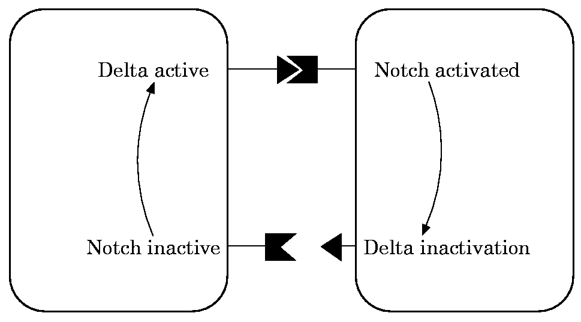
Example – Delta-Notch Patterning
We will use the model published by Collier et al. in 1996:
N : Notch
D : Delta
D: average Delta from neighbors

Slide 25
Example – Delta-Notch Patterning
In this model, when a cell receives high levels of Delta from neighbors its Notch level becomes downregulated.
This leads to the high/low Notch patterning shown by their simulations on an hexagonal lattice:

Slide 26
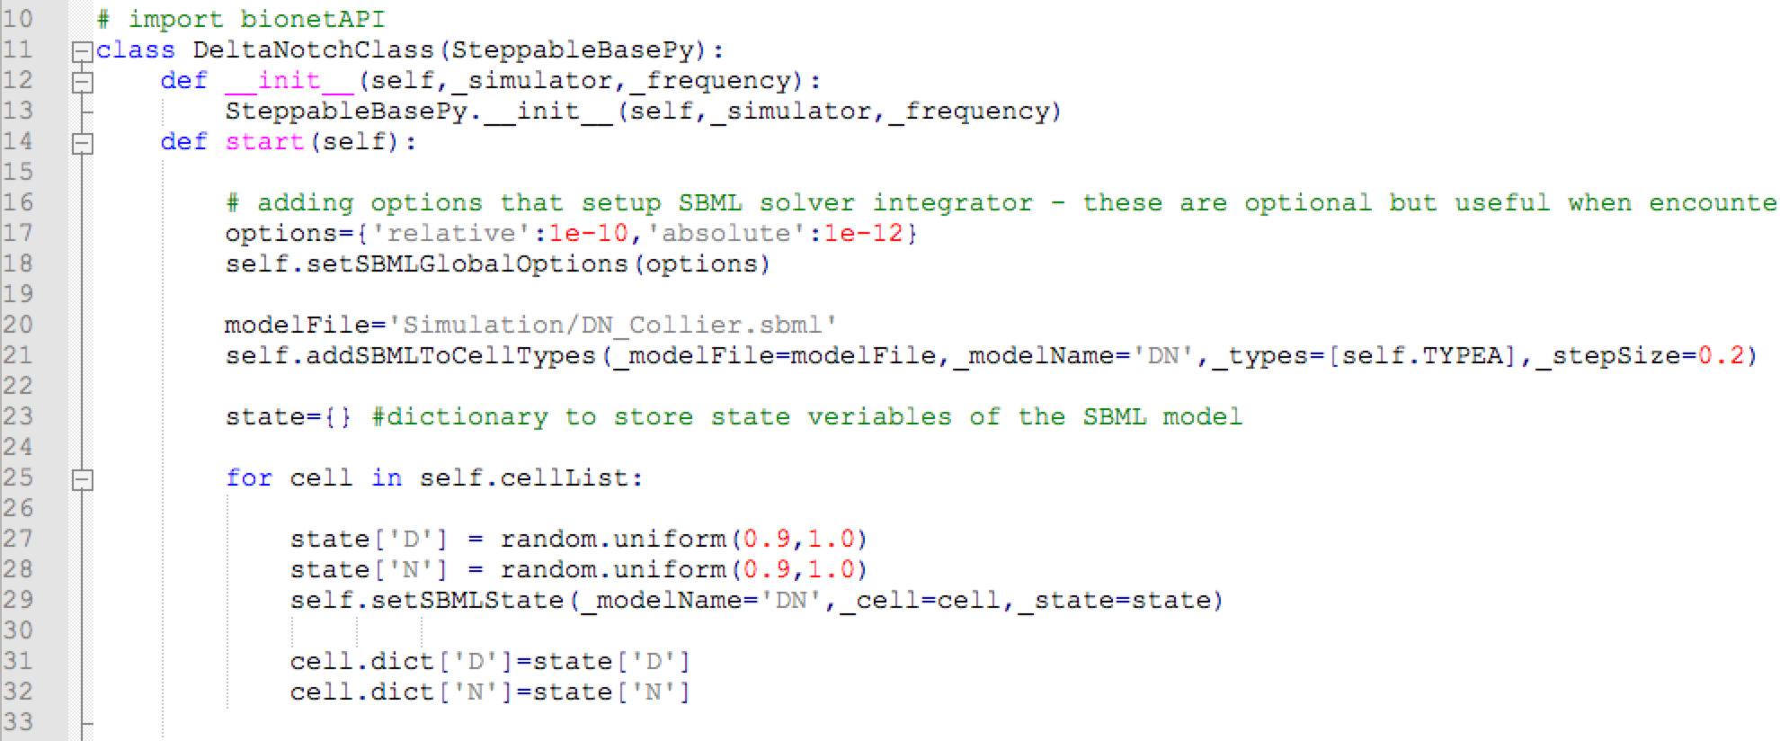
Example – Delta-Notch Patterning
In CC3D we first loop over all cells’ neighbors and store their Delta:
Then we average it and use it as the new D parameter of that cell:
File:
CompuCell3D\Demos\BoolChapterDemos_ComputationalMethodsInCellBiology\DeltaNotch

Slide 27
Example – Delta-Notch Patterning
Next we create a dictionary named “states” to keep the concentration value of all variables of the sbml model (here Delta and Notch levels):
Then we go over all cells, assing a random value of D and N for each cell and add it to the SBML of each cell:
File :
CompuCell3D\Demos\BoolChapterDemos_ComputationalMethodsInCellBiology\DeltaNotch

Slide 28
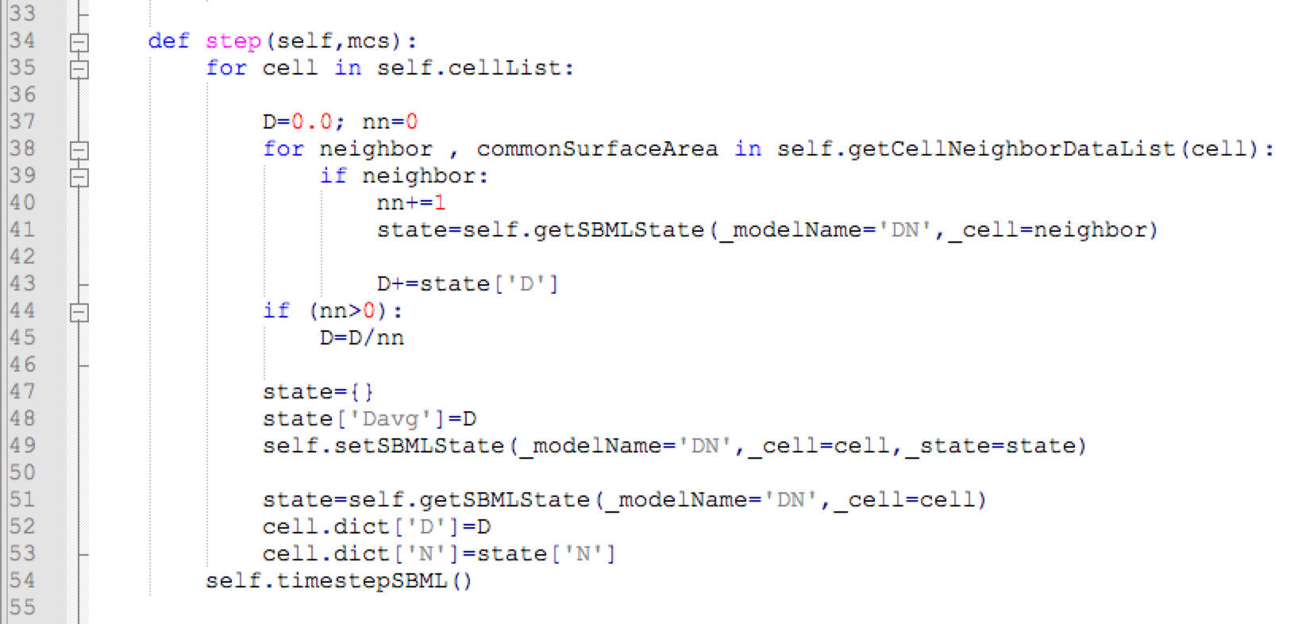
Example – Delta-Notch Patterning
In the step function we go over all cells and read and average the Delta levels of all the cell neighbors:
Then we create a new state dictionary, load it with the average Delta and use it to update the value of the parameter “Davg” of the cells sbml model:
File :
CompuCell3D\Demos\BoolChapterDemos_ComputationalMethodsInCellBiology\DeltaNotch

Slide 29
Example – Delta-Notch Patterning
When we run this model we can see that first the Notch values go down before the pattern emerges:

Slide 30
Example – Delta-Notch Patterning
Increase the level of membrane fluctuations and check how the pattern changes

Slide 31
Second Example – Cell Cycle from web
In our second example we will use a published model for the cell cycle.
The website www.sbml.org contains a repository of published models in SBML format.
If you wish to submit your own SBML to the repository, follow the instructions at: www.ebi.ac.uk/biomodels-main/submit

Slide 32
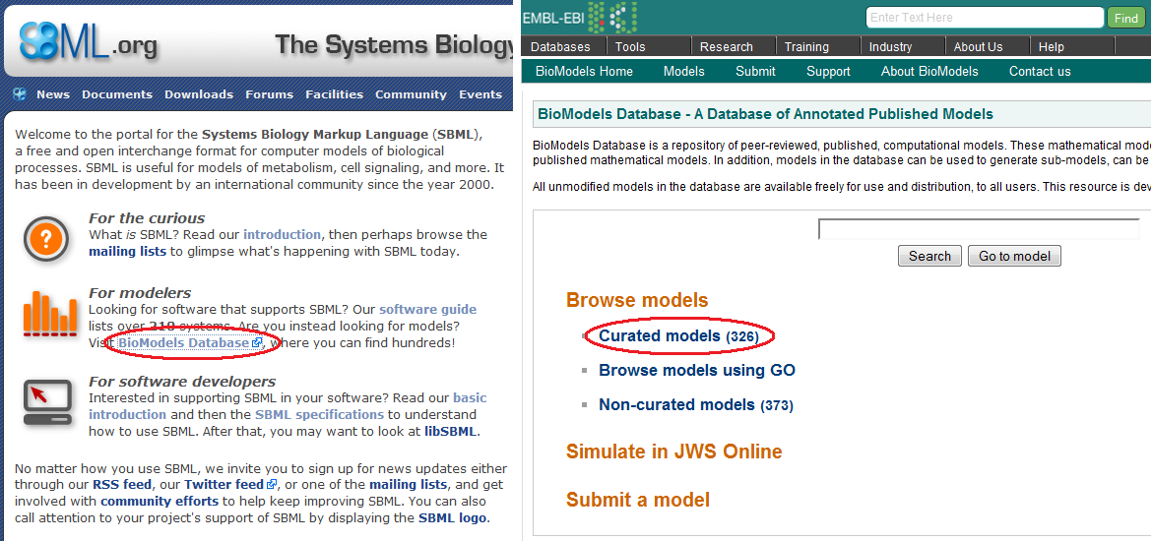
Second Example – Cell Cycle Model
On www.sbml.org, click on the link “BioModels Database” and then on “Curated models”:

Slide 33
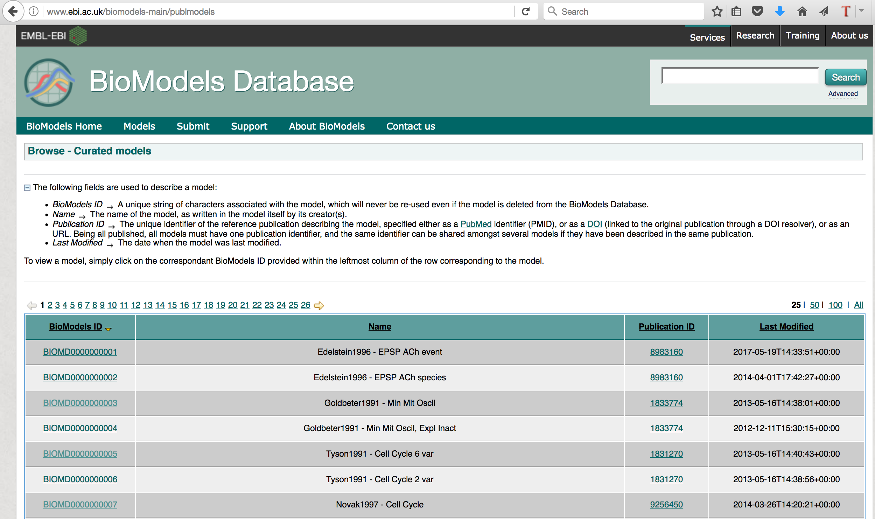
Second Example – Cell Cycle from web
From the model list select the fifth one by clicking on the link under the column “BioModels ID”

Slide 34
Example – Cell Cycle from web
To download the model click on “Download SBML” and select “SBML L2 V4 (curated)”

Slide 35
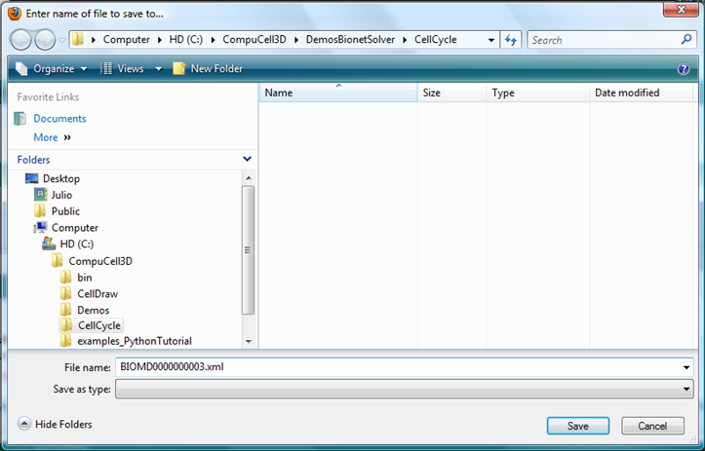
Example – Cell Cycle from web
Save the file BIOMD0000000005.xml in the desktop (we will place it in the appropriate directory later)

Slide 36
Example – Cell Cycle from web
In the last example all cells divide in synchrony.
The reason for this is the absence of any flow of information from the cell level to the subcellular level.
A more realistic model, where the cells do not maintain their cell cycle’s phase, is the one proposed by Tyson and Novak.

Slide 37
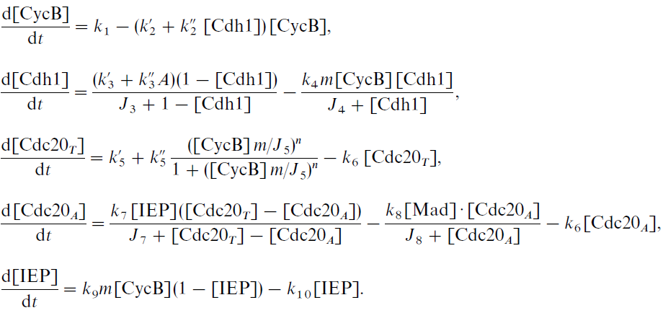
Example – Cell Cycle from web
This model has 5 variables, from which only the first 2 forms the core of the cell cycle oscillations:

Slide 38
Example – Cell Cycle from web
An important feature of this model is the presence of the parameter “m”, which is the normalized total mass of the cell:
This parameter varies between ~0.5 (right after mitosis) and ~1 (at normal size) and corresponds in CC3D to the ratio of volume to the resting volume (initial volume):

Slide 39
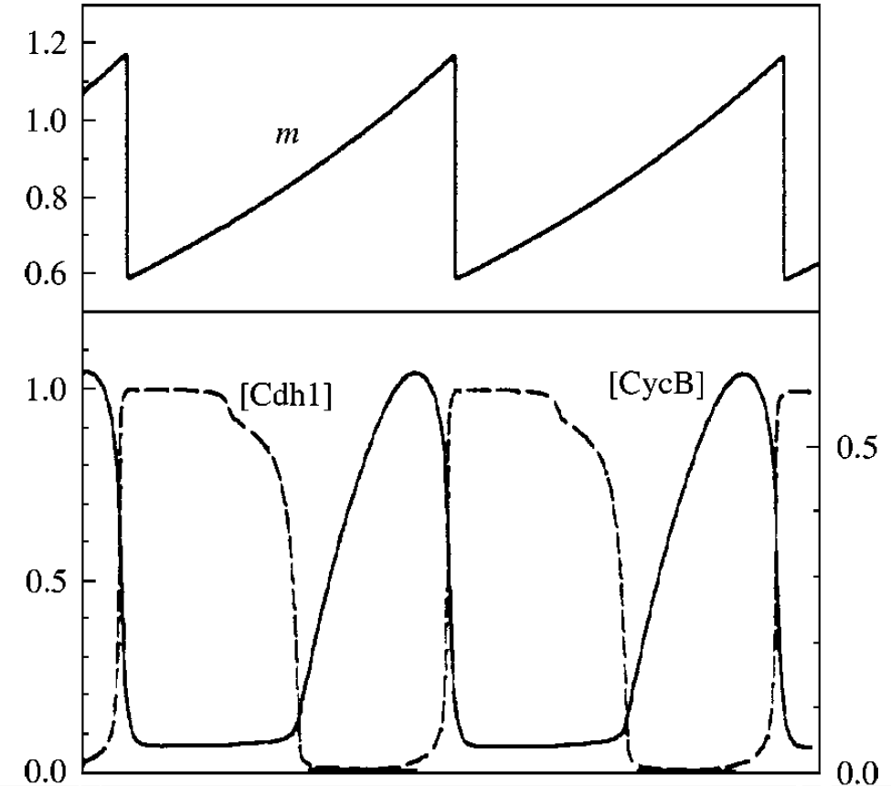
Example – Cell Cycle from web
In this model mitosis occur when the level of CycB drops below 0.1

Slide 40
Exercises
1
Create a model with a single cell
Add the SBML model to this cell
Create a visualization field to track the levels of CycB
2
Make the cell divide every time CycB drops below 0.5

Slide 41
Exercise 3 – 2 SBML models
Below is a simulation with Tyson’s Cell Cycle and Collier’s Delta Notch models:

