Slide 1


Multi-Cell Approaches To Virtual Tissues
Maciek Swat
Biocomplexity Institute
Indiana University
Bloomington, IN 47405
USA
Tutorial - Multiscale, Cell-based Modelling of Biological Development and Cancer
Stuttgart, October, 2014

Slide 2
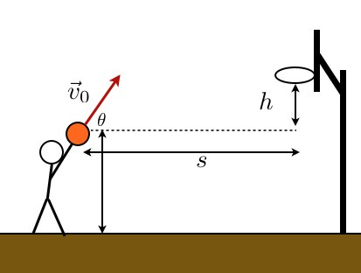
Multi-cell models are solvers
Let’s start with something simple:
Model input:
h,s, V₀, t
Model output:
X(t),Y(t)
We can a build mathematical model that takes as input the initial distance and initial velocity vector and calculates the trajectory of the basketball. The model can also PREDICT whether the shot was successful or not.

Slide 3
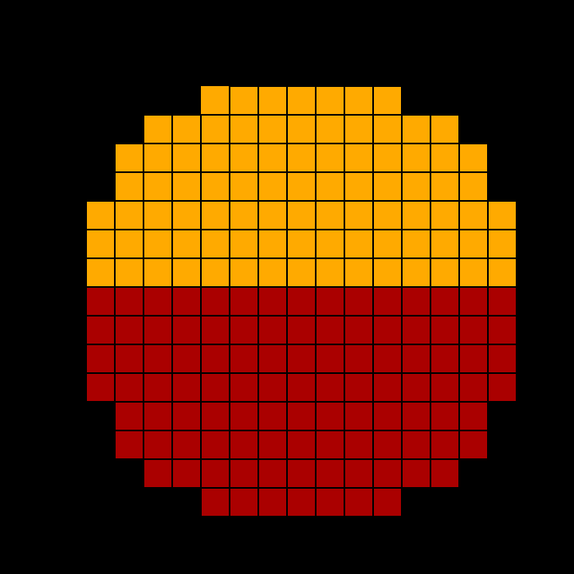
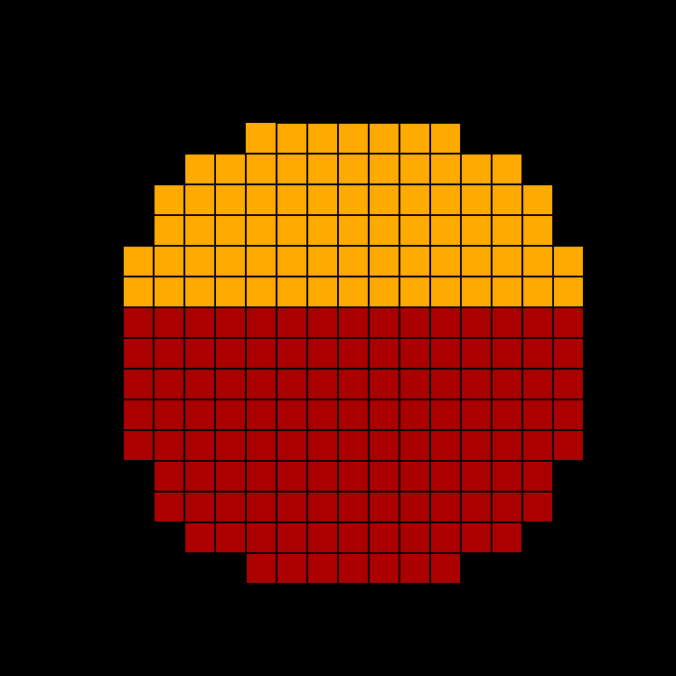
Cell movement during cell-sorting
Model input: initial cell configuration, average cell size, spontaneous cell motility, cell deformability, adhesion strengths between different cells and contact energy between cells and medium
Model output: trajectory of each cell
Model can PREDICT different sorting patterns

Slide 4
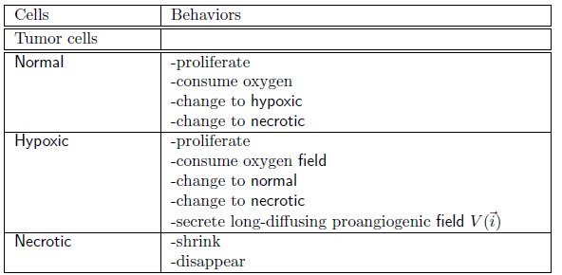
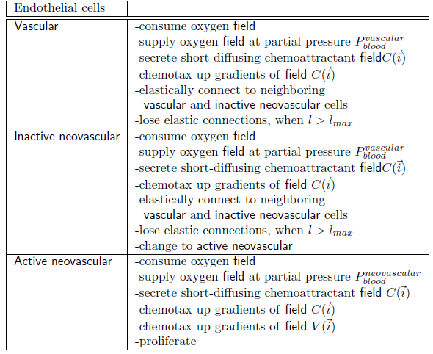
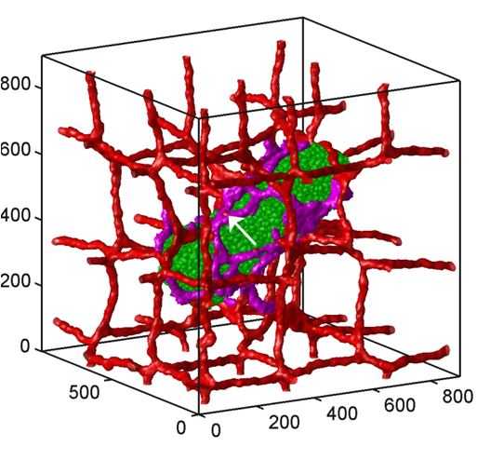
Complex Models: 3D vascularized tumor growth
Output: Position and type of each cell at each time. Concentration of O₂, VEGFs,…
“3D Multi-Cell Simulation of Tumor Growth and Angiogenesis,” Abbas Shirinifard, John S. Gens, Benjamin L. Zaitlen, Nikodem J. Popławski, Maciej Swat, James A. Glazier, PLoS ONE 4: e7190, doi:10.1371/journal.pone.0007190 (2009)
Notes:
4

Slide 5
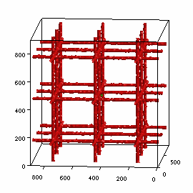
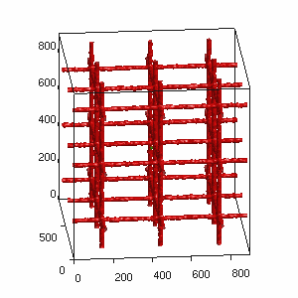
Predictions of Vascularized Tumor Growth Model (implemented in CompuCell3D)

Slide 6
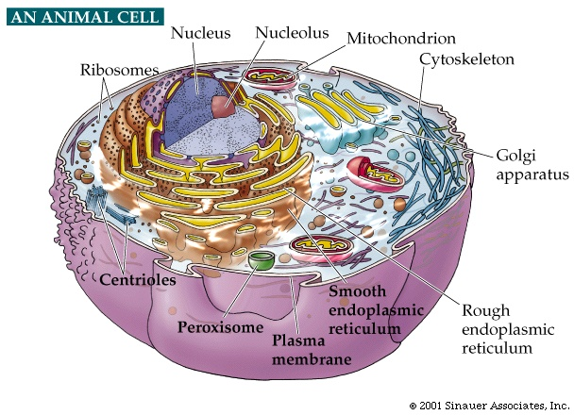
Key challenge in modeling many cells
How to simplify immense complexity of single cell?

Slide 7
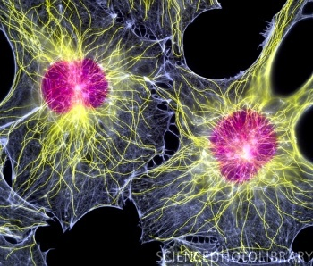
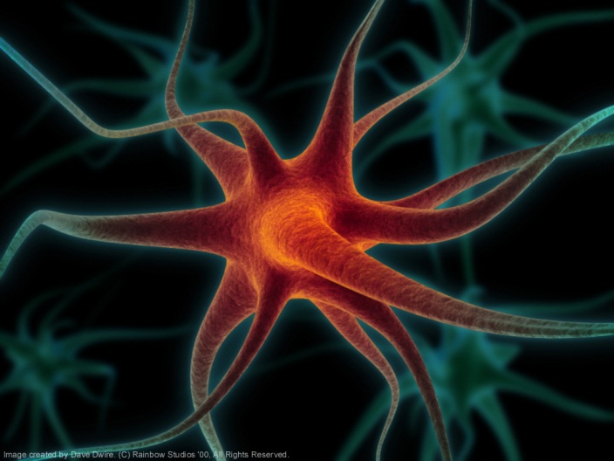
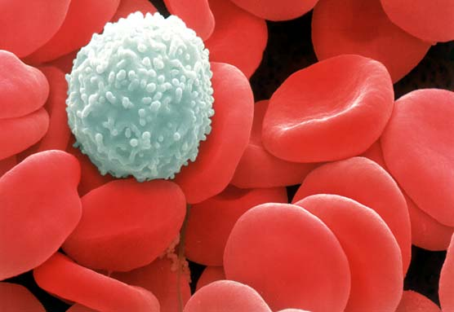
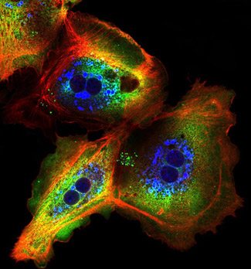
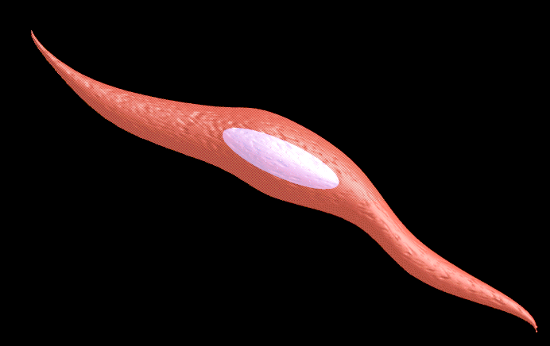

Challenges in cell-based modeling
Cells differ greatly in shape and function
Hard to define a “universal” modeling representation

Slide 8
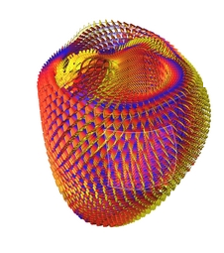
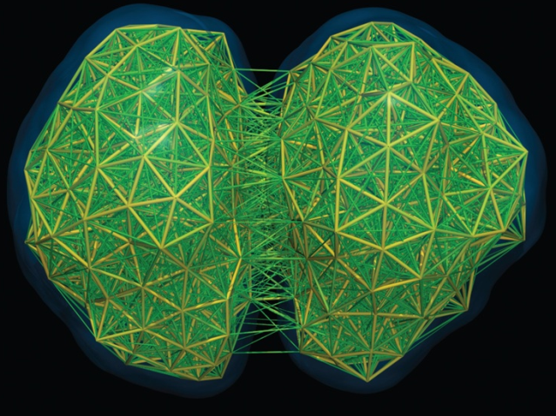
When must we represent individual cells?
Depends on the questions we ask:
Continuum methods work well for a large, organized tissue like the heart
Need single-cell detail to study mechanics of cell-cell interaction
Cardiac model, Andrew McCulloch
Modeling cell rheology, Tim Newman, Sebastian Sandersius

Slide 9
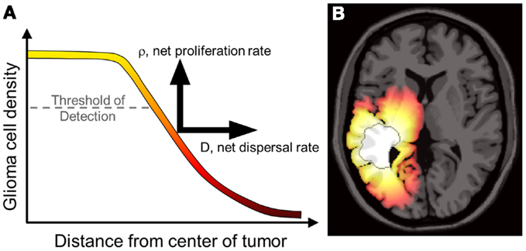
Continuum tissue models
Key Features:
Describe populations of cells rather than individual cells. Key concepts are cell density and flow of cells from one region to another
Focus on tissue/organ scale phenomena rather than microscopic details of cell-cell interactions.
Capable of modeling large structures, e.g. patient-calibrated model of glioma invasion
Typically based on sets of 2-50 coupled PDE’s
Require calibration, many parameters can be measured in the lab
First Virtual Tissues used in clinical setting
Software: FEM packages, various PDE-solvers, research codes
Kristen Swanson et al

Slide 10
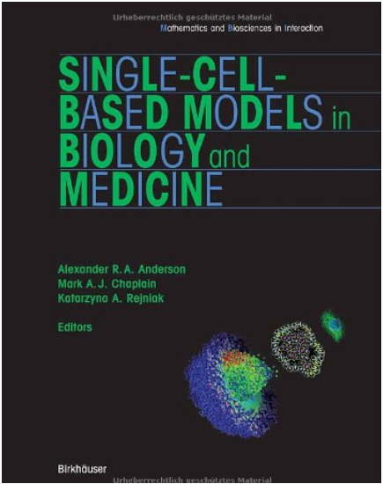
A good place to read about multi-cell models
http://link.springer.com/book/10.1007%2F978-3-7643-8123-3

Slide 11
Multi-Cell Methods
One biological concept—many mathematical and computational implementations
Rule-based:
Cellular Automata
Generic Agent Based Models
Physics Based:
Center Model
Subcellular Element Model
Vertex Model
Viscoelastic Model
Immersed Boundary Model
Cellular Potts Model/ Glazier Graner Hogeweg Model
The “dividing line” between Rule-based and Physics-based is blurry.
Presented classification is based on the origin of the modeling method.

Slide 12
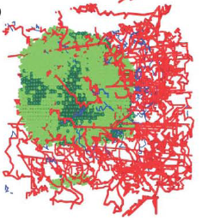
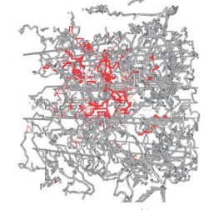
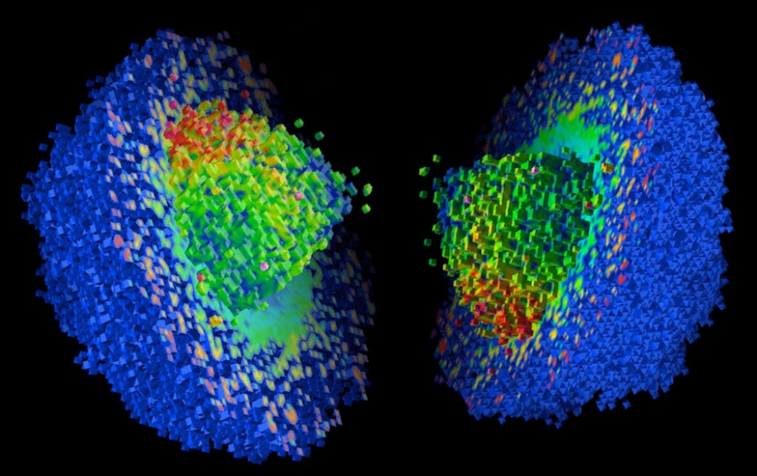
Cellular Automata
Lattice-based, probabilistic model
Cells represented as lattice points
Fast, allow simulations of fairly large tissue volumes
Rule-based
Cells have states and can move to different lattice sites. Transition probabilities define cell properties/behaviors
Detailed representation of single cell behaviors or interactions difficult
May be hard to match experimentally-measured quantities to model parameters
Implementation is simple. Many open source packages, e.g. Cellumat3D, CelLab etc…
3D model of in-silico tumor, Alexander Anderson
3D model of in-silico vascularized tumor, Holger Perfahl et al

Slide 13
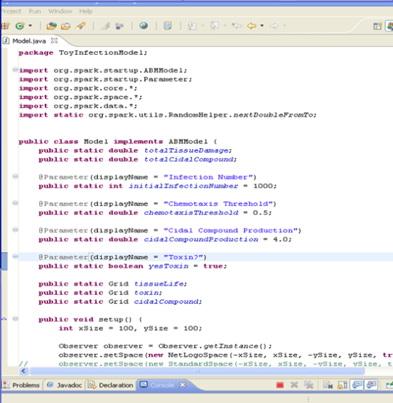
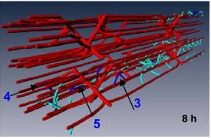
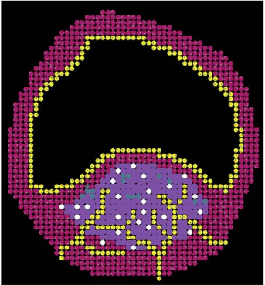
Rule-based models
Agents are independent entities with pre-programmed set of rules which interact leading to emergent phenomena
Agents can represent clusters of cells, cells, parts of cell, ECM components, etc…
Model description consists of heuristic rules
Models usually represented as programing language classes/functions
May be hard to translate lab-measured quantities into parameters/rules
Require training/tuning
When tuned/trained properly, have predictive power
Many software packages: SWARM, NetLogo, Mason, RePast, AnyLogic, SPARK, FLAME, GAMA, research code
Agent-Based Model angiogenesis, Gang Liu, Amina A Qutub, Alexander Popel
Agent-Based Model of Atherosclerotic Plaque Progression, Shayne Peirce-Cottler et al
ABM code for SPARK simulation, Alexey Solovyev, Gary An

Slide 14
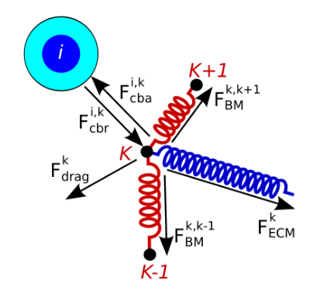
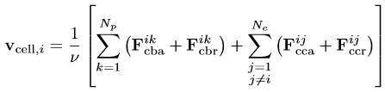
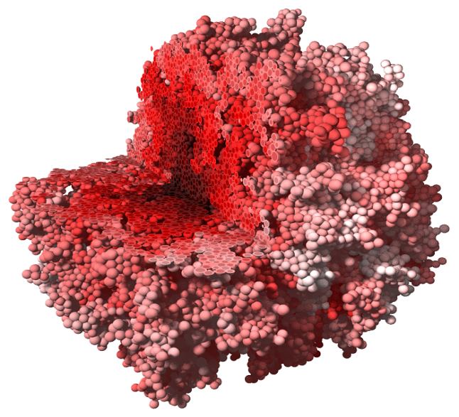
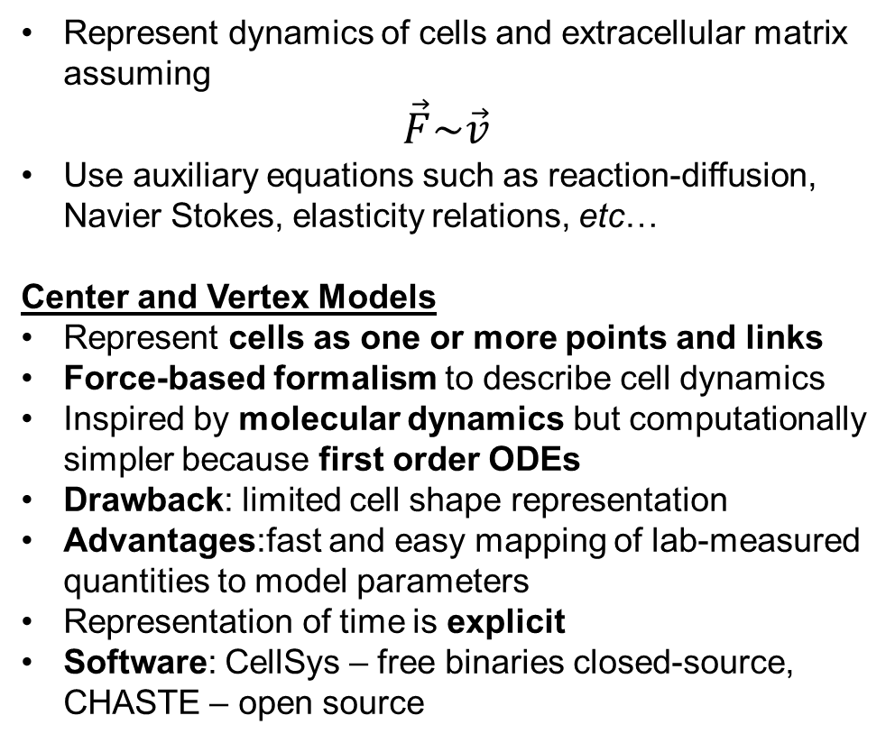
Physics-based multi-cell models
Represent dynamics of cells and extracellular matrix assuming
$$\vec{F}\sim \vec{v}$$
Use auxiliary equations such as reaction-diffusion, Navier Stokes, elasticity relations, etc…
Center and Vertex Models
Represent cells as one or more points and links
Force-based formalism to describe cell dynamics
Inspired by molecular dynamics but computationally simpler because first order ODEs
Drawback: limited cell shape representation
Advantages:fast and easy mapping of lab-measured quantities to model parameters
Representation of time is explicit
Software: CellSys – free binaries closed-source, CHASTE – open source
Paul Macklin: An agent-based model for elasto-plastic mechanical interactions between cells, basement membrane and extracellular matrix
Stefan Hohme, Dirk Drasdo: Growing multi-cellular population

Slide 15
Extensions of Center Model
Subcellular Element Model
Vertex Model
Dissipative Particle Dynamics Model
Viscoelastic Element Model
Virtual Leaf
They are all off-lattice models where each cell is represented as a collection of points in space

Slide 16
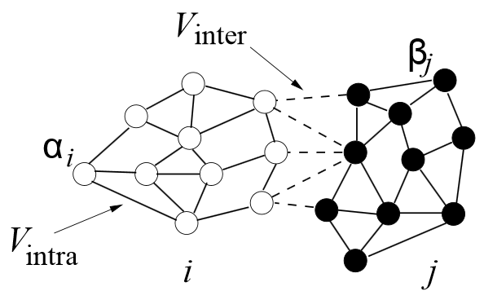
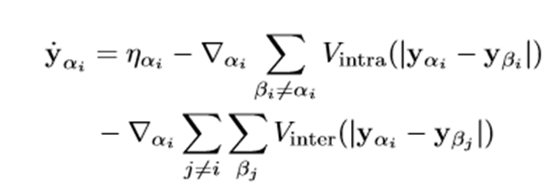
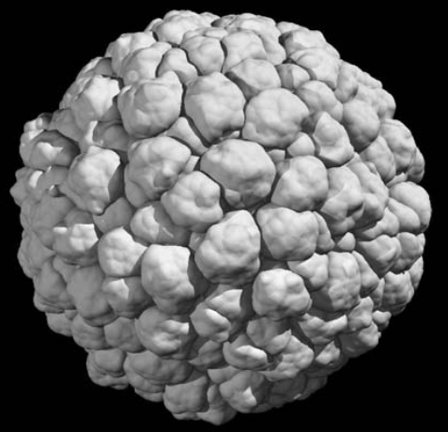
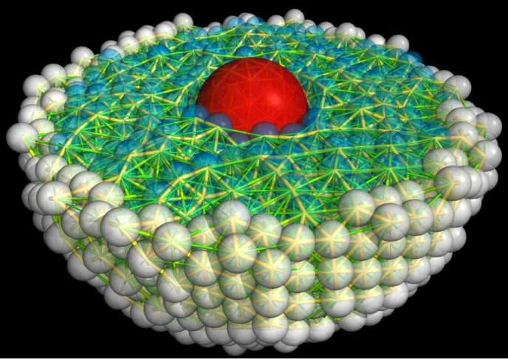
An Extended Center Models: The Subcellular Element Model
Introduced by Tim Newman (U. Dundee, Scotland).
Represents single cell as a collection of interacting subcellular elements – points/spheres. Interaction forces between elements of the same cell are much stronger than interactions between elements of difference cells
Advantages: force-based formalism, allows for fairly detailed cell shape representation. Representation of time is explicit
Drawbacks: computational cost, number of parameters can be large
Software: no established framework – research code
10 um
100 um
Detailed SEM model of a single cell, Sebastian Sandersius, Tim Newman
Modeling cellular aggregate using SEM, Tim Newman

Slide 17
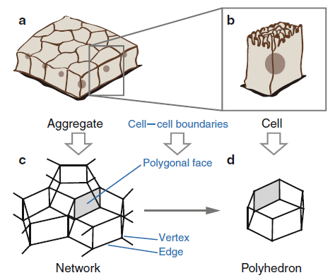


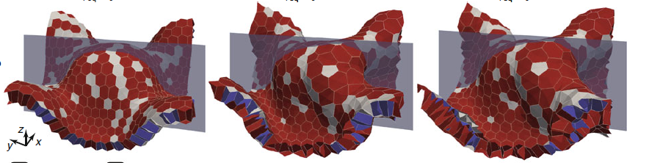
Vertex Model
Represents cells as polyhedra
Uses force or energy formalism to describe vertex dynamics
Calculations are similar to those performed for Center Models
3D implementations can be challenging – complex geometrical transformations during cell shape change
Good for modeling of quasi-rigid tissue structures such as e.g. epithelial sheets
Several implementations: Chaste, Satoru Okuda code
Forces at each vertex are expressed as energy gradients

Slide 18
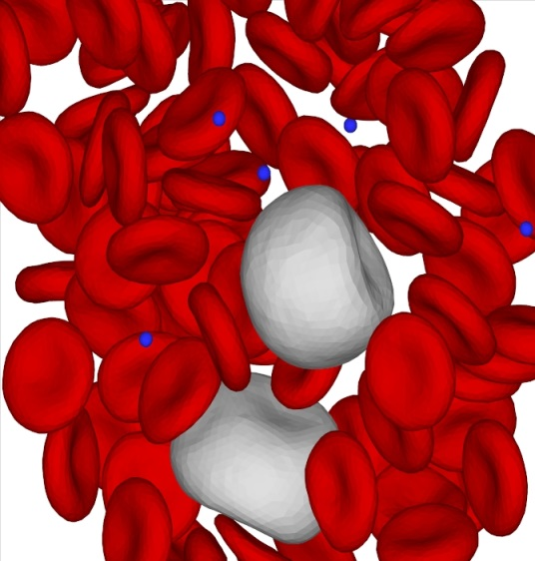
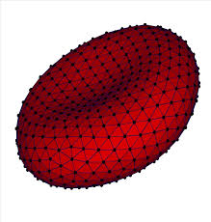
Dissipative Particle Dynamics (DPD) Model
Represents cells as collections of points in space. Usually each DPD particle represents a collection of molecules. For each DPD point we compute force:
Conservative(C), dissipative (D), random (R) terms
For each cell we solve the following eqs of motion:
Software: Molecular dynamics codes. e.g. LAMMPS (Sandia Natl Lab)
Simulating (Red) Blood Cell morphology, homeostasis and disease e.g. sickle cell anemia, using DPD approach. G Karniadakis Brown University
http://www.youtube.com/watch?v=0hibGZi8TWs
Hoogerbrugge PJ and Koelman JMVA. Simulating Microscopic Hydrodynamic Phenomena with Dissipative Particle Dynamics. EPL, 1992 19, 155.
http://www.dam.brown.edu/documents/Karniadakis.pdf

Slide 19
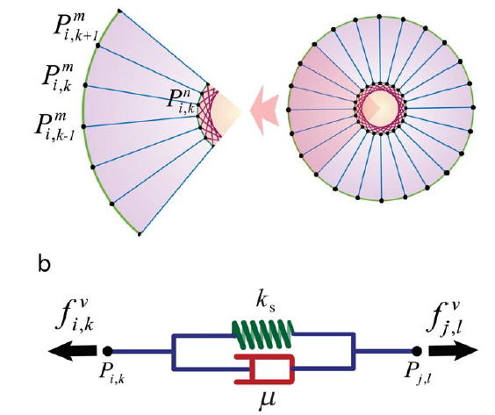
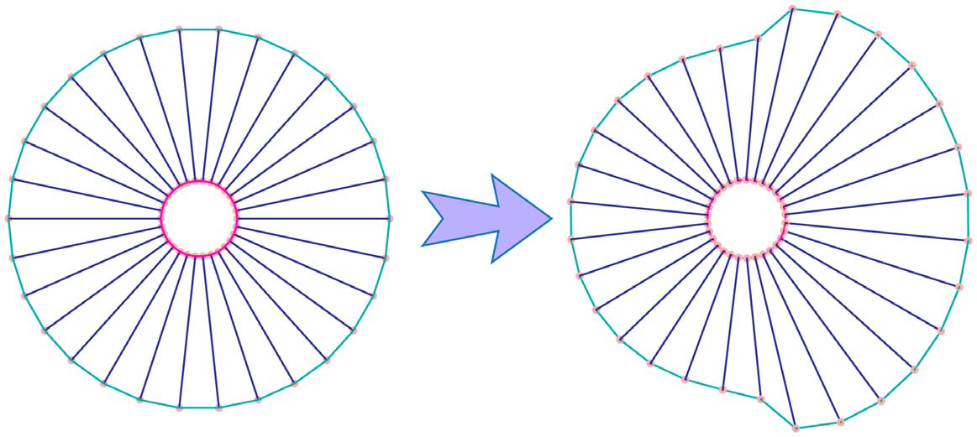
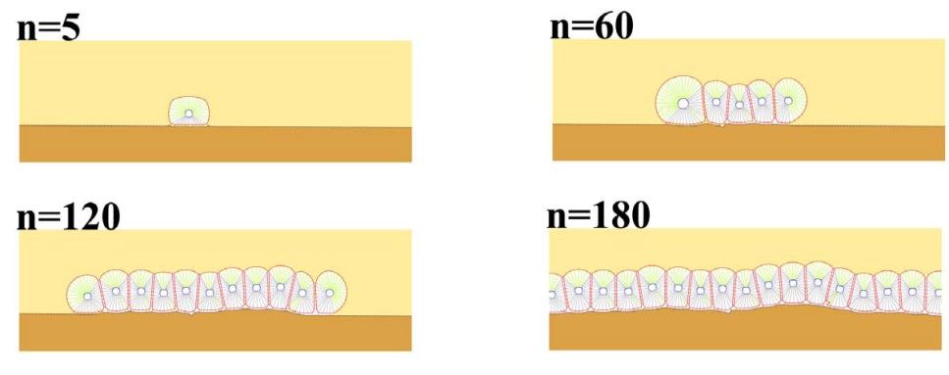
An Extended Vertex Model: The Sub-Cellular Viscoelastic Model
Models single cell as a collection points connected by visco-elastic links
Detail between Subcellular Element Model and Immersed Boundary Method
Models in detail intracellular components
Software: research code
E.g., Jamali Y, Azimi M, Mofrad MRK (2010), A Sub-Cellular Viscoelastic Model for Cell Population Mechanics. PLoS ONE 5: e12097. doi:10.1371/journal.pone.0012097
Formation of epithelial layer
Cell Shape change during movement
Images Courtesy Yousef Jamali*, Mohammad Azimi, Mohammad R. K. Mofrad, UC Berkeley

Slide 20
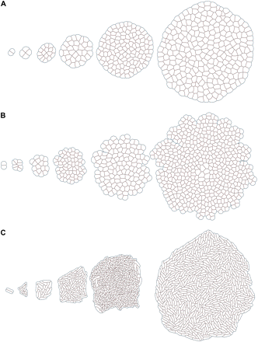
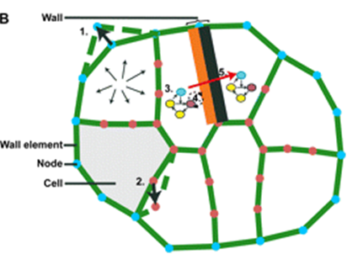
Stochastic Vertex Model: Virtual Leaf
Developed by Roeland Merks and collaborators at CWI Amsterdam.
Represents plant cells as a collection of points in space (off-lattice) located along the cell wall.
Points are connected by visco-elastic “springs”
2D implementation (Virtual Leaf) used mainly to model plant tissue morphogenesis
Uses Hamiltonian and Metropolis-like algorithm to describe cellular dynamics (very similar to Cellular Potts Model).
Open Source Code :https://code.google.com/p/virtualleaf/
R M H Merks, Van de Peer, Y., Inzé, D., & Beemster, G. T. S. (2007). Canalization without flux sensors: a traveling-wave hypothesis. Trends in Plant Science, 12(9), 384–390. doi:10.1016/j.tplants.2007.08.004

Slide 21
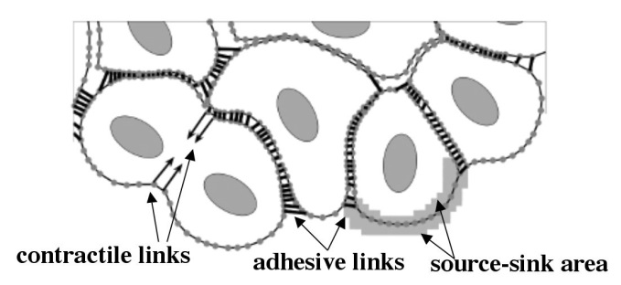
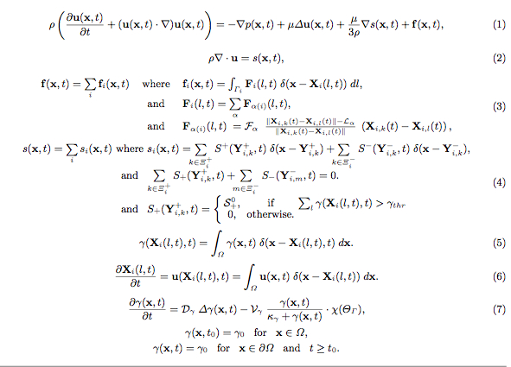
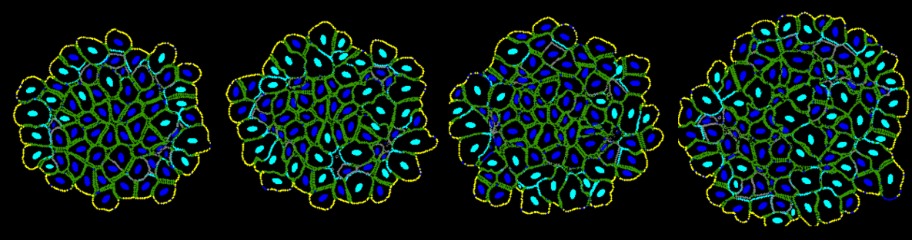
Immersed Boundary Method
Computational Fluid Dynamics approach, models a cell as a fluid enclosed inside a elastic membrane. Fluid motion affects membrane and membrane affects fluid motion
Deals gracefully with shape changes, can simulate subcellular organelles
Excellent spatial resolution for single cell modeling
Drawbacks: mathematical complexity
Computationally expensive (simulating 1000 cells is challenging)
Usually 2D
Software: IBCell (Kasia Rejniak), research code of Michael King, David Gee
Images courtesy of Kasia Rejniak, Moffitt Center, Tampa

Slide 22
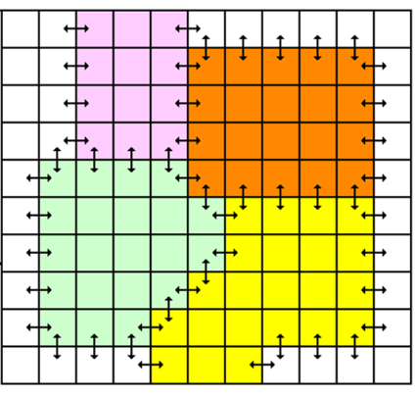
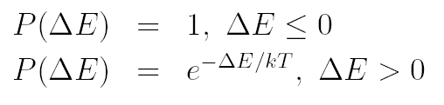
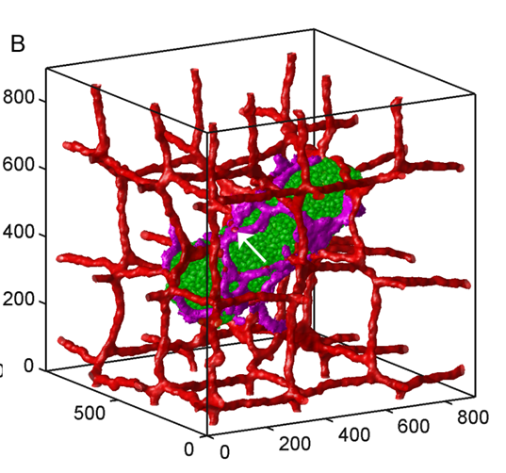
CPM/GGH model
Represents single cell as a collection of pixels on a 2D or 3D lattice (regular or irregular)
Physics based
Effective energy formalism describes cell behaviors compactly
Stochastic
Simple and intuitive mathematically
Capable of representing subcellular structures
Up to 10⁵ cells/CPU
Used extensively by many labs around the world
Drawbacks: Time implicit. Lattice granularity determines detail of objects.
Software: CompuCell3D, Chaste, Simmune, Morpheus, Tissue Simulation Toolkit

Slide 23
Focusing on cell behaviors
Energy formalism of the CPM allows implementing cellular behaviors as additive terms of the Hamiltonian:

Slide 24
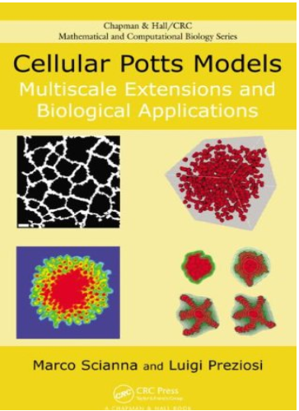
Good place to learn about CPM

Slide 25
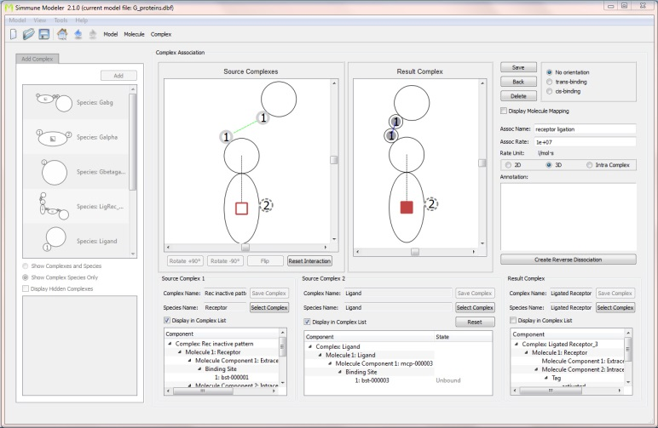
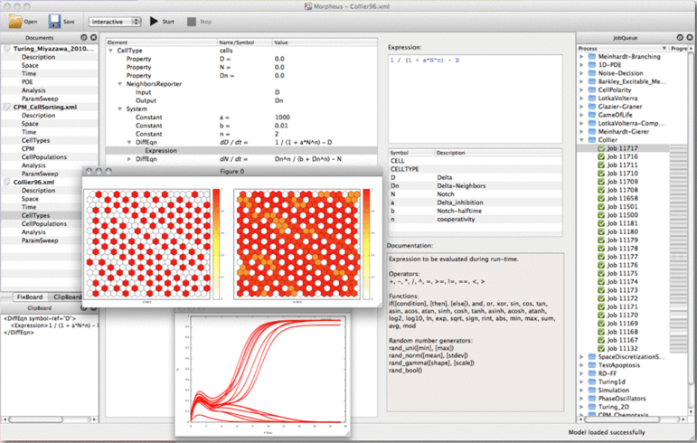



Cell-Based Virtual-Tissue Modeling Platforms
Many tools for generic agent based modeling
Very few tools for physics-based simulations. E.g.:
CompuCell3D (www.compucell3d.org) – implements CPM/GGH. Powerful and easy to use. Cross-platform and open source. Uses Python and XML model specification. Many users
Morpheus (http://imc.zih.tu-dresden.de/wiki/morpheus/doku.php) – CPM/GGH. XML model specification. Free but closed-source
Simmune (http://www.niaid.nih.gov/labsandresources/labs/aboutlabs/lsb/Pages/simmuneproject.aspx) – CPM/GGH. Free but closed-source
CHASTE (http://www.cs.ox.ac.uk/chaste/) – multi-method (CPM/GGH, Center Model, Vertex Model, FEM continuum). Open source. C++ library. Linux only. Hard to learn. C++ model specification
CellSys (Dirk Drasdo and Stefan Hohme)– Center model. Free but closed-source. GUI-based model specification is limiting

Slide 26




CompuCell3D
Cross-platform, open-source environment for building and running multi-cell multi-scale simulations of tissues and organs
Written in C++ and Python
Describes models using combination of XML and/or Python
Parallel implementation on GPU’s and multi-core machines
Simulation-wizards, simulation editors, graphical interfaces, visualization tools, SBML solvers, and FE solvers (experimental support) included
SBML models can run inside each cell
Model Generation, e.g. using H. Sauro’s JDesigner

Slide 27
Challenges in multi-cell modeling
Multi-cell models are hard to standardize
The only common concepts between approaches are biological Implementations are very diverse
Classes of objects, their properties, behaviors and interactions are much more diverse than those in SBML or CellML
Cell Behavior Ontology (J. Sluka, IUB) towards a universal multi-cell model description language
Model sharing limited. Most models hard coded and most software is closed
Model reproducibility limited
Lack of open multi-cell modeling software impedes use of virtual tissues
Software sustainability is a major challenge

Slide 28

Importance of Integration Platforms: A Commercial Success Story

Slide 29

Importance of Integration Platforms: A Commercial Success Story
Is Matlab really “one-size-fits-all” solution? In many cases
Features which make Matlab sell:
Easy to use scripting language – makes Matlab extensible, and the syntax does not change every 2 years
Plethora of computational tools under one roof
User interface – visualization, code editor, well defined data formats, etc…
Matlab models are shareable and exchangeable (within Matlab community)
Can be used in classroom setting to teach students modeling
Documentation and books teaching how to effectively use Matlab
Outreach efforts – training
Professionally maintained

Slide 30
Specification of the “ideal” cell-based modeling platform
Like Chaste it should support multiple modeling methods (Potts, Center Models, Cellular Automaton, etc…)
Allow easy import of experimental images and have tools to compare simulation to experiments
Scripting language. Without it Matlab or Mathematica would go nowhere
Open-source, modular ,extensible, cross-platform code base (credibility, reproducibility)
Easy-to-use, feature-rich visualization tools, user-friendly model editors
Links to other modeling scales (subcellular reaction-kinetics models, or whole body PBPK)
Generic PDE solver suite
Community-developed and supported – case in point - ImageJ
Standardized model description (really hard for cell-based models)

Slide 31
Why focusing on software usability makes sense?
Understanding biological development is hard already
Software should make research easier
Building computational models should be easy.
When experimentalists embrace modeling tools there is better chance they will come up with new hypotheses, verify existing ones, push research forward
Just as underlying biology can be described using relatively few cellular behaviors building computational model code reuses relatively few constructs and concepts
Even if model building itself is simple the big problem is being able to control and understand all parameters on which the simulation depends

Slide 32





Building a simple model in 60 seconds using CompuCell3D and Twedit++

Slide 33

Building a simple model in 60 seconds using CompuCell3D and Twedit++

Slide 34

Building a simple model in 60 seconds using CompuCell3D and Twedit++

Slide 35
The allure of graphical model configuration
The ability to define computational model sounds very appealing.
Puzzle: Computational model is simply a computer program. If graphical program/model definition is so good why do professional programmer still type code?
Common sense dictates that both approaches have their place in programming and modeling. However, insisting that GUI’s will simplify the science, make it broadly accessible and magically allow laymen build sophisticated models is a bit naïve.
The big problem with graphical model definitions for methods/approaches which are still evolving is that the development and maintenance costs are very high.
Designing user-friendly GUI’s is hard
While bare code can easily tolerate multiple API’s it is hard to support multiple GUI layouts as the application evolves.
GUIs make sense for repetitive and well defined tasks such as defining biochemical network, segmenting or applying filter to the experimental image, drawing initial cell layout etc…

Slide 36
Summary
Many approaches to build multi-cell models but surprisingly very limited choice of software tools for physics-based simulations
No universal modeling method
Multi-cell modeling is still a developing field
Even with most user-friendly tools , parameter control remains a problem. Blame Nature
Clinical and regulatory applications are emerging and the field has great prospects as a complement to *omics
Acknowledgements:
James Glazier (IU)
Jim Sluka (IU)
Funding:
NIH (GM 077136)
NIH (GM 076692)
US EPA (R8355001)

Slide 37



On-the Fly Selective Microcalculation of Parameters
Liver Necrosis
Arterial
flow
Venous
flow
Hepatocyte
k=0.05
K=1
k=0.0005
k=0.05
K=1
k=0.0005
k=0.05
RedBloodCell
k=0.0005
Blood Portion
k=0.0005
k=0.0005
K=1
k=0.05
Doing this is difficult!

Slide 38
Modeling Platform to Facilitate Multi-Scale AND Cross-Scale Calculations
We need a way of propagating information across different scales that is:
  Computationally feasible
  Capable of representing key features of models from different scales
Software solution—A Modeling Platform that will make modeler’s life easier – think Matlab for Computational Biology

Slide 39

Scientific Success Story – Physics Analysis Toolkit - Root

Slide 40
Prerequisites
Interconnectible scalable component libraries that cover computations at different modeling scales (e.g. many SBML simulator don’t work in a multi-cell model context)
Standardized links between tools operating at different scales (data exchange formats, simulation workflow tools, etc.) which facilitate model composition and enable fast model deployment
Flexible, user friendly, component integration platforms
Minimize effort duplication (SBML.org lists 200 SBML-compatible packages, many duplicate the same functionality – solving ODEs…)
Standard model description formats and modeling languages
Open-source with reasonable licenses (e.g. Python Software Foundation License)
Clear modeling code and accompanying documentation to allow third-party development

Slide 41
Suggestions for Modeling Community
Copying successful solutions is not a bad idea
Python emerging as a de-facto standard scripting language for scientific computing (Numpy, SciPy, Numba, Disco, PyPy, Cython, etc…)
Developing modeling standards in a way that would enable their reuse outside original target domains
Agree on core technology to avoid effort duplication - make sure that solutions you choose will be still in use few years from now
Focus on usability features – cryptic software (no matter how powerful) that is hard to understand and use is not what you want.
Provide training workshops, documentation and try to engage external developers to create vibrant community

Slide 42
What is a multi-cell model
Multi-scale model is a solver which takes as an input initial conditions specification, description of cell behavior. The model outputs time lapse images of how modeled tissue, organ or organism change over time.
It is just like models that predict e.g trajectory of an asteroids. We specify initial conditions, describe dynamics and let mathematical/computational aparatous take care of the rest
Add references to MSM exampls for multi-cell modeling Denise Kirchner, Sasha Popel, Michael King, Jay (Cornell), Mark Alber,

Slide 43
The CPM Model Formalism Overview
Configuration of Cells Evolves to Locally Minimize the Effective Energy, primarily by satisfying constraints) (Graner and Glazier, 1992)
Key concept is differential adhesion between components: Contact energy depending on cell types (differentiated cells)
σ(x) –denotes id of the cell occupying position x. All pixels pointed to by the arrow have same cell id, and belong to the same cell
τ(σ(x)) denotes the cell type of cell with id σ(x). In the picture above blue and yellow cells have different cell types and different cell id. Arrows mark different cell types

Slide 44
More Detail on Pixel Copy Attempts
invalid attempt
valid attempt
accept
valid attempt
accept
valid attempt
reject
valid attempt
accept

