Slide 1
Merging CompuCell3D and SBW/SBML
Julio M. Belmonte
Indiana University, Bloomington

Slide 2
Outline
Objectives
Ways to add RK to CC3D
SBML format
Generating SBML using Jarnac
    Simple Oscillator
Integrating with CC3D
    Bionet example – simple oscillator
    Adding Cell Cycle model from sbml.org
    John Tyson’s Cell Cycle model
    Collier et al. Delta-Notch patterning model

Slide 3

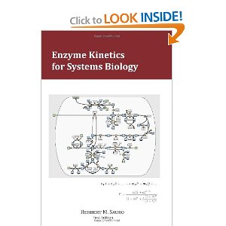
More on Reaction Kinetics Modeling
Essential Mathematical Biology
  Nicholas Britton
Enzyme Kinetics for Systems Biology
  Herbert Sauro
www.sys-bio.org/sbwWiki/tutorials/bloomington2011

Slide 4
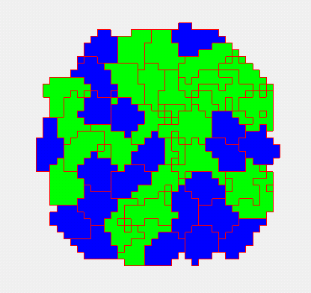
Cell-based modeling
Cellular behaviors:
    Location
    Volume
    Shape
    Movement
    Adhesion
    Mitosis
    Death
    Differentiation
    Polarization
    Etc…

Slide 5
Subcellular modelling
Biochemical Kinetics:
  Cell-Cycle
  Circadian rhythms
  Cardiac rhythms
  cAMP oscillations
  Delta-Notch patterning
  WNT pathway
  FGF pathway
  Etc…

Slide 6
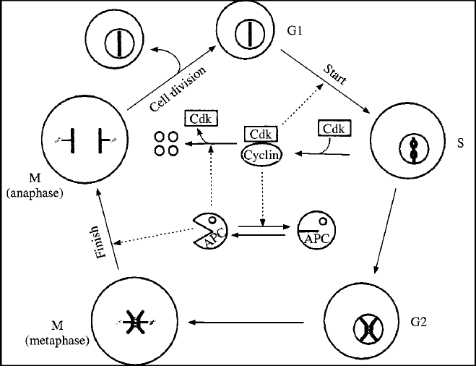
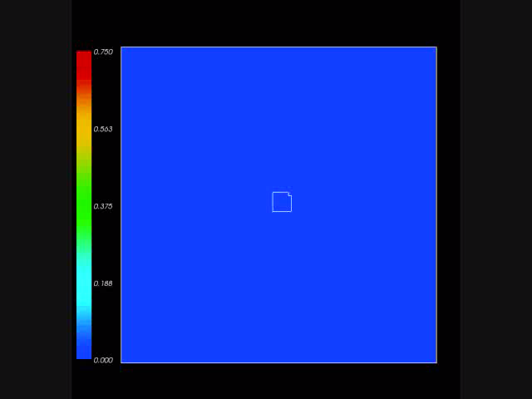
Subcellular modelling
Biochemical Kinetics:
  Cell-Cycle
  Circadian rhythms
  Cardiac rhythms
  cAMP oscillations
  Delta-Notch patterning
  WNT pathway
  FGF pathway
  Etc…

Slide 7
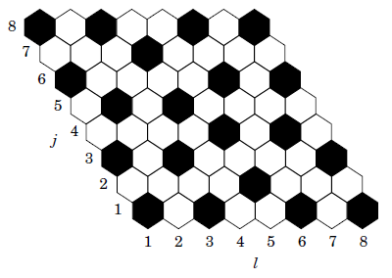
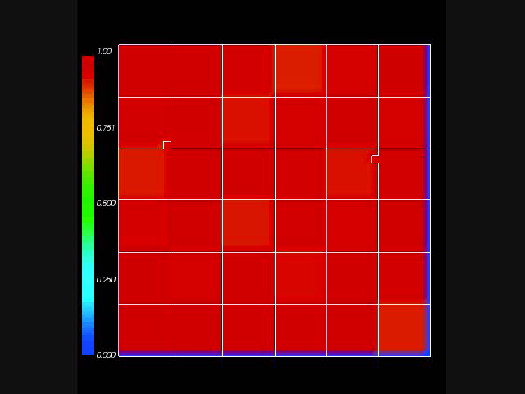
Subcellular modelling
Biochemical Kinetics:
  Cell-Cycle
  Circadian rhythms
  Cardiac rhythms
  cAMP oscillations
  Delta-Notch patterning
  WNT pathway
  FGF pathway
  Etc…

Slide 8
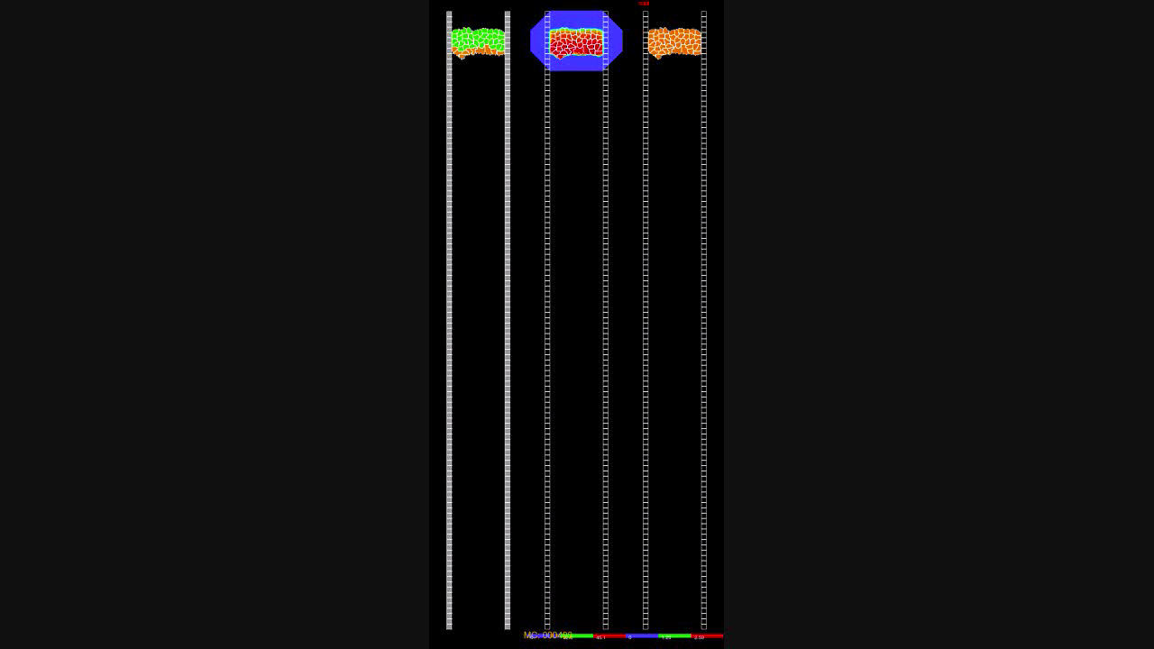
Multiscale model - Somitogenesis

Slide 9
How to add this into CompuCell?
Just another Python class!
  Too slow

Slide 10
How to add this into CompuCell?
Just another Python class!
  Too slow
C++ file to be wrapped into Python
  Too complicated

Slide 11
How to add this into CompuCell?
Just another Python class!
  Too slow
C++ file to be wrapped into Python
  Too complicated
Import SBML

Slide 12
SBML – Systems Biology Markup Language
Not a software!
Machine-readable format for representing subcellular models
Standard for storage and exchange of models
Implementation agnostic

Slide 13
SBML
How does it work?
Developer software (SBW/Jarnac)
SBML
Simulation software (CompuCell3D)

Slide 14
SBML
Initial conditions:
Parameters:

Slide 15
SBML
<?xml version="1.0" encoding="UTF-8"?>
<sbml xmlns = "http://www.sbml.org/sbml/level2" level = "2" version = "1">
<model id = "cell">
<listOfCompartments>
<compartment id = "compartment" size = "1"/>
</listOfCompartments>
<listOfSpecies>
<species id = "S1" boundaryCondition = "false" initialConcentration = “5.0" compartment = "compartment"/>
<species id = "S2" boundaryCondition = "false" initialConcentration = “0.0" compartment = "compartment"/>
</listOfSpecies>
<listOfParameters>
<parameter id = "k1" value = "0.1"/>
</listOfParameters>
<listOfReactions>
<reaction id = "_J1" reversible = "false">
<listOfReactants>
<speciesReference species = "S1" stoichiometry = "1"/>
</listOfReactants>
<listOfProducts>
<speciesReference species = "S2" stoichiometry = “2"/>
</listOfProducts>
<kineticLaw>
<math xmlns = "http://www.w3.org/1998/Math/MathML">
<apply>
<times/>
<ci>
k1
</ci>
<ci>
S1
</ci>
</apply>
</math>
</kineticLaw>
</reaction>
</listOfReactions>
</model>
</sbml>

Slide 16
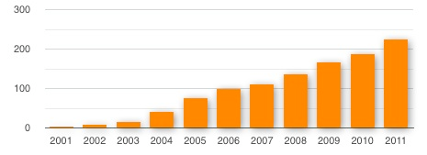
SBML
Total number of known SBML-compatible software packages each year :

Slide 17
How to write SBML?
Bio-Spice
    Large collection of tools, integrated via a "Dashboard." Free download (BSD), various platforms.
Teranode
    Suite of tools for model management, design, and simulation. (Linux/Mac/Windows) Commercial (30-day trial available).
SBW
    Systems Biology Workbench.
Check http://sbml.org/SBML_Software_Guide

Slide 18
SBW/Jarnac
SBW - Systems Biology Workbench:
  Open-source software framework for systems biology
Jarnac:
  Software for writing and simulating reaction kinetics
  Easy to use
  Translate to SBML (C++, Matlab, Mathematica, etc..)
Download at: http://www.sys-bio.org/

Slide 19
Integration with CC3D
Reaction kinetic models can be easily added in CC3D when in SBML format.
Once loaded, the model is converted into a set of ODEs and is solved by the BionetSolver library inside CC3D.
The commands used to load and manipulate the models inside CC3D are summarized on the “Quick Reference Guide” for Python in CC3D.

Slide 20
Integration with CC3D
import bionetAPI # Import bionetAPI functions
class <someClass>(SteppableBasePy):
def __init__(self,_simulator,_frequency=1):
SteppableBasePy.__init__(self,_simulator,_frequency)
bionetAPI.initializeBionetworkManager(self.simulator) # Initialize bionet inside class
def start(self):
# Load a specific subcellular SBML submodel
ModelName = <sbmlModelName> # Name of the model
ModelPath = <sbmlModelPath> # Path where the model is stored
ModelKey = <modelKey> # Nickname of the model
IntegrationStep = <timeStep> # Time step of integration
bionetAPI.loadSBMLModel( ModelName, ModelPath, ModelKey, IntegrationStep )
# Add SBML submodel to a group of cells or a single cell
bionetAPI.addSBMLModelToTemplateLibrary(<sbmlModelName>, {<cellType> or <cellId>})
…
# Modify the parameter value or molecular concentration of a cell (or group of cells)
bionetAPI.setBionetworkValue(<molecule/parameter>, <value>, {<cellType> or <cellId>})
…
# Initialize model
bionetAPI.initializeBionetworks()
def step(self,mcs):
# Iterate the model (run it for the time step specified on the load command)
bionetAPI.timestepBionetworks()
…
# Get the parameter value or molecular concentration from a cell (or group of cells)
<var>=bionetAPI.getBionetworkValue({<parameter> or <molecule>},{<cellType> or <cellId>})
…
# Modify the parameter value or molecular concentration of a cell (or group of cells)
bionetAPI.setBionetworkValue(<molecule/parameter>, <value>, {<cellType> or <cellId>})

Slide 21
Integration with CC3D
1
import bionetAPI # Import bionetAPI functions
class <someClass>(SteppableBasePy):
def __init__(self,_simulator,_frequency=1):
SteppableBasePy.__init__(self,_simulator,_frequency)
bionetAPI.initializeBionetworkManager(self.simulator) # Initialize bionet inside class
def start(self):
# Load a specific subcellular SBML submodel
ModelName = <sbmlModelName> # Name of the model
ModelPath = <sbmlModelPath> # Path where the model is stored
ModelKey = <modelKey> # Nickname of the model
IntegrationStep = <timeStep> # Time step of integration
bionetAPI.loadSBMLModel( ModelName, ModelPath, ModelKey, IntegrationStep )
# Add SBML submodel to a group of cells or a single cell
bionetAPI.addSBMLModelToTemplateLibrary(<sbmlModelName>, {<cellType> or <cellId>})
…
# Modify the parameter value or molecular concentration of a cell (or group of cells)
bionetAPI.setBionetworkValue(<molecule/parameter>, <value>, {<cellType> or <cellId>})
…
# Initialize model
bionetAPI.initializeBionetworks()
def step(self,mcs):
# Iterate the model (run it for the time step specified on the load command)
bionetAPI.timestepBionetworks()
…
# Get the parameter value or molecular concentration from a cell (or group of cells)
<var>=bionetAPI.getBionetworkValue({<parameter> or <molecule>},{<cellType> or <cellId>})
…
# Modify the parameter value or molecular concentration of a cell (or group of cells)
bionetAPI.setBionetworkValue(<molecule/parameter>, <value>, {<cellType> or <cellId>})
2
3
4
4
5

Slide 22
First Example
MODEL:
  2 cell types:
    Condensing
    NonCondensing
  Condesing cells have stable volume
  NonCondensing cells volume oscillate
  Volume oscillation is driven by a subcellular model:
    Oscli.sbml

Slide 23
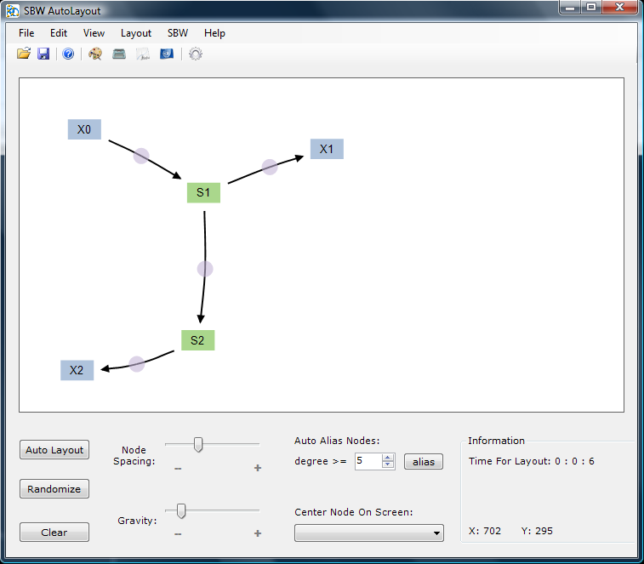
First Example
Oscli.sbml:

Slide 24
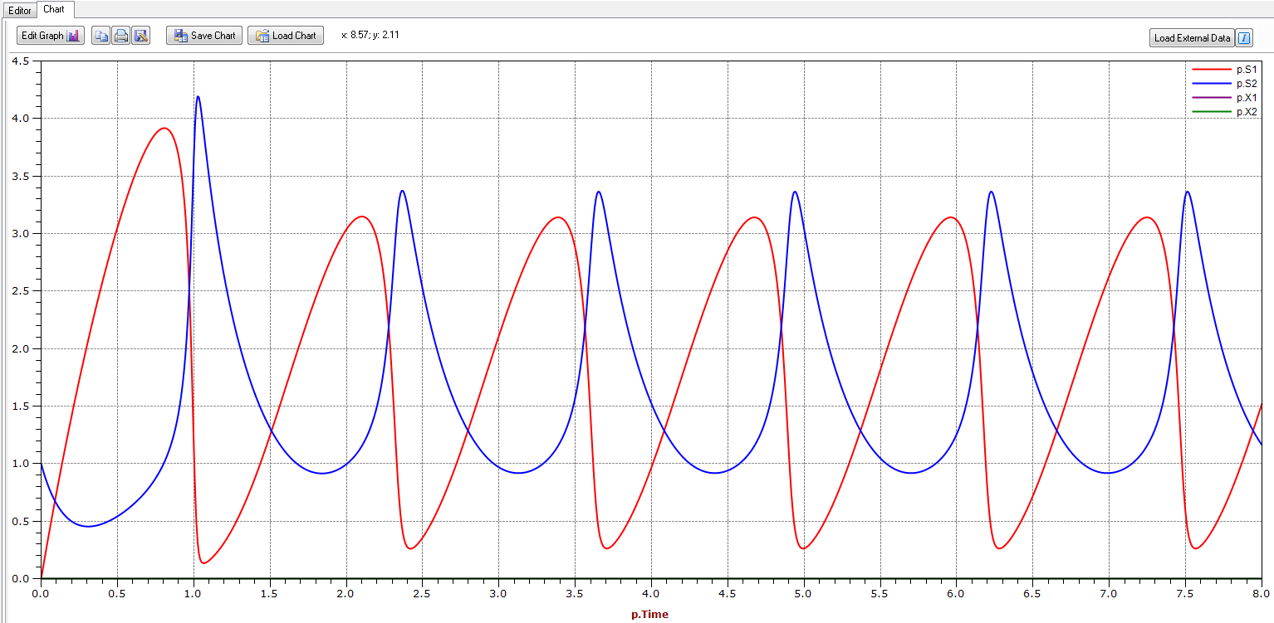
First Example
Oscli.sbml:

Slide 25
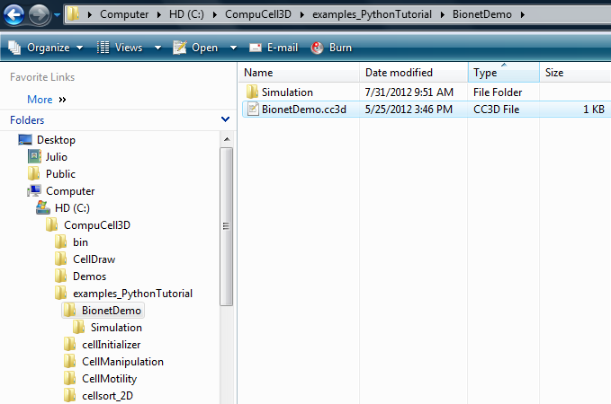
First Example
On Twedit++, open the Project File BionetDemo:

Slide 26
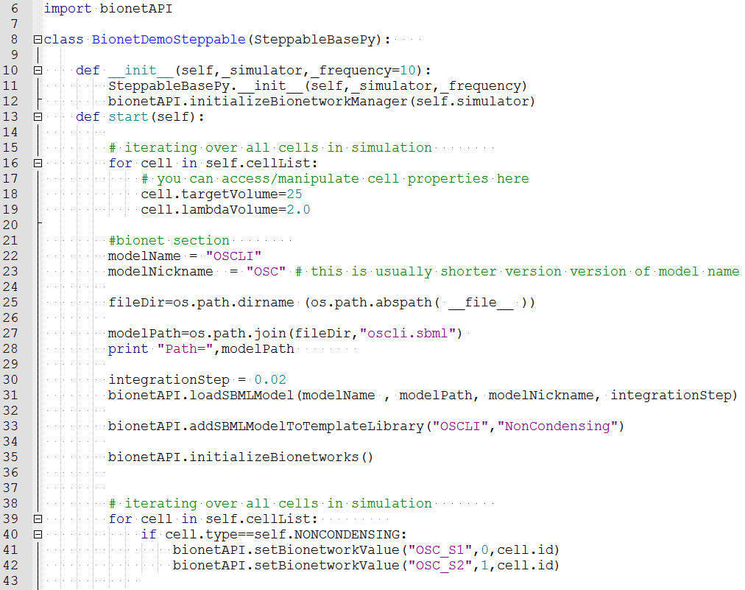
First Example

Slide 27
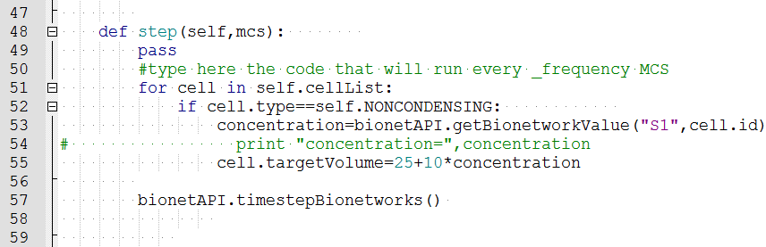
First Example
This is how we read concentration values:

Slide 28
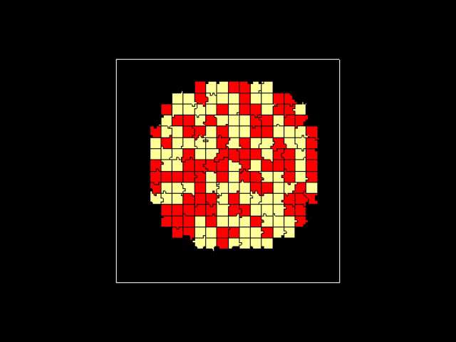
First Example

Slide 29
Exercises
1
  Change volume oscillation amplitude
  Make Condensing cells oscillate
  Make Condensing cells oscillate at opposite phase

Slide 30
Exercises
1
  Change volume oscillation amplitude
  Make Condensing cells oscillate
  Make Condensing cells oscillate at opposite phase
2
  Replace SBML model with the one from Tuesday: Boris Kholodenko, Eur J Biochem. 2000 Mar;267(6):1583-8

Slide 31
Second Example – Cell Cycle from web
In our second example we will use a published model for the cell cycle.
The website www.sbml.org contains a repository of published models in SBML format.
If you wish to submit your own SBML to the repository, follow the instructions at: www.ebi.ac.uk/biomodels-main/submit

Slide 32
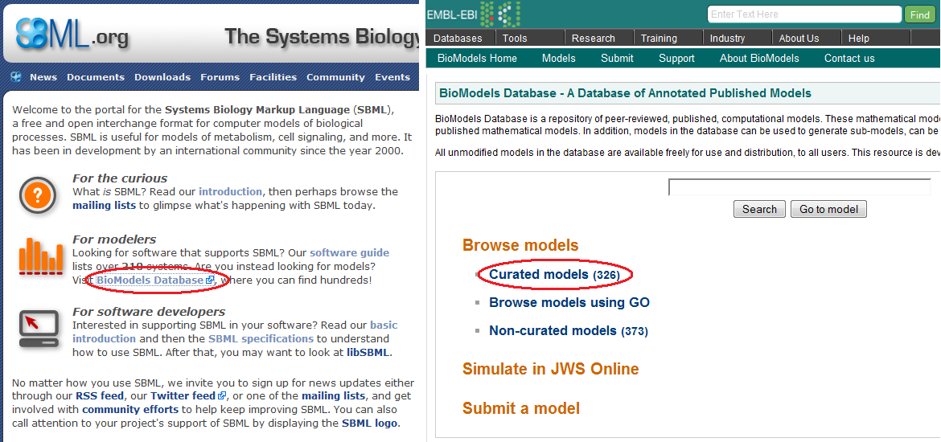
Second Example – Cell Cycle Model
On www.sbml.org, click on the link “BioModels Database” and then on “Curated models”:

Slide 33
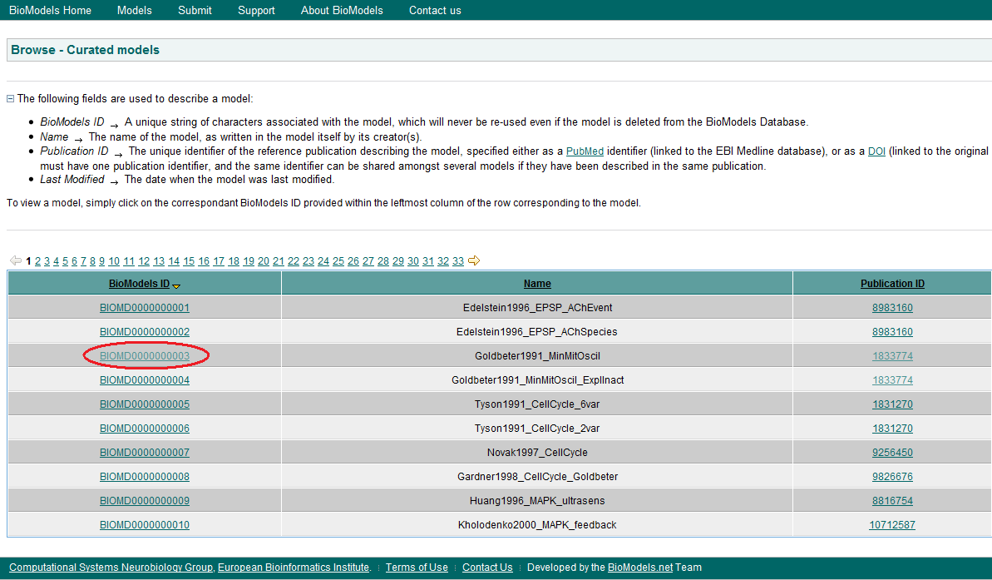
Second Example – Cell Cycle from web
From the model list select the third one by clicking on the link under the column “BioModels ID”

Slide 34
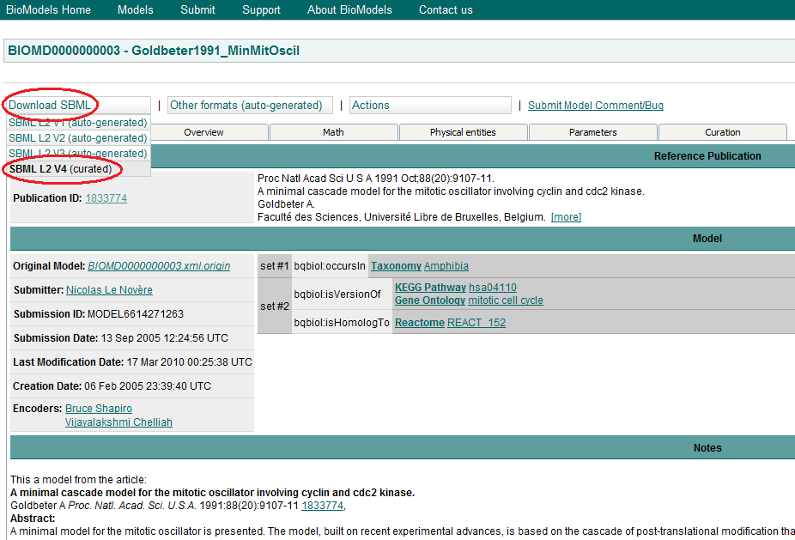
Second Example – Cell Cycle from web
To download the model click on “Download SBML” and select “SBML L2 V4 (curated)”

Slide 35
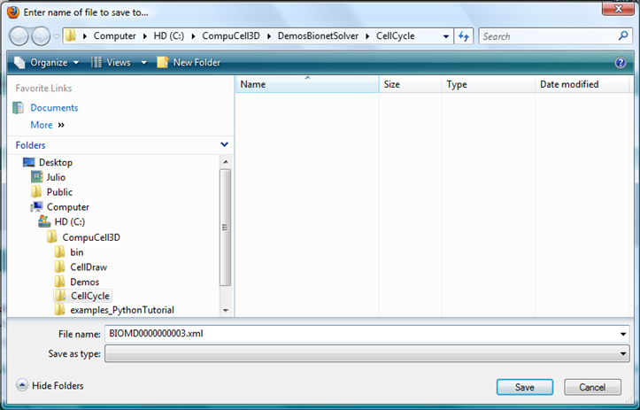
Second Example – Cell Cycle from web
Save the file BIOMD0000000003.xml inside the directory CompuCell3D\CellCycle\Simulation (Create the directories first)

Slide 36
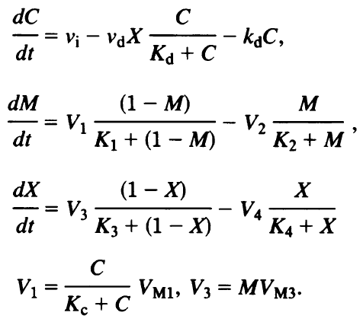
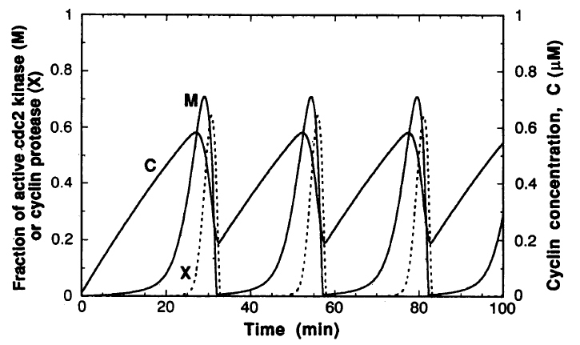
Second Example – Cell Cycle from web
This model is composed of 3 ODEs that forms an oscillating system:
  C : cyclin concentration
  M : fraction of active cdc2 kinase
  X : fraction of active cyclin protease

Slide 37
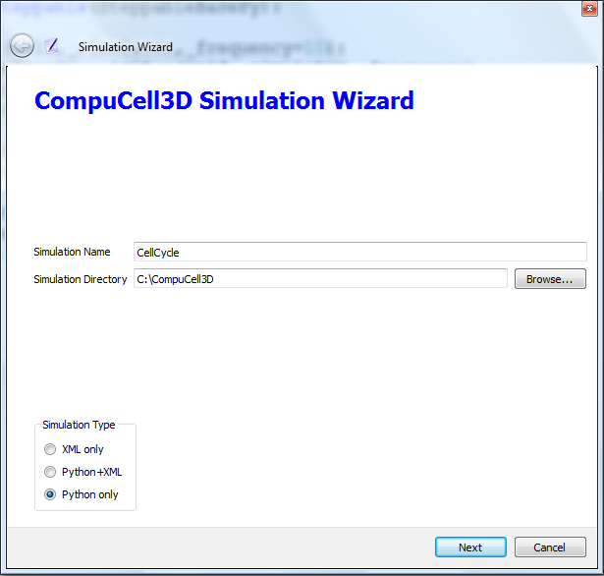
Second Example – Cell Cycle from web
Using Tweddit++ Wizard, create a new simulation:

Slide 38
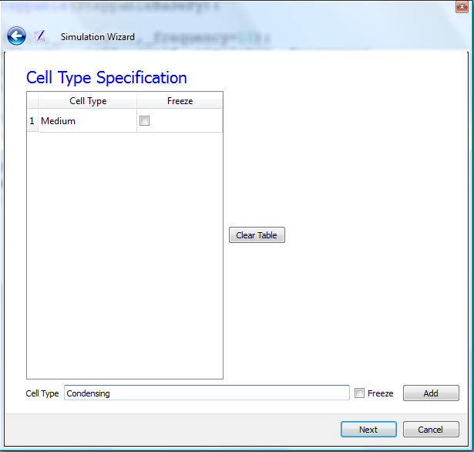
Second Example – Cell Cycle from web
Add cell type “Condensing”:

Slide 39
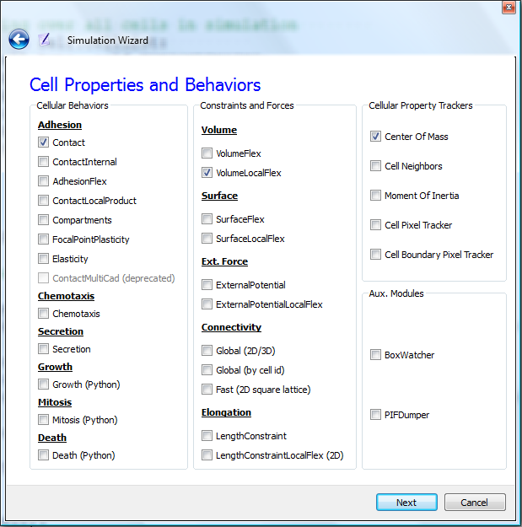
Second Example – Cell Cycle from web
Select Contact and VolumeLocalFlex

Slide 40
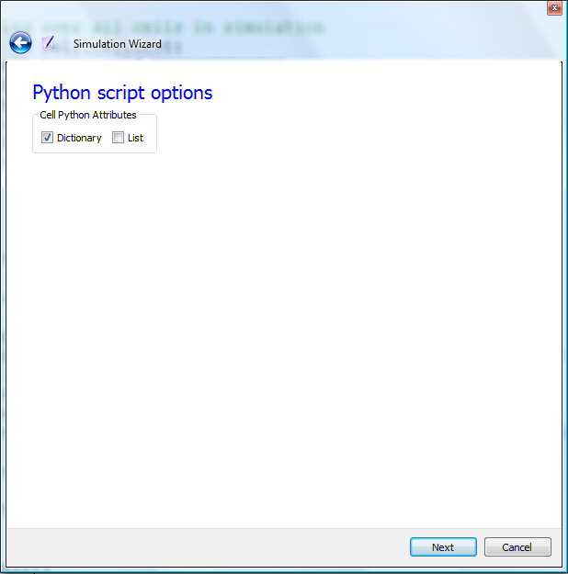
Second Example – Cell Cycle from web
Add a dictionary to the cells

Slide 41
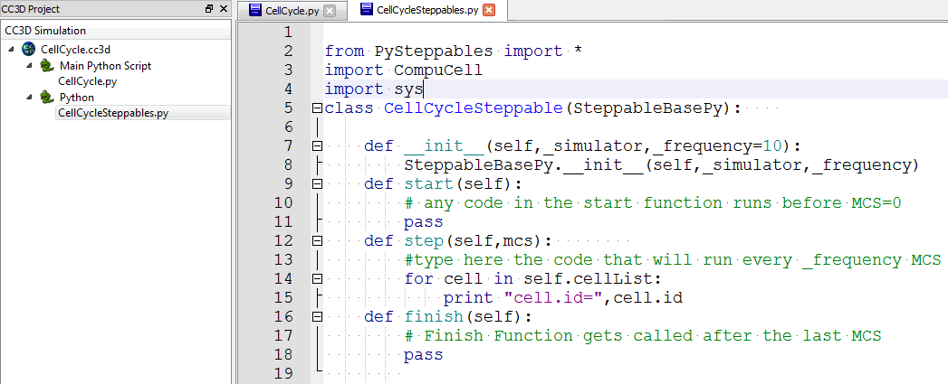
Second Example – Cell Cycle from web
Your Steppable File will look like that:

Slide 42
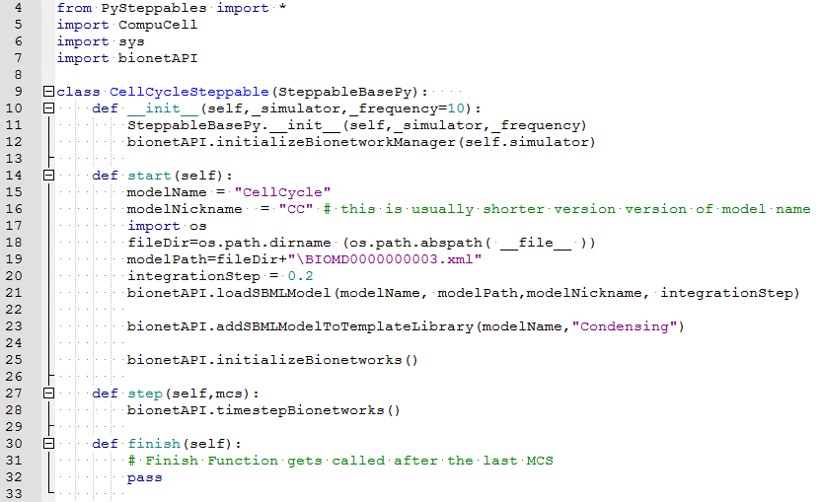
Second Example – Cell Cycle from web
Add the BionetSolver:
1
2
3
Python utilities
4
5

Slide 43
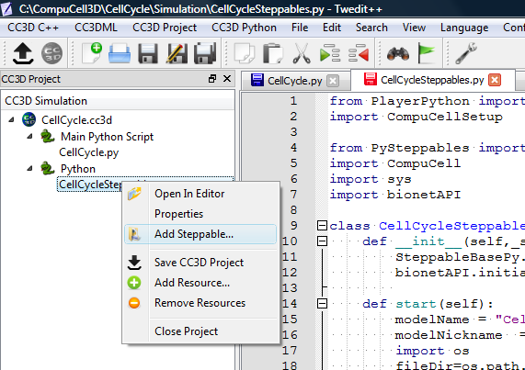
Second Example – Cell Cycle from web
Create a visualization field for the fraction of Cdc2 kinase.

Slide 44
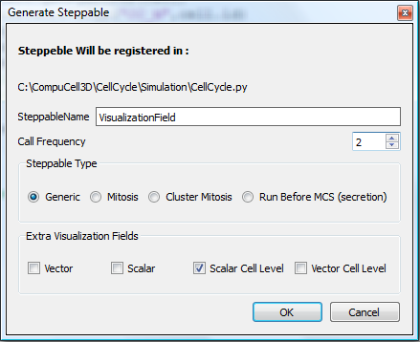
Second Example – Cell Cycle from web
Create a visualization field for the fraction of Cdc2 kinase.

Slide 45
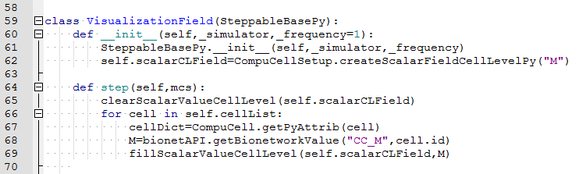
Second Example – Cell Cycle from web
Create a visualization field for the fraction of Cdc2 kinase.

Slide 46
Second Example – Cell Cycle from web
Mitosis occur when fraction of active Cdc2 kinase (M) reaches 0.7.
To model this we need to track the concentration of M in each cell and check when it passes the 0.7 mark.

Slide 47
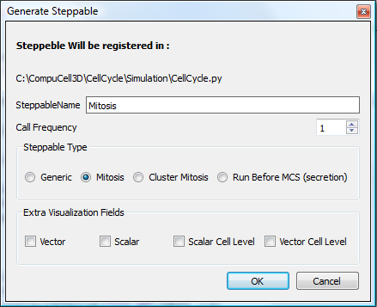
Second Example – Cell Cycle from web
Add a Steppable to divide cells based on the fraction of Cdc2 kinase:

Slide 48
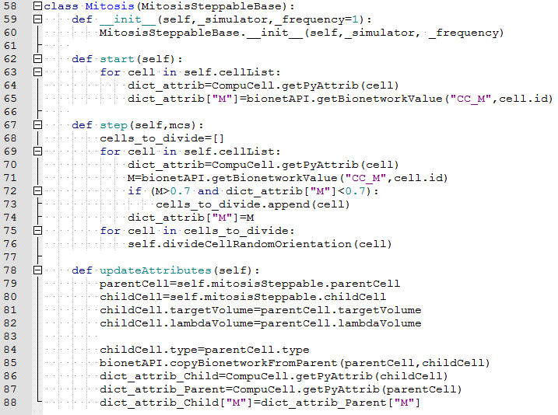
Second Example – Cell Cycle from web
Add a Steppable to divide cells based on the fraction of Cdc2 kinase:

Slide 49
Second Example – Cell Cycle from web
Open the model in CC3D, set the maximum concentration of the “M” field to 0.75, and run the simulation:

Slide 50
Exercises
1
  Change the Volume plugin so that cells slowly grow back to the original target Volume after mitosis
2
  Add a second cell type (NonCondensing) with half of the cycle time

Slide 51
Third Example – Tyson’s Cell Cycle
In the last example all cells divide in synchrony.
The reason for this is the absence of any flow of information from the cell level to the subcellular level.
A more realistic model, where the cells do not maintain their cell cycle’s phase, is the one proposed by Tyson and Novak.

Slide 52
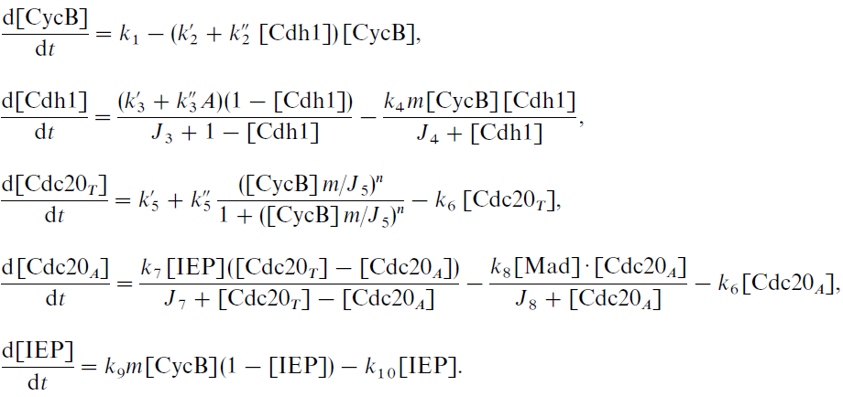
Third Example – Tyson’s Cell Cycle
This model has 5 variables, from which only the first 2 forms the core of the cell cycle oscillations:

Slide 53
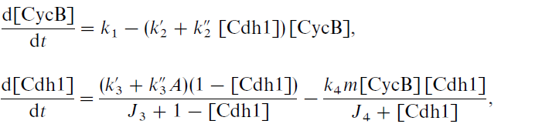
Third Example – Tyson’s Cell Cycle
The crucial difference from the previous model lies in the presence of the parameter “m”, which is the normalized total mass of the cell:
This parameter varies between ~0.5 (right after mitosis) and ~1 (at normal size) and corresponds in CC3D to the ratio of volume to the resting volume (initial volume):

Slide 54
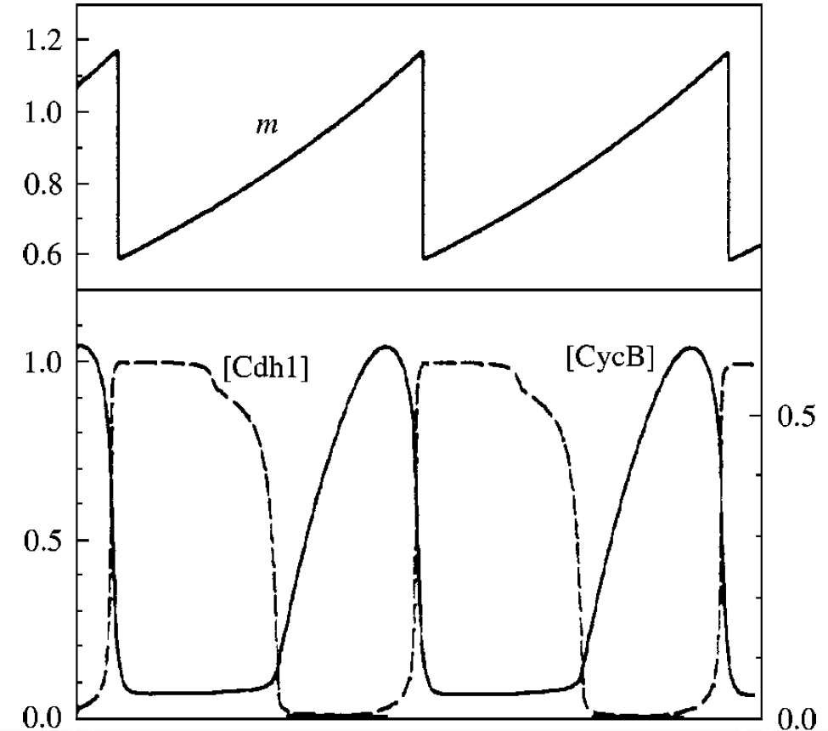
Third Example – Tyson’s Cell Cycle
This time mitosis occur when the level of CycB drops below 0.1

Slide 55
Exercises
1
  Download the paper by Tyson and Novak
  Code the first two ODEs in Jarnac and generate the SBML
2
  Using the code from the second example as a template, create a model that uses Tyson’s cell cycle

Slide 56
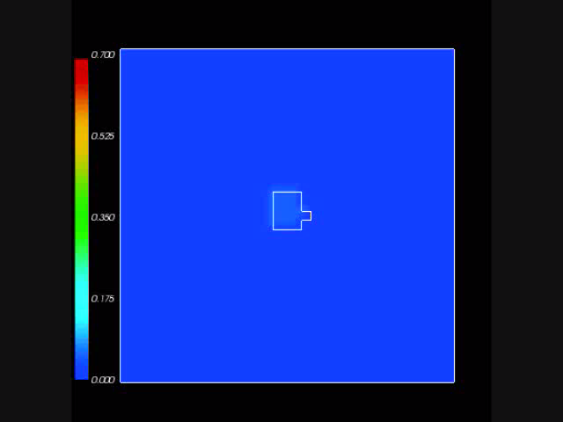
Third Example – Tyson’s Cell Cycle
When we run this model we can see that due to the fluctuations in cell volume, the divisions get out of sync:

Slide 57
Fourth Example – Delta-Notch Patterning
The third example (Tyson’s cell cycle model) illustrated how changes at the single cell level can affect the subcellular level (and in turn affect the cell behavior by initiating mitosis).
This last example will show how conditions external to the cell (the neighboring cells’ Delta) can affect the cell internal state (its Notch levels).

Slide 58
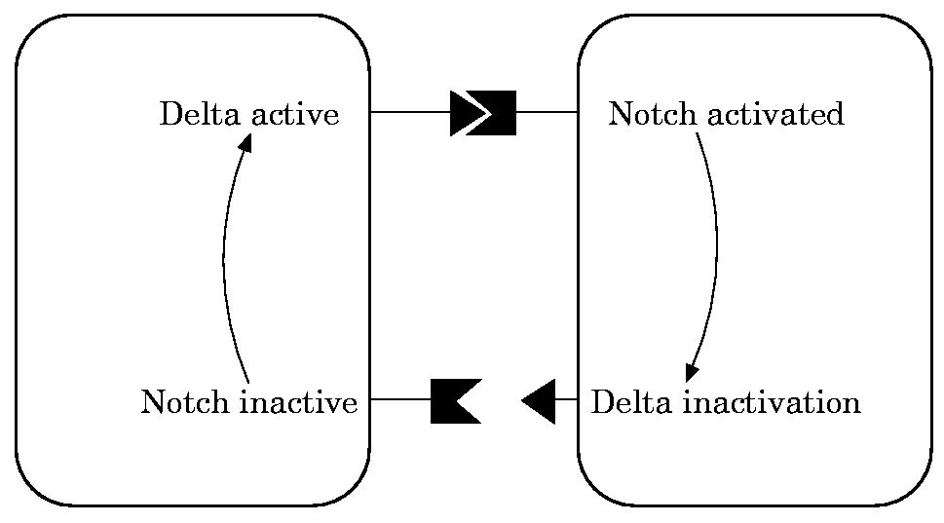
Fourth Example – Delta-Notch Patterning
We will use the model published by Collier et al. in 1996:
  N : Notch
  D : Delta
  D: average Delta from neighbors

Slide 59
Fourth Example – Delta-Notch Patterning
In this model, when a cell receives high levels of Delta from neighbors its Notch level becomes downregulated.
This leads to the high/low Notch patterning shown by their simulations on an hexagonal lattice:

Slide 60
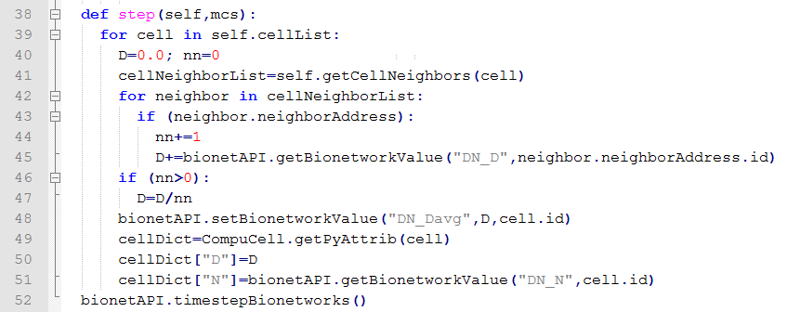
Fourth Example – Delta-Notch Patterning
In CC3D we first loop over all cells’ neighbors and store their Delta:
Then we average it and use it as the new D parameter of that cell:
File:
CompuCell3D\Demos\BoolChapterDemos_ComputationalMethodsInCellBiology\DeltaNotch

Slide 61
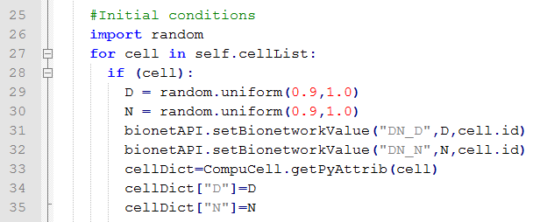
Fourth Example – Delta-Notch Patterning
As an initial condition all cells start with random values of Delta and Notch around 0.9.
To implement this we use the Python random function as shown below:
File:
CompuCell3D\Demos\BoolChapterDemos_ComputationalMethodsInCellBiology\DeltaNotch

Slide 62
Fourth Example – Delta-Notch Patterning
When we run this model we can see that first the Notch values go down before the pattern emerges:

Slide 63
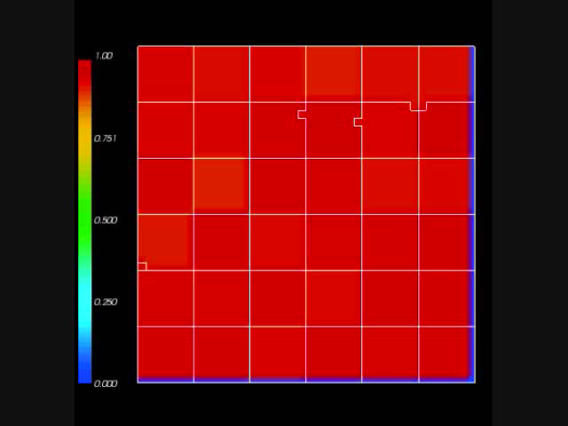
Fourth Example – Delta-Notch Patterning
If we increase the level of membrane fluctuations the pattern will be disrupted :

Slide 64
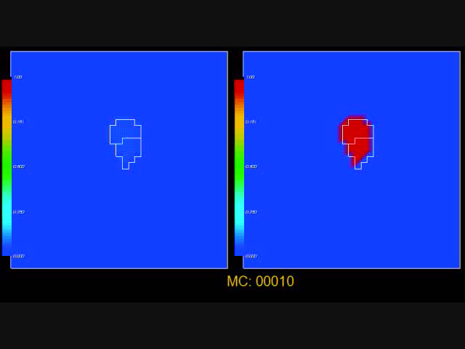
Exercise – 2 SBML models
Below is a simulation with Tyson’s Cell Cycle and Collier’s Delta Notch models:

