Slide 1
Merging CompuCell3D and SBW/SBML
Julio M. Belmonte
Indiana University, Bloomington

Slide 2
Outline
Objectives
Ways to add RK to CC3D
SBML format
Generating SBML using Jarnac
    Simple Oscillator
Integrating with CC3D
    Adding Simple Oscillator to CC3D
    Adding Cell Cycle model from sbml.org
    John Tyson’s Cell Cycle model
    Collier et al. Delta-Notch patterning model

Slide 3

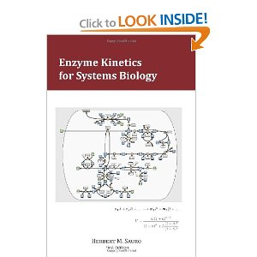
More on Reaction Kinetics Modeling
Essential Mathematical Biology
  Nicholas Britton
Enzyme Kinetics for Systems Biology
  Herbert Sauro
www.sys-bio.org/sbwWiki/tutorials/bloomington2011

Slide 4
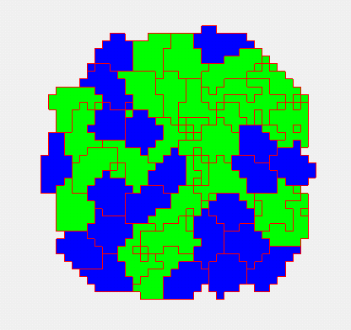
Cell-based modeling
Cellular behaviors:
    Location
    Volume
    Shape
    Movement
    Adhesion
    Mitosis
    Death
    Differentiation
    Polarization
    Etc…

Slide 5
Subcellular modelling
Biochemical Kinetics:
  Cell-Cycle
  Circadian rhythms
  Cardiac rhythms
  cAMP oscillations
  Delta-Notch patterning
  WNT pathway
  FGF pathway
  Etc…

Slide 6
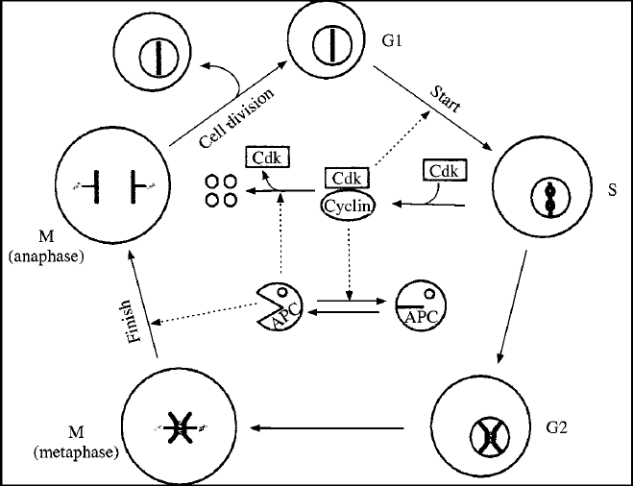
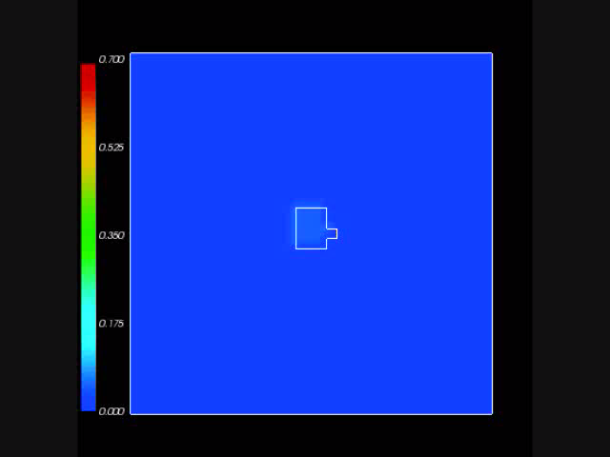
Subcellular modelling
Biochemical Kinetics:
  Cell-Cycle
  Circadian rhythms
  Cardiac rhythms
  cAMP oscillations
  Delta-Notch patterning
  WNT pathway
  FGF pathway
  Etc…

Slide 7
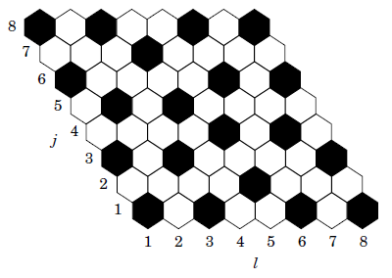
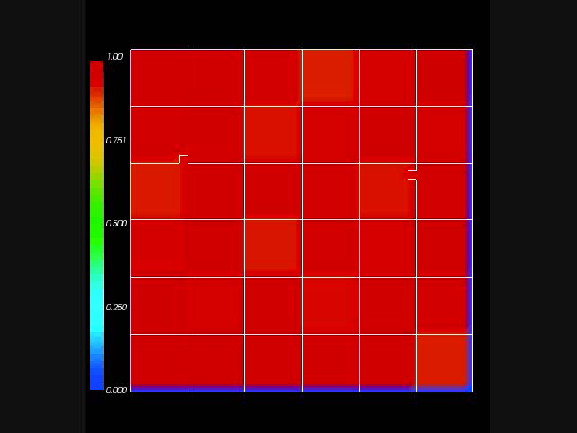
Subcellular modelling
Biochemical Kinetics:
  Cell-Cycle
  Circadian rhythms
  Cardiac rhythms
  cAMP oscillations
  Delta-Notch patterning
  WNT pathway
  FGF pathway
  Etc…

Slide 8
How to add this into CompuCell?
Just another Python class!
  Too slow

Slide 9
How to add this into CompuCell?
Just another Python class!
  Too slow
C++ file to be wrapped into Python
  Too complicated

Slide 10
How to add this into CompuCell?
Just another Python class!
  Too slow
C++ file to be wrapped into Python
  Too complicated
Import SBML

Slide 11
SBML – Systems Biology Markup Language
Not a software!
Machine-readable format for representing subcellular models
Standard for storage and exchange of models
Implementation agnostic

Slide 12
SBML
How does it work?
Developer software (SBW/Jarnac)
SBML
Simulation software (CompuCell3D)

Slide 13
SBML
Initial conditions:
Parameters:

Slide 14
SBML
<?xml version="1.0" encoding="UTF-8"?>
<sbml xmlns = "http://www.sbml.org/sbml/level2" level = "2" version = "1">
<model id = "cell">
<listOfCompartments>
<compartment id = "compartment" size = "1"/>
</listOfCompartments>
<listOfSpecies>
<species id = "S1" boundaryCondition = "false" initialConcentration = “5.0" compartment = "compartment"/>
<species id = "S2" boundaryCondition = "false" initialConcentration = “0.0" compartment = "compartment"/>
</listOfSpecies>
<listOfParameters>
<parameter id = "k1" value = "0.1"/>
</listOfParameters>
<listOfReactions>
<reaction id = "_J1" reversible = "false">
<listOfReactants>
<speciesReference species = "S1" stoichiometry = "1"/>
</listOfReactants>
<listOfProducts>
<speciesReference species = "S2" stoichiometry = “2"/>
</listOfProducts>
<kineticLaw>
<math xmlns = "http://www.w3.org/1998/Math/MathML">
<apply>
<times/>
<ci>
k1
</ci>
<ci>
S1
</ci>
</apply>
</math>
</kineticLaw>
</reaction>
</listOfReactions>
</model>
</sbml>

Slide 15
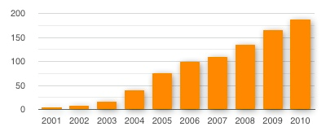
SBML
Total number of known SBML-compatible software packages each year :

Slide 16
How to write SBML?
Bio-Spice
    Large collection of tools, integrated via a "Dashboard." Free download (BSD), various platforms.
Teranode
    Suite of tools for model management, design, and simulation. (Linux/Mac/Windows) Commercial (30-day trial available).
SBW
    Systems Biology Workbench.
Check http://sbml.org/SBML_Software_Guide

Slide 17
SBW/Jarnac
SBW - Systems Biology Workbench:
  Open-source software framework for systems biology
Jarnac:
  Software for writing and simulating reaction kinetics
  Easy to use
  Translate to SBML (C++, Matlab, Mathematica, etc..)
Download at: http://www.sys-bio.org/

Slide 18
Integration with CC3D
Reaction kinetic models can be easily added in CC3D when in SBML format.
Once loaded, the model is converted into a set of ODEs and is solved by the BionetSolver library inside CC3D.
The commands used to load and manipulate the models inside CC4D are summarized on the “Quick Reference Guide” for Python in CC3D.

Slide 19
Integration with CC3D
import bionetAPI # Import bionetAPI functions
class <someClass>(SteppableBasePy):
def __init__(self,_simulator,_frequency=1):
SteppableBasePy.__init__(self,_simulator,_frequency)
bionetAPI.initializeBionetworkManager(self.simulator) # Initialize bionet inside class
def start(self):
# Load a specific subcellular SBML submodel
ModelName = <sbmlModelName> # Name of the model
ModelPath = <sbmlModelPath> # Path where the model is stored
ModelKey = <modelKey> # Nickname of the model
IntegrationStep = <timeStep> # Time step of integration
bionetAPI.loadSBMLModel( ModelName, ModelPath, ModelKey, IntegrationStep )
# Add SBML submodel to a group of cells or a single cell
bionetAPI.addSBMLModelToTemplateLibrary(<sbmlModelName>, {<cellType> or <cellId>})
…
# Modify the parameter value or molecular concentration of a cell (or group of cells)
bionetAPI.setBionetworkValue(<molecule/parameter>, <value>, {<cellType> or <cellId>})
…
# Initialize model
bionetAPI.initializeBionetworks()
def step(self,mcs):
# Iterate the model (run it for the time step specified on the load command)
bionetAPI.timestepBionetworks()
…
# Get the parameter value or molecular concentration from a cell (or group of cells)
<var>=bionetAPI.getBionetworkValue({<parameter> or <molecule>},{<cellType> or <cellId>})
…
# Modify the parameter value or molecular concentration of a cell (or group of cells)
bionetAPI.setBionetworkValue(<molecule/parameter>, <value>, {<cellType> or <cellId>})

Slide 20
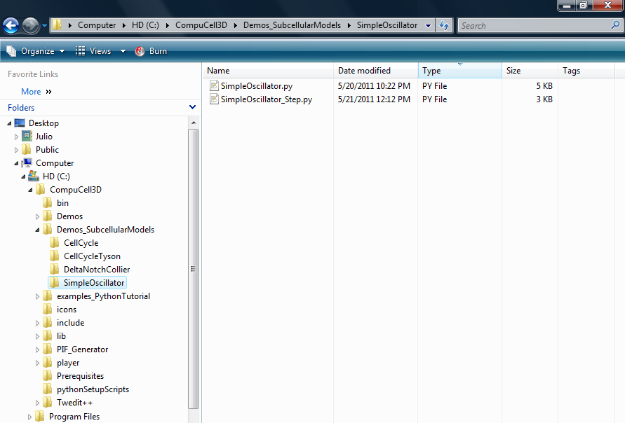
First Example – Simple Oscillator

Slide 21
First Example – Simple Oscillator
There is no sbml file
in the directory
You will create it

Slide 22
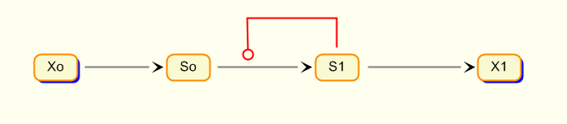
First Example – Simple Oscillator
Relaxation oscillator:

Slide 23
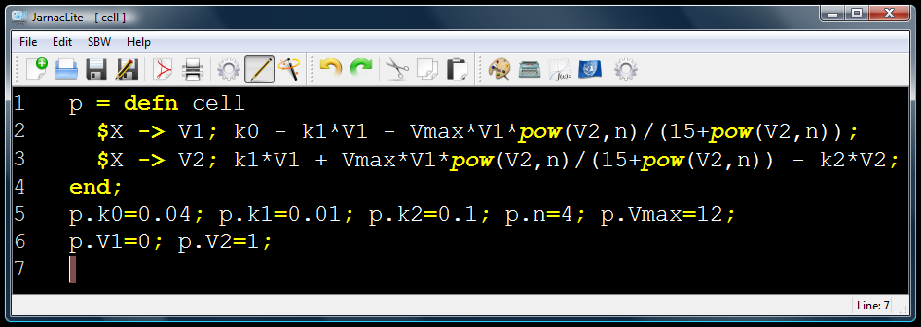
First Example – Simple Oscillator
Load your old exercise in Jarnac Lite.
If you don’t have it, it can be written as:
Note that should be written as pow(V2,n)

Slide 24
First Example – Simple Oscillator
Click on the Simulation Tool icon:

Slide 25
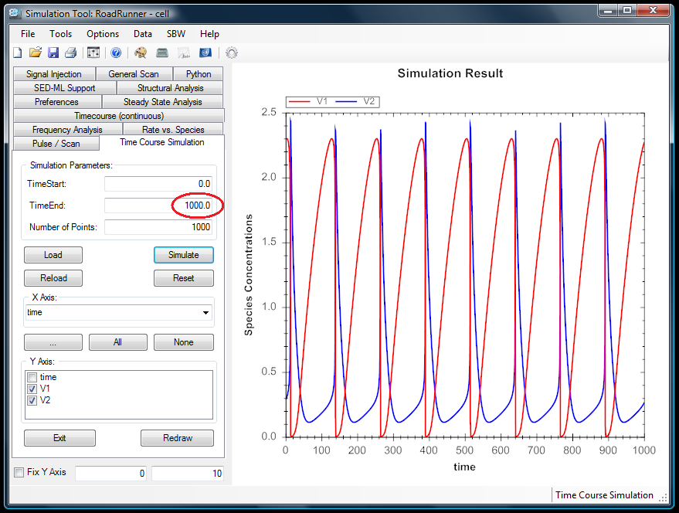
First Example – Simple Oscillator
The parameter values give oscillations (set TimeEnd to 1000):

Slide 26
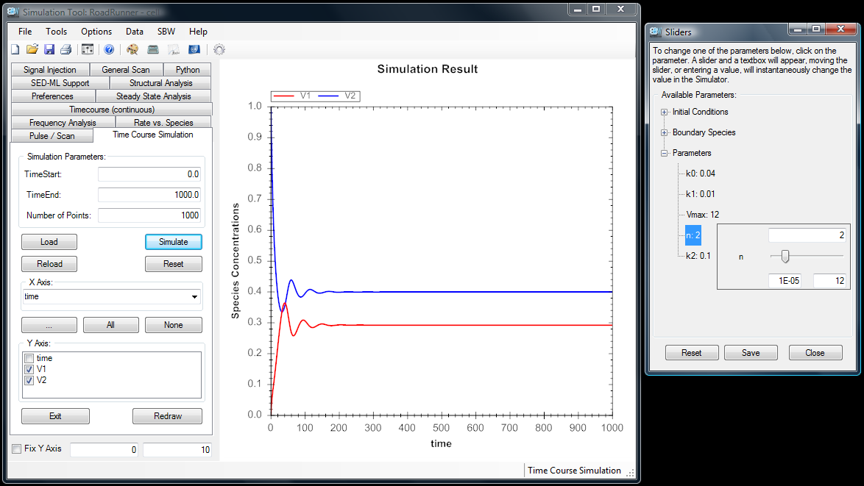
Simple Oscillator
But the oscillations cease if n is changed to 2:

Slide 27
First Example – Simple Oscillator
Go back to Jarnac Lite, click on SBW:

Slide 28
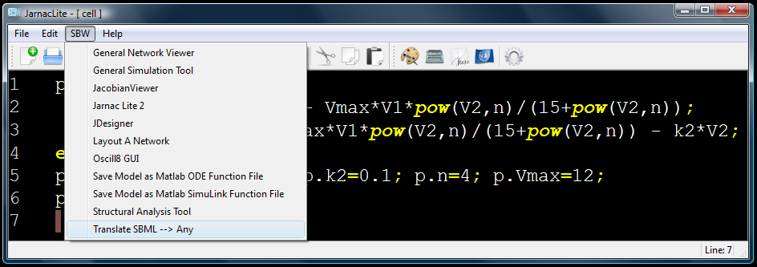
First Example – Simple Oscillator
Then click on Translate SBML --> Any:

Slide 29
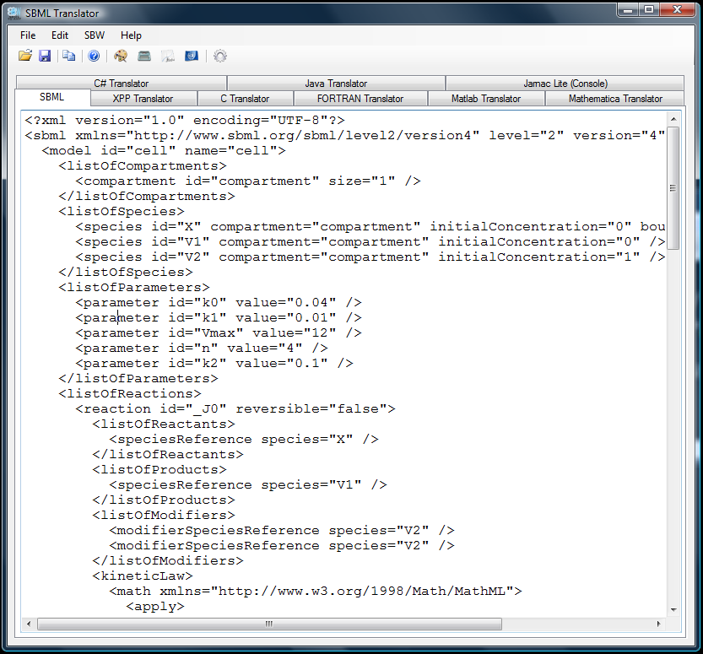
First Example – Simple Oscillator

Slide 30
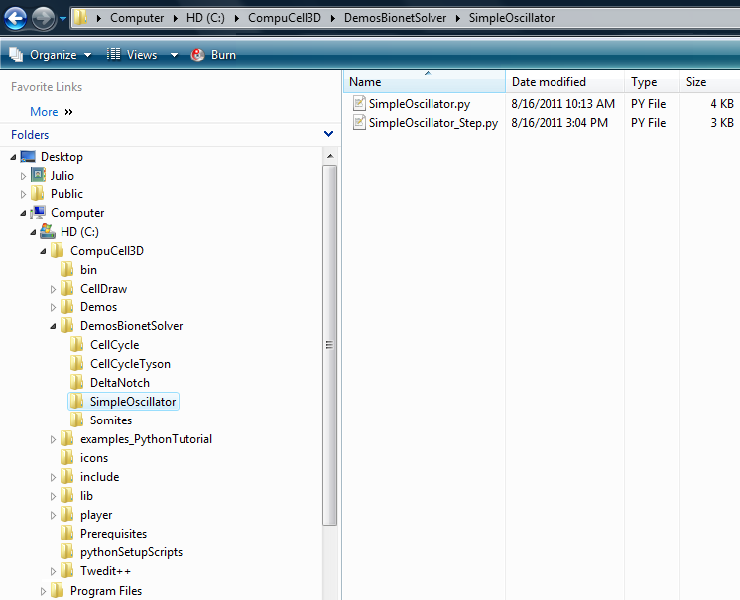
First Example – Simple Oscillator
Save it as “SimpleOscillator.sbml” inside:
  CompuCell3D\DemosBionetSolver\SimpleOscillator

Slide 31
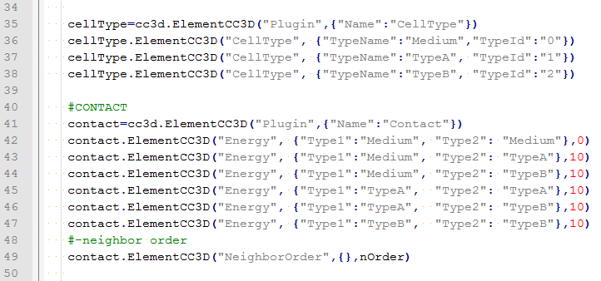
First Example – Simple Oscillator
The SimpleOscillator.py file contains the parameters of the cellular model.
It is important to note that in this model there are 2 cell types: “TypeA” and “TypeB”

Slide 32
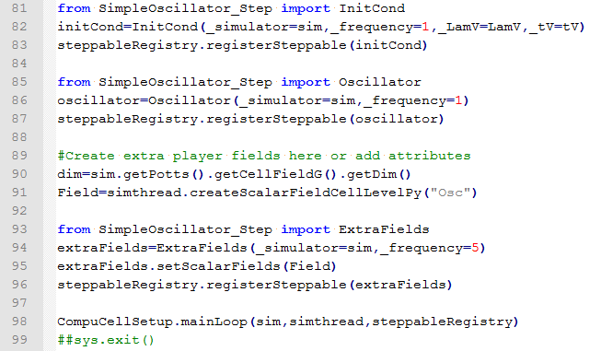
First Example – Simple Oscillator
The SimpleOscillator.py file calls 3 steppables:
  InitCond: where the initial conditions are set
  Oscillator: where the SBML model will be loaded
  ExtraFields: used to visualize one of the model’s variable

Slide 33
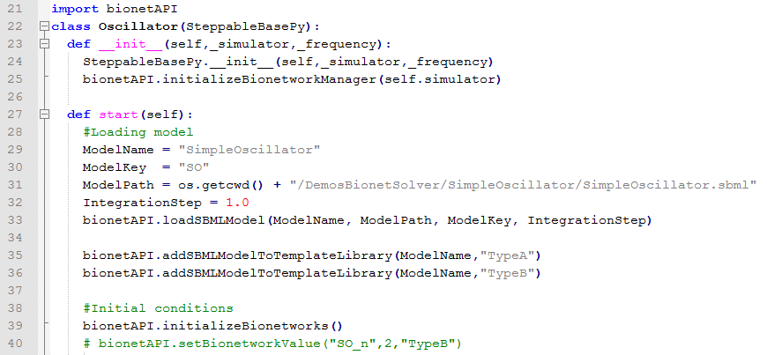
First Example – Simple Oscillator
Let’s open the SimpleOscillator_Step.py file and look at the beginning of the Oscillator steppable:

Slide 34
First Example – Simple Oscillator
The first thing to be done is to import the BionetSolver library by this command:

Slide 35
First Example – Simple Oscillator
Next, inside the steppable, we initialize the solver by using this command:

Slide 36
First Example – Simple Oscillator
Once the BionetSolver is loaded and initialized, it is time to load the model:

Slide 37
First Example – Simple Oscillator
This takes 4 parameters:
  First is the model name:
  For convenience the name will be SimpleOscillator, but it can be anything.

Slide 38
First Example – Simple Oscillator
This takes 4 parameters:
  Second is the model pathway:
  os.getcwd() gives the CompuCell3D root directory.
  Here it is crucial that the correct path and model name are given.

Slide 39
First Example – Simple Oscillator
This takes 4 parameters:
  Third is the model nickname:
  This is used as an abbreviation of the model name when referring to parameters of this model.

Slide 40
First Example – Simple Oscillator
This takes 4 parameters:
  And the last one is the size of the integration step:
  This specifies the correspondence between MCS and the unit of time of the model.

Slide 41
First Example – Simple Oscillator
Now we have to add this model to the cells in our simulation:
  The first line add the SimpleOscillator model to all cells of type “TypeA”, and the second to all cells of type “TypeB”.

Slide 42
First Example – Simple Oscillator
Finally, we initialize the SBML model in each cell by using the following command:

Slide 43
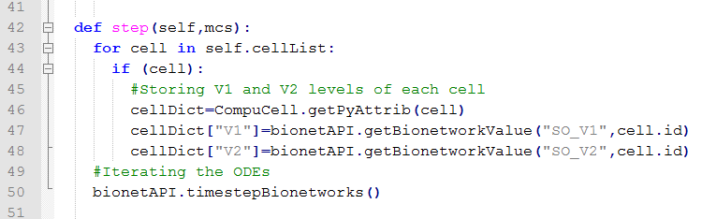
First Example – Simple Oscillator
On the step function we create a dictionary where the two variables of the SimpleOscillator will be stored:

Slide 44
First Example – Simple Oscillator
To extract the current value of a variable or parameter from the SBML model inside the cell, we use the command:
  Where the first parameter indicate the model (by its nickname) followed by a underscore “_” and the name of the variable.
  The second parameter indicate the cell from which this information will be extracted.

Slide 45
First Example – Simple Oscillator
The last command runs the SBML model inside each cell for one time step of integration:
  If this command is not called, the ODE model will not run and all variables will stay at their initial values.

Slide 46
First Example – Simple Oscillator
Next, open the file SimpleOscillator.py on the CC3D player.

Slide 47
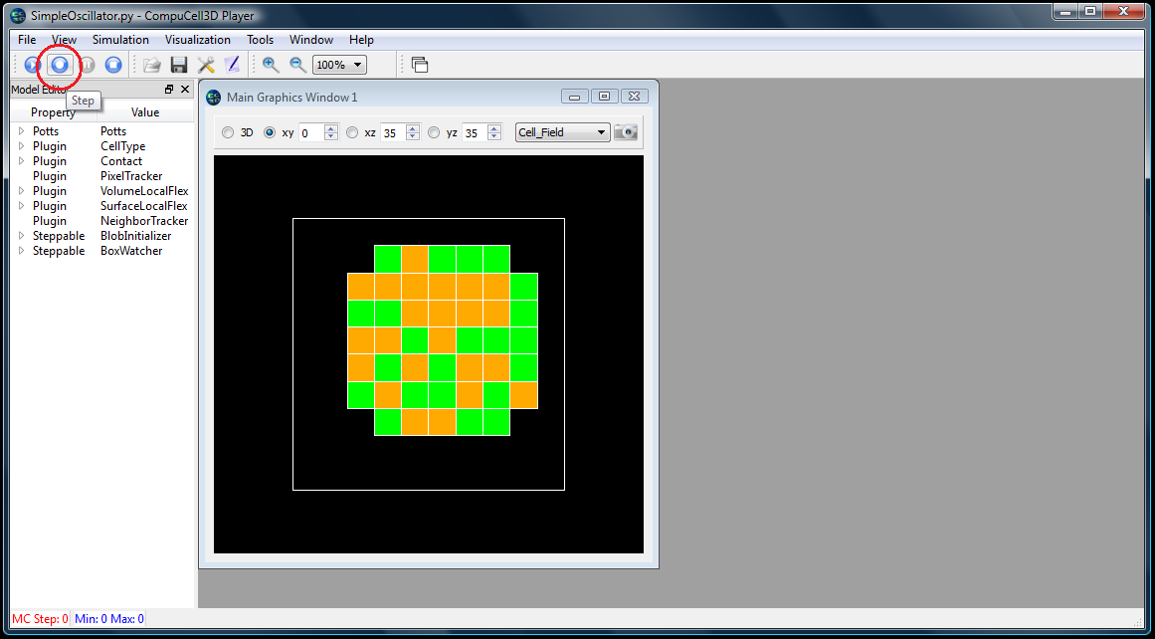
First Example – Simple Oscillator
Hit the “step” button, as indicated below, to run the simulation just one MCS.

Slide 48
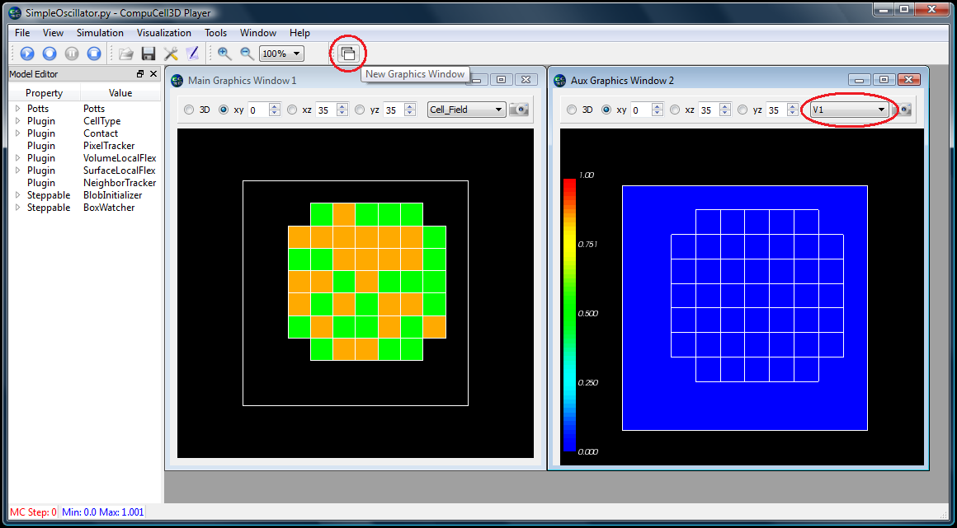
First Example – Simple Oscillator
Click the indicated button to open a new graphics window and select V1 in place of Cell_field in it:

Slide 49
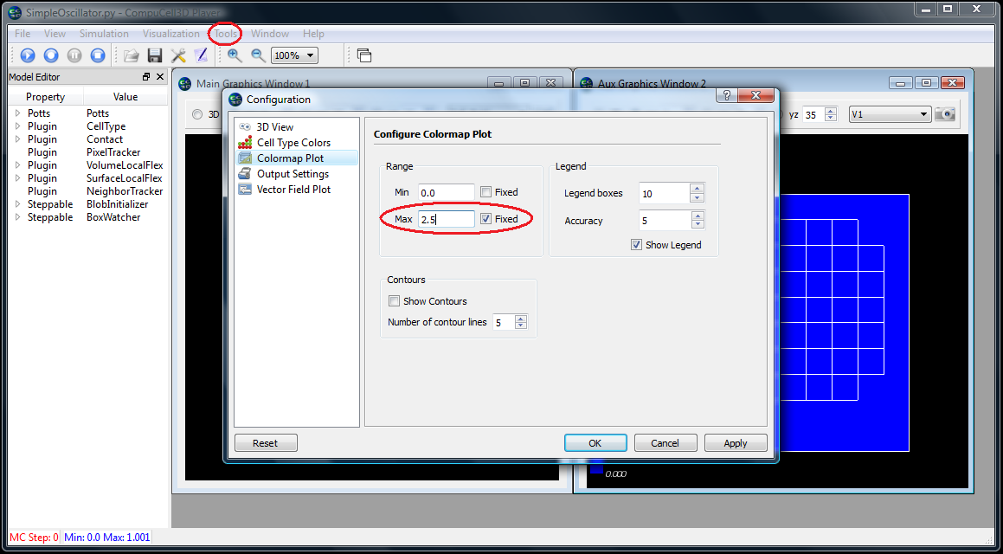
First Example – Simple Oscillator
Next go to Tools -> Configuration, and under “Colormap Plot”, fix the maximum range at 2.5:

Slide 50
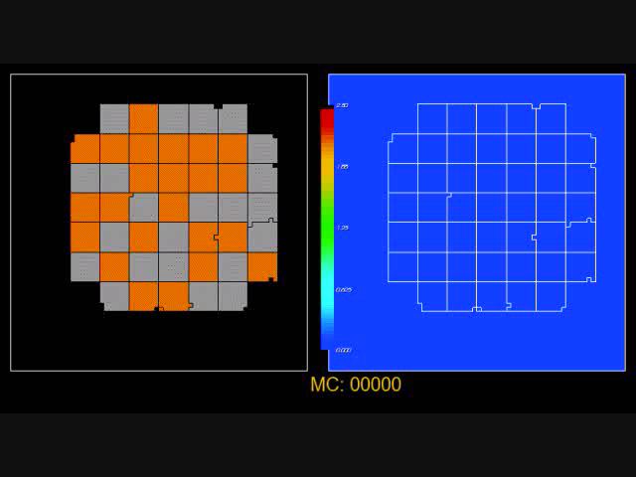
First Example – Simple Oscillator
When you run the simulation, the second graphics window should display an oscillating V1 concentration similar to this:

Slide 51
Second Example – Simple Oscillator 2
In the last example both cell types, “TypeA” and “TypeB”, had exactly the same oscillator with the same parameters and initial conditions.
In this second example we are going to assign the same SBML model to both cell types, but change the parameter “n” for one of them.

Slide 52
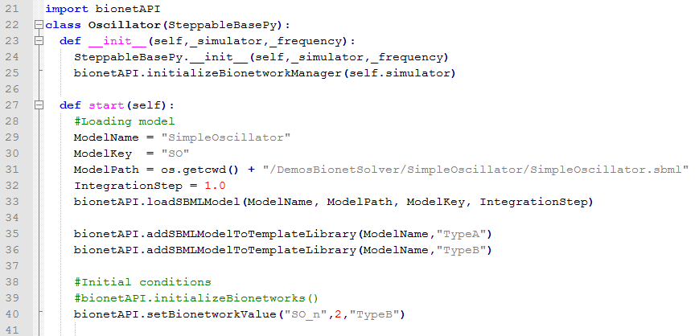
Second Example – Simple Oscillator 2
To do this, uncomment the following line from the steppable file SimpleOscillator_Step.py:

Slide 53
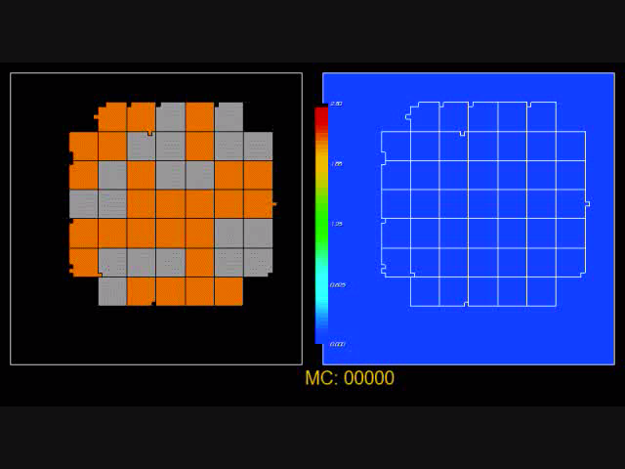
Second Example – Simple Oscillator 2
As a result, cells of type “TypeB” will cease to oscillate:

Slide 54
Third Example – Cell Cycle from web
In our third example, instead of building our own SBML model, we are going to use an existing one.
The website www.sbml.org contains a repository of published models in SBML format.
If you wish to submit your own SBML to the repository, follow the instructions at: www.ebi.ac.uk/biomodels-main/submit

Slide 55
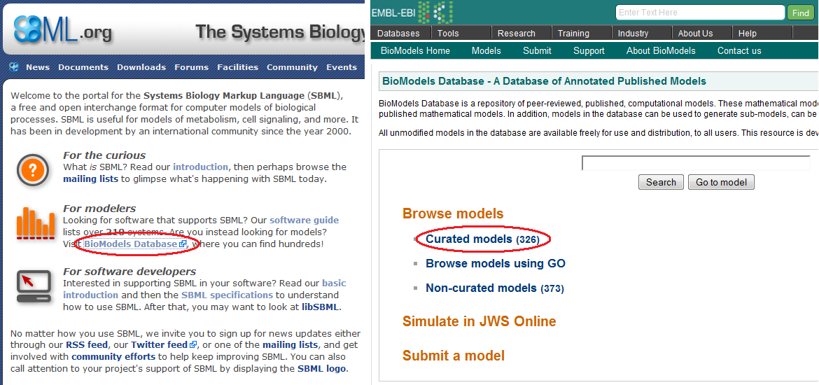
Third Example – Cell Cycle from web
To access the SBML model repository click on the link “BioModels Database” and then on “Curated models”:

Slide 56
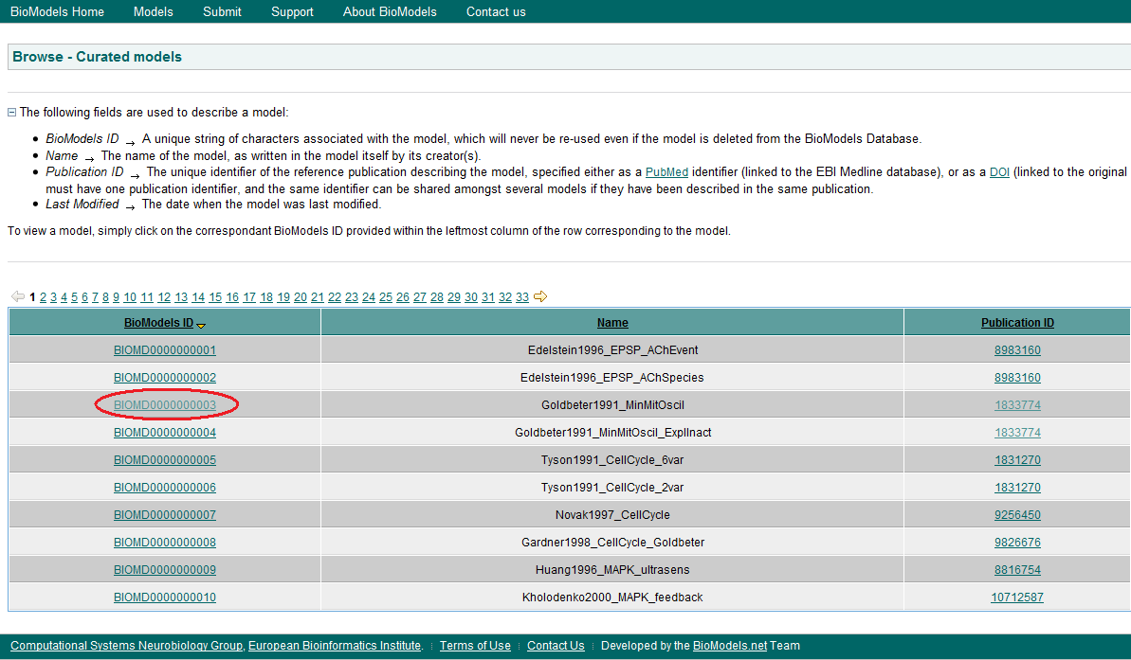
Third Example – Cell Cycle from web
From the model list select the third one by clicking on the link under the column “BioModels ID”

Slide 57
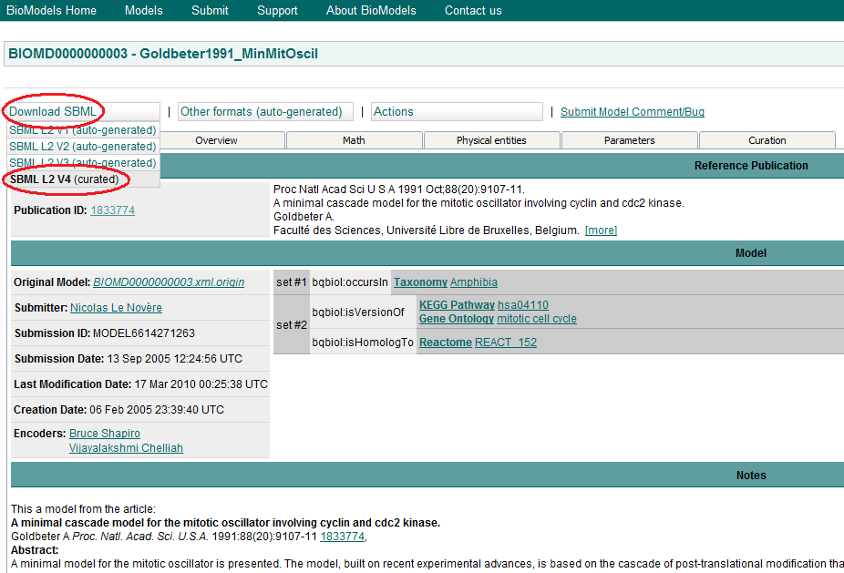
Third Example – Cell Cycle from web
To download the model click on “Download SBML” and select “SBML L2 V4 (curated)”

Slide 58
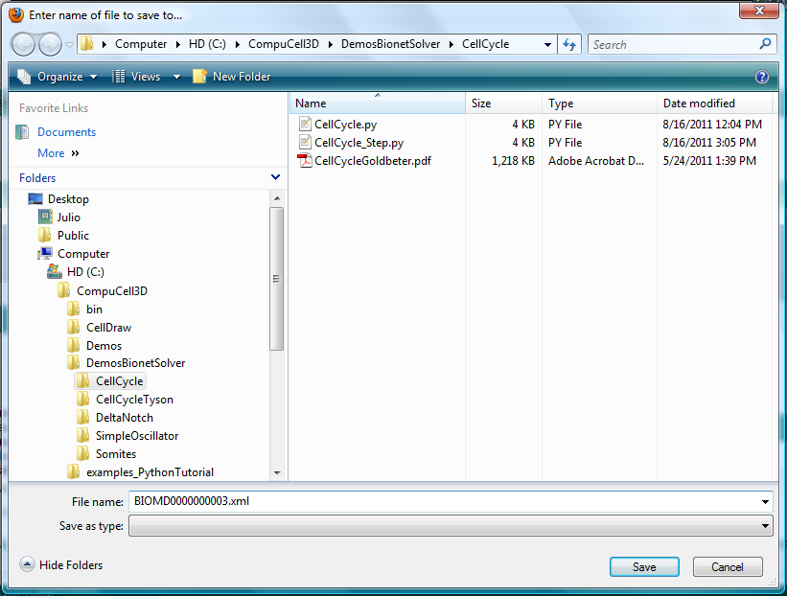
Third Example – Cell Cycle from web
Save the file BIOMD0000000003.xml inside the directory CompuCell3D\DemosBionetSolver\CellCycle\

Slide 59
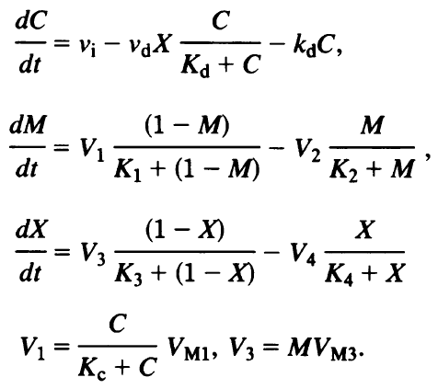
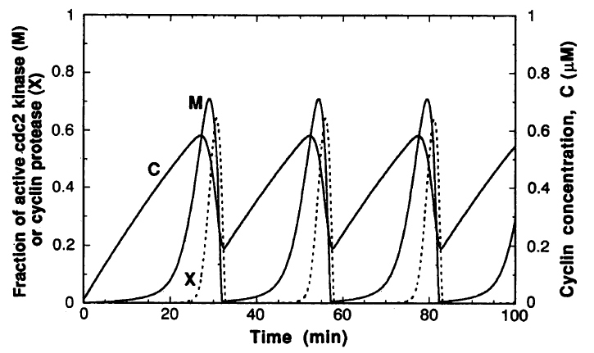
Third Example – Cell Cycle from web
This model is composed of 3 ODEs that forms an oscillating system:
  C : cyclin concentration
  M : fraction of active cdc2 kinase
  X : fraction of active cyclin protease

Slide 60
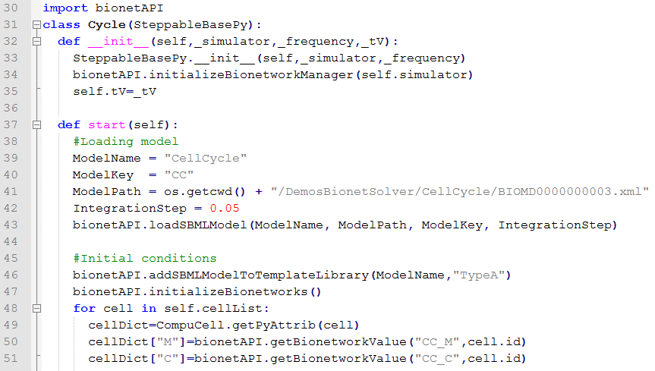
Third Example – Cell Cycle from web
The model is implemented into CC3D in the same ways as in the first example, but this time we just have 1 cell type:

Slide 61
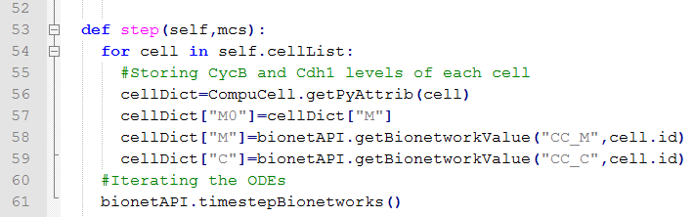
Third Example – Cell Cycle from web
According to the original paper, mitosis happens after the fraction of active cdc2 kinase (M) reaches its maximum at around 0.7.
To implement this we store the value of M at each MCS and the previous MCS:

Slide 62
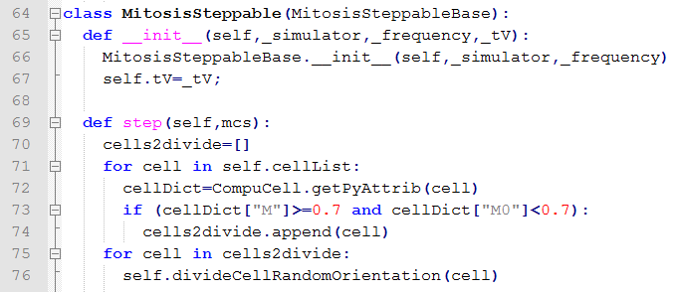
Third Example – Cell Cycle from web
Then, inside the Mitosis steppable, we check if the cell’s internal fraction of M crosses the 0.7 threshold:

Slide 63
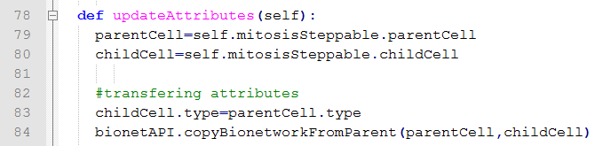
Third Example – Cell Cycle from web
Inside the updateAtrributes function, we must copy the SBML model network from the parent to the child:
But before doing this, we must assign a cell type to the child cell:

Slide 64
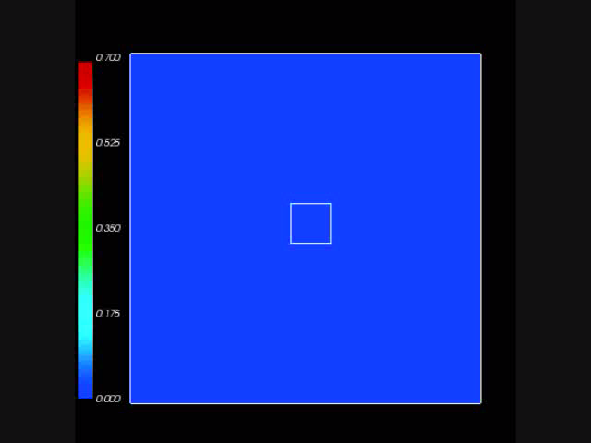
Third Example – Cell Cycle from web
Next, open the model in CC3D, set the maximum concentration of the “Colormap Plot” to 0.75, and run the simulation:

Slide 65
Fourth Example – Tyson’s Cell Cycle
In the last example all cells divided in synchrony.
The reason for this is the absence of any flow of information from the cell level to the subcellular level that would alter the state of the cell cycle oscillations.
A more realistic model, where the cells do not maintain their cell cycle’s phase, is the one proposed by Tyson and Novak.

Slide 66
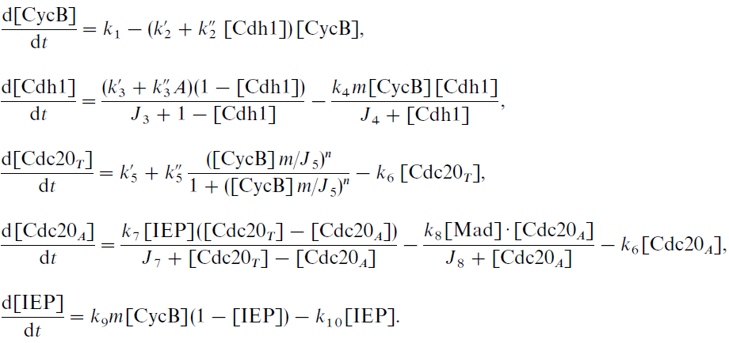
Fourth Example – Tyson’s Cell Cycle
This model has 5 variables, from which only the first 2 forms the core of the cell cycle oscillations:

Slide 67
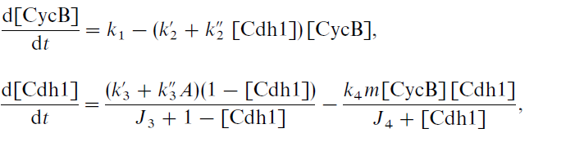
Fourth Example – Tyson’s Cell Cycle
The crucial difference from the previous model lies in the presence of the parameter “m”, which is the normalized total mass of the cell:
This parameter varies between ~0.5 (right after mitosis) and ~1 (at normal size) and corresponds in CC3D to the ratio of volume to target volume:

Slide 68
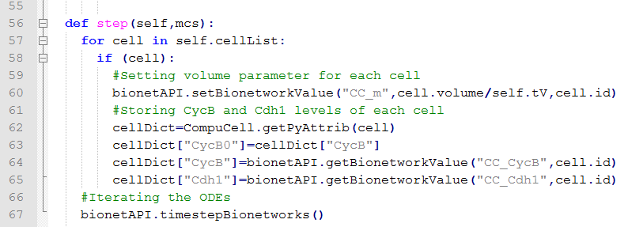
Fourth Example – Tyson’s Cell Cycle
In the steppable file, CellCycle_Tyson_Step.py, this is implemented as:
Where “self.tV” is a variable which contains the original target volume of the cells and is passed into the steppable class from the main Python file.

Slide 69
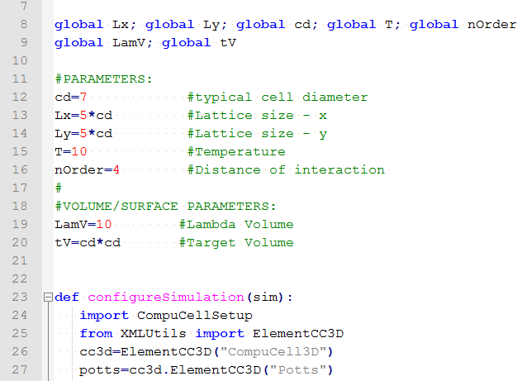
Fourth Example – Tyson’s Cell Cycle
This passage of variables is done in the following way:
  At the beginning of the CellCycle_Tyson.py file I declare and define global variables, from which tV – target volume – is one:

Slide 70
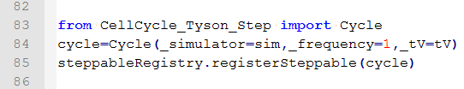
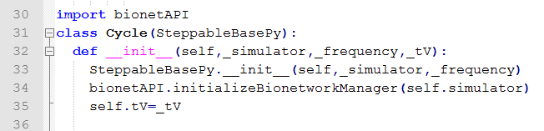
Fourth Example – Tyson’s Cell Cycle
This passage of variables is done in the following way:
  Later, when the steppable is called, the variable is passed as an argument:
  And in the CellCycle_Tyson_Step.py file, the argument is stored in the following way:
  The storage of the parameter as self.tV is necessary for it to be accessible to all functions inside the class.

Slide 71
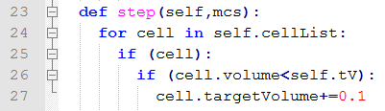
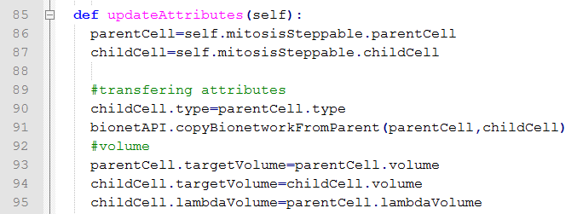
Fourth Example – Tyson’s Cell Cycle
We went through all this trouble because the right way to implement cell growth in CC3D is by gradual increases in its target volume after mitosis:
If we keep the target volume (Vt) constant after mitosis, instead of resetting it to the actual cell volume (V), the difference between V and Vt would be too great, leading to unrealistic cell dynamics.

Slide 72
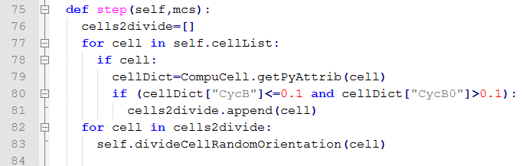
Fourth Example – Tyson’s Cell Cycle
Back to Tyson’s cell cycle model.
Here, the criteria for cell division is a low level of cycling B variable.
  Once cycling B drops below a concentration of 0.1 grams of protein per gram of total cell mass, the cell undergoes mitosis

Slide 73
Fourth Example – Tyson’s Cell Cycle
When we run this model we can see that due to the fluctuations in cell volume, the divisions get out of sync:

Slide 74
Fifth Example – Delta-Notch Patterning
The fourth example (Tyson’s cell cycle model) illustrated how changes at the single cell level can affect the subcellular level (and in turn affect the cell behavior by initiating mitosis).
This last example will show how conditions external to the cell (the neighboring cells’ Delta) can affect the cell internal state (its Notch levels).

Slide 75
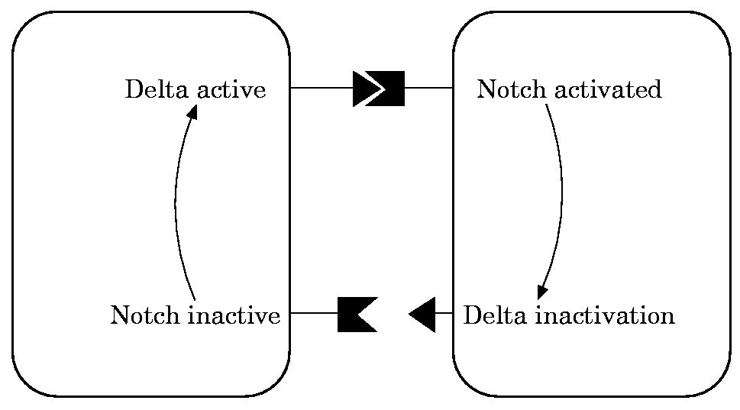
Fifth Example – Delta-Notch Patterning
We will use the model published by Collier et al. in 1996:
  N : Notch
  D : Delta
  D: average Delta from neighbors

Slide 76
Fifth Example – Delta-Notch Patterning
In this model, when a cell receives high levels of Delta from neighbors its Notch level becomes downregulated.
This leads to the high/low Notch patterning shown by their simulations on an hexagonal lattice:

Slide 77
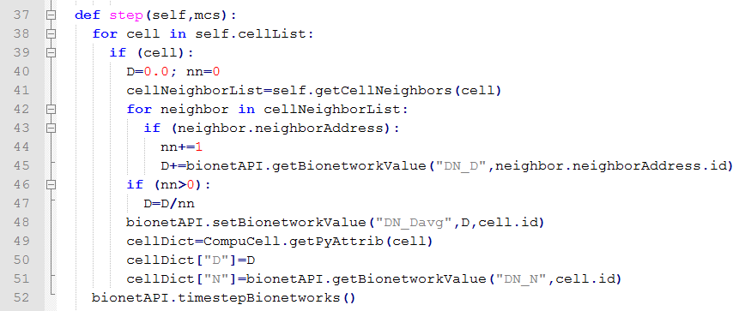
Fifth Example – Delta-Notch Patterning
In CC3D we first loop over all cells’ neighbors and store their Delta:
Then we average it and use it as the new D parameter of that cell:

Slide 78
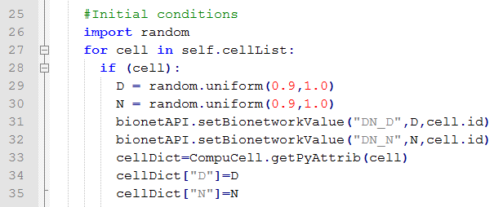
Fifth Example – Delta-Notch Patterning
As an initial condition all cells start with random values of Delta and Notch around 0.9.
To implement this we use the Python random function as shown below:

Slide 79
Fifth Example – Delta-Notch Patterning
When we run this model we can see that first the Notch values go down before the pattern emerges:

Slide 80
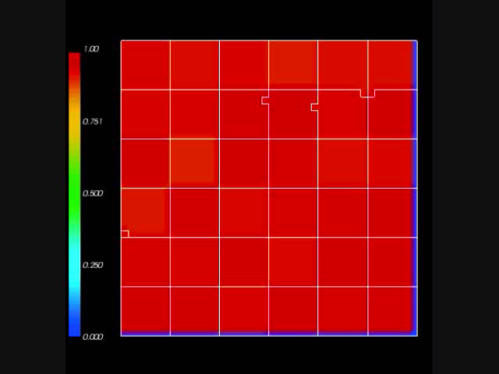
Fifth Example – Delta-Notch Patterning
If we increase the level of membrane fluctuations the pattern will be disrupted :

Slide 81
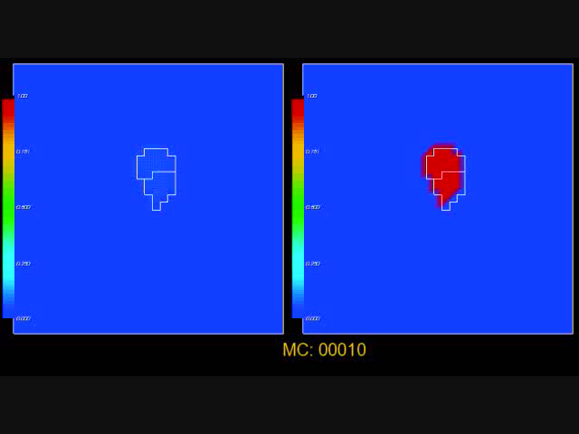
Sixth Example – 2 ODE models
Below is a simulation with Tyson’s Cell Cycle and Collier’s Delta Notch models:

