Slide 1
Tellurium / CompuCell3D User Training Workshop Introduction to Python Programming
The workshop will begin at 11:00 EDT
Screensharing and microphones have been disabled
Please submit questions / concerns vis zoom chat
User support will be done in zoom breakout rooms.
Biocomplexity Institute
Indiana University
Bloomington, IN 47405
USA
Generous funding by: NIH U24 EB028887, NIH R01 GM122424, NIH R01 GM123032, NIH P41 GM109824, NSF 1720625
Notes:
Setu:
Screensharing and microphones have been disabled
Please submisue quesitn s/ comens vis azoom chang
User support will be done in zoom breakoour tooms.

Slide 2
Tellurium / CompuCell3D User Training Workshop Introduction to Python Programming
Instructor: Dr Andy Somogyi,
Moderator: Dr. Javier Quetzalcóatl Toledo-Marín
Assisting: Juliano Ferrari Gianlupi,
Biocomplexity Institute
Indiana University
Bloomington, IN 47405
USA
Generous funding by: NIH U24 EB028887, NIH R01 GM122424, NIH R01 GM123032, NIH P41 GM109824, NSF 1720625
Notes:
Setu:
Screensharing and microphones have been disabled
Please submisue quesitn s/ comens vis azoom chang
User support will be done in zoom breakoour tooms.

Slide 3
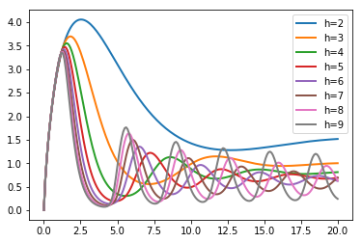
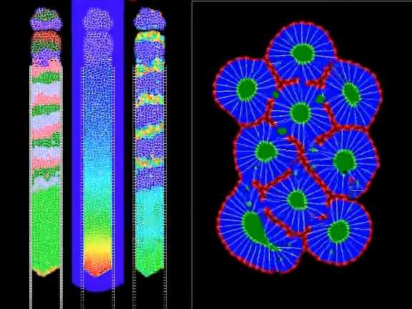
Why Learn Python?
Reaction-Network design and analysis
Adding behaviors to model biological cells
Analyzing data from experiments
Python is a convenient, widely used language that works well at these tasks
Will use ‘programming’ a bit differently in reaction/network analysis vs. biological cell model construction

Slide 4
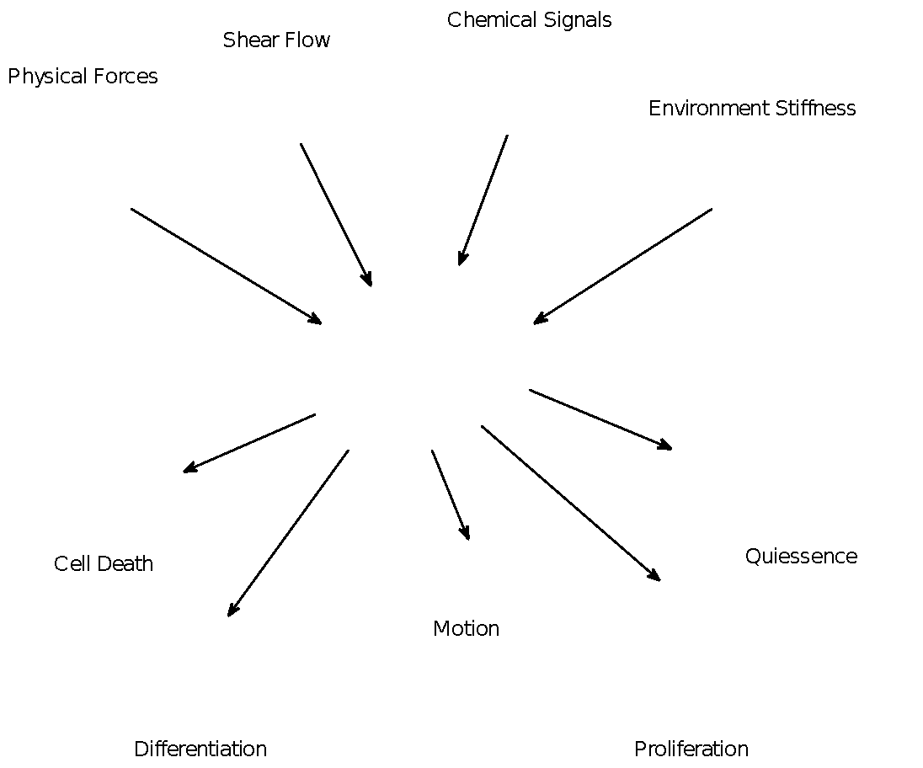
Topics
Learn the necessary programming concepts to build, study, and analyze
Biochemical networks such as chemical, gene regulatory, signaling, etc..
Read data files to parameterize models
Analyze results
Read files to parametrize models
Add behaviors to biological cell models

Slide 5
Rules
You learn by doing
Programming, even more so
EXPERIMENT ON YOUR OWN
Type stuff, see what what happens!
You can’t break anything
The more you use your own curiosity to experiment, the better you will get.
You will never learn programming by watching others

Slide 6
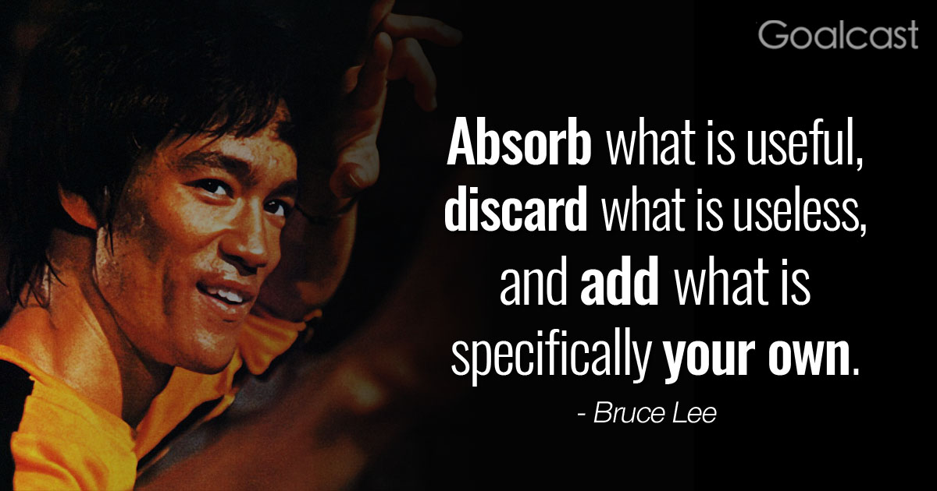
Prerequisites
Curiosity
Self-Motivation
Be able to look up things on your own
Desire to make things and figure things out
Very basic mathematics (algebra)

Slide 7
Nanohub Environment
Most here will use the Nanohub environment
Creating account
Logging in
Finding Tellurium app
Web-based Jupyter
Uploading files
Opening scripts
Running cells
Installing other packages

Slide 8
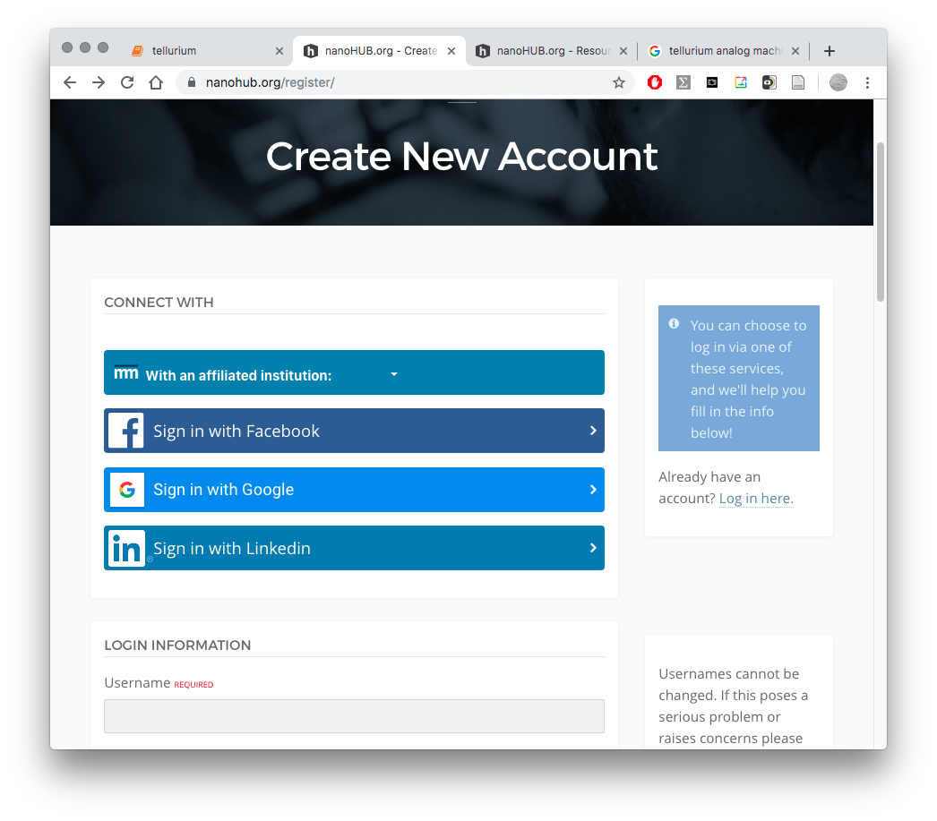
Create a nanoHUB Account
Go to https://nanohub.org
From ‘Menu’, select ‘sign up’
Choose ‘With an affiliated institution’, choose Indiana University
Choose an appropriate username / password / user info

Slide 9
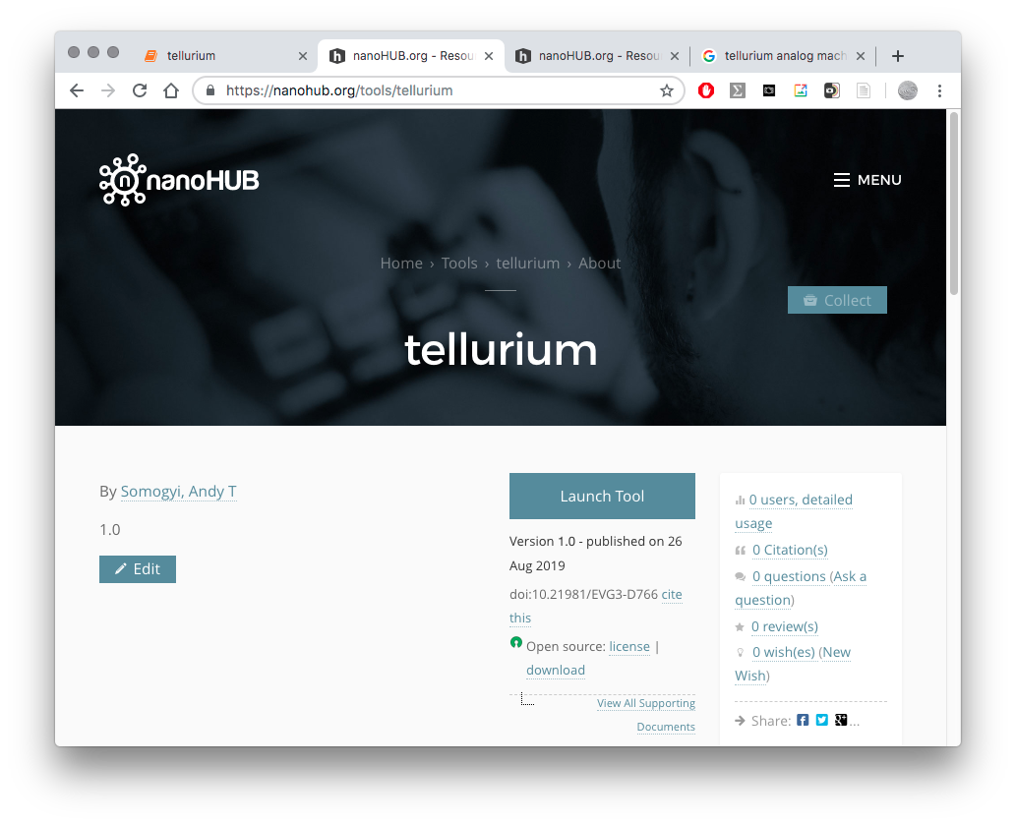
Launch The Tellurium App on nanoHUB
https://nanohub.org/tools/tellurium
Hit Launch Tool to open a Jupyter Notebook to run Tellurium

Slide 10
Launch The Tellurium App on nanoHUB
https://nanohub.org/tools/tellurium
Can choose ‘Collect’ to pin Tellurium to your dashboard in nanoHub

Slide 11
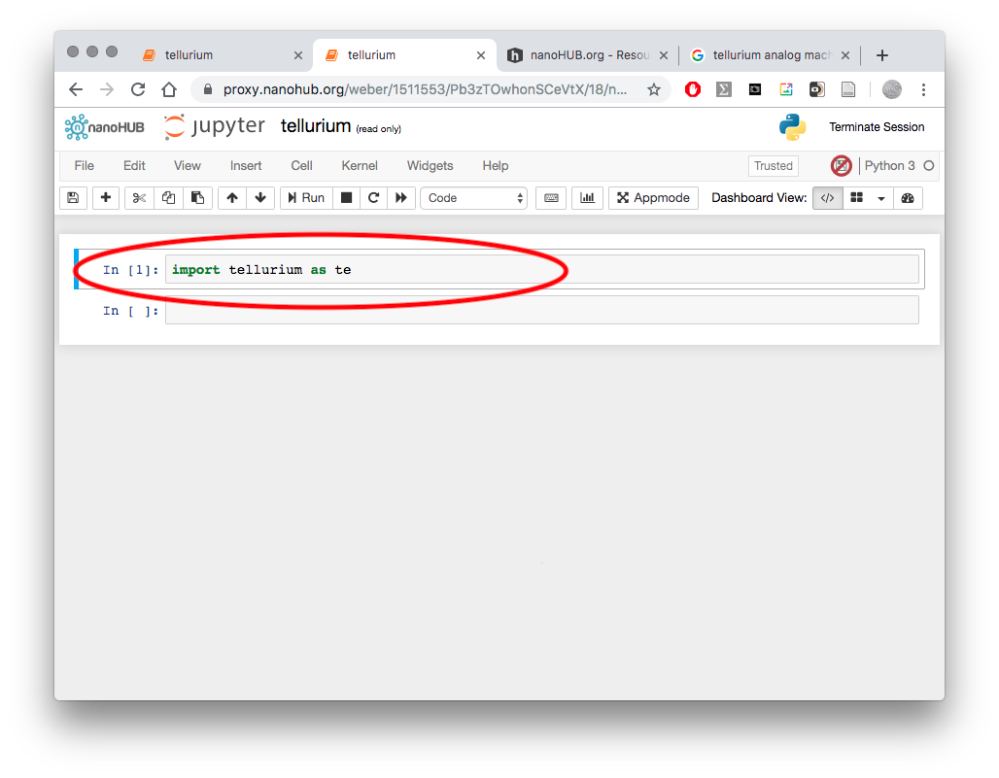
Using Tellurium in nanoHub or Jupyter Notebooks
Native language is Python
Boxes are interactive ‘cells’
Cells are interactive edit boxes where you will type Python code
Type “shift+enter” to evaluate (execute code in) selected cells

Slide 12
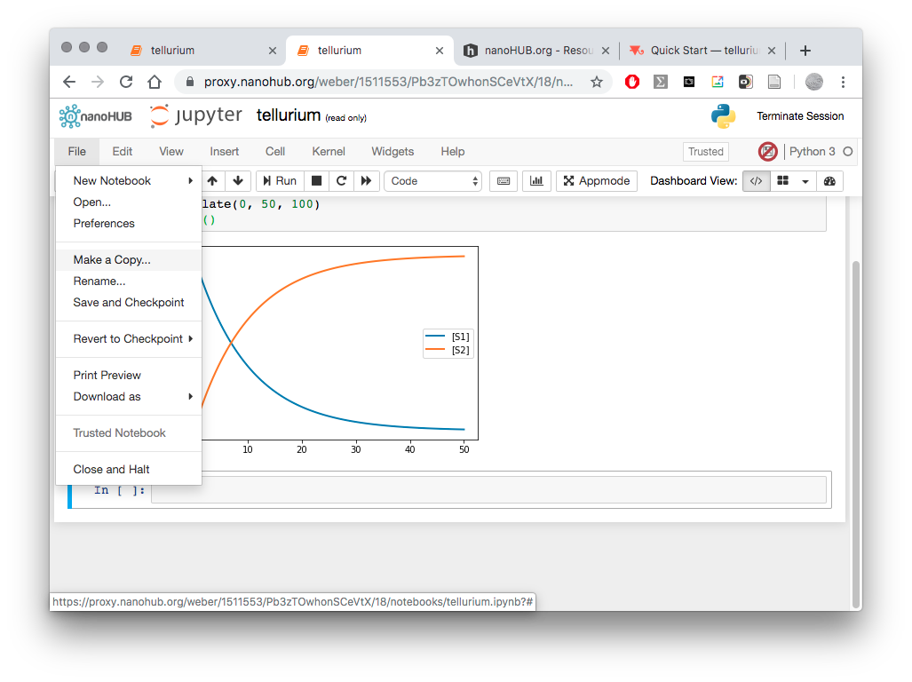
Making Your Notebook Savable
The default notebook is read-only
Need to make a copy in order to save (only have to do this when you create a new notebook)
Pull down File Menu, Select Make a Copy

Slide 13
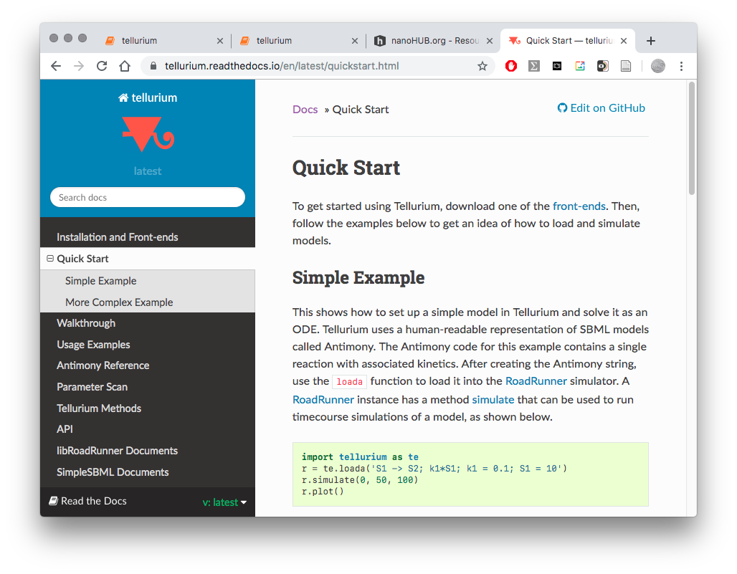
Help and References for Tellurium
Have documentation open in a separate window
https://tellurium.readthedocs.io/
Printed Handouts (“Cheat Sheet”)

Slide 14
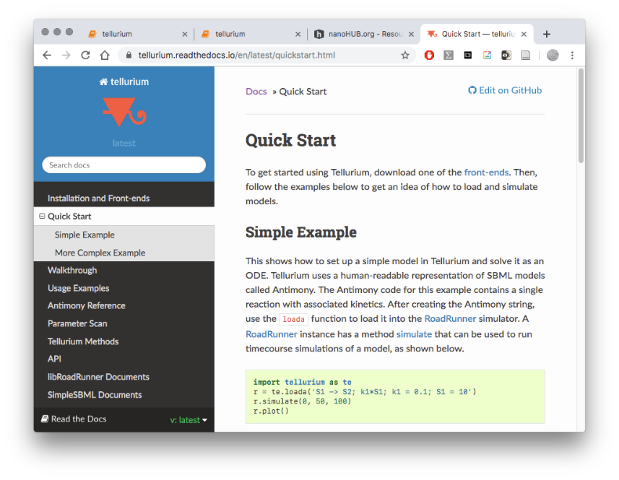
In Class Exercise—Quick Example of Edit and Execution in Tellurium
Highlight code example

Slide 15
In Class Exercise—Quick Example of Edit and Execution in Tellurium
Highlight code example
Copy it

Slide 16
In Class Exercise—Quick Example of Edit and Execution in Tellurium
Highlight code example
Copy it
Paste it into the Jupyter Notebook Cell

Slide 17
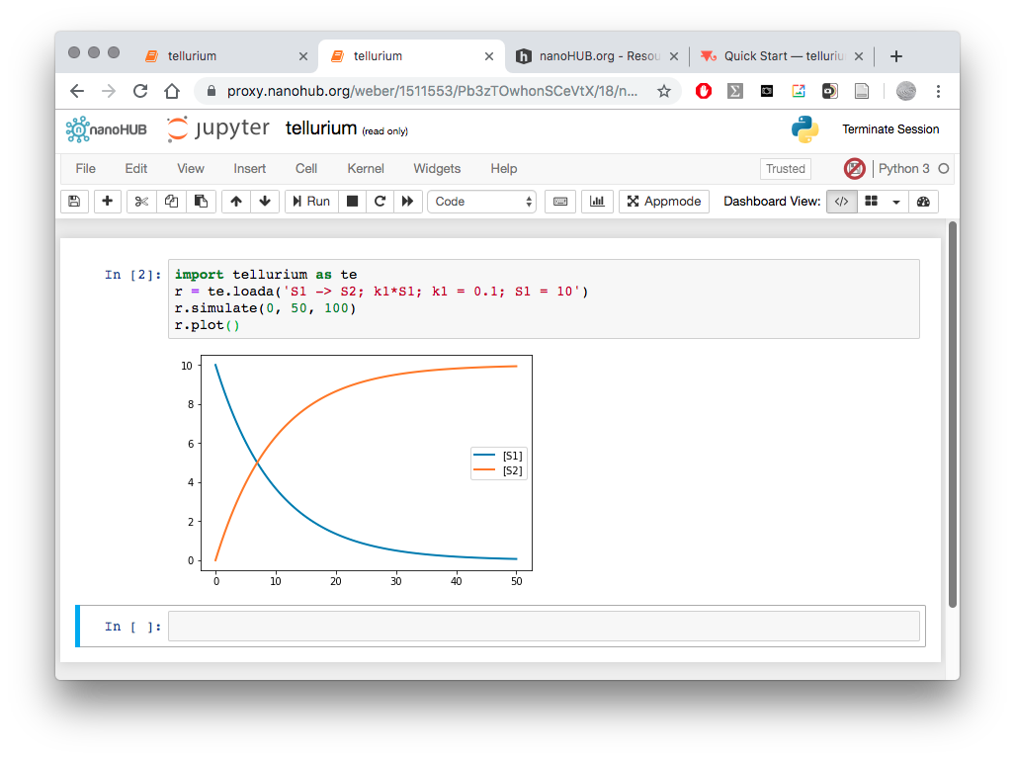
In Class Exercise—Quick Example of Edit and Execution in Tellurium
Type “shift+enter” to evaluate (execute code in) cells and see results

Slide 18
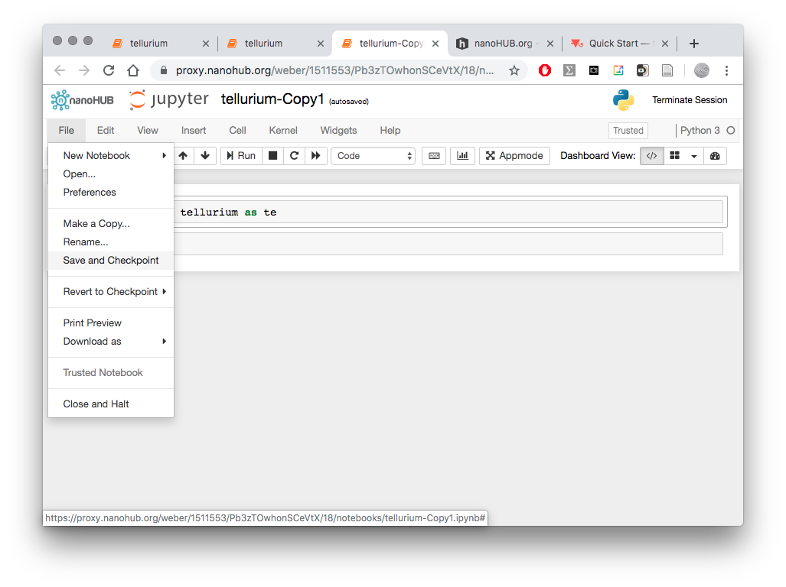
Saving Notebooks
To save use “Save and Checkpoint” in the File Pulldown Menu
nanoHub saves Notebooks in the session subdirectory by default
For safety always download your work to your local computer before you end a session

Slide 19
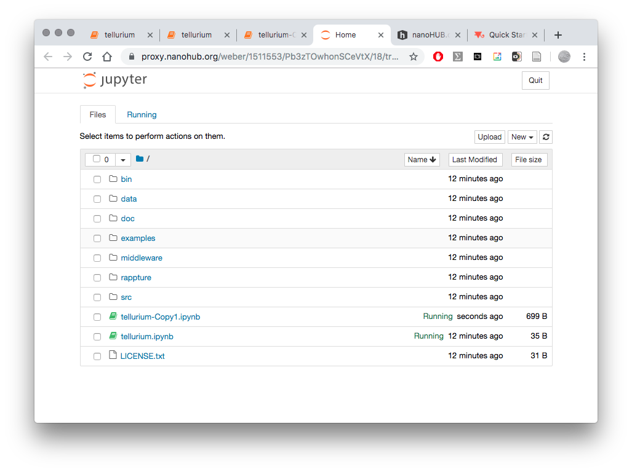
Opening Saved Notebooks
File Open to open saved notebooks

Slide 20
Model and Simulation Definition Structure in Tellurium
You will type your mathematical model defined in the Antimony language here inside the ”””” ””””
and your Python commands to simulate the model and display the results here
Note that all your simulations will have a mixture of these two languages

Slide 21
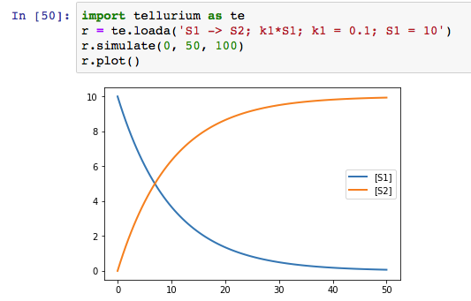
Exercise: copy and paste from the Tellurium website
Go to https://tellurium.readthedocs.io in your web browser.
Example of a basic chemical reaction
Copy the first example into the Jupyter notebook cell:

Slide 22
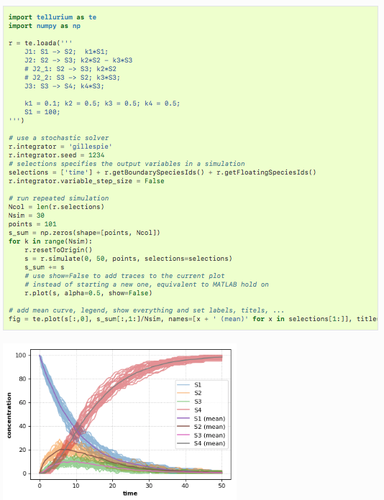
Exercise: copy and paste from the Tellurium website
Copy the second example
Tellurium can also handle stochastic models. This example shows how to select Tellurium’s stochastic solver. The underlying simulation engine used by Tellurium implements a Gillespie direct method for simulating this model.

Slide 23
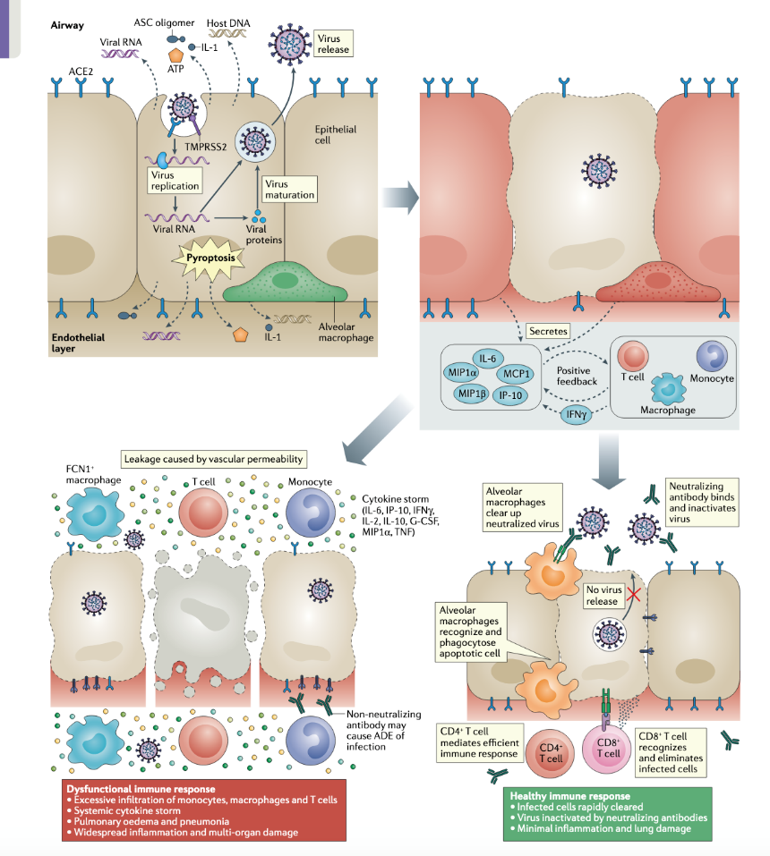
Biological Components of SARS-CoV-2 Infection
Epithelial target tissue (nasal, throat, bronchial, alveolar)
Extracellular environment
Virus entry, replication, spread and removal
Immune cells (lots of them) and their recruitment and actions
Immune signals (lots of them)
Tissue damage and recovery
Lymph nodes/systemic immune system
Immune signaling
Immune-cell proliferation
Whole body transport (blood, lymph, air)
Other non-target or secondary target organs (blood, heart, kidneys,…)
Innate and adaptive immune responses
Tay et. al., Nat Rev Immunol, 2020

Slide 24
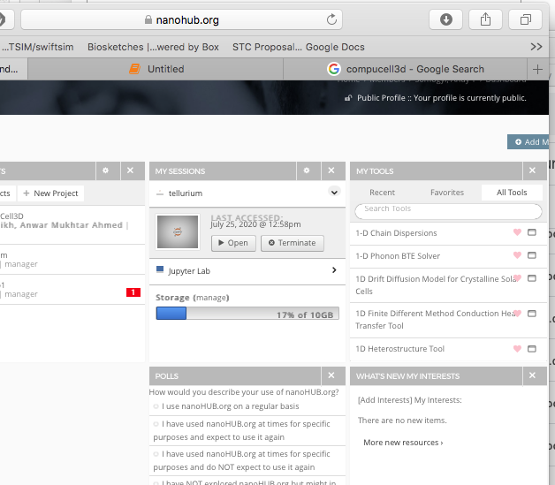
Compucell3D Covid Model

Slide 25
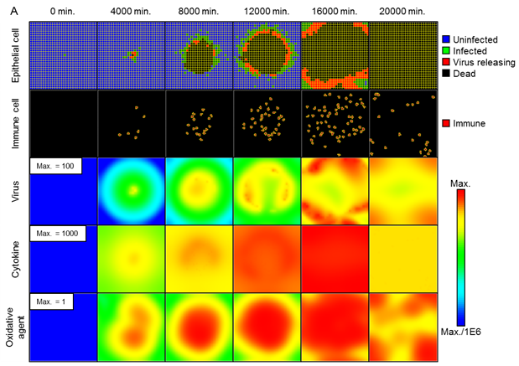
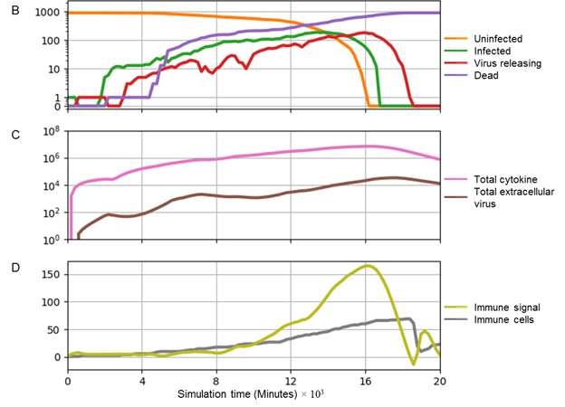
Compucell3D Covid Model Results

Slide 26
Exercise: calculating distance
Type expressions in the cell, see the output
You can type expressions in each cell.
Type shift-enter to evaluate
Type some mathematical expressions…
Operators: +, -, /, *, **
Problem
Given: Two positive integers a and b,
Return: The integer corresponding to the square of the hypotenuse of the right triangle whose legs have lengths a and b.

Slide 27
You’ve just used Scalar Types
programs manipulate objects (we will only be concerned with manipulating data objects, but programs can also manipulate function objects if the language is correctly designed)
objects have a type that defines the kinds of things programs can do to them
Ana is a human so she can walk, speak English, etc.
Chewbacca is a wookie so he can walk, “mwaaarhrhh”, etc.
objects are
scalar (cannot be subdivided)
non-scalar (have internal structure that can be accessed)

Slide 28
Scalar Types
int
– represent integers, ex. 5
float
bool
– represent real numbers, ex. 3.27
– represent Boolean values True and False
NoneType
– special and has one value, None
can use type()
to see the type of an object
>>> | type(5)
int
>>> type(3.0) float
Exercises

Slide 29
TYPE CONVERSIONS (CAST)
can convert object of one type to another
float(3) converts integer 3 to float 3.0
int(3.9) truncates float 3.9 to integer 3
Exercises

Slide 30
PRINTING TO CONSOLE
to show output from code to a user, use print
function
In [11]: 3+2
Out[11]: 5
In [12]: print(3+2)
5
Exercises

Slide 31
EXPRESSIONS
combine objects and operators to form expressions
an expression has a value, which has a type
syntax for a simple expression
<object> <operator> <object>

Slide 32
OPERATORS ON ints and floats
i+j
i-j
i*j
i/j
→ the sum
→ the difference
→ the product
→ division
if both are ints, result is int
if either or both are floats, result is float
result is float
i%j
→ the remainder when i is divided by j
i**j → i to the power of j
Exercises

Slide 33
How to do math calculations
parentheses used to tell Python to do these
operations first
operator precedence without parentheses ()
**
*
/
◦ + and – executed left to right, as appear in expression
Exercises

Slide 34
Assigning values to variables
equal sign is an assignment of a value to a variable name
pi =
3.14159
pi_approx = 22/7
value stored in computer memory
an assignment binds name to value
retrieve value associated with name or variable by invoking the name, by typing pi
Exercises

Slide 35
Think about relating inputs to outputs: Recipes
a programming language provides a set of primitive
operations
expressions are complex but legal combinations of primitives in a programming language
expressions and computations have values and meanings in a programming language

Slide 36
Can change the values stored in variables
value for area does not change until you tell the computer to do the calculation again
pi = 3.14
radius = 2.2
area = pi*(radius**2) radius = radius+1
3.14
pi
radius area
2.2
3.2
15.1976
Exercises

Slide 37
Exercise: Guessing Root
Remember the numerical example, square root of a number x is y such that y*y = x
recipe for deducing square root of a number x (16)
Start with a guess, g
If g*g is close enough to x, stop and say g is the answer
Otherwise make a new guess by averaging g and x/g
Using the new guess, repeat process until close enough
g | g*g | x/g | (g+x/g)/2
3 | 9 | 16/3 | 4.17
4.17 | 17.36 | 3.837 | 4.0035
4.0035 | 16.0277 | 3.997 | 4.000002

Slide 38
Exercise: Guessing Root
g | g*g | x/g | (g+x/g)/2
3 | 9 | 16/3 | 4.17
4.17 | 17.36 | 3.837 | 4.0035
4.0035 | 16.0277 | 3.997 | 4.000002
set g to previous guess
Lather, rinse and repeat…

Slide 39
STRINGS
letters, special characters, spaces, digits
enclose in quotation marks or single quotes
hi = "hello there"
concatenate strings
name = "ana"
greet = hi + name
greeting = hi + " " + name
do some operations on a string as defined in Python docs
silly = hi + " " + name * 3

Slide 40
INPUT/OUTPUT: print
used to output stuff to console
function is print
x = 1
print(x)
x_str = str(x)
print("my fav num is", | x, ".", | "x =", x)
print("my fav num is " | + x_str | + ". " + "x = " + x_str)

Slide 41
INPUT/OUTPUT: input("")
only for standard python, will not work in Tellurium console
prints whatever is in the quotes
user types in something and hits enter
binds that value to a variable
text = input("Type anything... ") print(5*text)
input
gives you a string so must cast if working
with numbers
num = int(input("Type a number... ")) print(5*num)

Slide 42
COMPARISON OPERATORS ON
int, float, string
i and j are variable names
comparisons below evaluate to a Boolean
i > j
i >= j
j > i
i <= j
i == j ⇾ equality test, True if i is the same as j
i != j ⇾ inequality test, True if i not the same as j

Slide 43
LOGIC OPERATORS ON bools
a and b are variable names (of type Boolean)
not a ⇾
a and b ⇾
a or b ⇾
True if a is False False if a is True
True if both are True
True if either or both are True
A | B | A and B | A or B
True | True | True | True
True | False | False | True
False | True | False | True
False | False | False | False

Slide 44
WHERE THINGS GO WRONG
syntactic errors
common and easily caught
static semantic errors
some languages check for these before running program
can cause unpredictable behavior
no semantic errors but different meaning than what programmer intended
program crashes, stops running
program runs forever
program gives an answer but different than expected

