Slide 1
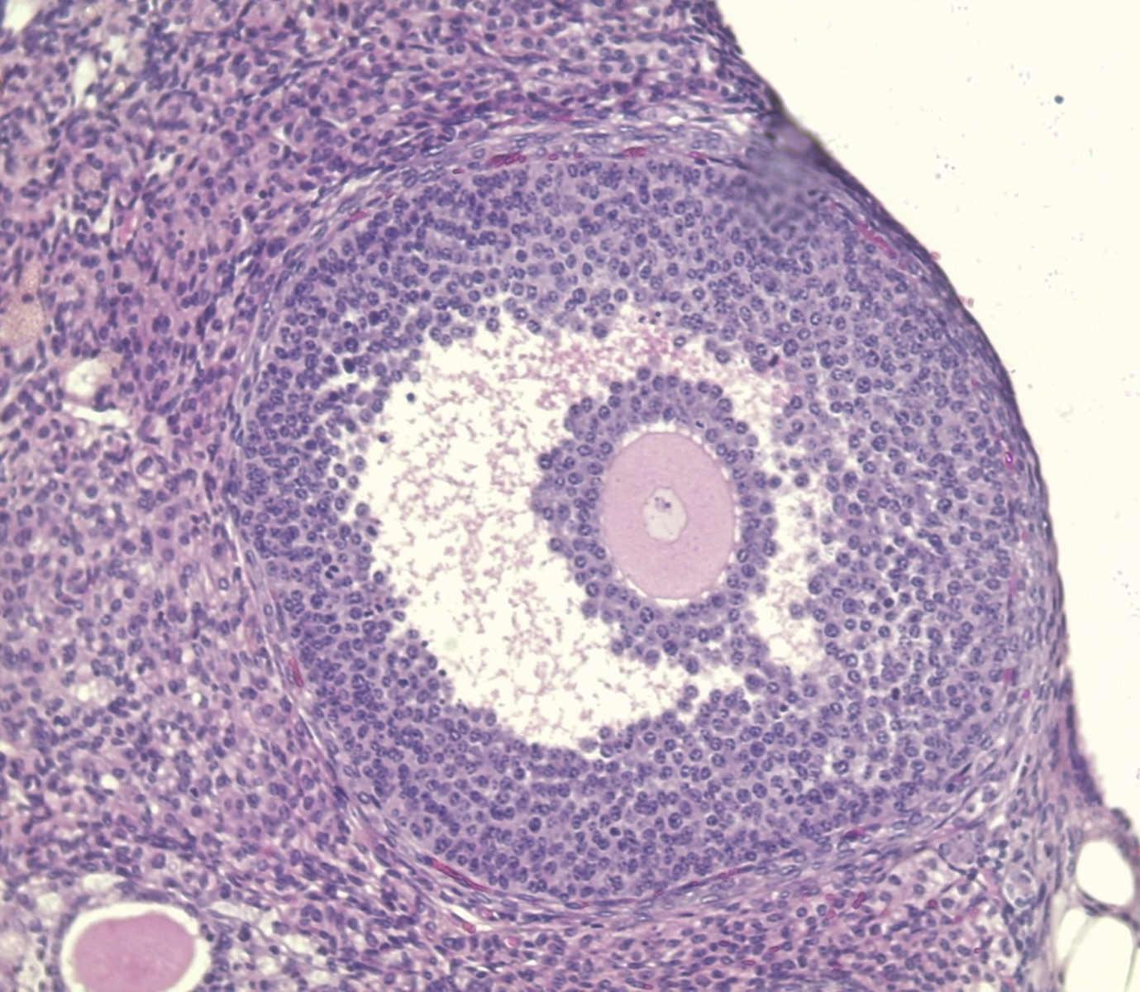
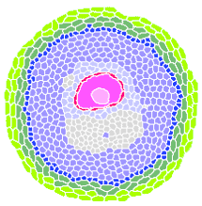
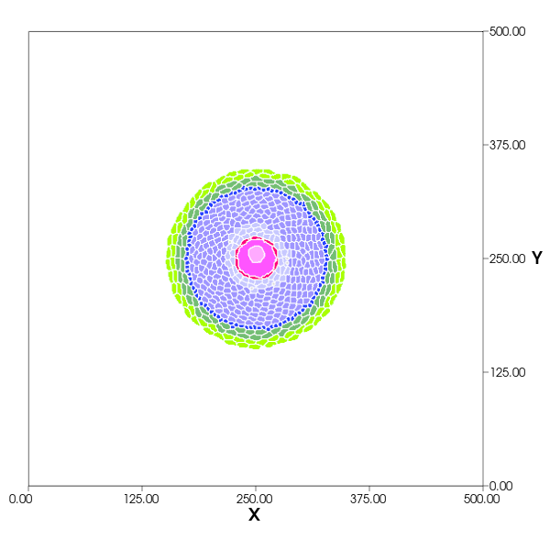
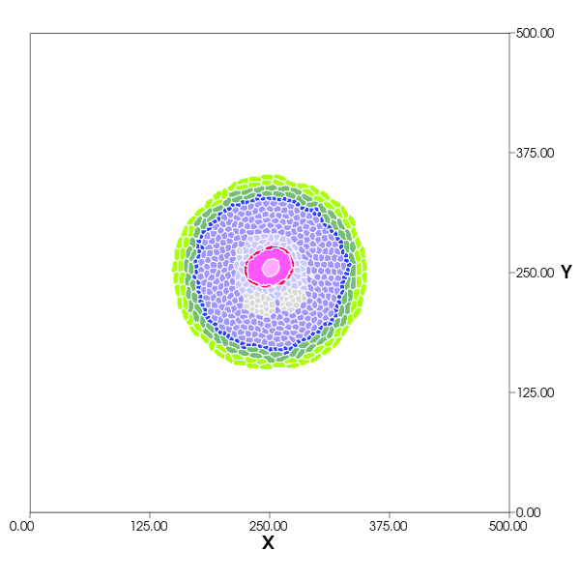
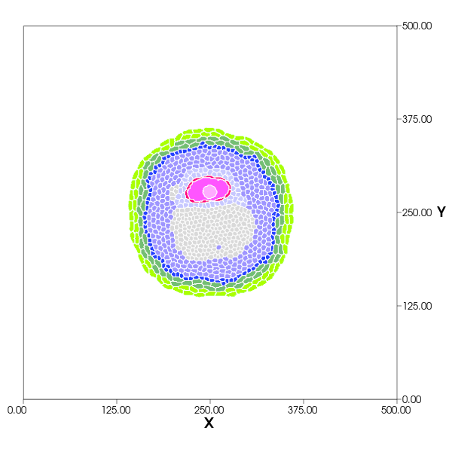
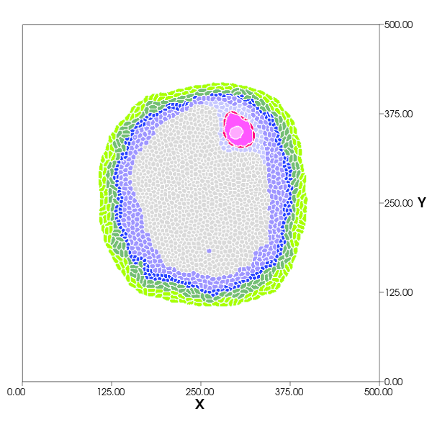
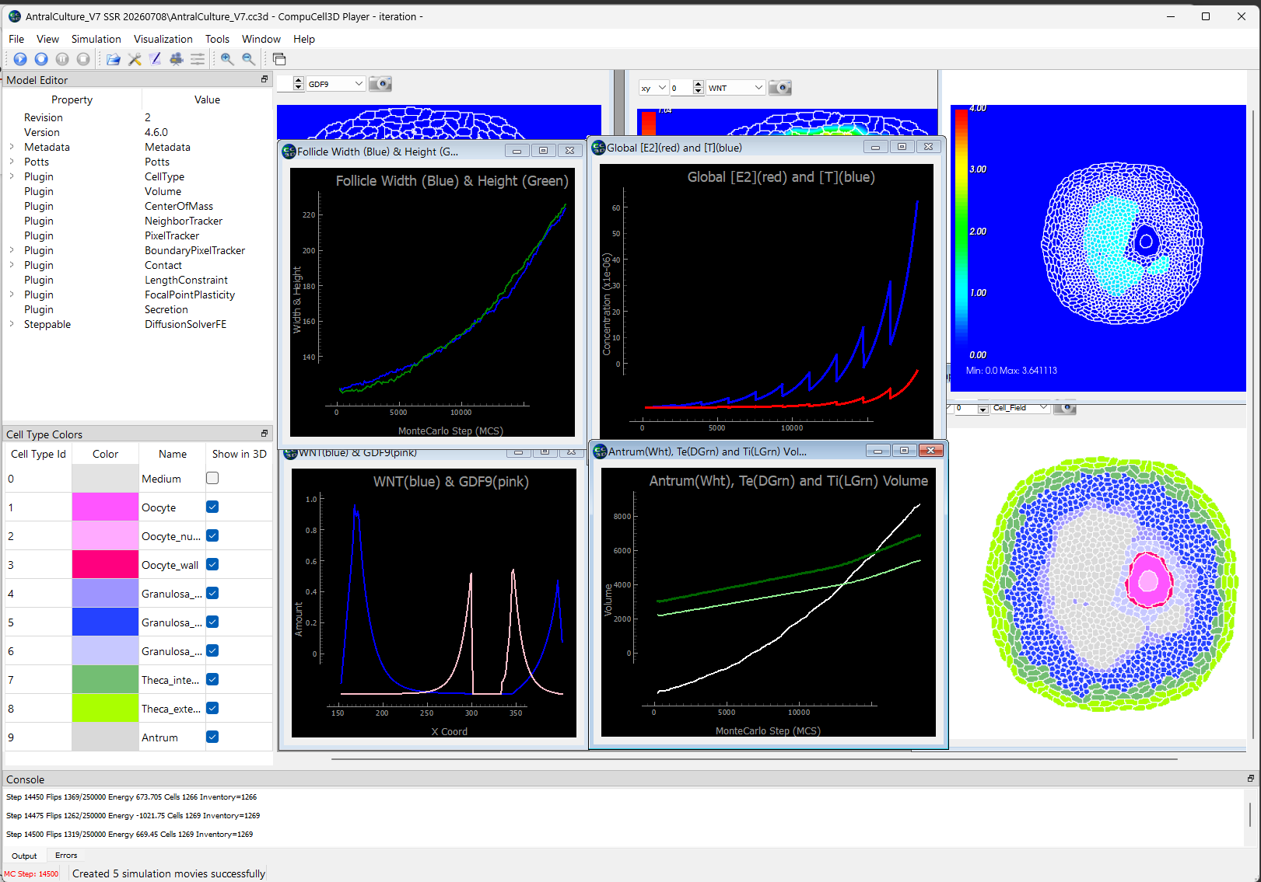
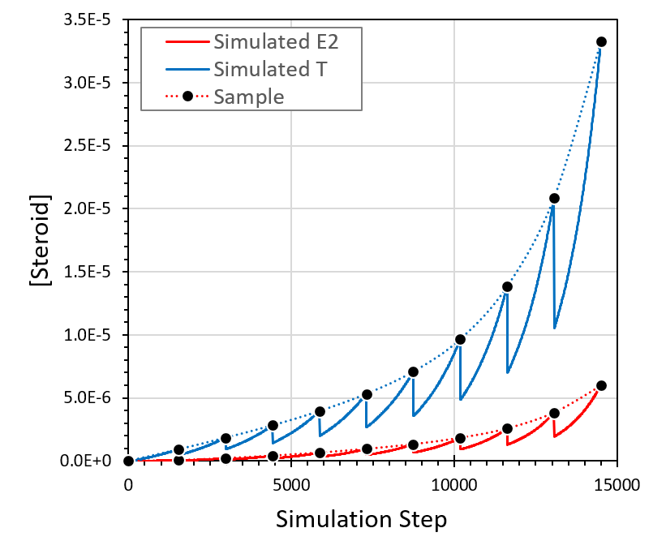
A Multiscale Integration of In Vitro and In Vivo Ovarian and Endocrine Dynamics,
via Computational Modeling, to Predict Toxicant Effects on Female Reproduction
Zelieann R. Craig¹, Miely A. Suarez¹, Viviana A. Romero¹, Talia N. Owen¹, James P. Sluka², Karen Watanabe³,
Israel Chagolla³, Qiang Zhang⁴, Adam J. Krieg^{5,6}, Mary Zelinski^{5,6}.
1. School of Animal & Comparative Biomedical Sciences, The University of Arizona, Tucson, AZ, USA; 2. Intelligent Systems Engineering, Indiana University, Bloomington, USA; 3. School of Mathematical and Natural Sciences, Arizona State University, Glendale, AZ, USA 4. Gangarosa Department of Environmental Health, Rollins School of Public Health, Emory University, Atlanta, USA; 5. Department of Obstetrics & Gynecology, Oregon Health & Science University, Portland, USA; 6. Division of Reproductive & Developmental Sciences, Oregon National Primate Research Center, Beaverton, USA.
Simulation Methods Supplement
We have developed, in CompuCell3D (CC3D)[1], a spatial model representing a growing ovarian follicle with multiple interacting cell types and a dynamic antrum. Cell behaviors—including adhesion, growth, secretion, and proliferation—drive structural organization and expansion over a 10-day in vitro simulation.
Ovarian histology section → CompuCell3D Cell Layout
Steroidogenesis Pathways
Mural (border) granulosa
Mural (antral) Granulosa
Granulosa mural border
Granulosa mural
Chol
Cholesterol
(e.g., LDL)
LH stimulation
Diffusion
to media
FSH stimulation
Oocyte
slow
Granulosa Cell
Oocyte Wall
(Zona Pellucida)
P5
Theca Cell
Cumulus Granulosa
Oocyte Nucleus
Oocyte wall
P4
P5
Chol
slow
fast
P4
fast
E2
Theca
Oocyte
Theca external
Granulosa cumulis
Based on: (2014). "Diagram of the pathways of human steroidogenesis". WikiJournal of Medicine 1 (1). DOI:10.15347/wjm/2014.005. ISSN 20018762. - Häggström M, Richfield D (2014). "Diagram of the pathways of human steroidogenesis". WikiJournal of Medicine 1 (1). DOI:10.15347/wjm/2014.005. ISSN 20024436.
A4
mitochondria
fast
A4
T
slow
T
Blood Vessel
Antrum
Oocyte Nucleus
Theca internal
Antrum
T
E2
smooth endoplasmic
reticulum
smooth endoplasmic
reticulum
Cell types: Theca cells: external and internal Granulosa cells: mural, mural border, and cumulus Oocyte: nucleus, cytosol, and wall (zona pellucida) Antrum ECM: proteoglycan-rich matrix Antrum formation: Cumulus and some mural granulosa cells secrete proteoglycans (“org-salt”) Org-salt forms a diffusing field confined to antrum This field drives water influx and antrum expansion Growth and proliferation: Mural border granulosa and theca cells proliferate to maintain proper layer structure during expansion Tissue organization: Cell–cell adhesion largely maintains spatial layering Additional constraints link oocyte to cumulus cells Morphogen Fields: Growth Differentiation Factor 9 (GDF9) is secreted by the oocyte and stimulates differentiation and growth of granulosa cells. [2] WNT5α is secreted by the Theca internal cells and stimulates differentiation and growth of granulosa cells. [3] GDF9 and WNT are used to differentiate granulosa into mural and cumulus. Testosterone and Estradiol are assumed to freely, and rapidly diffuse Simulation details: Duration: 10 simulated days Resolution: 1 µm/pixel Time scale: 1 simulation step = 1 min The simulation includes removal of 50% of the culture media once a day. | Steroidogenesis: Theca interna cells: Each cell has an ODE model simulating steroidogenesis: cholesterol (Chol) → pregnenolone (P5) → progesterone (P4) → androstenedione (A4) → testosterone (T) Mural Granulosa cells: Each cell has an ODE model simulating conversion of testosterone (T) → estradiol (E2) Rate-limiting assumption: Steps involving intracellular transport or intercellular diffusion are treated as slow, with potential loss of substrate to the media. Cholesterol → pregnenolone (Chol → P5): Modeled as a single slow step, reflecting transport of cholesterol from the media or within theca cells. Testosterone transport: T is produced in theca cells and diffuses to granulosa cells; this is assumed to be slow, with partial loss to the media. Granulosa (T → E2): Diffusion of T into granulosa cells and conversion to E2 are combined into a single process. Feedback Pathways: Testosterone stimulates cholesterol transfer in theca cells and mural granulosa cell proliferation
Not shown: Steroid transfer facilitated by LDL receptor on theca cells,
and sterol carrier proteins in both theca and granulosa cells.
LH + LHR ↔ LH•LHR FSH + FSHR ↔ FSH•FSHR
Chol_{serum} || Chol_{theca} → P5 → P4 → A4 → T_{theca} || T_{gran} → E2
slow slow
Serum
Theca Cell
Granulosa Cell
Simulation Results
CompuCell3D simulation window. Subwindows show the cell field (lower right), proteoglycan osmotic pressure (upper right), follicle height and width (upper left), testosterone and estradiol levels, (upper middle), Wnt and GDF9 fields along a horizontal line through the follicle (bottom left) and antrum and theca cell “volumes” (areas in this 2D simulation) (bottom center).
Typical results for the follicle growth simulation. Cell field after 10 simulated days. The follicle diameter increases by 50%. Cell maintain reasonable type-specific locations.
MCS: 100, 1400, 4300, 13,000 (simulated days: 0.07, 1, 3, 9)
The in vitro system includes removal of 50% of the well volume
once daily and replacement with fresh media. The removed sample
is used for hormone measurements. This significant loss of material
in the media needs to be accounted for in the simulation. Here, the
total T and E2 concentrations in the simulation is plotted versus
time where one “Simulation Step” is one minute of simulated time.
The in vitro samples correspond to the top of the peaks in the
curves, connected by the dashed lines. The in vitro sampling not
only creates concentration fluctuations but also reduces the
measured total amount of T and E2 secreted by the follicle in the
in vitro data.
Acknowledgments NIH/NIEHS ViCTER Project: In Vitro to In Vivo Extrapolation of Toxicant Effects on Ovarian Function, 1R01ES034690
Notes:
* Poster printer has a max width of 36”, length can be anything

