Slide 1
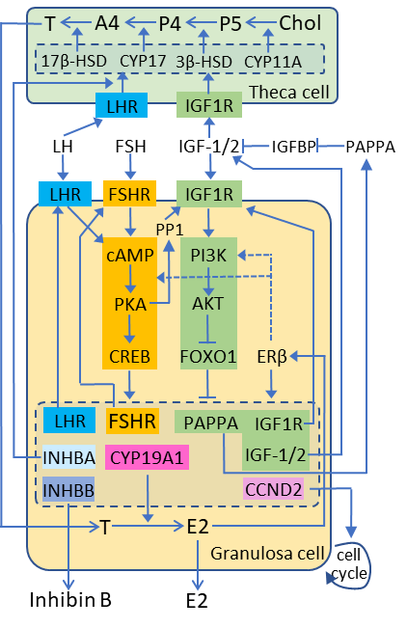
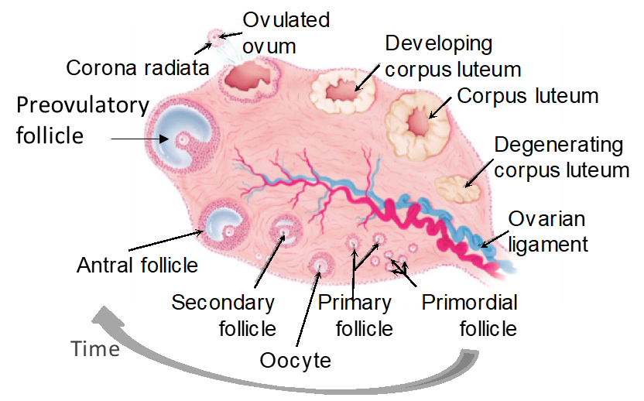
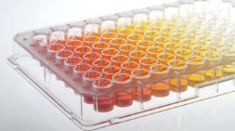
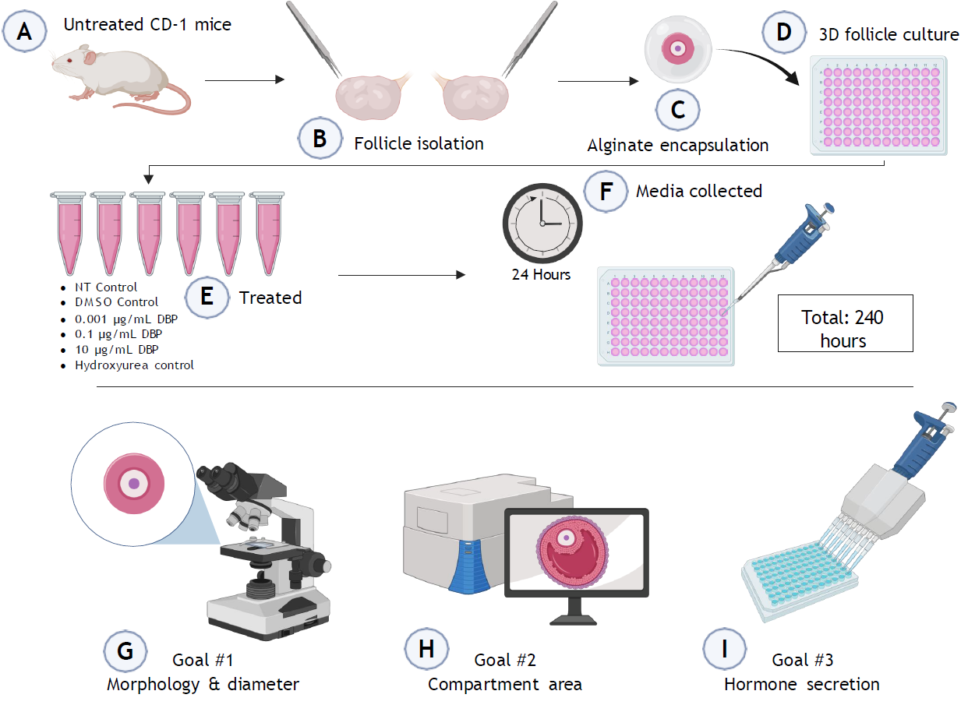
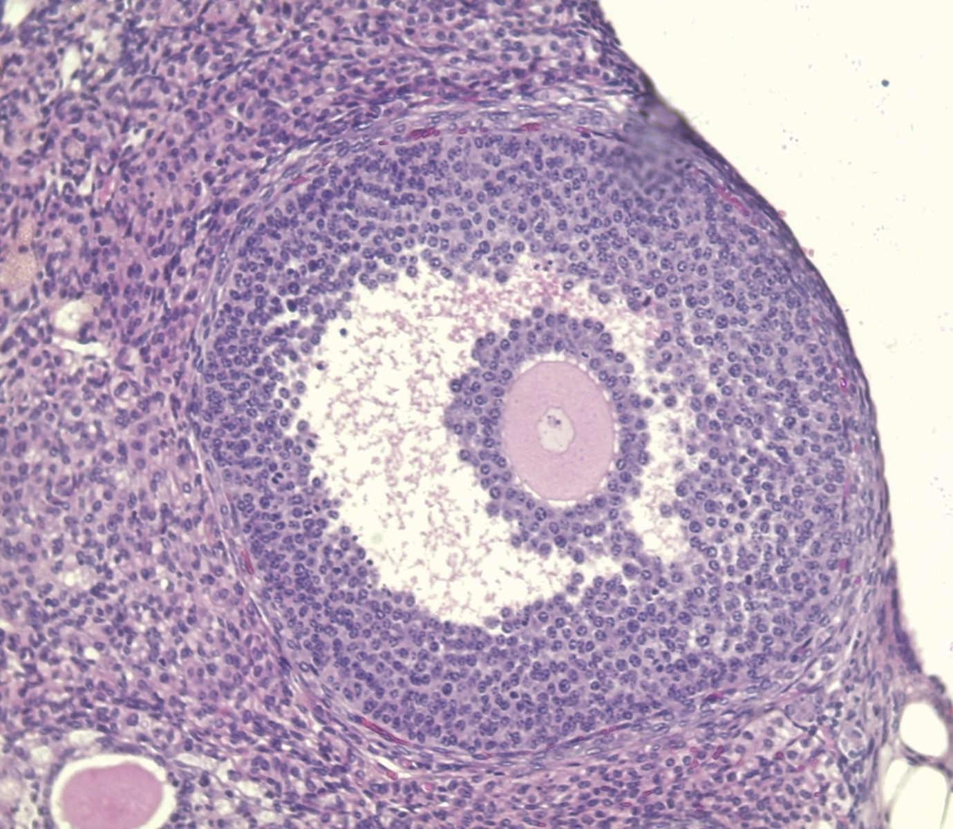
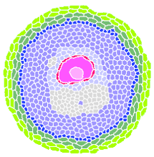

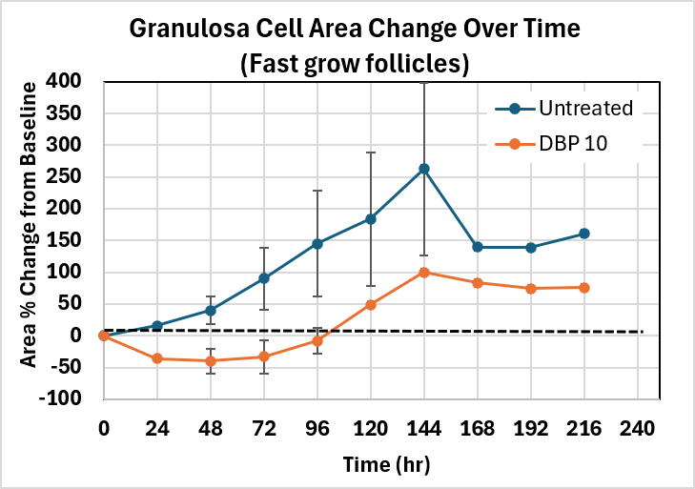
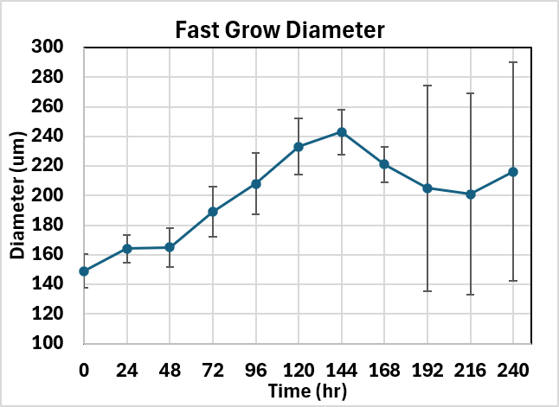
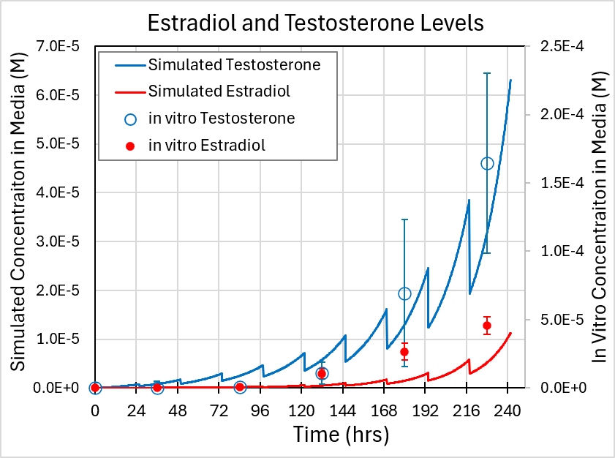
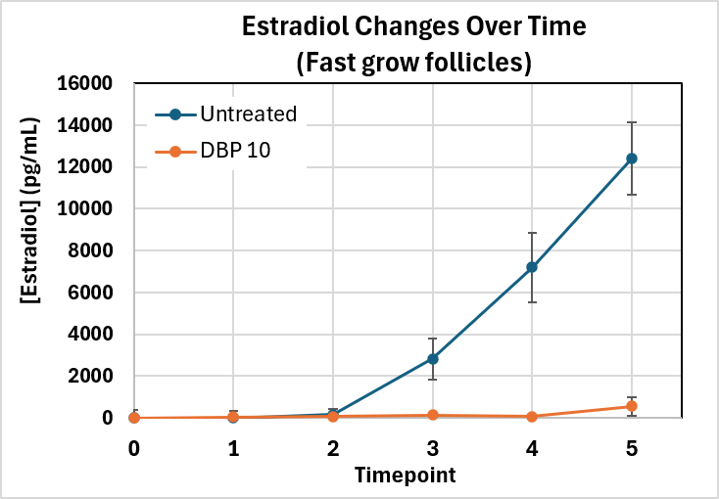
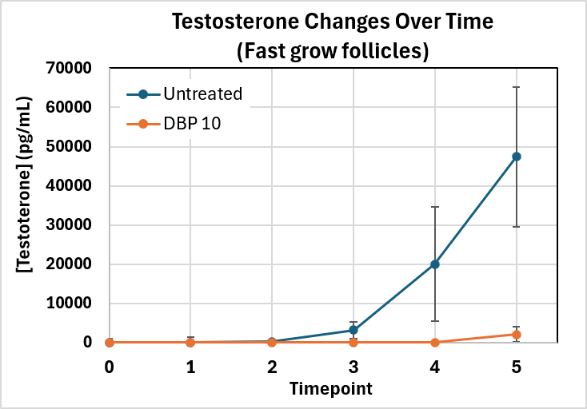
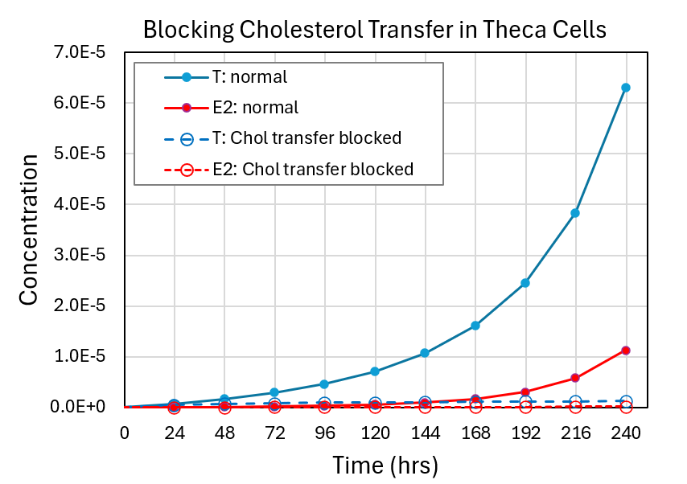
A Multiscale Integration of In Vitro and In Vivo Ovarian and Endocrine Dynamics,
via Computational Modeling, to Predict Toxicant Effects on Female Reproduction
Zelieann R. Craig¹, Miely A. Suarez¹, Viviana A. Romero¹, Talia N. Owen¹, James P. Sluka², Karen Watanabe³,
Israel Chagolla³, Qiang Zhang⁴, Adam J. Krieg^{5,6}, Mary Zelinski^{5,6}.
1. School of Animal & Comparative Biomedical Sciences, The University of Arizona, Tucson, AZ, USA; 2. Intelligent Systems Engineering, Indiana University, Bloomington, USA; 3. School of Mathematical and Natural Sciences, Arizona State University, Glendale, AZ, USA 4. Gangarosa Department of Environmental Health, Rollins School of Public Health, Emory University, Atlanta, USA; 5. Department of Obstetrics & Gynecology, Oregon Health & Science University, Portland, USA; 6. Division of Reproductive & Developmental Sciences, Oregon National Primate Research Center, Beaverton, USA.
Introduction
Whole Body:
Physiologically Based Model
Ovary:
Multi-cell Model
(CompuCell3D)
Cells:
Signaling Pathways
We are developing in vivo, in vitro, and in silico models of gonadotropin-dependent ovarian follicle development to explore toxicant effects on reproduction (Fig. 1). Our long-term goal is to use mechanistic, multiscale computational models for in vitro to in vivo extrapolation (IVIVE) of toxicant effects.
We present preliminary in vitro mouse follicle culture data and a spatially resolved model of follicle development incorporating cell proliferation, morphogen signaling, and subcellular steroidogenesis, which converts cholesterol to testosterone and estradiol. We also present preliminary data on the effects of dibutyl phthalate (DBP), a model toxicant, on follicle growth. Parallel in vitro studies using monkey follicles and in vivo studies in mice and monkeys are underway.
Computation
Biology
In vivo
In vitro
Isolate multilayer follicles
In Vitro Methods
Simulation Methods
Fig. 1: Project workflow and relationships between in vivo, in vitro and in silico components.
(A) Secondary and multilayer follicles (100-250 μm in diameter) were (B) mechanically isolated from 21-day old female CD-1 mice, (C) encapsulated in alginate beads (0.5%), and (D) individually cultured. (E) Follicles were treated with vehicle control (0.075% DMSO), three concentrations of DBP (0.001, 0.1, 10 μg/mL), or cell death control (7600 μg/mL hydroxyurea) in supplemented media containing FSH (N = 15-20 follicles/treatment). (F) Culture medium was collected (150 μl) every 24 hours for up to 240 hours. (G) Follicle diameter and brightfield images were obtained every 24 hours to assess daily growth, (H) compartment-specific morphology and area, and antrum formation. (I) Collected media was used to measure 17β-estradiol (E2) and testosterone (T) secretion over time.
We have developed, in CompuCell3D (CC3D)[1], a spatial model representing a growing ovarian follicle with multiple interacting cell types and a dynamic antrum. Cell behaviors—including adhesion, growth, secretion, and proliferation—drive structural organization and expansion over a 10-day in vitro simulation.
Granulosa mural
Cholesterol
(e.g., LDL)
LH stimulation
Diffusion
to media
FSH stimulation
Mural (antral) Granulosa
Granulosa mural border
slow
Granulosa Cell
Mural (border) granulosa
Oocyte
Theca Cell
Cumulus Granulosa
Oocyte Wall
(Zona Pellucida)
Oocyte Nucleus
Oocyte wall
P5
Chol
slow
fast
P4
fast
E2
Theca
Theca external
mitochondria
fast
A4
T
slow
T
Blood Vessel
Antrum
Oocyte Nucleus
Oocyte
Granulosa cumulis
smooth endoplasmic
reticulum
smooth endoplasmic
reticulum
Theca internal
Antrum
Not shown: Steroid transfer facilitated by LDL receptor on theca cells,
and sterol carrier proteins in both theca and granulosa cells.
Cell-based model: Compucell3D [1] simulation of mouse ovarian follicle including theca, granulosa, oocyte, and antral ECM compartments.
Tissue mechanics: Cell adhesion, proliferation, and other constraints preserve follicle structure.
Antrum formation: Granulosa-secreted proteoglycans drives water influx and antrum expansion.
Steroidogenesis: Cell-specific ODE models simulate cholesterol-to-testosterone conversion in theca
cells and testosterone-to-estradiol conversion in mural granulosa cells.
Transport assumptions: Cholesterol and testosterone transport are treated as rate-limiting
processes with substrate loss to the culture medium.
Simulation: 10-day simulation at 1 μm resolution, 1-minute time steps, with 50% daily
media replacement. For additional details on the simulation →
In Vitro Results
Cultured ovarian follicles exhibited three distinct growth trajectories: fast-growing, slow-growing, and non-growing. Analyses were restricted to fast-growing follicles because they exhibit the characteristic morphological and functional hallmarks of healthy follicular development, including sustained growth, granulosa cell expansion, antrum formation, and increased steroid hormone production.
Simulation Results
Simulation results for Fast-grow follicles:
Follicle diameter increase can be reproduced.
Testosterone and estradiol synthesis show similar exponential
trend and final T/E2 ratio.
Predicted E2 levels lower than observed.
DBP mimetic:
Phthalates often inhibit cholesterol delivery to the mitochondria,
perhaps via inhibition of STARD1 expression [4]. We tested this
hypothesis by blocking the feedback of testosterone on the first
step in the theca cell cholesterol → Pregnenolone (P5) reaction.
Reduces follicle growth as observed for DBP 10 treatment.
Reduces T and E2 as observed for DBP 10 treatment, though the
inhibition is too strong (25-fold reduction in cell culture versus
~50-fold reduction in simulation).
However, the antrum still grows. This suggest the model needs an
additional steroid regulation on proteoglycan secretion by the
mural granulosa cells.
Percent change of granulosa cell area over time from baseline for DMSO control and DBP 10 μg/mL treated follicles. Data are shown as mean ± SEM (n = 14-17 per treatment). Only results for Fast Grow follicles are shown.
Follicles were stratified into three distinct growth Fast frow follicle diameters versus time. Data are shown as mean ± SEM. Only “Fast Grow” data is shown.
Concentration of estradiol in media over time for DMSO control and DBNP 10 treated follicles. Data are shown as mean ± SEM. Only data for fast grow follicles is shown.
Concentration of testosterone in media over time for DMSO control and DBNP 10 treated follicles. Data are shown as mean ± SEM. Only data for fast grow follicles is shown.
Conclusions
The preliminary computational model captures many essential features of mouse ovarian follicle development, including tissue growth, spatial organization, morphogen signaling, and steroidogenesis. Agreement with experimental data supports the modeling approach while highlighting areas for refinement, particularly hormone regulation of antrum formation. The framework provides a foundation for future IVIVE studies and extension to monkey and in vivo models for predicting reproductive toxicity.
References
[1] Multi-Scale Modeling of Tissues Using CompuCell3D – M. Swat, Gilberto L. Thomas, Julio M. Belmonte, A. Shirinifard, D. Hmeljak, J. A. Glazier, Computational Methods in Cell Biology, Methods in Cell Biology 110: 325-366 (2012). [2] Growth differentiation factor 9 signaling requires ERK1/2 activity in mouse granulosa and cumulus cells. Sasseville M, et al. J Cell Sci. 2010 Sep 15;123(Pt 18):3166-76. doi: 10.1242/jcs.063834. Epub 2010 Aug 24. PMID: 20736313. [3] WNT signaling in pre-granulosa cells is required for ovarian folliculogenesis and female fertility. Development. Habara O, et al. 2021 May 1;148(9):dev198846. doi: 10.1242/dev.198846. Epub 2021 Apr 29. PMCID: PMC8126407. [4] Adverse Outcome Pathway: Peroxisome Proliferator-Activated Receptor α Activation and Reproductive Toxicity—Development and Application in Assessment of Endocrine Disruptors/Reproductive Toxicants. Nepelska M, et al. Applied In Vitro Tox. 2017;3(3):234-249. doi:10.1089/aivt.2017.0004 Acknowledgment NIH/NIEHS ViCTER Project: In Vitro to In Vivo Extrapolation of Toxicant Effects on Ovarian Function, 1R01ES034690
Notes:
* Poster printer has a max width of 36”, length can be anything

