Slide 1
CC3D Workshop 3.5: How CC3D does Calculations and Introduction to Cell Division
Maciek Swat
Biocomplexity Institute
Indiana University
Bloomington, IN 47408
USA
Funding Sources: NIH U24 EB028887, NIH R01 GM122424, NIH R01 GM123032, NIH P41 GM109824, NSF 1720625 and nanoHUB

Slide 2
Topics
Cellular Potts/GGH Model
Effective-Energy Functionals
Monte Carlo Dynamics
Effective Energy Terms Implement Biological Behaviors and Interactions
Constraints
Lattices and Timestepping
Volume Constraints
Cell Growth
Cell Division/Mitosis
Avascular Tumor Model
Vascular Tumor Model

Slide 3
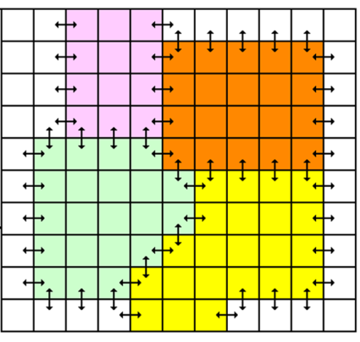
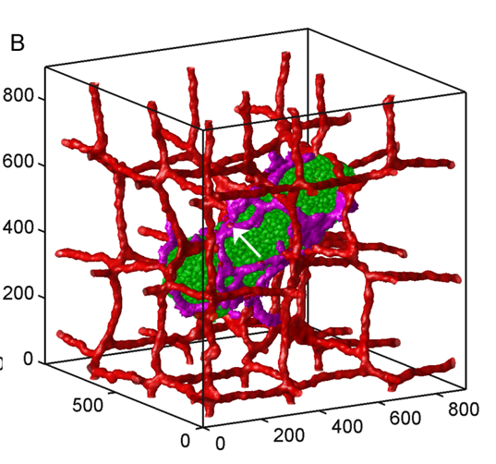
Celular Potts Model
Developed by James Glazier and Francois Graner
Represents single cell as a collection of pixels on a lattice (regular or irregular)
Physics based.
Uses energy formalism to describe cell properties (usually in the form of constraints), cell-cell interactions and cells’ behaviors.
Stochastic not, deterministic
Very simple and intuitive. Mathematical complexity does not go beyond understanding second order polynomials.
Capable of representing cellular and subcellular structures
Relatively fast up to 10^5 cells on a single CPU.
Used extensively by many labs around the world.
Drawbacks: Time has to be converted from simulation unit to physical unit. Lattice granularity determines level of details of simulated objects. Simulation parameters are not independent –changing one of them triggers changes in others
Software: CompuCell3D, Chaste, Simmune, Morpheus, Tissue Simulation Toolkit

Slide 4
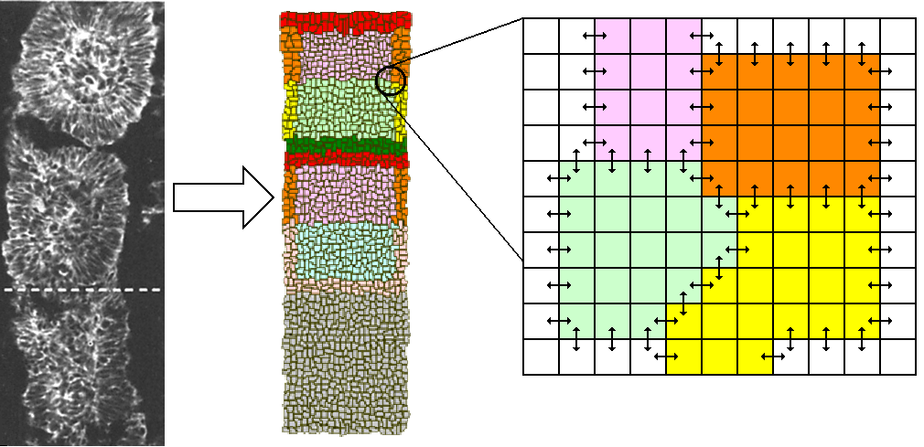
Review of the GGH Model
Key properties:
Cells live on a lattice.
Each cell occupies many lattice sites.
Each cell has a unique index.
Each cell has a type—can have many cells of each type. E.g. a simple cell sorting simulation has many cells of type “Condensing” and many of type “NonCondensinig”

Slide 5
The CPM Model Formalism Overview
Configuration of Cells Evolves to Locally Minimize the Effective Energy, primarily by satisfying constraints) (Graner and Glazier, 1992)
Key concept is differential adhesion between components: Contact energy depending on cell types (differentiated cells)
σ(x) –denotes id of the cell occupying position x. All pixels pointed to by the arrow have same cell id, and belong to the same cell
τ(σ(x)) denotes the cell type of cell with id σ(x). In the picture above blue and yellow cells have different cell types and different cell id. Arrows mark different cell types
Every interface between two different cells contributes to overall contact energy

Slide 6
The GGH Model Formalism Overview—Dynamics
To simulate the cytoskeleton-driven extension and retraction of cell membranes (including pseudopods, filopodia and lamellipodia). The GGH algorithm tries randomly to extend and retract cell boundaries one pixel at a time.
At each attempt, it calculates the new configuration Effective Energy and accepts the new configuration according to the Metropolis algorithm: probability of configuration change
Result is movement with velocity proportional to the gradient of the Energy (or linear in the applied force).
Configurations evolve to satisfy the constraints.
When constraints conflict, evolve to balance errors.

Slide 7
More Detail on Pixel Copy Attempts
invalid attempt
valid attempt
accept
valid attempt
accept
valid attempt
reject
valid attempt
accept

Slide 8
Single Pixel Copy Attempt in Detail
Assume we have Hamiltonian that involves only two terms – Volume Constraint and Adhesion Energy (with nearest neighbor interaction.
$$E_{after}=λ_{green }{(19−V_{taget_green})}^{2}+λ_{orange }{(14−V_{taget_orange})}^{2}$$
$$2J\left(green, orange\right)$$
$$+other contact energies$$
Before pixel copy
$$E_{before}=λ_{green }{(18−V_{taget_green})}^{2}+λ_{orange }{(15−V_{taget_orange})}^{2}$$
$$2J\left(green, orange\right)$$
$$+other contact energies$$
After pixel copy (if accepted)

Slide 9
Single Pixel Copy Attempt in Detail - continued
$$E_{after}=λ_{green }{(19−V_{taget_green})}^{2}+λ_{orange }{(14−V_{taget_orange})}^{2}$$
$$2J\left(green, orange\right)$$
$$+other contact energies$$
Before pixel copy
$$E_{before}=λ_{green }{(18−V_{taget_green})}^{2}+λ_{orange }{(15−V_{taget_orange})}^{2}$$
$$2J\left(green, orange\right)$$
$$+other contact energies$$
After pixel copy (if accepted)
Other contact energies are contact energies contributed by interfaces between two different cells that are away from the change pixel. Because we are interested in the change of Energy those contributions cancel out and therefore are never computed. We only care about what happens in the vicinity of the change pixel
$${ΔE= E}_{after}−E_{before} =λ_{green }{\left(19−V_{taget_green}\right)}^{2}+λ_{orange }{\left(14−V_{taget_orange}\right)}^{2}$$
$$−λ_{green }{\left(18−V_{taget_green}\right)}^{2}−λ_{orange }{(15−V_{taget_orange})}^{2}$$

Slide 10
Single Pixel Copy Attempt in Detail - continued
Before pixel copy
After pixel copy (if accepted)
$${ΔE= E}_{after}−E_{before} =λ_{green }{\left(19−V_{taget_green}\right)}^{2}+λ_{orange }{\left(14−V_{taget_orange}\right)}^{2}$$
$$−λ_{green }{\left(18−V_{taget_green}\right)}^{2}−λ_{orange }{(15−V_{taget_orange})}^{2}$$
Once we know change in Energy due to proposed pixel copy we compute probability of pixel copy according to it we perform pixel copy. If probability of pixel copy is less than 1.0 we generate random number and accept pixel copy if the generated random number is less than computed probability
We then proceed to the next pixel copy attempt and the process repeats

Slide 11
Focusing on cellular behaviors
Energy formalism of the CPM allows implementing cellular behaviors as additive terms of the Hamiltonian:

Slide 12
CompuCell3D Terminology and Relation to GGH
CompuCell has two basic time scales a fast scale and a slow scale:
Fast Scale:
A Pixel-copy attempt is an event where program randomly picks a lattice site and attempts to copy the pixel to a neighboring lattice site.
CompuCell3D Plugins either calculate terms in the Effective Energy or implement actions in response to accepted pixel copies (Lattice Monitors). Most Plugins are coded in C++ for speed.
Slow Scale:
A Monte Carlo Step (MCS) consists of a number of pixel-copy attempts. equal to the number of lattice sites.
CompuCell3D Steppables at the end of each MCS and at the beginning and end of simulations. Most customizations of CompuCell3D simulations use user-written Python Steppables

Slide 13
CompuCell3D Terminology – Visual Guide
Change pixel
During pixel copy “blue” pixel (newCell) replaces “yellow” pixel (oldCell)
100x100x1 square lattice = 10000 lattice sites (pixels)
MCS 21
MCS 22
MCS 23
MCS 24
10000 pixel-copy attempts
10000 pixel-copy attempts
10000 pixel-copy attempts
10000 pixel-copy attempts
Run
Steppables
Run
Steppables
Run
Steppables

Slide 14
Nearest neighbors in 2D and their Euclidian distances from the central pixel
5
4
3
4
5
4
2
1
2
4
3
1
1
3
4
2
1
2
4
5
4
3
4
5
Pixel copies could take place between any order neighbors.
In practice we use only the few first neighbors (1-4).
To specify a pixel-copy range of 2 in a simulation insert the CC3DML command :
<NeighborOrder>2</NeighborOrder>
In the <Potts></Potts> section of the simulation .
Contact energy calculations have their range specified separately
To specify an interaction range of 3 in a simulation insert the CC3DML command :
<NeighborOrder>3</NeighborOrder>
In the <Plugin Name="Contact"> </Plugin> section of the simulation .

Slide 15
Hexagonal Lattices
To reduce intrinsic lattice anisotropy of the square lattice, we can use a hexagonal lattice Instead.
The area/volume of each pixel is fixed to 1, so the length scale changes when you move from square to hex lattices.
To specify a simulation on a hex lattice, insert the CC3DML command :
<LatticeType>Hexagonal</LatticeType>
In the <Potts></Potts> section of the simulation .
 | 2D Square Lattice |  | 2D Hexagonal Lattice
Neighbor Order | Number of Neighbors | Euclidian Distance | Number of Neighbors | Euclidian Distance
1 | 4 | 1 | 6
2 | 4 |  | 6
3 | 4 | 2 | 6
4 | 8 |  | 12
WARNING: a few functions may not work properly for hex lattices.

Slide 16
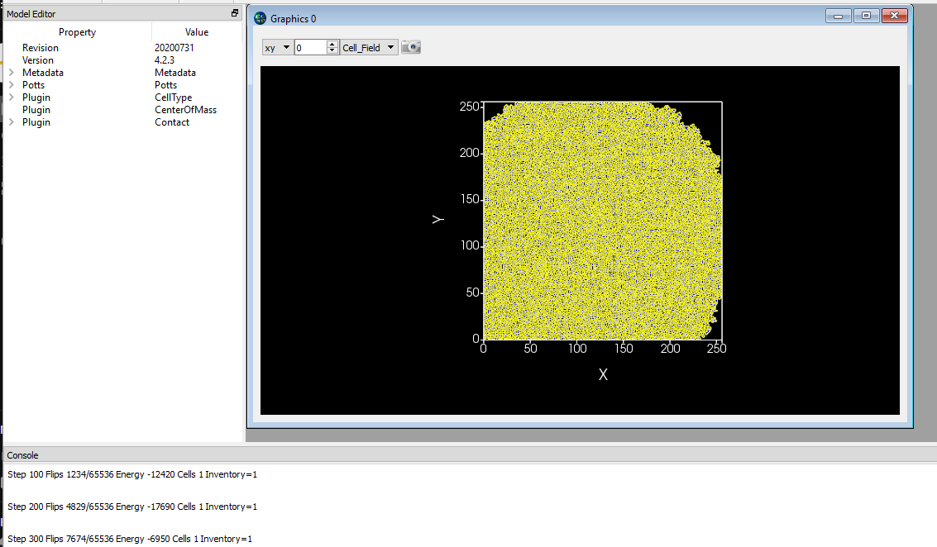
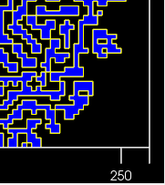
Understanding Contact Energy
SingleCellExample_1.cc3d
Start with a single cell
and change the sign of Contact Energy coefficients to be negative. The pattern evolves and after few MCS we
have the following layout that involves only a single cell:
Why does the single cell „explode” and occupy the entire lattice?

Slide 17
Code Highlights SingleCellExample_1.cc3d
<CompuCell3D Revision="20200731" Version="4.0.0"> <Metadata> <NumberOfProcessors>1</NumberOfProcessors> <DebugOutputFrequency>10</DebugOutputFrequency> </Metadata> <Potts> <Dimensions x="256" y="256" z="1"/> <Steps>100000</Steps> <Temperature>10.0</Temperature> <NeighborOrder>1</NeighborOrder> </Potts> <Plugin Name="CellType"> <CellType TypeId="0" TypeName="Medium"/> <CellType TypeId="1" TypeName="Condensing"/> </Plugin> <Plugin Name="CenterOfMass"/> <Plugin Name="Contact"> <Energy Type1="Medium" Type2="Medium">10.0</Energy> <Energy Type1="Medium" Type2="Condensing">-10.0</Energy> <Energy Type1="Condensing" Type2="Condensing">-10.0</Energy> <NeighborOrder>4</NeighborOrder> </Plugin> </CompuCell3D>
from cc3d.core.PySteppables import * class SingleCellExample_1Steppable(SteppableBasePy): def __init__(self,frequency=1): SteppableBasePy.__init__(self,frequency) def start(self): """ any code in the start function runs before MCS=0 """ self.cell_field[100:101, 100:101, 0] = self.new_cell(self.CONDENSING)

Slide 18
Energy Minimization
Energy minimization leads to simulation choosing to maximize number of interfaces between Medium and Condensing cell, because each interface contributes -10 units of contact energy to the overall Energy and as a result maximizing number of interfaces minimizes energy
and change the sign of Contact Energy coefficients to be negative. The pattern evolves and after few MCS we
have the following layout that involves only a single cell:
Each interface leads to decrease of overall Energy by 10 units

Slide 19
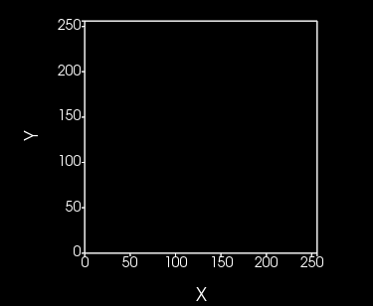
Understanding Contact Energy – positive Contact Energy Coefficients
SingleCellExample_2.cc3d
Start with a single cell
and change the sign of Contact Energy coefficients to be positive.
Why does the single cell disappear? Single cell pixel contributes 4*10 units to overall energy. Getting rid of single pixel cell we lower energy by 4*10 units.

Slide 20
Code Highlights - SingleCellExample_2.cc3d
<CompuCell3D Revision="20200731" Version="4.0.0"> <Metadata> <NumberOfProcessors>1</NumberOfProcessors> <DebugOutputFrequency>10</DebugOutputFrequency> </Metadata> <Potts> <Dimensions x="256" y="256" z="1"/> <Steps>100000</Steps> <Temperature>10.0</Temperature> <NeighborOrder>1</NeighborOrder> </Potts> <Plugin Name="CellType"> <CellType TypeId="0" TypeName="Medium"/> <CellType TypeId="1" TypeName="Condensing"/> </Plugin> <Plugin Name="CenterOfMass"/> <Plugin Name="Contact"> <Energy Type1="Medium" Type2="Medium">10.0</Energy> <Energy Type1="Medium" Type2="Condensing">10.0</Energy> <Energy Type1="Condensing" Type2="Condensing">10.0</Energy> <NeighborOrder>4</NeighborOrder> </Plugin> </CompuCell3D>
from cc3d.core.PySteppables import * class SingleCellExample_1Steppable(SteppableBasePy): def __init__(self,frequency=1): SteppableBasePy.__init__(self,frequency) def start(self): """ any code in the start function runs before MCS=0 """ self.cell_field[100:101, 100:101, 0] = self.new_cell(self.CONDENSING)

Slide 21
Adding Volume Constraint
SingleCellExample_3.cc3d
Start with a single cell, negative contact Energy and a volume constraint
<CompuCell3D Revision="20200731" Version="4.2.3"> <Metadata> <NumberOfProcessors>1</NumberOfProcessors> <DebugOutputFrequency>10</DebugOutputFrequency> </Metadata> <Potts> <Dimensions x="256" y="256" z="1"/> <Steps>100000</Steps> <Temperature>10.0</Temperature> <NeighborOrder>1</NeighborOrder> </Potts> <Plugin Name="Volume"/> <Plugin Name="CellType"> <CellType TypeId="0" TypeName="Medium"/> <CellType TypeId="1" TypeName="Condensing"/> </Plugin> <Plugin Name="CenterOfMass"/> <Plugin Name="Contact"> <Energy Type1="Medium" Type2="Medium">0.0</Energy> <Energy Type1="Medium" Type2="Condensing">-10.0</Energy> <Energy Type1="Condensing" Type2="Condensing">-10.0</Energy> <NeighborOrder>4</NeighborOrder> </Plugin> </CompuCell3D>
from cc3d.core.PySteppables import * class SingleCellExample_3Steppable(SteppableBasePy): def __init__(self,frequency=1): SteppableBasePy.__init__(self,frequency) def start(self): """ any code in the start function runs before MCS=0 """ cell = self.new_cell(self.CONDENSING) self.cell_field[100:101, 100:101, 0] = cell cell.targetVolume = 25 cell.lambdaVolume = 5.0

Slide 22
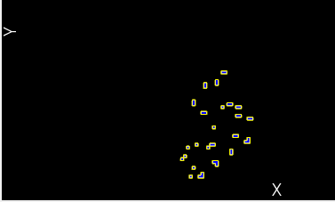
Adding Volume Constraint
Adding cell volume constraint seams to limit the size of the cell but the cell gets fragmented. Why?
Volume constraint ensures that total cell volume is under control but because we are using negavite contact energy coefficients it is energetically favorable to create as many cell-medium interfaces as possible (leading to lower contribution from contact energy) while ensuring that cell volume is as close to target volume as possible

Slide 23
Adding Volume Constraint - positive contact energy
SingleCellExample_4.cc3d
Start with a single cell, negative contact energy and a volume constraint
<CompuCell3D Revision="20200731" Version="4.2.3"> <Metadata> <NumberOfProcessors>1</NumberOfProcessors> <DebugOutputFrequency>10</DebugOutputFrequency> </Metadata> <Potts> <Dimensions x="256" y="256" z="1"/> <Steps>100000</Steps> <Temperature>10.0</Temperature> <NeighborOrder>1</NeighborOrder> </Potts> <Plugin Name="Volume"/> <Plugin Name="CellType"> <CellType TypeId="0" TypeName="Medium"/> <CellType TypeId="1" TypeName="Condensing"/> </Plugin> <Plugin Name="CenterOfMass"/> <Plugin Name="Contact"> <Energy Type1="Medium" Type2="Medium">0.0</Energy> <Energy Type1="Medium" Type2="Condensing">10.0</Energy> <Energy Type1="Condensing" Type2="Condensing">10.0</Energy> <NeighborOrder>4</NeighborOrder> </Plugin> </CompuCell3D>
from cc3d.core.PySteppables import * class SingleCellExample_3Steppable(SteppableBasePy): def __init__(self,frequency=1): SteppableBasePy.__init__(self,frequency) def start(self): """ any code in the start function runs before MCS=0 """ cell = self.new_cell(self.CONDENSING) self.cell_field[100:102, 100:102, 0] = cell cell.targetVolume = 25 cell.lambdaVolume = 5.0

Slide 24
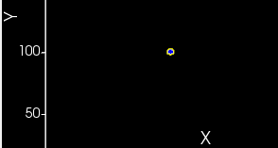
Adding Volume Constraint - positive contact energy
Adding cell volume constraint and keeping positive contact energies removes cell fragmentation and keeps cell volume under control. Why?
Volume constraint ensures that total cell volume is under control but because we are using positive contact energy coefficients it is energetically favorable to create as few cell-medium interfaces as possible (leading to lower contribution from contact energy) while ensuring that cell volume is as close to target volume as possible

Slide 25
Implementing Cell Growth
CellGrowth1.cc3d
Start with a single cell, positive contact energy and a volume constraint that varies over time. Keep increasing target volume
<CompuCell3D Revision="20200731" Version="4.2.3"> <Potts> <Dimensions x="256" y="256" z="1"/> <Steps>100000</Steps> <Temperature>10.0</Temperature> <NeighborOrder>1</NeighborOrder> </Potts> <Plugin Name="CellType"> <CellType TypeId="0" TypeName="Medium"/> <CellType TypeId="1" TypeName="Tumor"/> <CellType TypeId="2" TypeName="TumorProliferating"/> <CellType TypeId="3" TypeName="Necrotic"/> </Plugin> <Plugin Name="Volume"/> <Plugin Name="CenterOfMass"/> <Plugin Name="Contact"> <Energy Type1="Medium" Type2="Medium">10.0</Energy> <Energy Type1="Medium" Type2="Tumor">10.0</Energy> <Energy Type1="Medium" Type2="TumorProliferating">10.0</Energy> <Energy Type1="Medium" Type2="Necrotic">10.0</Energy> <Energy Type1="Tumor" Type2="Tumor">10.0</Energy> <Energy Type1="Tumor" Type2="TumorProliferating">10.0</Energy> <Energy Type1="Tumor" Type2="Necrotic">10.0</Energy> <Energy Type1="TumorProliferating" Type2="TumorProliferating">10.0</Energy> <Energy Type1="TumorProliferating" Type2="Necrotic">10.0</Energy> <Energy Type1="Necrotic" Type2="Necrotic">10.0</Energy> <NeighborOrder>4</NeighborOrder> </Plugin> </CompuCell3D>
from cc3d.core.PySteppables import * class CellGrowth1Steppable(SteppableBasePy): def __init__(self, frequency=1): SteppableBasePy.__init__(self, frequency) def start(self): cell = self.new_cell(self.TUMORPROLIFERATING) self.cell_field[100:102, 100:102, 0] = cell cell.targetVolume = 25 cell.lambdaVolume = 5.0 def step(self, mcs): for cell in self.cell_list: if cell.type in [self.TUMORPROLIFERATING]: cell.targetVolume += 0.2

Slide 26
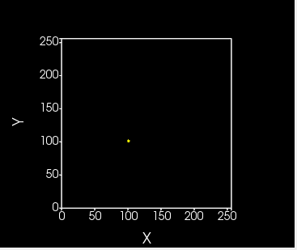
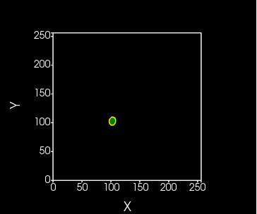
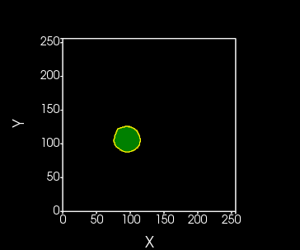
Implementing Cell Growth
Cell is gradually adjusting its volume in such a way that it is always close to target volume

Slide 27
Mitosis
CellGrowth2.cc3d
Once cell starts growing it makes sense to divide the cell once it reaches doubling volume
self.parent_cell
Before mitosis we have single object that represents cell
self.child_cell
self.parent_cell represents CC3D cell object that exist before mitosis takes place
self.child_cell represents new CC3D cell object that gets created during mitosis
In biology we talk about two daughter cells. However in simulation it is very convenient to use parent, child terminology so that we can copy cell properties from cell that existed before mitosis to newly created cell object

Slide 28
Code Highlights - CellGrowth2.cc3d
class CellGrowth2Steppable(SteppableBasePy): def __init__(self, frequency=1): SteppableBasePy.__init__(self, frequency) def start(self): cell = self.new_cell(self.TUMORPROLIFERATING) self.cell_field[100:102, 100:102, 0] = cell cell.targetVolume = 25 cell.lambdaVolume = 5.0 def step(self, mcs): for cell in self.cell_list: if cell.type in [self.TUMORPROLIFERATING]: cell.targetVolume += 0.2
class MitosisSteppable(MitosisSteppableBase): def __init__(self, frequency=1): MitosisSteppableBase.__init__(self, frequency) def step(self, mcs): cells_to_divide = [] for cell in self.cell_list: if cell.volume > 50: cells_to_divide.append(cell) for cell in cells_to_divide: self.divide_cell_random_orientation(cell) def update_attributes(self): # reducing parent target volume self.parent_cell.targetVolume /= 2.0 self.clone_parent_2_child() if self.parent_cell.type == self.TUMORPROLIFERATING: self.child_cell.type = self.TUMOR else: self.child_cell.type = self.TUMORPROLIFERATING
from cc3d import CompuCellSetup from CellGrowth2Steppables import CellGrowth2Steppable from CellGrowth2Steppables import MitosisSteppable CompuCellSetup.register_steppable(steppable=CellGrowth2Steppable(frequency=1)) CompuCellSetup.register_steppable(steppable=MitosisSteppable(frequency=1)) CompuCellSetup.run()

Slide 29
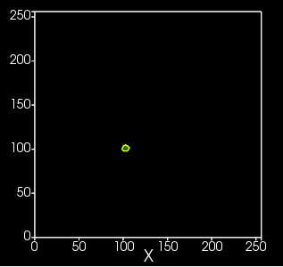
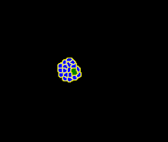
Mitosis - continued
After 2500 MCS
Why do we observe a single cell of type TumorProliferating and a lot of cells of type Tumor?
Based on the code, can you spot which cells grow and (thus divide)?
Can you modify the code so that cells of all types grow and divide?

Slide 30
Mitosis code explained
self.parent_cell
Before mitosis we have single object that represents cell
self.child_cell
class MitosisSteppable(MitosisSteppableBase): def __init__(self, frequency=1): MitosisSteppableBase.__init__(self, frequency) def step(self, mcs): cells_to_divide = [] for cell in self.cell_list: if cell.volume > 50: cells_to_divide.append(cell) for cell in cells_to_divide: self.divide_cell_random_orientation(cell) def update_attributes(self): # reducing parent target volume self.parent_cell.targetVolume /= 2.0 self.clone_parent_2_child() if self.parent_cell.type == self.TUMORPROLIFERATING: self.child_cell.type = self.TUMOR else: self.child_cell.type = self.TUMORPROLIFERATING
update_attributes function gets called immediately after new cell is created here
update_attributes function is a right place to initialize properties of the newly created cell and adjust properties of self.parent_cell

Slide 31
Contact inhibition of proliferation
ContactInhibitionOfProliferation.cc3d
When We can build a simple model where we make cell growth rate pressure dependent. When pressure inside the cell - defined as targetVolume – volume, grows the cell growth rate gets smaller
class CellGrowthSteppable(SteppableBasePy): def __init__(self, frequency=1): SteppableBasePy.__init__(self, frequency) def start(self): cell = self.new_cell(self.TUMORPROLIFERATING) self.cell_field[100:102, 100:102, 0] = cell cell.targetVolume = 25 cell.lambdaVolume = 5.0 def step(self, mcs): for cell in self.cell_list: if cell.type in [self.TUMORPROLIFERATING, self.TUMOR]: delta = max(0.0, 0.2 - 0.05*(cell.targetVolume - cell.volume)) cell.targetVolume += delta
Simple implementation of contect inhibition of proliferation

Slide 32
Code highlights - ContactInhibitionOfProliferation.cc3d
class MitosisReadyPlotterSteppable(SteppableBasePy): def __init__(self, frequency=1): SteppableBasePy.__init__(self, frequency) self.create_scalar_field_cell_level_py("MitosisReadyCells") def step(self, mcs): field = self.field.MitosisReadyCells field.clear() for cell in self.cell_list: if cell.volume > 50: field[cell] = 100 print('adding cell ', cell.id) else: field[cell] = 1
from cc3d import CompuCellSetup from ContactInhibitionOfProliferationSteppables import CellGrowthSteppable from ContactInhibitionOfProliferationSteppables import MitosisSteppable from ContactInhibitionOfProliferationSteppables import MitosisReadyPlotterSteppable CompuCellSetup.register_steppable(steppable=CellGrowthSteppable(frequency=1)) # it is essential to register plotter before Mitosis otherwise we will never see which cell was ready for mitosis CompuCellSetup.register_steppable(steppable=MitosisReadyPlotterSteppable(frequency=1)) CompuCellSetup.register_steppable(steppable=MitosisSteppable(frequency=1)) CompuCellSetup.run()

Slide 33
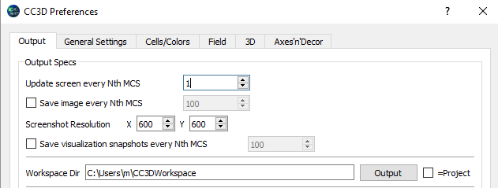
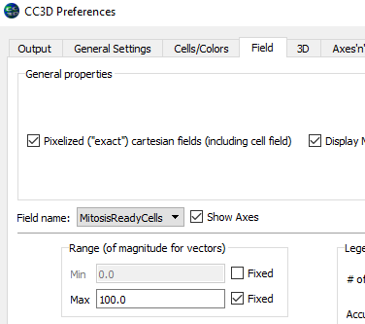
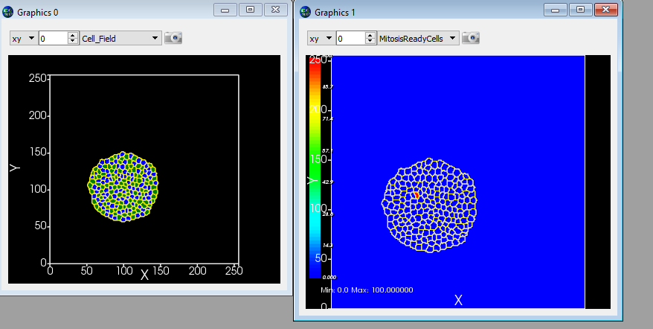
MitosisReadyPlotter – Player Settings
To observe mitosis ready plotter output set screen update frequency to 1 once there is enough cells to see the effect
Set fixed value of 100 for MitosisReadyCell field
Cell about to divide

Slide 34
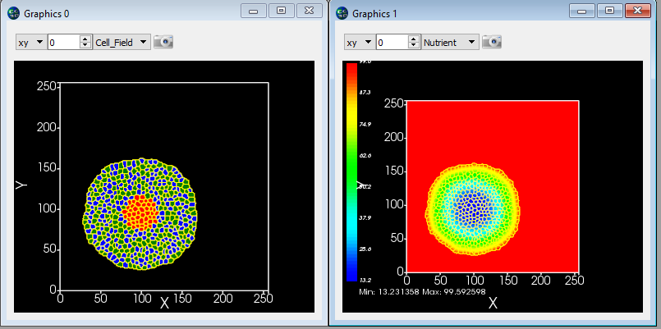
Putting it all together – Avascular Tumor Simulation
AvascularTumor.cc3d
So far we have learned the following CC3D concepts and techniques:
How to use contact energy and volume constraint to control cell shape
How to grow cells
How to divide cells
How to add diffusive field
How to change cell type
Let’s combine those techniques together and build a simplified simulation of avascular tumor.
We will use 3 cell types ,Tumor, TumorProliferating and Necrotic
We will make cell growth depend on level of nutrients and on cell pressure (contact inhibition of proliferation)
Cells turn necrotic once the level of nutrients falls below critical threshold. Necrotic cells do not grow or divide
Tumor or TumorProliferating cells
Necrotic cells

Slide 35
Code highlights - AvascularTumor.cc3d
from cc3d.core.PySteppables import * def ir(x): return int(round(x)) class AvascularTumorSteppable(SteppableBasePy): def start(self): cell = self.new_cell(self.TUMORPROLIFERATING) self.cell_field[100:102, 100:102, 0] = cell cell.targetVolume = 25 cell.lambdaVolume = 5.0 def step(self, mcs): nutrient_field = self.field.Nutrient for cell in self.cell_list: x_com = ir(cell.xCOM) y_com = ir(cell.yCOM) z_com = ir(cell.zCOM) nutrient_level = nutrient_field[x_com, y_com, z_com] if cell.type in [self.TUMORPROLIFERATING, self.TUMOR]: nutrient_based_growth_component = min(0.2, 0.01 * nutrient_level) delta = max(0.0, nutrient_based_growth_component - 0.05 * (cell.targetVolume - cell.volume)) cell.targetVolume += delta if len(self.cell_list) > 200:
for cell in self.cell_list: x_com = ir(cell.xCOM) y_com = ir(cell.yCOM) z_com = ir(cell.zCOM) nutrient_level = nutrient_field[x_com, y_com, z_com] if nutrient_level < 20: cell.type = self.NECROTIC
Convenience function to round COM coordinate to nearest integer
Nutrient-based contribution to growth rate
Pressure dependent growth rate
Tumor-> necrotic transition

Slide 36
Building 3D Vascular Tumor simulation
While we are not going to go through this exercise in this introductory session it is worth mentioning that building
The simulation presented below does not take that much more coding that we have already done so far.
from .TumorVasc3DSteppables import VolumeParamSteppable from .TumorVasc3DSteppables import MitosisSteppable import cc3d.CompuCellSetup as CompuCellSetup vol_steppable = VolumeParamSteppable(frequency=1) vol_steppable.set_params(1, 5, 1) CompuCellSetup.register_steppable(steppable=vol_steppable) doublingVolumeDict = {1: 54, 2: 54, 4: 80, 6: 80} mitosis_steppable = MitosisSteppable(frequency=1) mitosis_steppable.set_params(doublingVolumeDict=doublingVolumeDict) CompuCellSetup.register_steppable(steppable=mitosis_steppable) CompuCellSetup.run()
The simulation uses the same mechanisms that we have covered so far

Slide 37
def step(self, mcs): field_neo_vasc = self.field.VEGF2 field_malig = self.field.Oxygen for cell in self.cellList: # Inactive neovascular differentiation if cell.type == 6: total_area = 0 x = int(round(cell.xCM / max(float(cell.volume), 0.001))) y = int(round(cell.yCM / max(float(cell.volume), 0.001))) z = int(round(cell.zCM / max(float(cell.volume), 0.001))) concentration = field_neo_vasc[x, y, z] if concentration > 0.5: neighbor_list = self.get_cell_neighbor_data_list(cell) for neighbor, common_surface_area in neighbor_list: if neighbor: if neighbor.type in [5, 6, 7]: total_area += common_surface_area print(cell.type, total_area) if total_area < 70: # Growth rate equation cell.targetVolume += 0.06 * concentration / (0.5 + concentration) cell.targetSurface += 0.15 * concentration / (0.5 + concentration) ## Active neovascular growth if cell.type == 4: total_area = 0 x = int(round(cell.xCM / max(float(cell.volume), 0.00000001))) y = int(round(cell.yCM / max(float(cell.volume), 0.00000001))) z = int(round(cell.zCM / max(float(cell.volume), 0.00000001))) concentration = field_neo_vasc[x, y, z] if concentration > 0.5: neighbor_list = self.get_cell_neighbor_data_list(cell) for neighbor, common_surface_area in neighbor_list: if neighbor: if neighbor.type in [5, 6, 7]: total_area += common_surface_area if total_area < 50: # Growth rate equation cell.targetVolume += 0.06 * concentration / (0.5 + concentration) cell.targetSurface += 0.15 * concentration / (0.5 + concentration)
# Malignat and Hypoxic Cells growth if cell.type == 1 or cell.type == 2: x = int(round(cell.xCM / max(float(cell.volume), 0.001))) y = int(round(cell.yCM / max(float(cell.volume), 0.001))) z = int(round(cell.zCM / max(float(cell.volume), 0.001))) concentration2 = field_malig[x, y, z] # switch to Hypoxic cell type if concentration2 < self.nutrient_thresh and mcs > 100: cell.type = 2 # switch to Necrotic cell type if concentration2 < self.necrotic_thresh and mcs > 100: cell.type = 3 # set growth rate equation if mcs > 100: cell.targetVolume += 0.04 * concentration2 / (10 + concentration2) cell.targetSurface += 0.12 * concentration2 / (10 + concentration2) # Hypoxic Cells if cell.type == 2: x = int(round(cell.xCM / max(float(cell.volume), 0.001))) y = int(round(cell.yCM / max(float(cell.volume), 0.001))) z = int(round(cell.zCM / max(float(cell.volume), 0.001))) concentration3 = field_malig[x, y, z] # switch to Necrotic cell type if concentration3 < self.necrotic_thresh and mcs > 100: cell.type = 3 # switch to Normal cell type if concentration3 > self.nutrient_thresh: cell.type = 1 # Necrotic Cells if cell.type == 3: # set growth rate equation cell.targetVolume -= 0.5 cell.lambdaSurface = 0

