Slide 1
CC3D Workshop 4.1: Delta-Notch Models
Julio M. Belmonte
NC State University
Raleigh, NC
Screensharing and microphones have been disabled for participants in the main session—they are available in breakout rooms
Please submit questions/concerns/suggestions via zoom chat
User support will be available in zoom breakout rooms
Workshop will be live-streamed, recorded and distributed
Make sure you save the zoom link after registering so you do not have to re-register
Please take the time now to be sure you have a working nanoHUB account and to download and install CompuCell3D to your desktop if you are planning to run it locally
Please also join the workshop slack channel at https://join.slack.com/t/multiscalemod-ags3330/shared_invite/zt-g0up1lz7-z5XGFC73UZk1j3BPeW7RVA
Funding Sources: NIH U24 EB028887, NIH R01 GM122424, NIH R01 GM123032, NIH P41 GM109824, NSF 1720625 and nanoHUB

Slide 2
Topics
Multiscale modelling in CC3D
Intercell contact signaling (Delta-Notch)
Building a Delta-Notch model in CC3D
SBML Models
Exercises
Building a simple Colonic Crypt model in CC3D

Slide 3
CPM modeling Scope
Cellular behaviors:
Location
Volume
Shape
Movement
Adhesion
Differentiation
Polarization
Mitosis
Death
Etc…

Slide 4
Subcellular modelling
Biochemical Kinetics:
Cell-Cycle
Circadian rhythms
Cardiac rhythms
cAMP oscillations
Delta-Notch patterning
WNT pathway
FGF pathway
Etc…

Slide 5
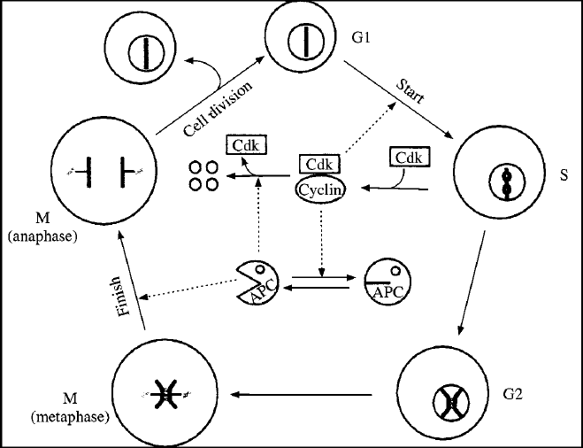
Subcellular modelling
Biochemical Kinetics:
Cell-Cycle
Circadian rhythms
Cardiac rhythms
cAMP oscillations
Delta-Notch patterning
WNT pathway
FGF pathway
Etc…

Slide 6
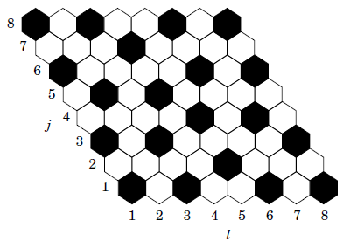
Subcellular modelling
Biochemical Kinetics:
Cell-Cycle
Circadian rhythms
Cardiac rhythms
cAMP oscillations
Delta-Notch patterning
WNT pathway
FGF pathway
Etc…

Slide 7
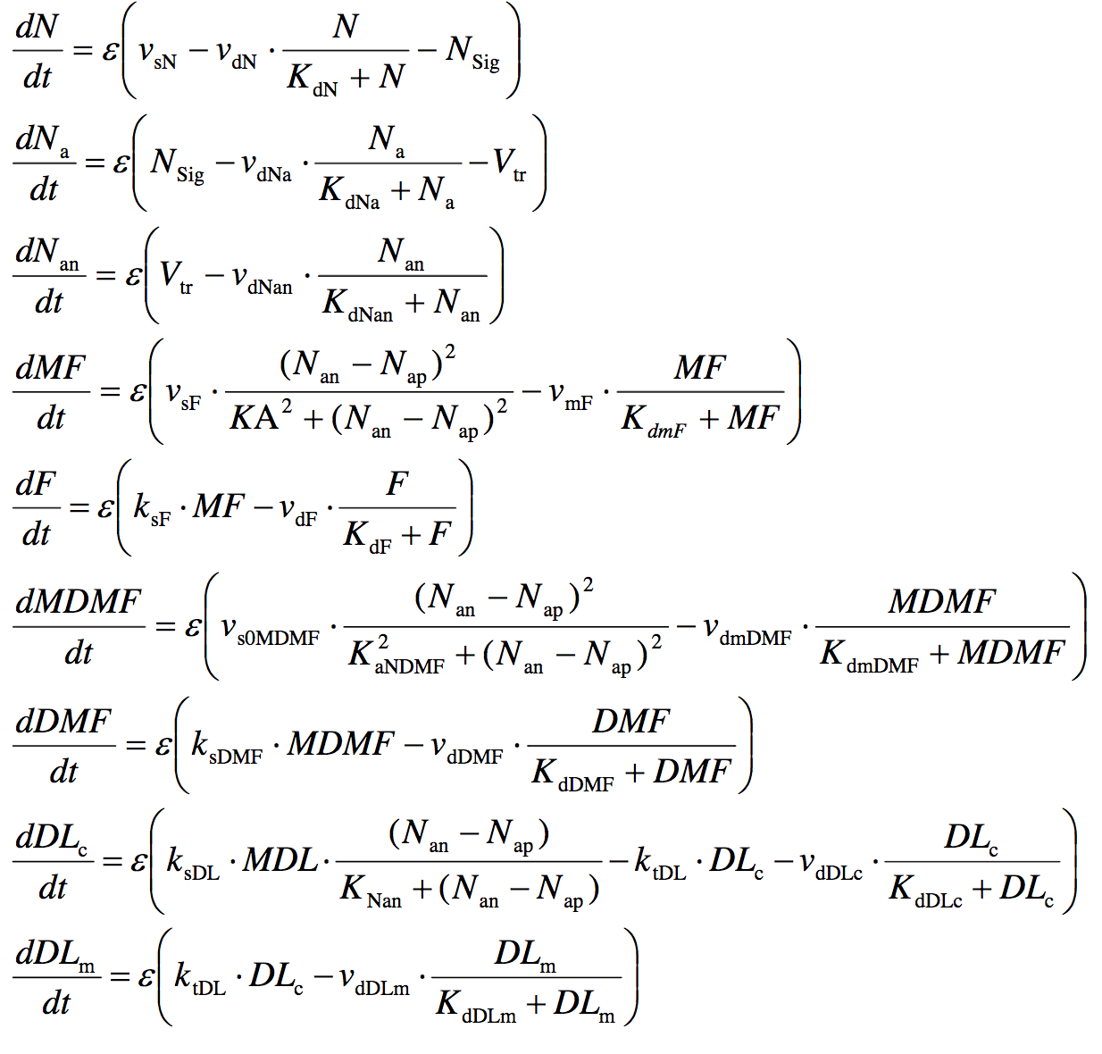
Multiscale model Somitogenesis
Hester, Belmonte et al. PLoS Comput Biol 2012

Slide 8
How to add RK models to CC3D
Developer software
(Tellurium, Copasi, etc)
SBML file
(Systems Biology Markup Language)
Simulation software
(CompuCell3D)

Slide 9
How to add RK models to CC3D
Developer software
(Tellurium, Copasi, etc)
SBML file
(Systems Biology Markup Language)
Simulation software
(CompuCell3D)
Antimony specification
(Twedit++)
Simulation software
(CompuCell3D)

Slide 10
How to add RK models to CC3D
Developer software
(Tellurium, Copasi, etc)
SBML file
(Systems Biology Markup Language)
Simulation software
(CompuCell3D)
Antimony specification
(Twedit++)
Simulation software
(CompuCell3D)

Slide 11
CC3D+RK
CC3D:
RK
Degradation
E2
Activator
E1
S
E3
Metabolism
Gene Regulation
Protein Regulation

Slide 12
CC3D+RK
CC3D cells:
RK
Degradation
E2
Activator
E1
S
E3
Metabolism
Gene Regulation
Protein Regulation

Slide 13
Integration with CC3D – 1 cell
CC3D:
RK
Degradation
E2
Activator
E1
S
E3
Metabolism
Gene Regulation
Protein Regulation

Slide 14
Integration with CC3D – cell type
CC3D:
RK
Degradation
E2
Activator
E1
S
E3
Metabolism
Gene Regulation
Protein Regulation

Slide 15
Integration with CC3D – External (PBPK)
CC3D:
RK
Degradation
E2
Activator
E1
S
E3
Metabolism
Gene Regulation
Protein Regulation

Slide 16
# Define a RK model
String = ‘‘‘ J: A -> B; k*A*B; ’’’ # Antimony model specification
def start(self):
# Other definitions
Name = ‘MODEL_NAME’ # Name of the model
Step = <timeStep> # Time step of integration
# Add RK model to one cell
self.add_antimony_to_cell(model_string=String, model_name=Name, cell=cell, step_size=Step)
# Add RK model to cell ids
self.add_antimony_to_cell_ids(model_string=String, model_name=Name, ids=[…], step_size=Step)
# Add RK model to cell types
self. add_antimony_to_cell_types(model_string=String, model_name=Name, cell_types=[…], step_size=Step)
# Add free floating SBML
self.add_free_floating_antimony(model_string=String, model_name=Name, step_size=Step)
def step(self,mcs):
# Iterate the model (run it for the time step specified on the load command)
self.timestep_sbml()
# Get the parameter value or molecular concentration from a cell
for cell in self.cell_list:
variable = cell.sbml.MODEL_NAME['<molecule/parameter_name>']
# Set a new parameter value or molecular concentration value for a cell
cell.sbml.MODEL_NAME['<molecule/parameter_name>’] = NEW_VALUE
# Copy RK model from one cell to another
self.copy_sbml_simulators(from_cell=cell1, to_cell=cell2)
self.copy_sbml_simulators(from_cell=cell1, to_cell=cell2), sbml_names=[…])
# Delete a RK model from a cell
self.delete_sbml_from_cell(model_name=‘MODEL_NAME’,_cell=cell)

Slide 17
Example – Delta-Notch Patterning
Human intestinal crypt cup
Chen et al. MSB (2017)
Zebrafish photoreceptors
Bernardos et al. Dev Biol (2005)
Hair cells of Drosophila inner ear
Eddison et al. PNAS (2000)

Slide 18
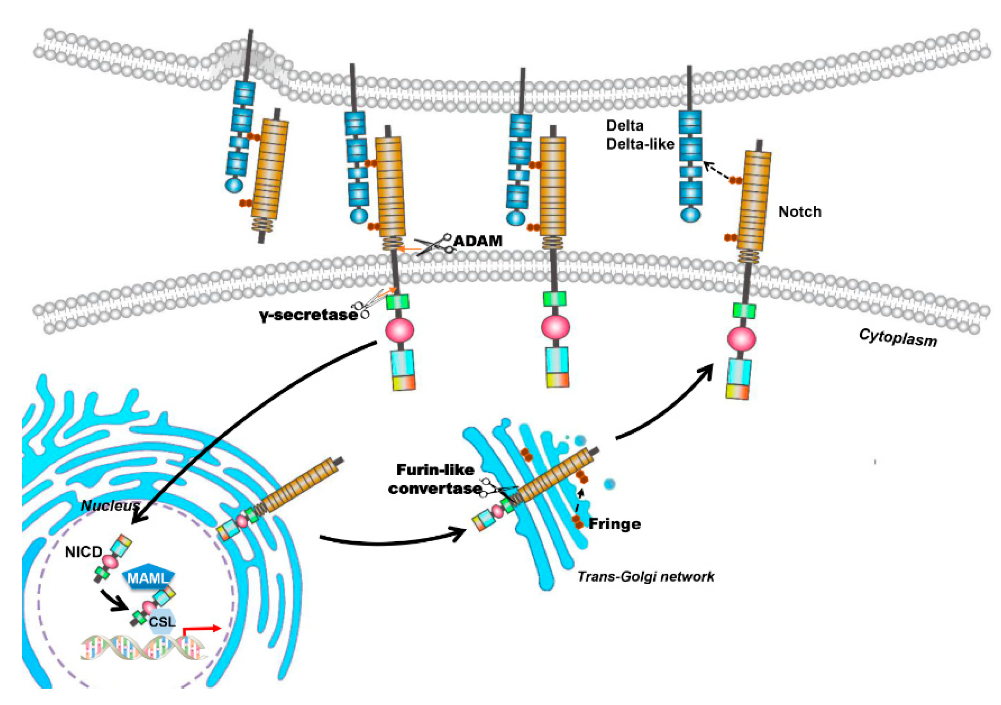
Example – Delta-Notch Patterning

Slide 19
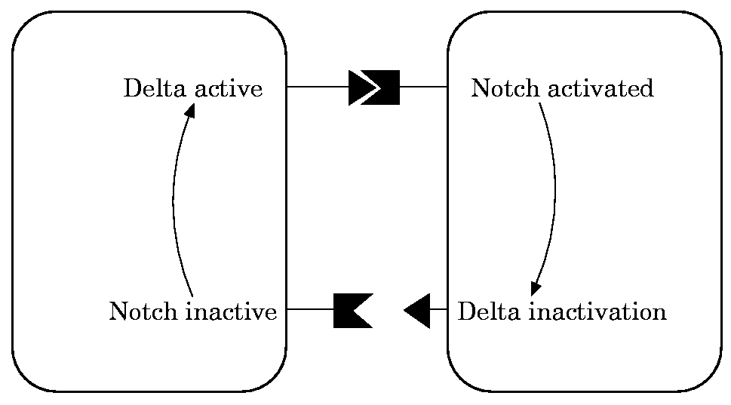
Example – Delta-Notch Patterning
We will use the model published by Collier et al. in 1996:

Slide 20
Example – Delta-Notch Patterning
We will use the model published by Collier et al. in 1996:
N : Notch
D : Delta
D: average Delta from neighbors

Slide 21
Example – Delta-Notch Patterning
In this model, when a cell receives high levels of Delta from neighbors its Notch level becomes downregulated.
This leads to the high/low Notch patterning shown by their simulations on a fixed hexagonal lattice:

Slide 22
Example – Delta-Notch Patterning
Create space filled with cells (uniform initializer)
Type model in Antimony
Add to all cells
At each MCS:
Loop over each cell
Loop over cell neighbors
Calculate average D from neighbors
Set new value of <D> to cell
Visualize patterning

Slide 23
Example – Delta-Notch Patterning
When we run this model we can see that first the Notch values go down before the pattern emerges:

Slide 24
Exercises – Delta-Notch Patterning
Increase the level of membrane fluctuations (temperature) and check how the pattern changes
Make delta signaling in proportion to fraction of shared membrane area
Add long range of DN signaling (count neighbor of neighbors)
Explore different cell arrangements

Slide 25
How to add RK models to CC3D
Developer software
(Tellurium, Copasi, etc)
SBML file
(Systems Biology Markup Language)
Simulation software
(CompuCell3D)
Antimony specification
(Twedit++)
Simulation software
(CompuCell3D)

Slide 26
SBML – Systems Biology Markup Language
Not a software!
Machine-readable format for representing subcellular models
Standard for storage and exchange of models
Implementation agnostic

Slide 27
SBML
$$S_{1}\underset{→}{{ S}_{1}∙k }{2∙S}_{2}$$
Initial conditions:
Parameters:

Slide 28
SBML
<?xml version="1.0" encoding="UTF-8"?>
<sbml xmlns = "http://www.sbml.org/sbml/level2" level = "2" version = "1">
<model id = "cell">
<listOfCompartments>
<compartment id = "compartment" size = "1"/>
</listOfCompartments>
<listOfSpecies>
<species id = "S1" boundaryCondition = "false" initialConcentration = “5.0" compartment = "compartment"/>
<species id = "S2" boundaryCondition = "false" initialConcentration = “0.0" compartment = "compartment"/>
</listOfSpecies>
<listOfParameters>
<parameter id = "k1" value = "0.1"/>
</listOfParameters>
<listOfReactions>
<reaction id = "_J1" reversible = "false">
<listOfReactants>
<speciesReference species = "S1" stoichiometry = "1"/>
</listOfReactants>
<listOfProducts>
<speciesReference species = "S2" stoichiometry = “2"/>
</listOfProducts>
<kineticLaw>
<math xmlns = "http://www.w3.org/1998/Math/MathML">
<apply>
<times/>
<ci>
k1
</ci>
<ci>
S1
</ci>
</apply>
</math>
</kineticLaw>
</reaction>
</listOfReactions>
</model>
</sbml>
$$S_{1}\underset{→}{{ S}_{1}∙k }{2∙S}_{2}$$

Slide 29
def start(self):
# Define a SBML model
Path = ‘Simulation/MODEL.XML’ # Path where the model is stored
Name = ‘MODEL_NAME’ # Name of the model
Step = <timeStep> # Time step of integration
# Add SBML model to one cell
self.add_sbml_to_cell(model_file=Path, model_name=Name, cell=cell, step_size=Step)
# Add SBML model to cell ids
self.add_SBML_to_cell_ids(model_file=Path, model_name=Name, ids=[…], step_size=Step)
# Add SBML model to cell types
self.add_SBML_to_cell_types(model_file=Path, model_name=Name, cell_types=[…], step_size=Step)
# Add free floating SBML
self.add_free_floating_sbml(model_file=Path, model_name=Name, step_size=Step)
def step(self,mcs):
# Iterate the model (run it for the time step specified on the load command)
self.timestep_sbml()
# Get the parameter value or molecular concentration from a cell
for cell in self.cell_list:
variable = cell.sbml.MODEL_NAME['<molecule/parameter_name>']
# Set a new parameter value or molecular concentration value for a cell
cell.sbml.MODEL_NAME['<molecule/parameter_name>’] = NEW_VALUE
# Copy SBML model from one cell to another
self.copy_sbml_simulators(from_cell=cell1, to_cell=cell2)
self.copy_sbml_simulators(from_cell=cell1, to_cell=cell2), sbml_names=[…])
# Delete a SBML model from a cell
self.delete_sbml_from_cell(model_name=‘MODEL_NAME’,_cell=cell)

Slide 30
Exercises – Delta-Notch Patterning 2
Starting with 2 cells, growth tissue while patterning it with DN
Starting with 2 cells, repeat simulation, but now only Notch-rich cells growths and divides
Repeat simulation again, but this time, turn off the DN pattern for all cells away from the center of the lattice by 3 cell diameters

Slide 31
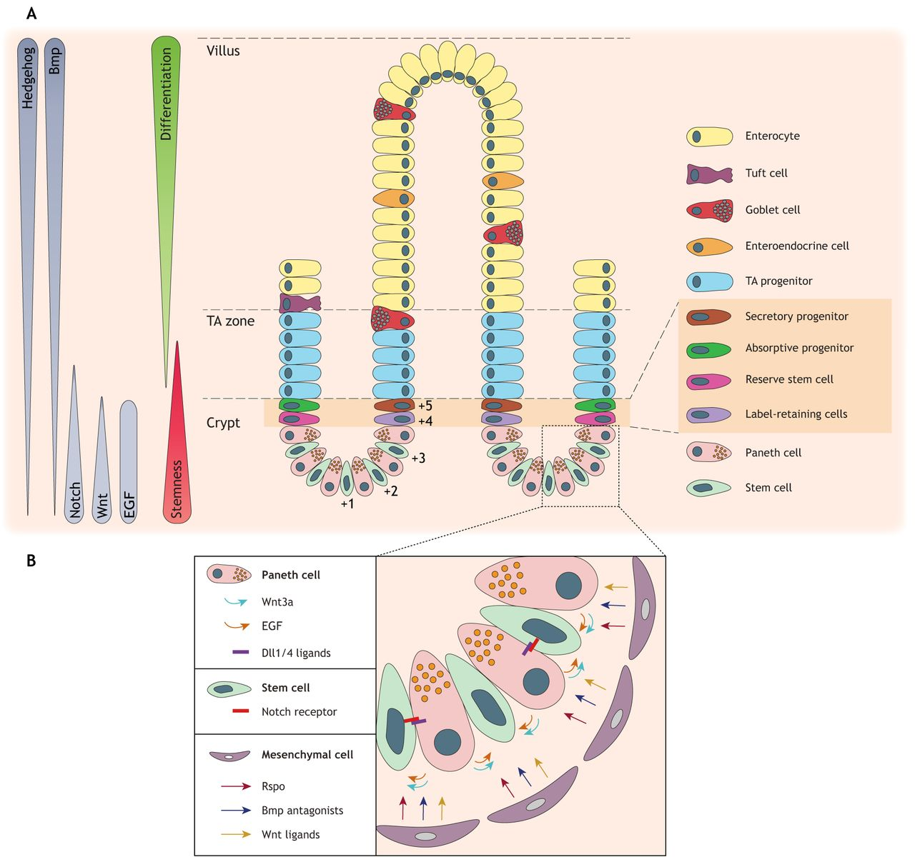
Mini Project – Colonic crypt
What you have done last time is very close to a a toy model of the colonic crypt dynamics in intestinal layer.
Baulies, Angelis & Li
Development (2020)
Human intestinal crypt cup
Chen et al. MSB (2017)

Slide 32
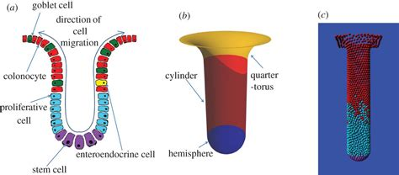
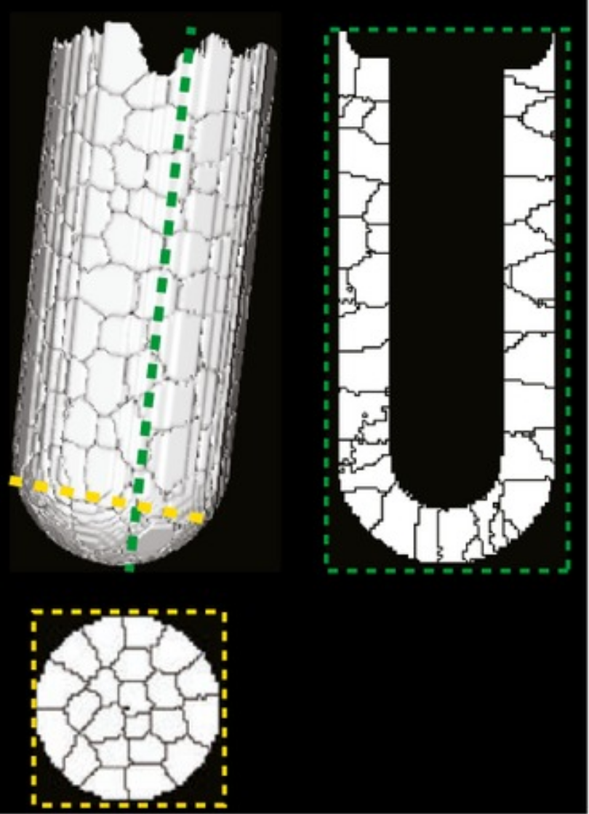
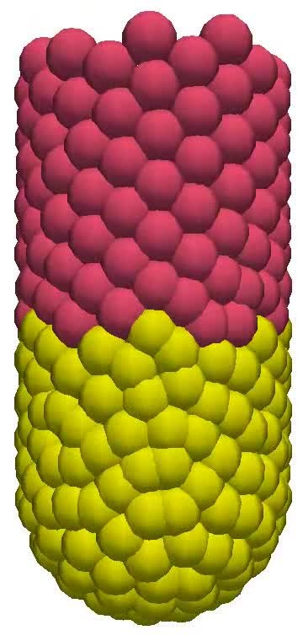
Mini Project – Colonic crypt
The intestinal crypt is a 3D structure
Human intestinal crypt cup
Chen et al. MSB (2017)

Slide 33
Mini Project – Colonic crypt
Rough model of intestinal crypt
Remove cells
Periodic boundary
Unroll cylinder
DN signaling
Notch+ cells proliferate

