Slide 1
CC3D Workshop 2.4: Implementing the Viral Infection Model in CC3D—Part 4: Cell Movement
James A. Glazier
Dept. of Intelligent Systems Engineering
and Biocomplexity Institute
Indiana University
Bloomington, IN 47408
USA
Screensharing and microphones have been disabled for participants in the main session—they are available in breakout rooms
Please submit questions/concerns/suggestions via zoom chat
User support will be available in zoom breakout rooms
Workshop will be live-streamed, recorded and distributed
Please also join the workshop slack channel at https://join.slack.com/t/multiscalemod-ags3330/shared_invite/zt-g0up1lz7-z5XGFC73UZk1j3BPeW7RVA
Funding Sources: NIH U24 EB028887, NIH R01 GM122424, NIH R01 GM123032, NIH P41 GM109824, NSF 1720625 and nanoHUB

Slide 2
Topics
Random motility modeling
Chemotaxis modeling
Exercises
Random motility in single-cell migration
Chemotaxis in single-cell migration
Controlling chemotaxis

Slide 3
Before we Begin…
For this module, you can begin from Module2_3.Version3

Slide 4

The Model… so far
$$\left\{\begin{aligned}&\frac{dT}{dt}=−βTV \\ &\frac{dI_{1}}{dt}=βTV−kI_{1} \\ &\frac{dI_{2}}{dt}=kI_{1}−dI_{2} \\ &\frac{dD}{dt}=dI_{2} \\ &\frac{dV}{dt}=pI_{2}−cV \\ &\frac{dC}{dt}=p_{C}\left(I_{1}+I_{2}\right)−c_{C}C−k_{C}C \\ &\frac{dC_{L}}{dt}=k_{C}C−c_{cl}C_{L} \\ &\frac{dE}{dt}=k_{e}E_{L}−d_{E}E \\ &\frac{dE_{L}}{dt}=p_{el}C_{L}+r_{el}C_{L}E_{L}\frac{K_{el}}{K_{el}+E_{L}}−k_{e}E_{L}\end{aligned}\right.$$
Up to this point, we have
An epithelial sheet
Viral life cycle
Inflammatory signaling
Immune cell recruitment
Motile immune cells

Slide 5
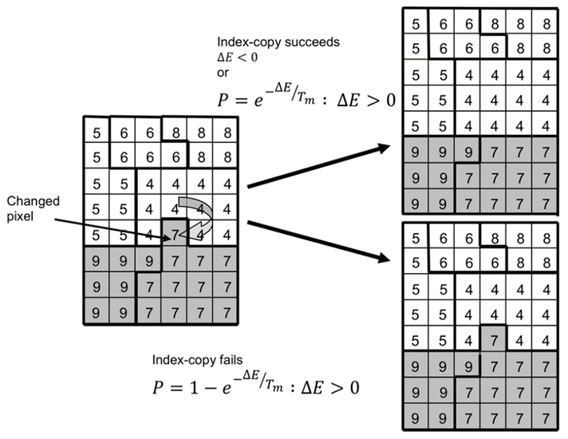
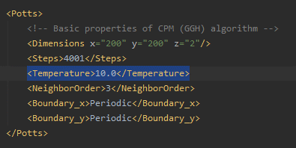
Basics of Random Motility
CC3D cellular dynamics are intrinsically stochastic
i.e., the Cellular Potts model (CPM)
i.e., the Glazier-Graner-Hogeweg (GGH) model
Cellular dynamics occur by surface fluctuations at contact interfaces
One parameter controls the frequency of fluctuations
In GlazierModel.xml, <Potts> element: <Temperature>
Higher “Temperature” = more surface fluctuations
Possible outcomes of a copy attemptt.
(Andasari, PLoS One, 2012).

Slide 6
Setup for Experiments with Single Cells
To study migration behaviors, let’s initialize simulations with a single immune cell
In GlazierModelSteppables.py
At the end of steppable start(), add a single immune cell at the center of the domain
Store a reference to the cell: self.test_cell
Store its initial center of mass coordinates
(self.init_x, self.init_y)

Slide 7
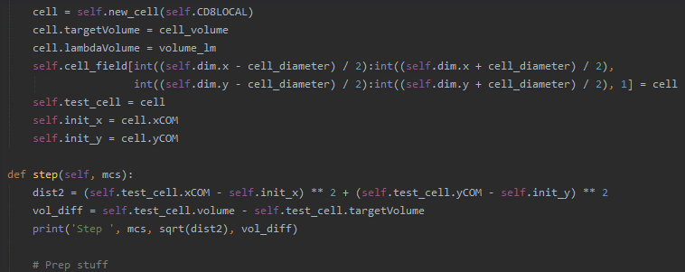
Setup for Experiments with Single Cells
Let’s take some measurements
At beginning of steppable step()
Measure the cell’s distance from its starting point
Measure the difference between the cell’s current and target volumes
Print the step and both measurements (sorry nanoHUB users!)

Slide 8
Exercise 2.4.1: Random Motility
Let’s vary randomness of the simulation
In GlazierModel.xml
Set “Temperature” to 1
Run simulation for 100 steps and observed printed measurements
How does the cell’s volume fluctuate?
Does the cell move much?
Compare to when “Temperature” is 10 and 20
How do volume fluctuations change?
Does the cell move more?
Finish: set “Temperature” back to 10

Slide 9
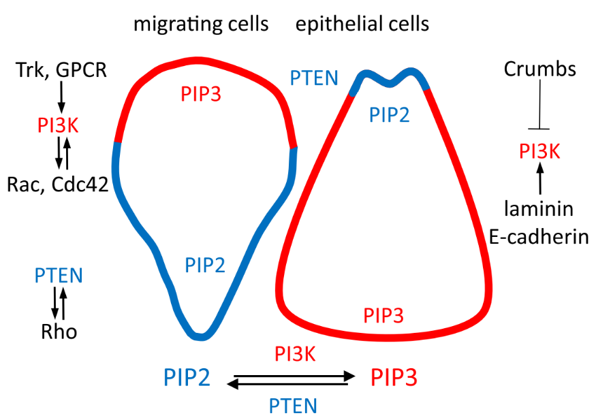
Basics of Chemotaxis Modeling
Cells move “up” or “down” chemical gradients
Up a gradient: field is a chemoattractant
Down a gradient: field is a chemorepellent
Contact-inhibited chemotaxis
Cell contacts prevent chemotaxis
Cells only chemotax into available space
Chemical field values can vary over several orders of magnitude
Cells can be smashed or torn apart by chemotactic forces
Requires normalization of gradient-based force calculations
Polarized spatial distribution of phosphatidylinositides (Mazel, Protoplasma, 2017).
Linear Chemotactic Force
$$\vec{F}=λ_{c}∇c$$
Logarithmic Chemotactic Force
$$\vec{F}=\frac{λ_{c}}{1+c}∇c$$

Slide 10
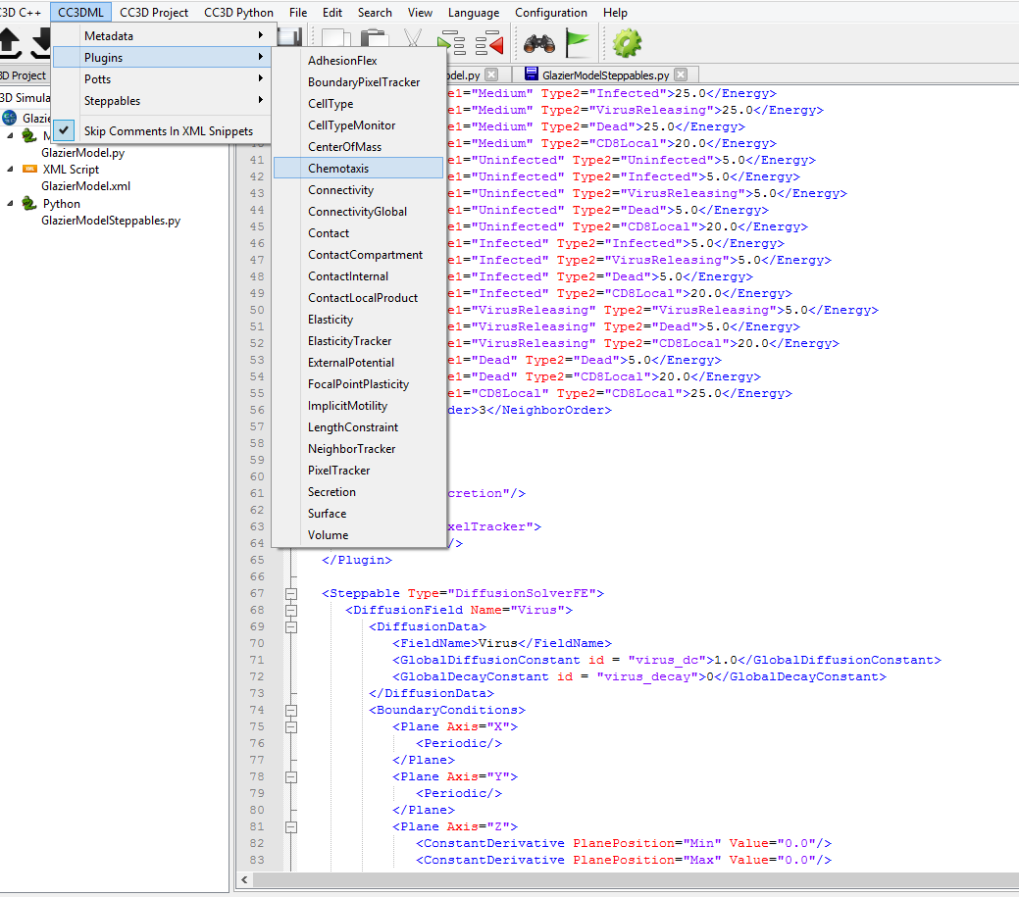
Adding Chemotaxis Plugin
In GlazierModel.xml
Place cursor on an empty line
Use Twedit code-generator: CC3DML->Plugins->Chemotaxis

Slide 11
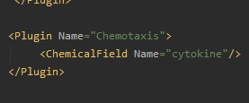
Configuring Chemotaxis Plugin
Generated code shows lots of options for automatic calculations
Adds and assigns chemotaxis data automatically
We’ll manage chemotaxis in Python
Allows chemotaxis data per cell
Caution: No automatic chemotaxis data!
Simple configuration:
<ChemicalField Name=“cytokine”/>

Slide 12
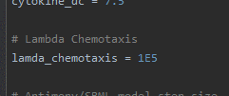

Adding a Chemotaxis Model Input
In GlazierModelSteppables.py
Add model input for strength of chemotaxis
lambda_chemotaxis = 1E5
Chemotactic Force
$$\vec{F}=\frac{λ_{c}}{1+c}∇c$$

Slide 13
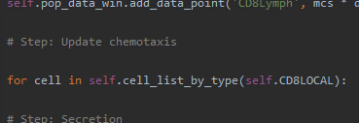
Starting Chemotaxis Implementation
Need to update chemotaxis by local cytokine for each immune cell
In steppable step(), between immune recruitment and secretion
Add a loop over all immune cells
Chemotactic Force
$$\vec{F}=\frac{λ_{c}}{1+c}∇c$$

Slide 14
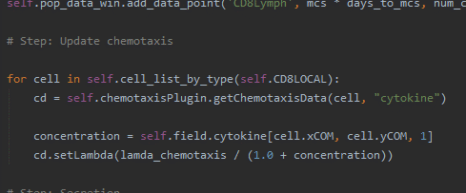
Updating Chemotaxis
Get a reference to a cell’s chemotaxis data for cytokine
self.chemotaxisPlugin.getChemotaxisData(cell, “cytokine”)
Get the cytokine level at the cell’s center of mass
self.field[cell.xCOM, cell.yCOM, 1]
Update the effective strength of chemotaxis
cd.setLambda(lambda_chemotaxis / (1 + concentration))

Slide 15
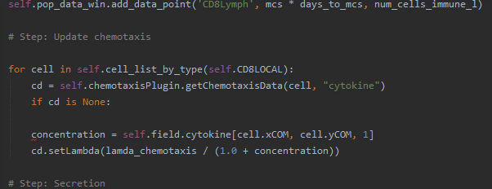
Checking Chemotaxis Data
Immune recruitment adds immune cells
Chemotaxis data is not added automatically
Need to check for cells that need chemotaxis data
Check: if getChemotaxisData() data returns None, then the cell needs chemotaxis data
Start an if block: test for if chemotaxis data is None

Slide 16
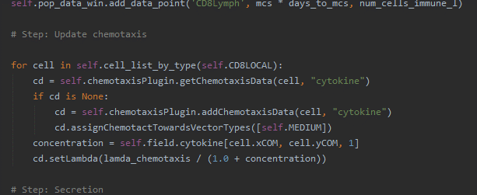
Adding Chemotaxis Data on-the-fly
Two model features need set when adding chemotaxis data
The cell chemotaxes along cytokine gradients
self.chemotaxisPlugin.addChemotaxisData()
The cell chemotaxes towards the medium
assignChemotactTowardsVectorTypes()

Slide 17
Exercise 2.4.2: Single Cell Chemotaxis
Simulate with initial single immune cell and observed printed measurements
Does the cell move more?
Set lambda_chemotaxis = 1E7
Does the cell move even more?

Slide 18
Exercise 2.4.3: Single Cell Chemotaxis
Set lambda_chemotaxis = 1E12
Simulate with initial single immune cell
Do you notice anything strange about the cell?
Based on what you observe, what can you say about using our chemotaxis equation?
How could we counteract chemotaxis that’s too strong (besides turning it down)?

Slide 19
Exercise 2.4.4: Model with Chemotaxis
Set lambda_chemotaxis back to 1E5
Remove seeding the initial single immune cell and all measurements
Run the full model with chemotaxis. Are immune cells moving differently?
Delete!

