Slide 1
CC3D Workshop 1.6: Implementing the Viral Infection Model in CC3D—Part 1: Running Tellurium in CC3D and Plotting Time Series
Josua Aponte Serrano
Dept. of Intelligent Systems Engineering
and Biocomplexity Institute
Indiana University
Bloomington, IN 47408
USA
Screensharing and microphones have been disabled for participants in the main session—they are available in breakout rooms
Please submit questions/concerns/suggestions via zoom chat
User support will be available in zoom breakout rooms
Workshop will be live-streamed, recorded and distributed
Please also join the workshop slack channel at https://join.slack.com/t/multiscalemod-ags3330/shared_invite/zt-g0up1lz7-z5XGFC73UZk1j3BPeW7RVA
Funding Sources: NIH U24 EB028887, NIH R01 GM122424, NIH R01 GM123032, NIH P41 GM109824, NSF 1720625 and nanoHUB

Slide 2
Topics
Using Twedit++ Wizard to Create a CC3D Simulation
Minimal CC3D Model Components to Specify in Wizard
Structure of a CC3D Model—CC3DML and Python Steppables
Twedit++ Code snippets
Loading an Antimony Model as a Freestanding Model in CC3D
Issue of Time Step Relation Between CC3D and Tellurium
Reading and Writing Tellurium Variables
Plotting in CC3D
Creating Plot Windows
Adding Series to Plot Windows
Adding data points to a Series
Exercise 1.6.1: Adding Additional Data Series and Plot Windows
Exercise 1.6.2: Saving Data from plots in CC3D

Slide 3
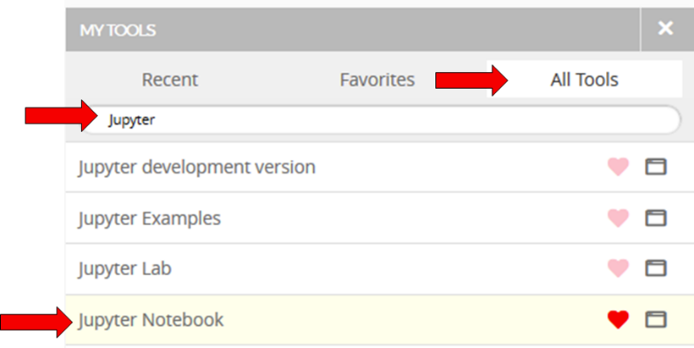
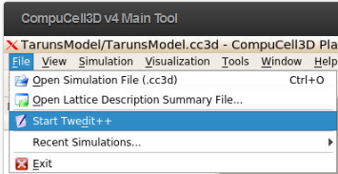
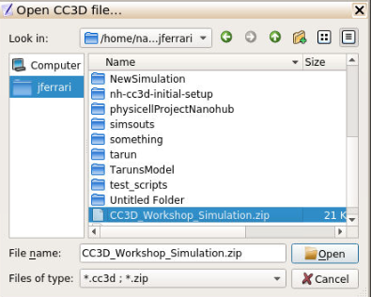
Reminder of How to Upload to nanoHUB
Go to your dashboard in NanoHub
Look for the “My Tools”, select the “All Tools” tab, search for Jupyter, and open and launch Jupyter Notebook
Before uploading a file rename it to have no spaces or special characters (only letters and underscore)
Inside Jupyter notebook click upload, select the file to upload. By default the upload will put the file in your home directory.
After selecting open the files should appear in the file list inside jupyter, you need to now click on the “upload” next to the files to confirm the upload
Open CompuCell3D v4 Main Tool on nanohub (similar steps to opening jupyter notebook)
Go to File (it’ll be under your username on the left) and select Start Twedit++
Once in Twedit select CC3D Project > Open CC3D Project
Select the project to unzip, Twedit will unzip it and open it (you can see it on the left-hand panel)

Slide 4
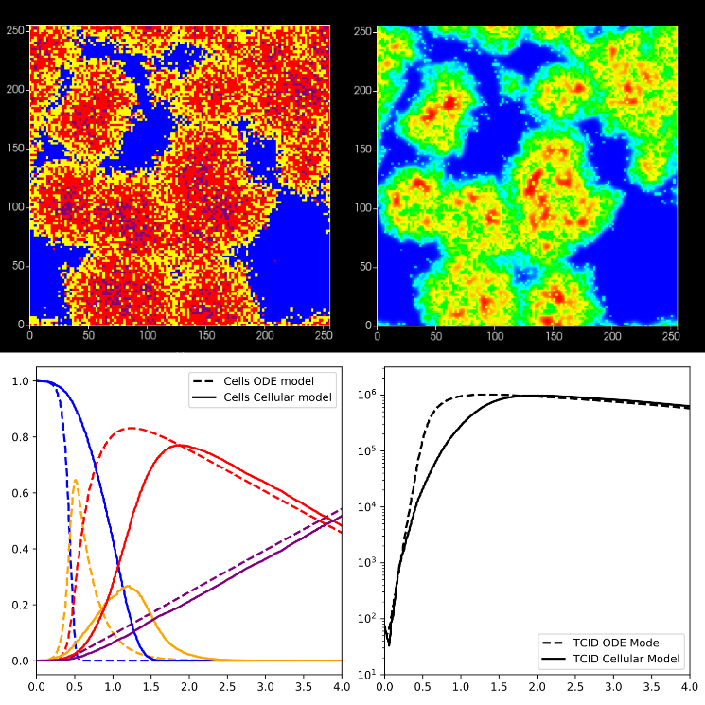
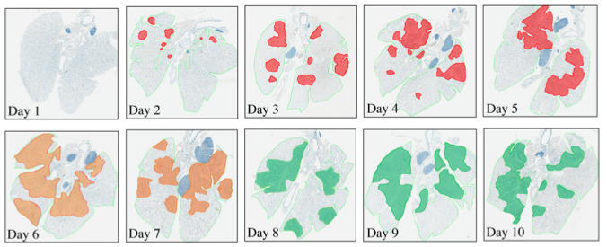
Spatializing ODE models in CC3D
ODE models are extensively to understand dynamics of wide ranges of biological systems (from ecosystems down to whole organism down to cell populations to intracellular pathways and responses)
ODE systems can be powerful predictive tools when fitted to experimental data
However, ODE do not include individual heterogeneity nor spatial resolution
For some disease, stochasticity associated with individual agents and the resulting spatiotemporal dynamics are important predictors of disease outcomes
Myers MA, Smith AP, Lane LC, Moquin DJ, Vogel P, Woolard S, Smith AM. Dynamically Linking Influenza Virus Infection with Lung Injury to Predict Disease Severity. bioRxiv. 2019 Jan 1:555276.

Slide 5
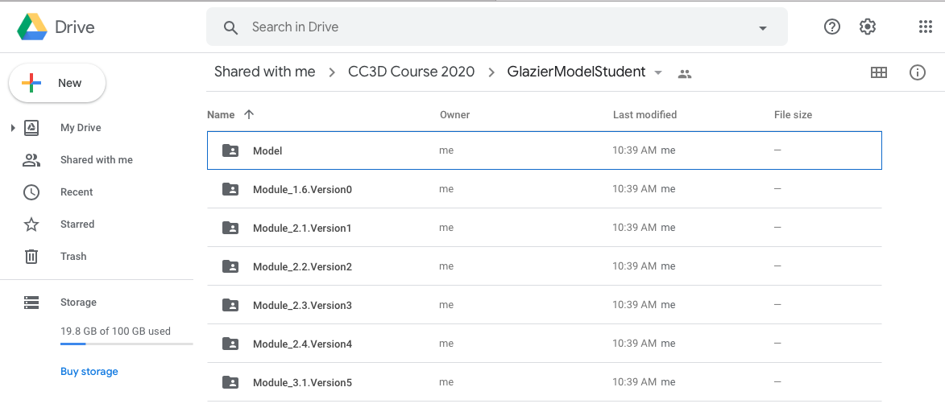
Download Simulation Scripts
Versions of the different projects we will be working during the following modules are available in Google Drive:
https://drive.google.com/drive/folders/1xzAsdpc7LK3Yhjr-Yx0-KWhHzVUIoT15?usp=sharing

Slide 6
Creating a New Simulation Using CC3D Wizard
Wizard is a code generator tool inside of Twedit++ that provides a convenient Graphical User Interface to specify new simulation templates very rapidly
Wizard allows CC3D users to specify simulation properties (lattice dimensions, boundary conditions) and model components (cells and their properties, chemical fields)
Wizard creates major simulation components with the correct syntax, but full simulations will still require editing to specify details and parameter values

Slide 7
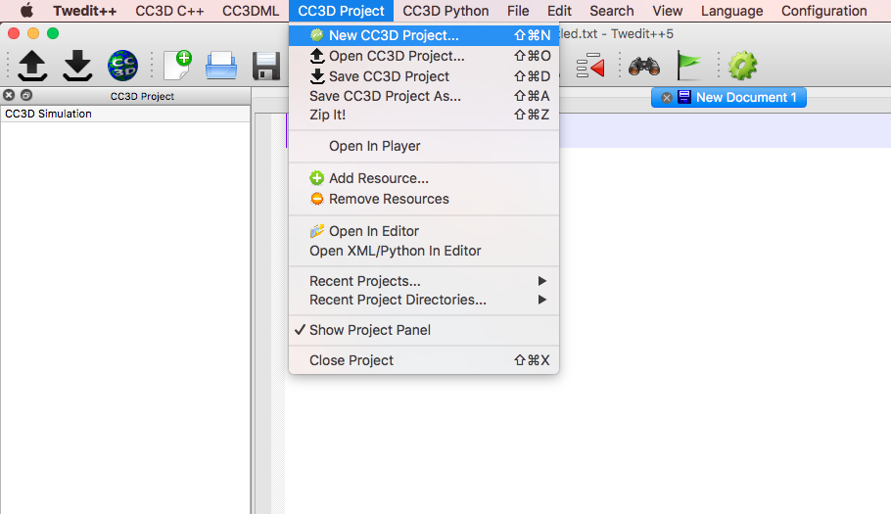
Launch Twedit++ and Use Wizard
To launch Wizard, launch Twedit: CC3D Project -> New Project

Slide 8
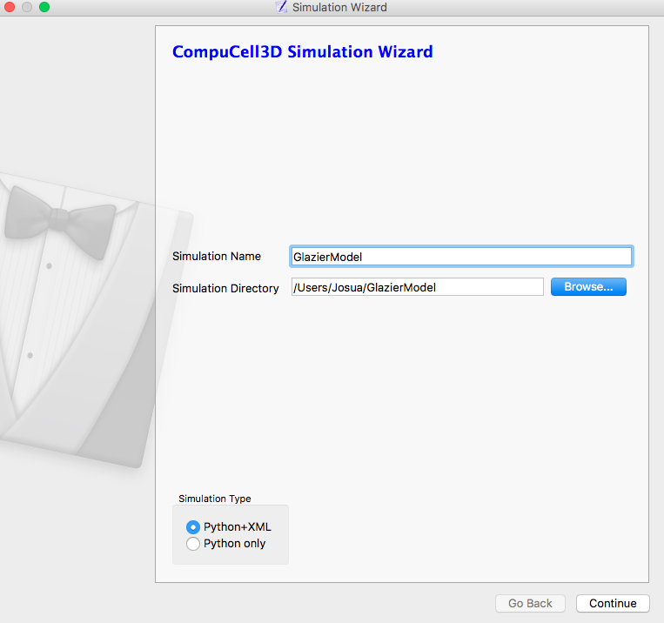
Set Project Name and Location
Choose a name for your project (Simulation Name) and a location (Simulation Directory).
Choose the Python+XML option
XML (using the CC3DML markup language) specifies static model structure (objects like lattices and chemical fields, behaviors and mechanisms including diffusion, adhesion, volumes and surface areas, chemotaxis, and initial conditions,…)
Python (programming language) allows dynamic manipulation of simulation and model properties

Slide 9
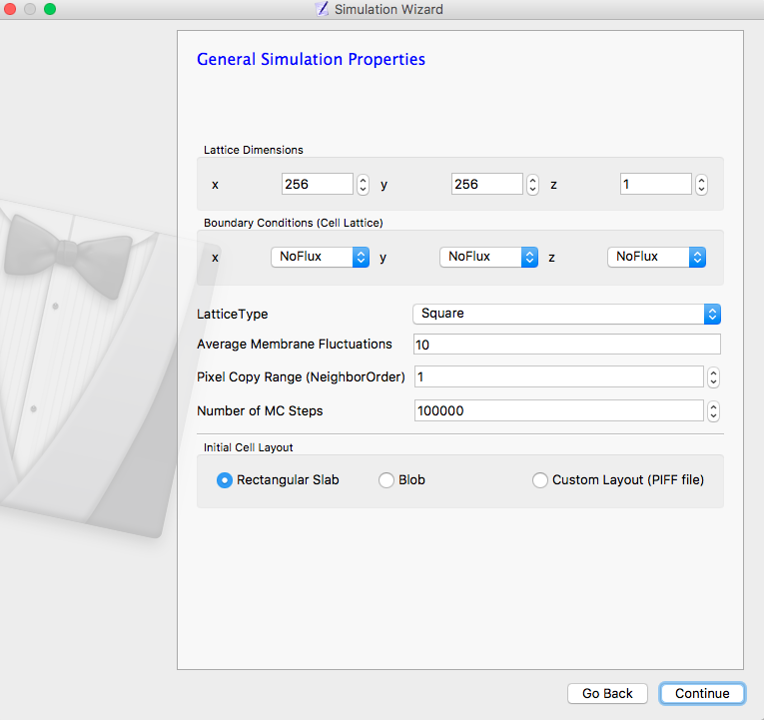
Configure the Cell Lattice
CC3D simulates cells as domains of voxels in a 2D or 3D cell lattice
We won’t use the cell lattice right away, but any CC3D simulation must have one, even if it is empty
We are anticipating a simulation domain that will contain two 2D layers: 0) epithelial cells 1) immune cells and chemical fields
periodic boundaries in the $x$ and $y$ directions and no-flux boundaries in the $z$ direction
We need to Change the default lattice dimensions and boundary conditions to match this concept

Slide 10
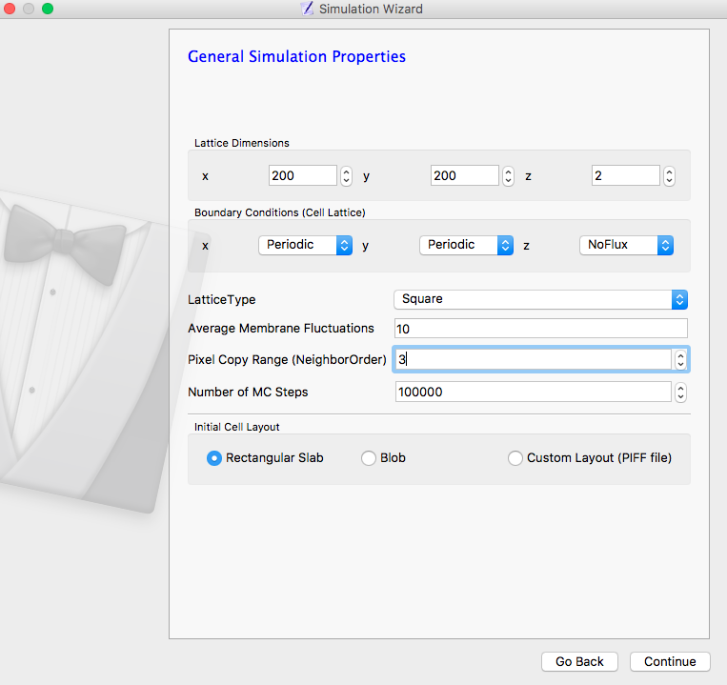
Configure the Cell Lattice
CC3D simulates cells as domains of voxels in a 2D or 3D cell lattice
We won’t use the cell lattice right away, but any CC3D simulation must have one, even if it is empty
We are anticipating a simulation domain that will contain two 2D layers: 0) epithelial cells 1) immune cells and chemical fields
periodic boundaries in the $x$ and $y$ directions and no-flux boundaries in the $z$ direction
We need to Change the default lattice dimensions and boundary conditions to match this concept

Slide 11
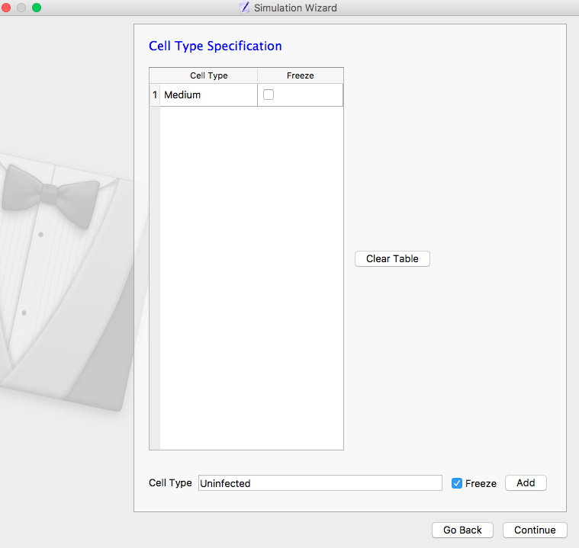
Adding Cell Types
We anticipate using four types of epithelial cells in the epithelial layer: Uninfected, Infected, Virus Releasing and Dead.
Since epithelial cells don’t move relative to each other these cells will be “frozen” (immobile)
To add a cell type: Add name Uninfected in Cell Type, choose Freeze option and Add

Slide 12
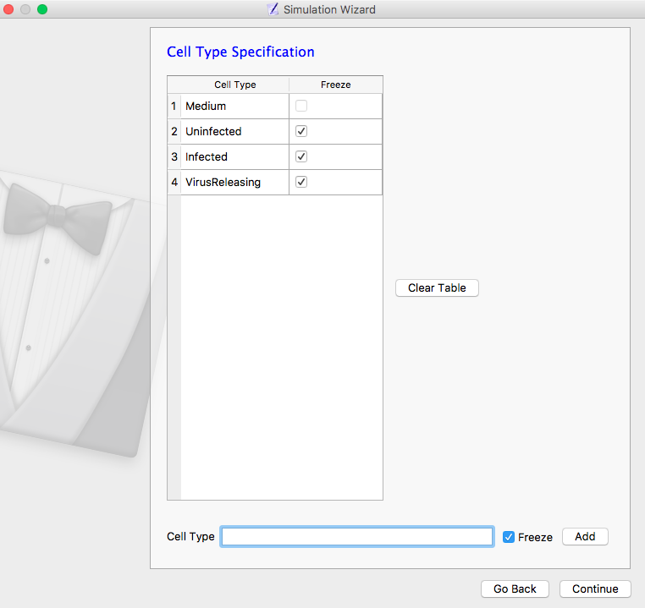
Adding Cell Types
We anticipate using four types of epithelial cells in the epithelial layer: Uninfected, Infected, Virus Releasing and Dead.
Since epithelial cells don’t move relative to each other these cells will be “frozen” (immobile)
To add a cell type: Add name Uninfected in Cell Type, choose Freeze option and Add
Add remaining cell types: Infected, Virusreleasing, Dead

Slide 13
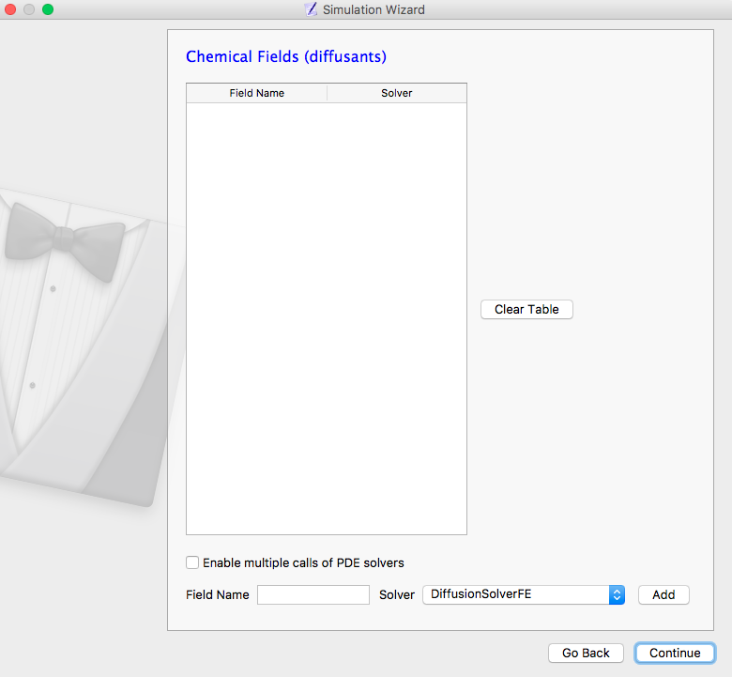
Adding Chemical Fields and Choosing Diffusion Solver
Don’t need any chemical fields at the moment, so hit continue

Slide 14
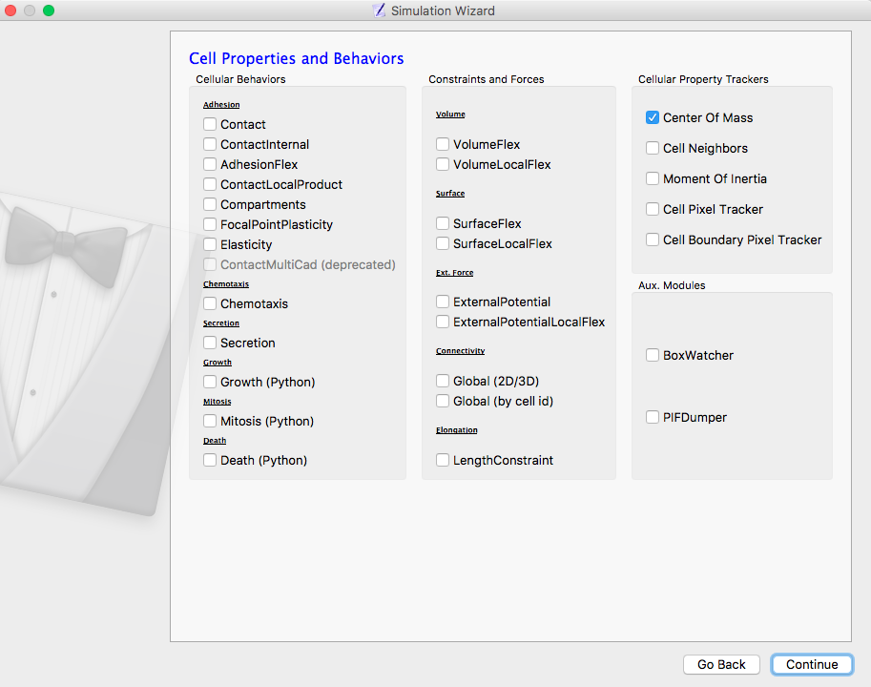
Choose Cell Properties and Behaviors
Don’t need any specific cell properties for frozen cells, so hit ‘Continue’

Slide 15
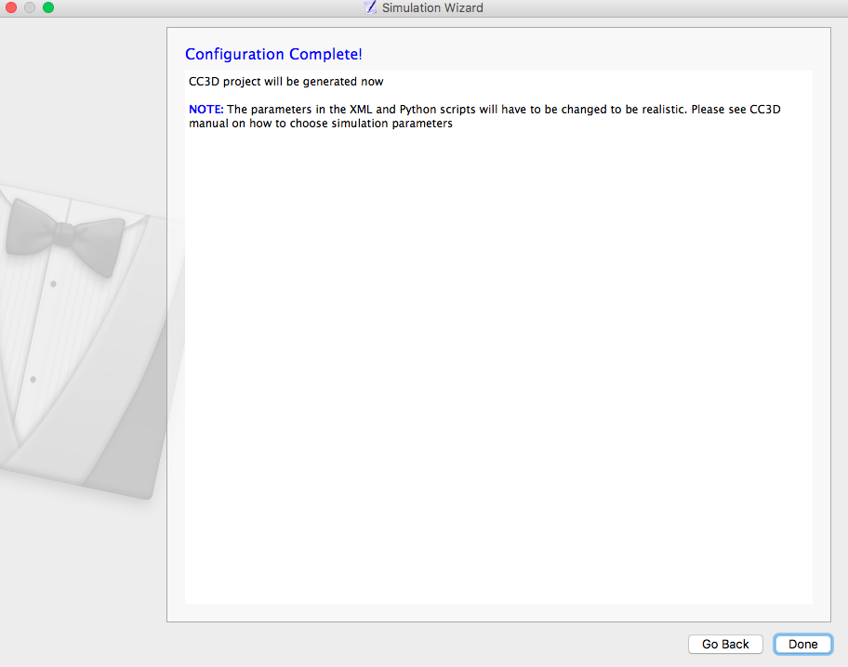
Finalize Wizard to Create Template Simulation

Slide 16
Open Newly Created Project on Twedit++
Double click on project on the sidebar to open all files associated with the project

Slide 17
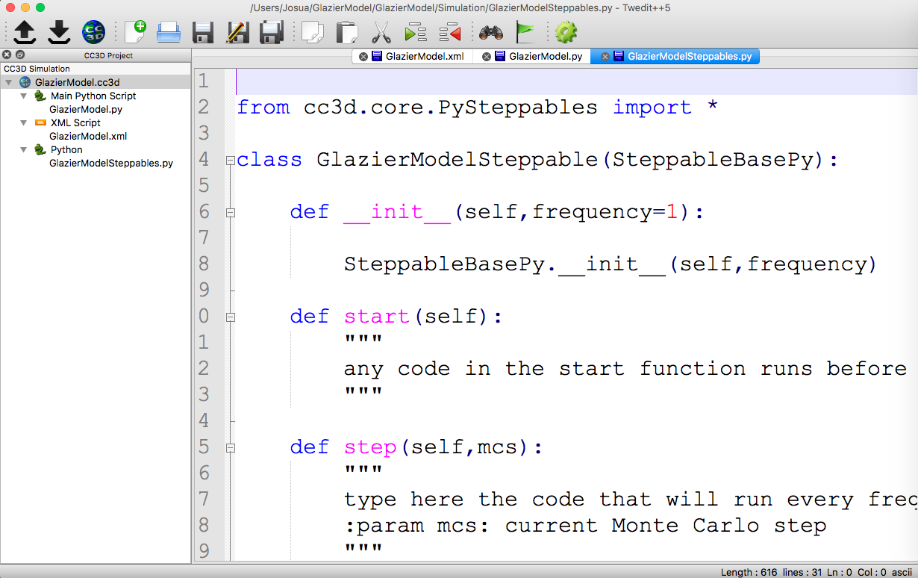
Open Newly Created Project on Twedit++
Double click on project on the sidebar to open all files associated with the project

Slide 18
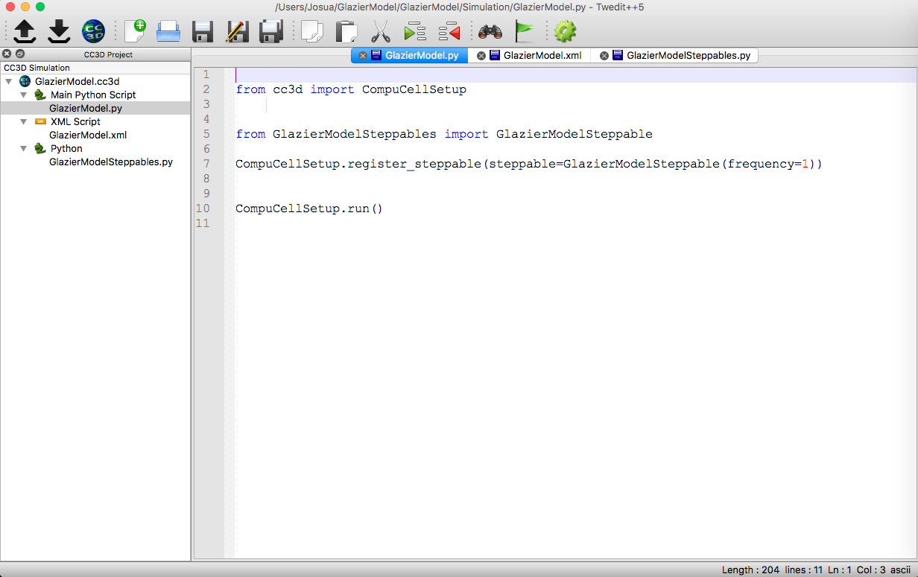
Main Python Script
Main Python Script: executes CC3D by calling classes and functions specified in the Steppables file
We will edit and manipulate the Main Python Script only occasionally

Slide 19
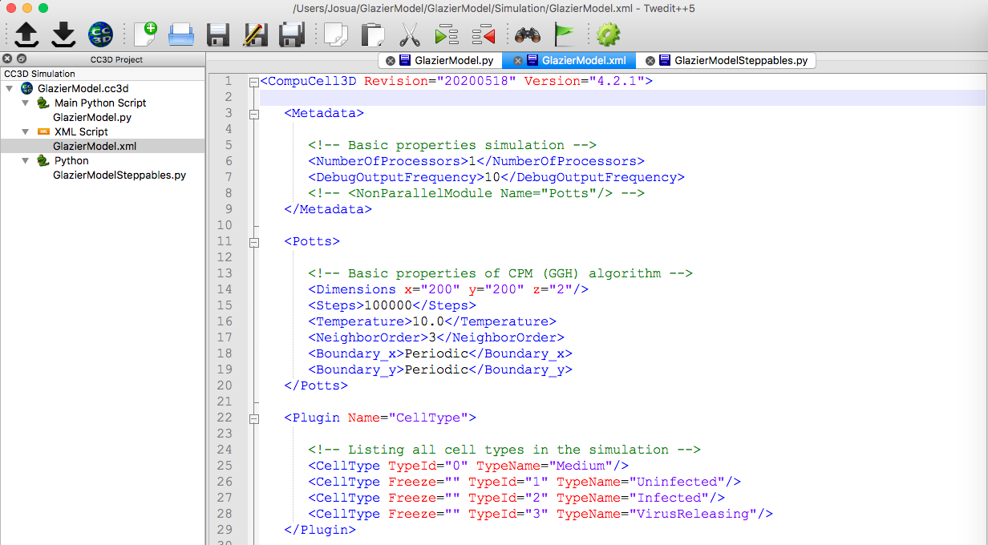
CC3DML File
Uses XML (a markup language where specifications are organized by categories) for static simulation specifications such as lattice dimensions and boundary conditions, simulation time and cell types created in Wizard
We will edit CC3DML frequently for model specification
<Potts> Lattice properties
<Cell Type> Contains all the cell types we initialized in Wizard

Slide 20
Delete Blob Initializer from CC3DML file
JOSUA—OK but you can leave it—doesn’t do any harm
A default Steppable loaded with Wizard is the <Blob Initializer>, where cells are initialized as blob in the center of the simulation
Since we don’t need cells for this particular module, we will delete this stoppable from the XML file
We will initialize cells later (in module 2.1) in the Steppable Python Script

Slide 21
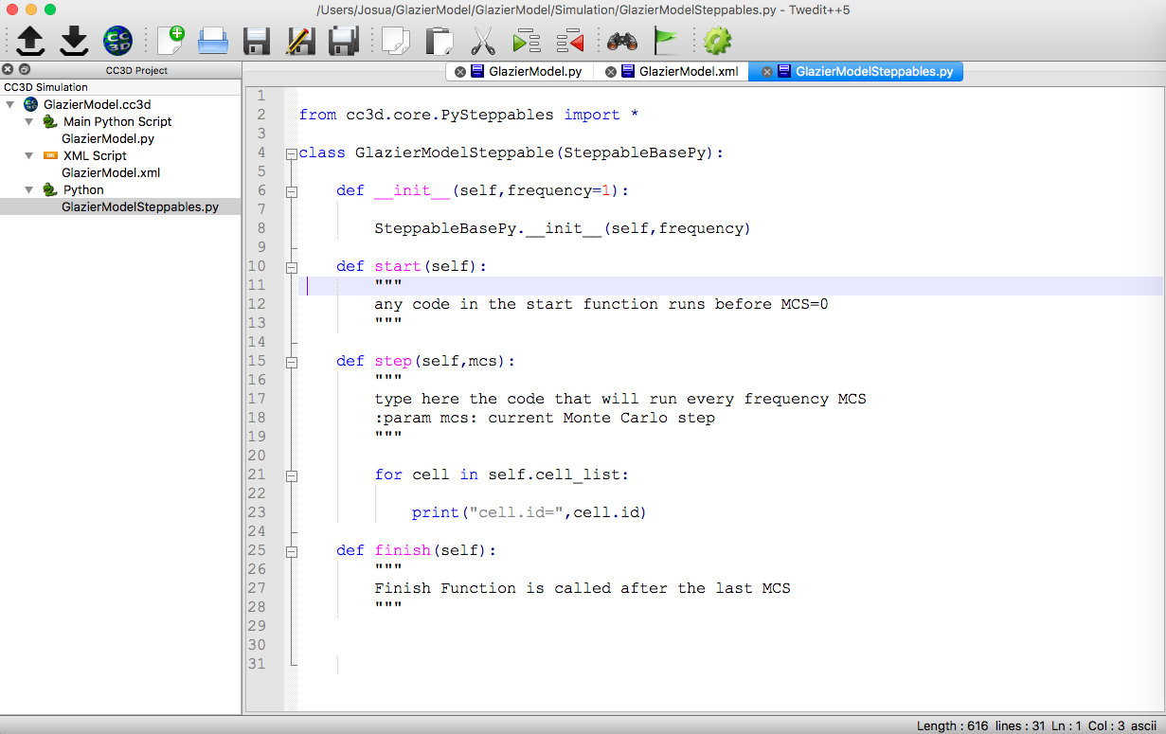
Python Steppables Script
Allows Python dynamic manipulation of simulation properties and events in Python classes called Stepabbles (these classes are called by the Main Python Script)
These are the main place we specify model events and data processing and display
_init_ (): standard Python class initializer, variables that are used throughout the class should be declared here
start(self): routines executed at the beginning of the simulation
step(self,mcs): routines executed every simulation step (mcs)
finish(self): routines executed at the end of the simulation

Slide 22
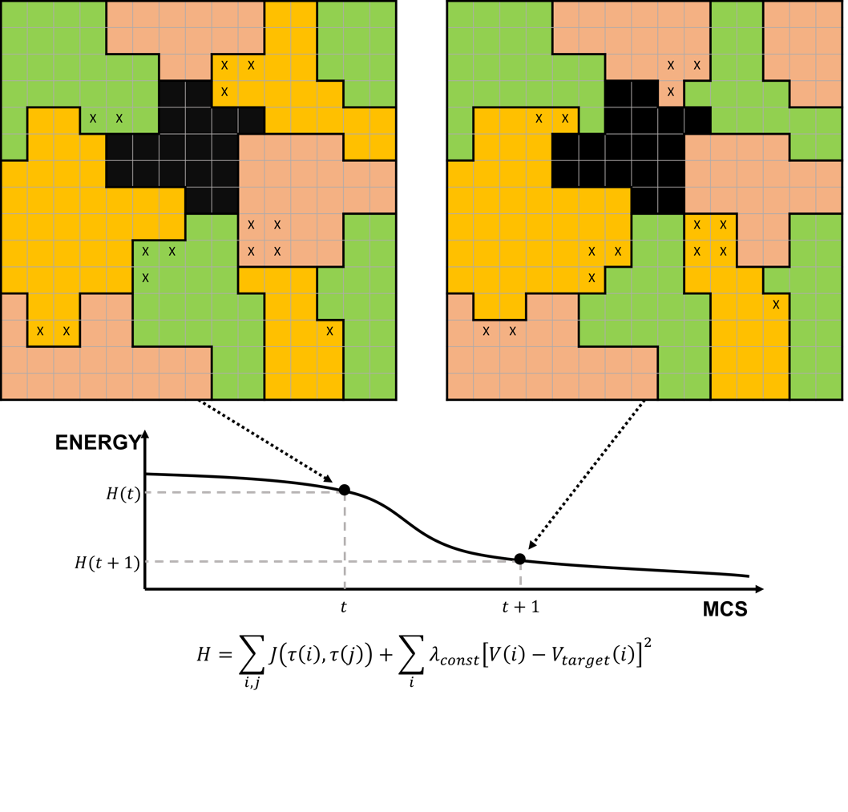
CC3D units and Conversion Factors
The intrinsic units of CC3D simulations are the voxel and the mcs.
A voxel is the minimal spatial unit. The simulation domain (the lattice) is composed of arrays of voxels.
Cells occupy some of these voxels, and chemical concentrations are defined in terms of amount of chemical per voxel.
An mcs is the minimal time unit. The mcs consist of a series of attempts to change what simulation objects occupy which voxels in the lattice
To be able to compare simulations results with experiment we need to choose space and time conversion units between CC3D and real-world units
We usually use the conversion factor s_to_mcs for time unit conversion
We usually use cell_diameter for space unit conversion
When integrating an ODE Model inside CC3D we need to specify how much ‘model time’ corresponds to a mcs

Slide 23
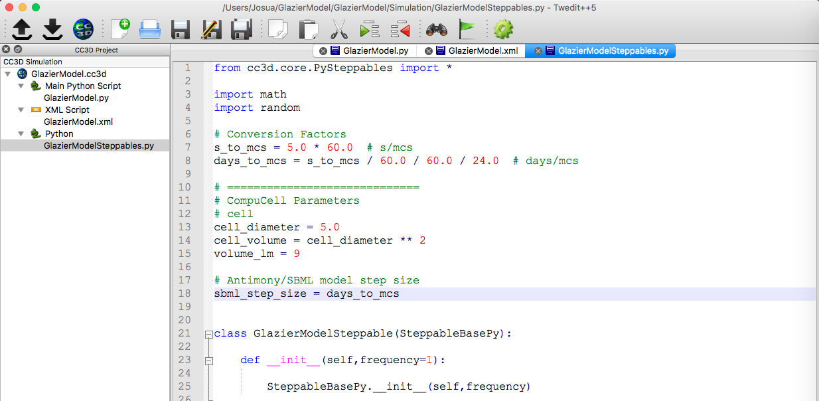
CC3D units and Conversion Factors

Slide 24
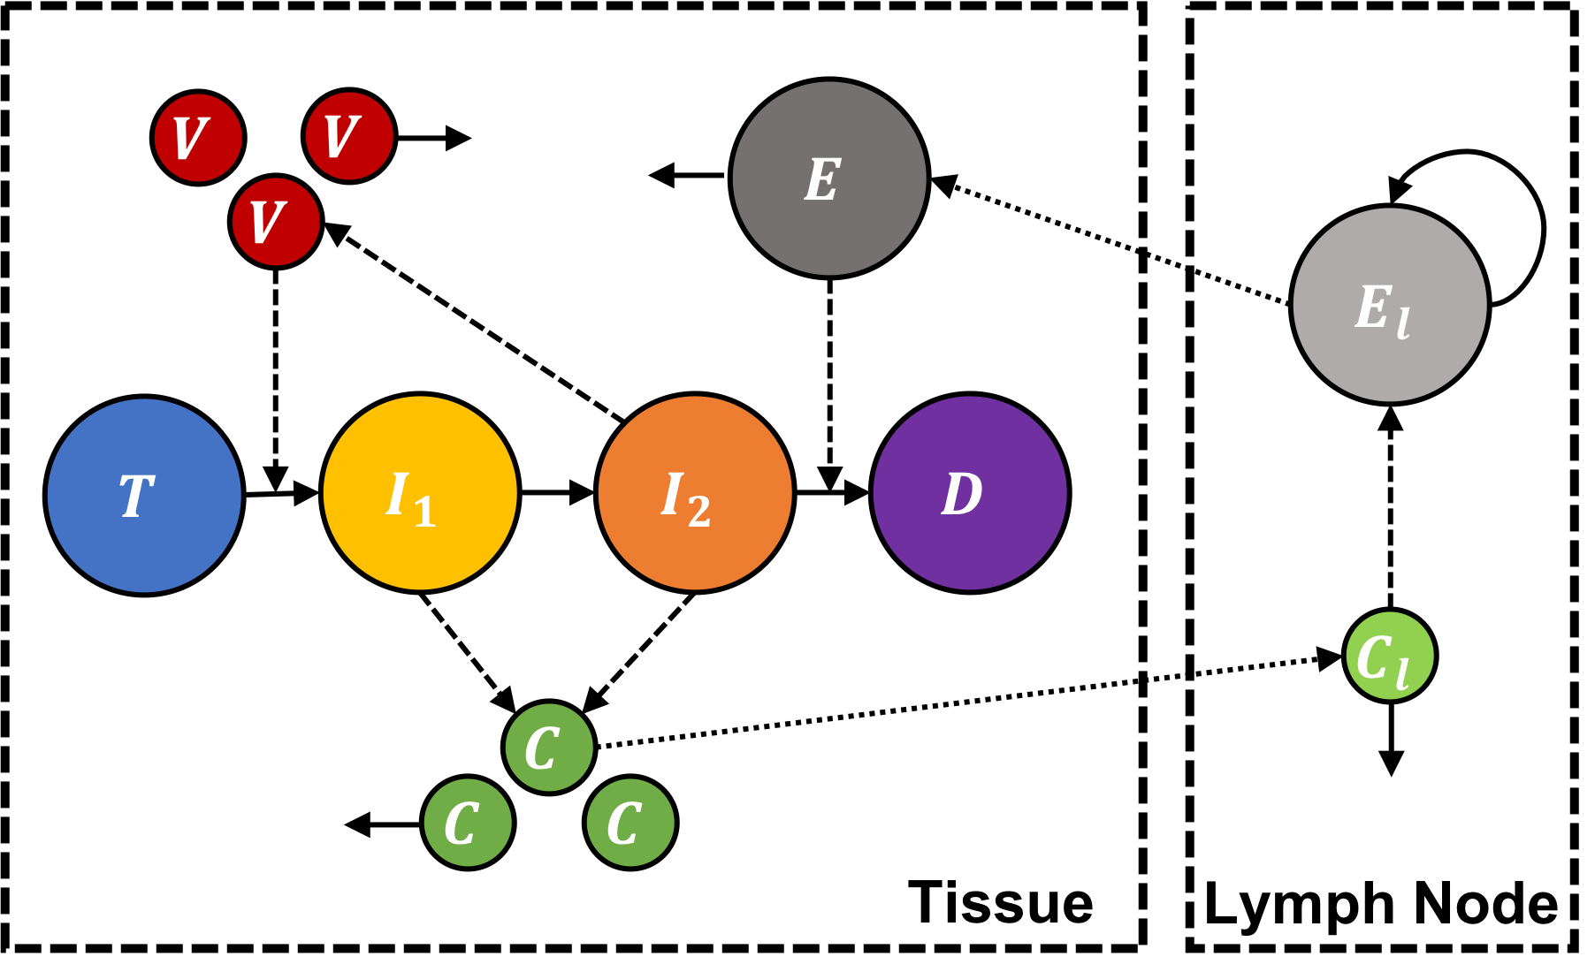
Specify Antimony Model String in CC3D
The first step in the process of cellularizing an ODE model is to import the Antimony Model into CC3D.
You can download the Antimony String as .txt document from: https://multiscalemodags3330.slack.com/files/U01861ESBT4/F017ZUFJE1L/odemodel.txt

Slide 25
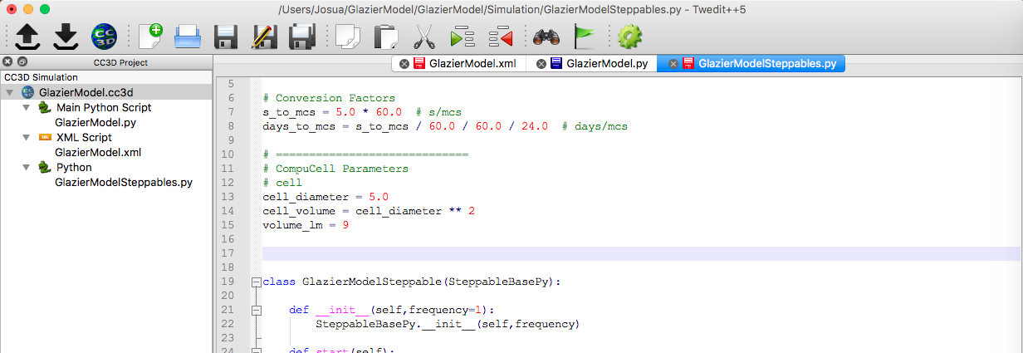
Specify Antimony Model String in CC3D
Define the Antimony Model as a string after the conversion factors and before the Steppable Class.

Slide 26
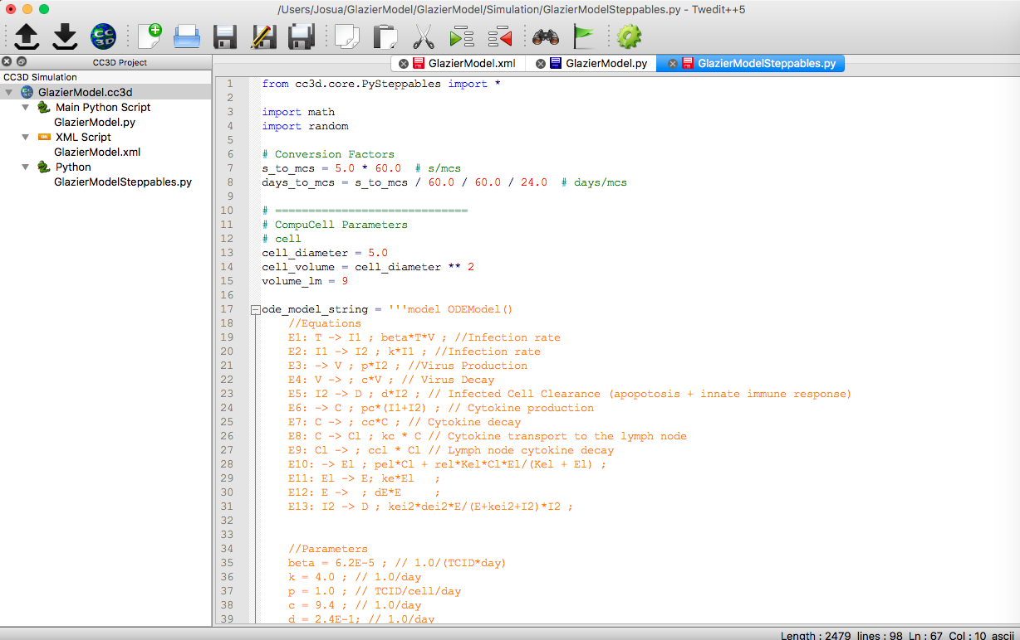
Specify Antimony Model String in CC3D
Define the Antimony Model as a string after the conversion factors and before the Steppable Class.

Slide 27
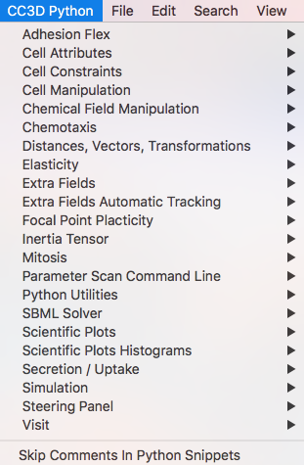
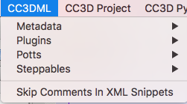
Twedit++ Code Snippets
Twedit++ has convenient code snippets that work as templates to manipulate simulation properties in both the Python Steppable Files.
Code Snippets can access in the CC3D toolbar:
CC3D Python: pull down menu that contain collection of code snippets to manipulate different aspects of the simulation in the Steppable Python script
CC3DML: pull down menu with collection of code snipper to manipulate simulation specifications in the CC3DML file
The code snippets need to be edited for the specific needs of the user and the context of the simulation.

Slide 28
Load Free-Floating Antimony Model in CC3D
Next, we need to load the Antimony Model. We will have one copy of the Antimony model for the whole simulation, so we load it as a Free Floating SBML model in the start function.
Free floating means that the Antimony String is attached to the simulation as a whole, not to individual cell.
SBML is a markup language to describe reactions and network models extensively used to share biological model specifications

Slide 29
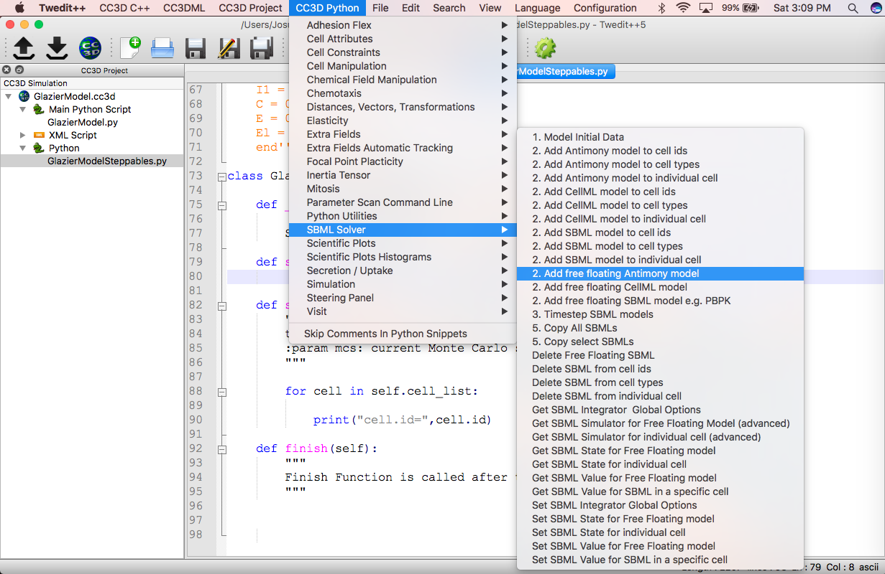
Load Free-Floating Antimony Model in CC3D
Use the Code Snippet Function in Twedit++ to load Antimony model in the start function
CC3D Python -> SBML Solver -> Add free floating Antimony model

Slide 30
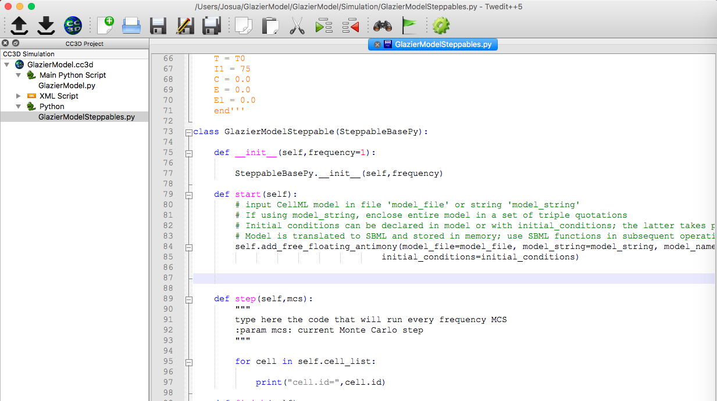
Load Free-Floating Antimony Model in CC3D
Use the Code Snippet Function in Twedit++ to load Antimony model in the start function
CC3D Python -> SBML Solver -> Add free floating Antimony model

Slide 31
Load Free-Floating Antimony Model in CC3D
Modify inputs to the template function imported with the snippet code
model_string: string to be inputted as Antimony string.
model_name: reference to the Antimony model (will be extensively used when referencing model variables)
step_size: size of the integration step when the integration function is called (discussed later)

Slide 32
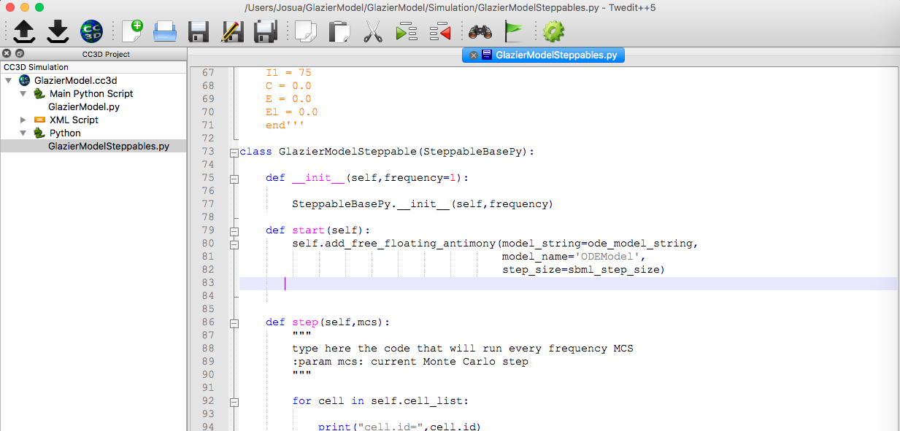
Load Free-Floating Antimony Model in CC3D
model_string = ode_model_string variable we used to define the Antimony String
model_name = ‘ODEModel’ easy and descriptive reference to be used when referencing model variables
step_size = sbml_step_size the time in the ODE model is measured in days, thus we need to specify how many days will pass

Slide 33
Time Stepping the Antimony Model in CC3D
A convenient function timestep_sbml() integrates any SBML and Antimony models forward in time by the time step defined when the Antimony model was loaded (in the step_size attribute)
The function is typically called once per mcs, so we must specify how much Antimony model time passes in one mcs.
We need to include sbml_step_size = days_to_mcs among our conversion factors
The timestep_sbml() uses an adaptive time step to microstep the ODE model

Slide 34
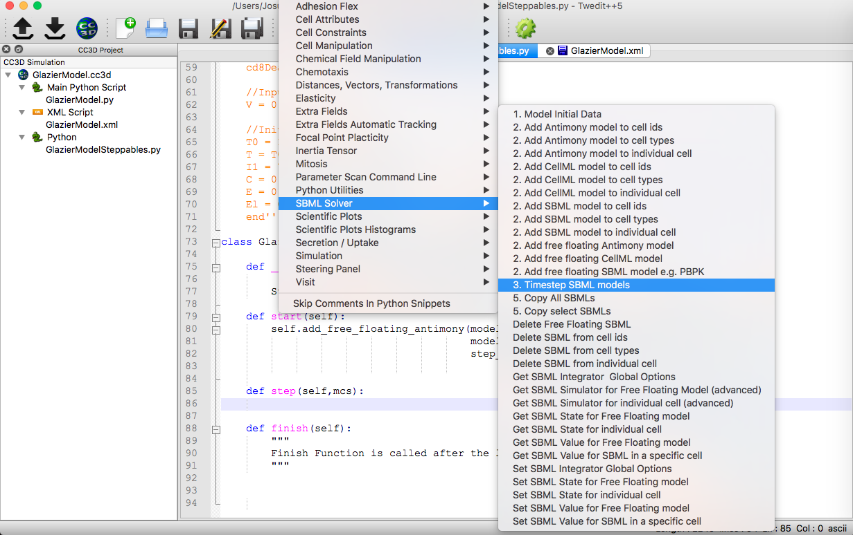
Time Stepping the Antimony Model in CC3D
Put the function inside the step function
CC3D Python -> SBML Solver -> Timestep SBML models

Slide 35
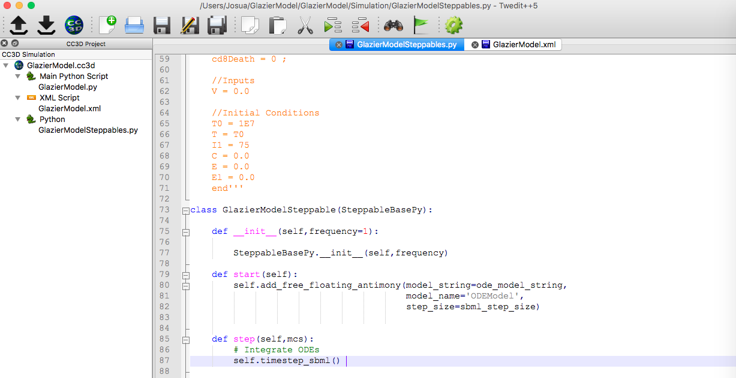
Time Stepping the Antimony Model in CC3D
Put the function inside the step function
CC3D Python -> SBML Solver -> Timestep SBML models

Slide 36
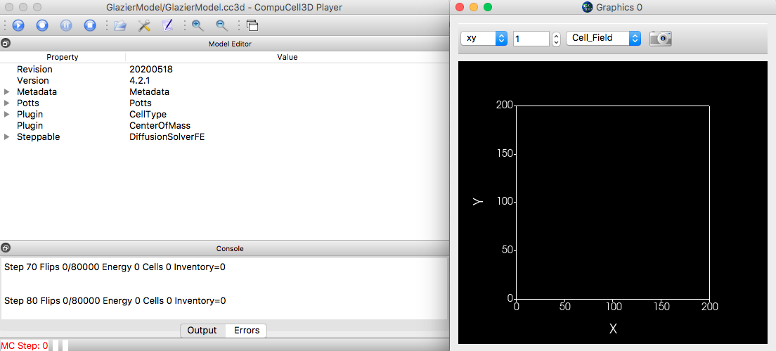
Run the ODE Viral Replication Model in CC3D
CC3D is integrating the Antimony Model but we cannot see the results yet…

Slide 37
Access Free Floating Antimony Model Quantities
Python dictionaries are unordered collections of items. Each item has an associated key (‘name’) and a value.
To access the values of the Antimony model, we need to reference them by their keys
The keys of the Antimony Model dictionary are the variables, parameter and rate equations name specified in the antimony string.
Python Dictionaries of are declared in the form Dict = {{‘key1’:value1},{‘key1’:value2,…}
To access the values associated with a key, we can use the reference Dict[‘key1’]
We need to access the values of the Antimony Model to be able to display them (and use for other purposes, as we will discuss later).
The values of Antimony model variables, parameters and rates are stored in a python dictionary
self.sbml.Model_Name
The antimony string contains variables T, I1, I2, D…, parameters p,k,d,c…, initial conditions T0…, and rate equations E1, E2…
We can access the value of any of these by using name of the name of the variable, parameter, initial condition and rate equation as a key
self.sbml.ODEModel[‘T’] returns the number of T cells in the Antimony model
self.sbml.ODEModel[‘p’] returns the values of the parameter p

Slide 38
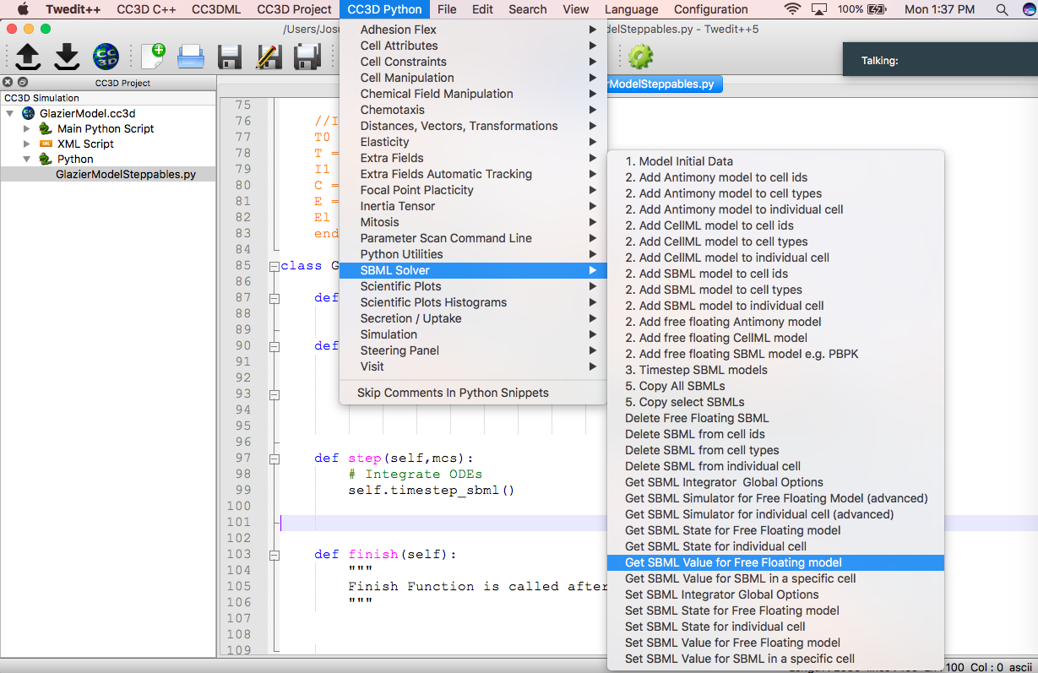
Access Free Floating Antimony Model Values
To access the syntax for referencing values of an Antimony Model
CC3D Python -> SBML Solver -> Get SBML Value for Free Floating Model

Slide 39
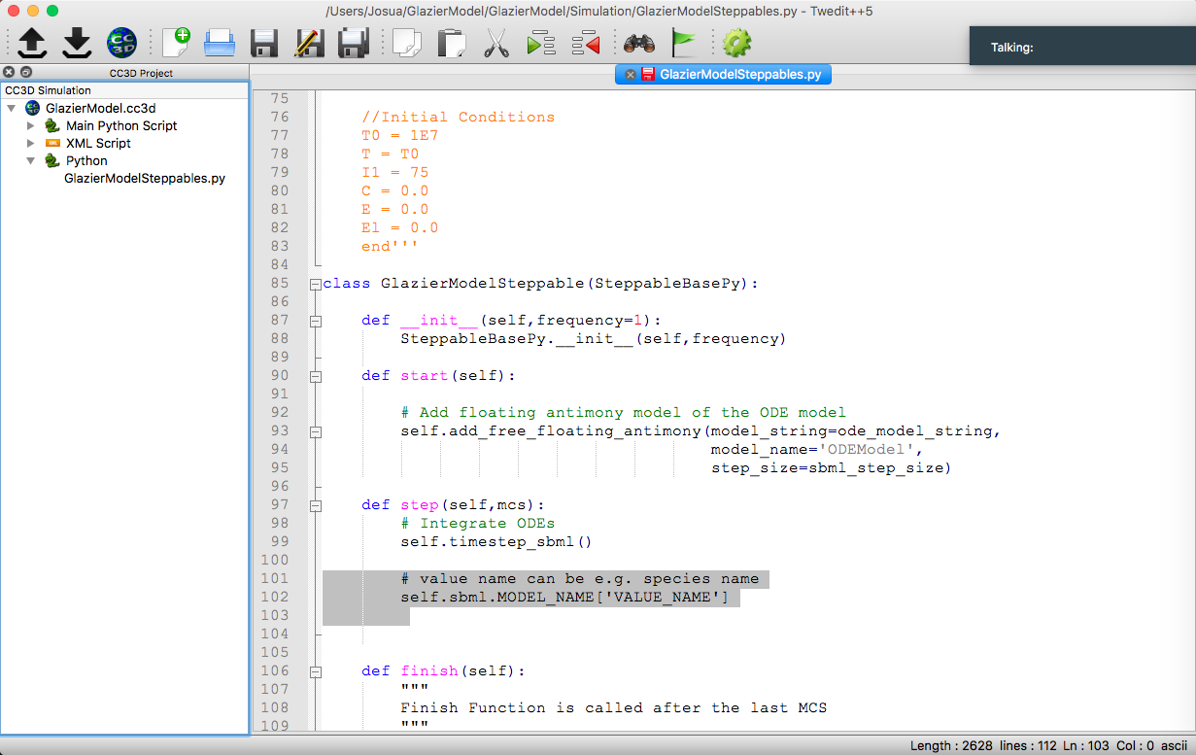
Access Free Floating Antimony Model Values
Now we can reference our specific Antimony model and specific variables by editing the snippet code:
self.sbml.MODEL_NAME[‘VALUE_NAME’] -> self.sbml.ODEModel[‘T]

Slide 40
Printing Antimony Model Values to the Console
To track how CC3D is integrating the Antimony model, we can print the values of the variables to the CC3D console.
print() is a python function that outputs messages to the output display console
CC3D has its own console where information about the simulation is displayed to.
Most basic information is the step the simulation is currently at
Errors are also displayed in the console
Calling the print() function inside the Steppables will output to the console
If the print function is in the start function it will only print at beginning of the simulation
If the print function is inside the step function, it will print every simulation step

Slide 41
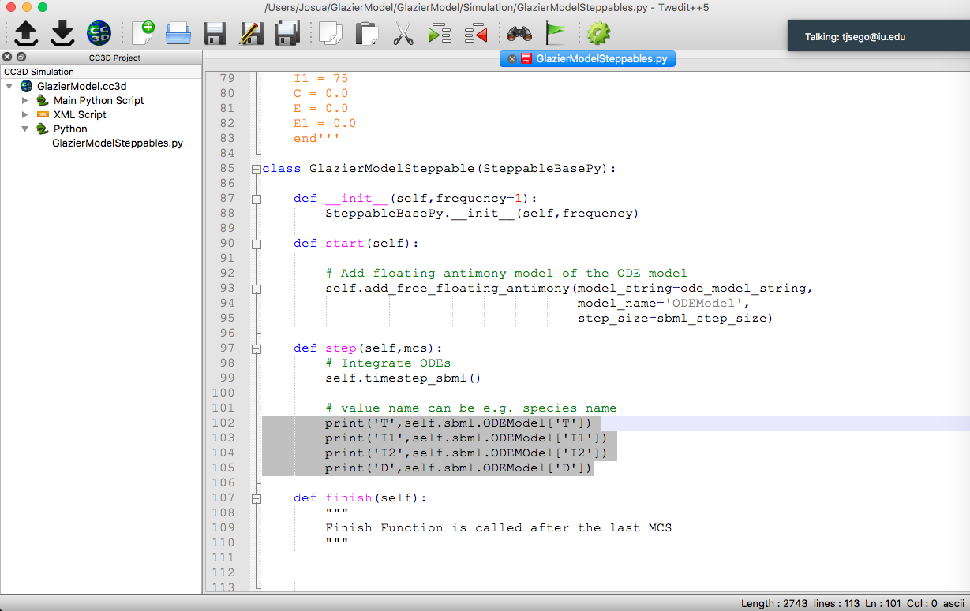
Printing Antimony Model Values to the Console
Use print functions for each of the variables of the epithelial cells in the ODE Model inside the step function.

Slide 42
Run the ODE Viral Replication Model in CC3D
Values of the Antimony variables will now be displayed in the console

Slide 43
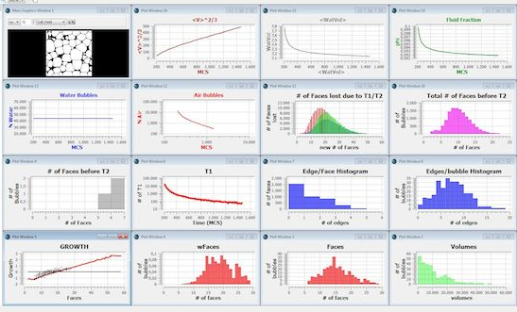
Scientific Plots in CC3D
CC3D has extensive capabilities to display time series of scalar quantities and histograms.
We will use these to plot the time series of our model variable, the same way we used m.plot() in Tellurium
However, because we are updating the plots on the fly we need to do a little more work to define our plots

Slide 44
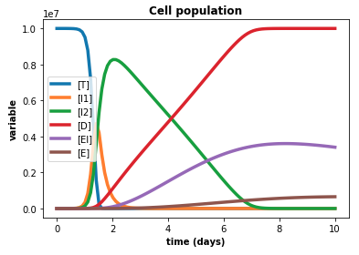
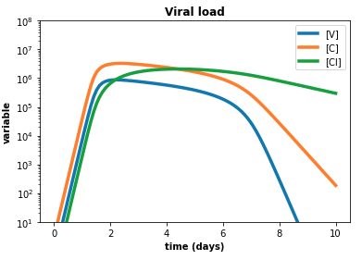
Creating Scientific Plots using Twedit++
Purpose of generating plots:
We want to be able to visualize the results of time stepping the ODE model such that we can compared to Tellurium plots
We can later compare cellular version of the model to the ODEs

Slide 45
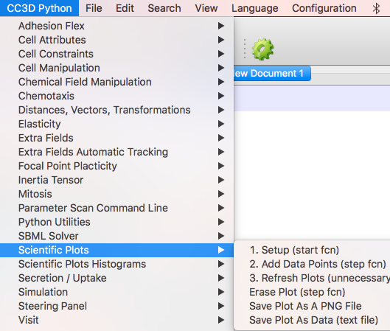
Creating Scientific Plots using Twedit++
Twedit++ provides a host of predefined code snippets for specifying plots in the Steppable file.
We will use the pull-down menu to generate plots showing the volume and surface areas of all cells in our simulation
These code snippets provide a helpful template but need to be edited and possibly reading of manuals to do exactly what we want
To create a dynamic plot:
We first create and configure a plot window in the Steppable class start function
Define the data series that will be associated with the plot window
Add the data points to plot in the step function

Slide 46
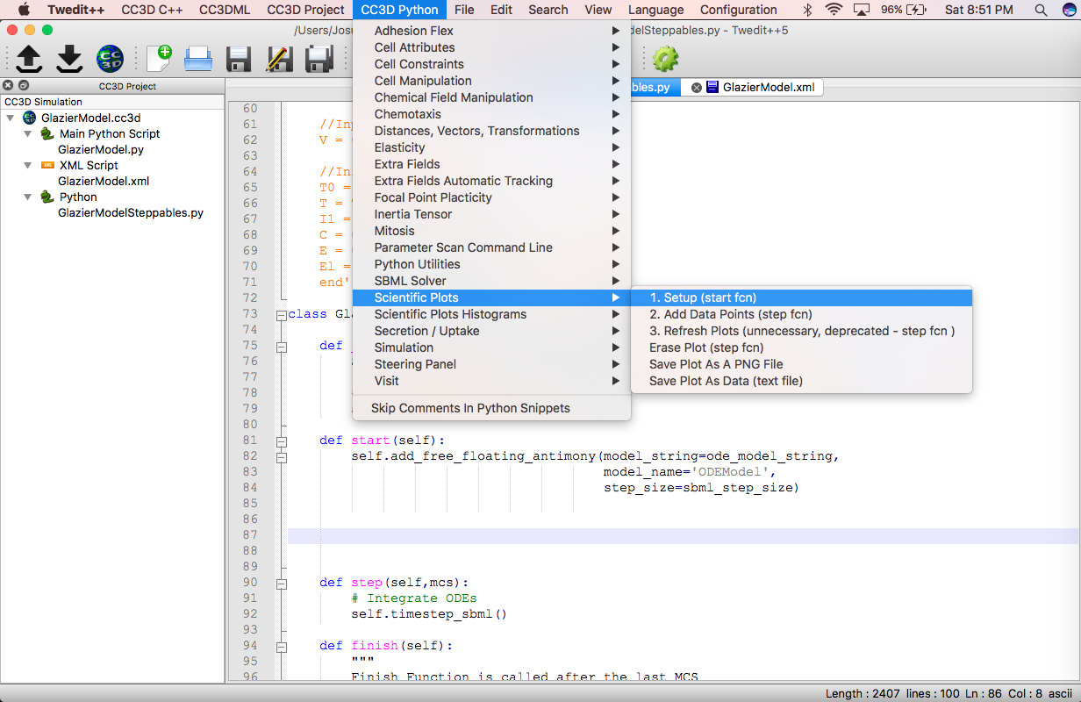
Adding Plots in CC3D: Create Plot Window
1) Adding Plot Window
Plot windows are added in the start function
CC3D Python -> Scientific Plot -> Setup (start fcn)
Add in start function after loading Antimony String

Slide 47
Twedit++ Code Snippet for
Defining a Plot Window and Plot Series
The function will paste in the following sample code snippet
self.plot_win = self.add_new_plot_window(title='Average Volume And Surface',
x_axis_title='MonteCarlo Step (MCS)',
y_axis_title='Variables',
x_scale_type='linear',
y_scale_type='linear',
grid=False)
self.plot_win.add_plot("MVol", style='Lines', color='red', size=5)
self.plot_win.add_plot("MSur", style='Dots', color='green', size=1)
The first line creates a Plot Window and a handle to it, the next two lines create Plot Series within that window

Slide 48
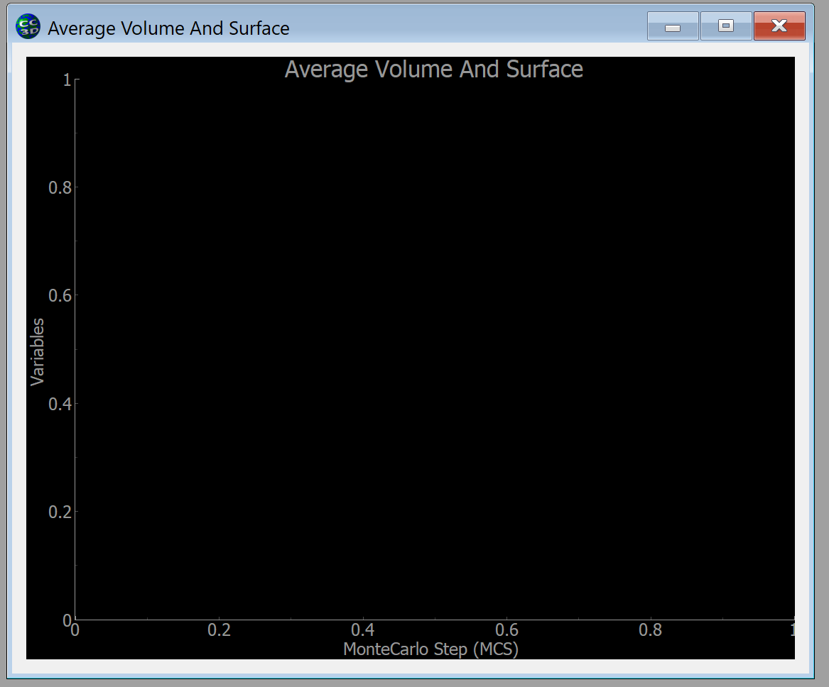
Adding Plots in CC3D: Create Plot Window
The first line in the code snippet
Creates a single plot window and assigns it to the handle self.plot_win (we will rename them)
You will need to remember the name of handle for the window when you add data to the plot
The window contains a single graph with title Average Volume And Surface, x axis labeled MonteCarlo Step (MCS) and y axis labeled Variables
You can add additional plot windows with the same command but each one must have unique handle, e.g. plot_win2 AND a unique title (reusing plot_win or ‘Average Volume And Surface’ will generate an error)
self.plot_win = self.add_new_plot_window(title='Average Volume And Surface',
x_axis_title='MonteCarlo Step (MCS)',
y_axis_title='Variables',
x_scale_type='linear',
y_scale_type='linear',
grid=False)

Slide 49
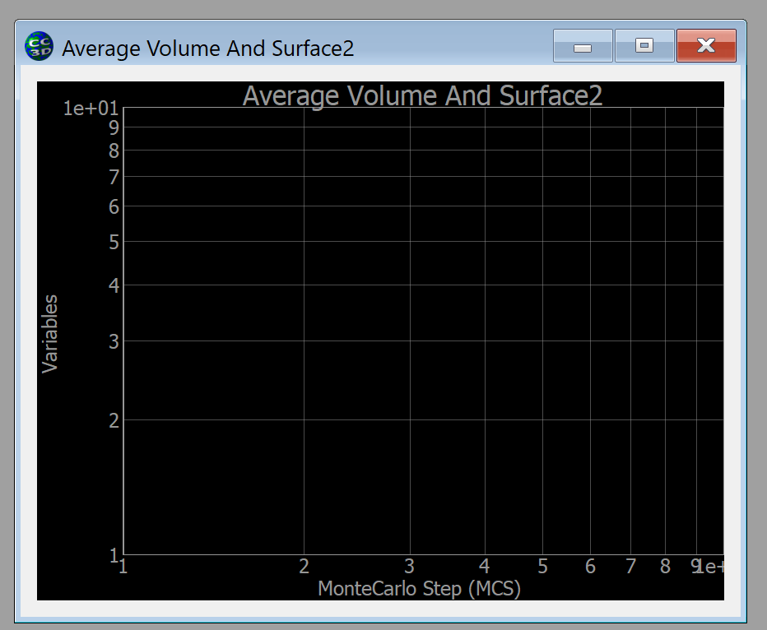
Plot Window Creation Options
We can set the axes independently to be linear or logarithmic (x_scale_type=‘log’), and turn on or off a background set of grid lines (grid=True) or add legends (config_options={'legend': True})
By default axis ranges autoscale
For more options see http://www.pyqtgraph.org/documentation/
self.plot_win = self.add_new_plot_window(title='Average Volume And Surface',
x_axis_title='MonteCarlo Step (MCS)',
y_axis_title='Variables',
x_scale_type='linear',
y_scale_type='linear',
grid=False)
self.plot_win = self.add_new_plot_window(title='Average Volume And Surface',
x_axis_title='MonteCarlo Step (MCS)',
y_axis_title='Variables',
x_scale_type=‘log',
y_scale_type=‘log',
grid=True)

Slide 50
Adding Plots in CC3D: Create Plot Window
The Twedit++ template script creates a plot window and adds two data series. We need to change inputs to the plot function for our specific datasets:
We will define the plot handle in the _init_ function as
self.pop_data_win = None
The plot inputs:
title = ‘Population Data’
x_axis_title = ‘Time (days)’
y_axis_title = ‘Number of Cells’
x_scale_type = ‘Linear’
y_scale_type = ‘linear’
grid = True
config_options={'legend': True})

Slide 51
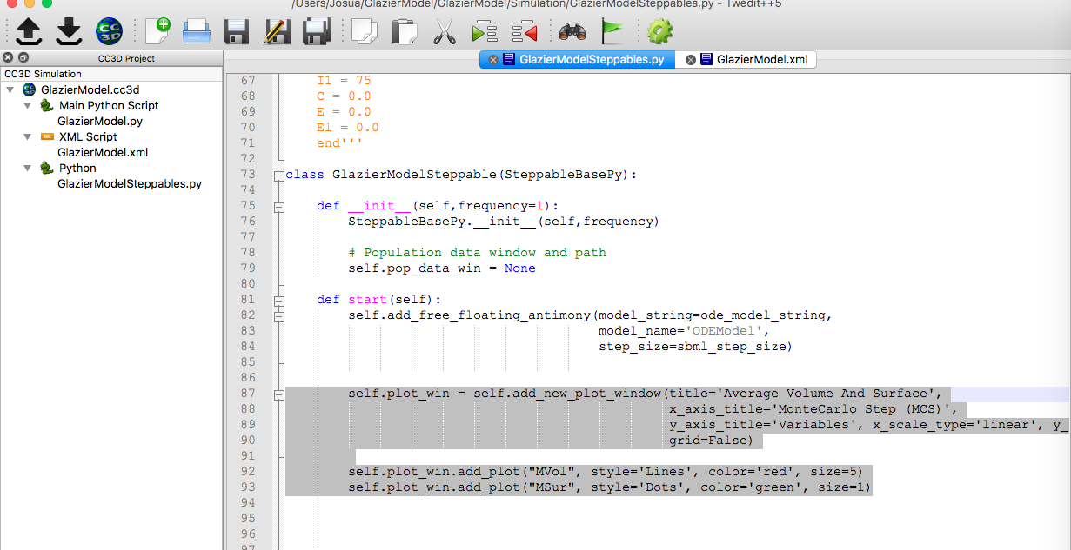
Adding Plots in CC3D: Create Plot Window

Slide 52
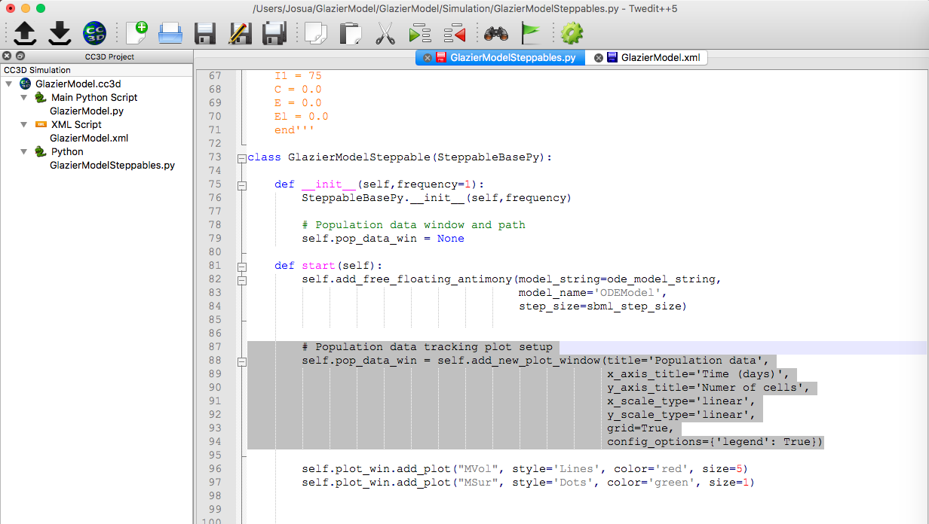
Adding Plots in CC3D: Create Plot Window

Slide 53
Adding Data Series to a Plot Window
2) Adding Data series to the Plot Window
To add a particular data series to the plot window we use self.WINDOW_HANDLE.add_plot (must refer to the specific handle of the window we want to add the data series to)
self.plot_win = self.add_new_plot_window(title='Average Volume And Surface',
x_axis_title='MonteCarlo Step (MCS)',
y_axis_title='Variables',
x_scale_type='linear',
y_scale_type='linear',
grid=False)
self.plot_win.add_plot("MVol", style='Lines', color='red', size=5)
self.plot_win.add_plot("MSur", style='Dots', color='green', size=1)
Each call to add_plot adds one plot series, with the PLOT_NAME given in the first position, e.g. “Mvol”
You will need to remember the PLOT_NAME when you add data points to the plot
You can add as many plot series to a plot window as you like, but each PLOT_NAME must be unique within a plot window
Common options for the plot series include:
Styles of graph, style=‘Lines’/’Dots’,
Colors, color=‘red’/’green’/’blue’…
Side of the line or symbols, size=x
For details on all the options see http://www.pyqtgraph.org/documentation/

Slide 54
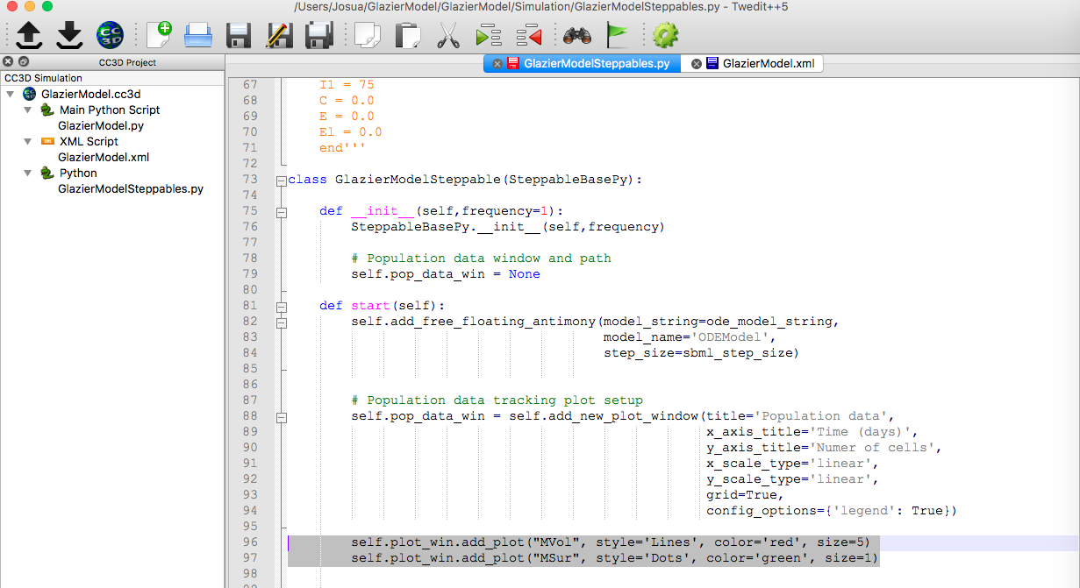
Adding Plots in CC3D: Add Data Series to Plot Window
We need to add a data series to the pop_data_win:
UninfectedODE data series
style = ‘Lines’
color = ‘blue’
size = 3 (which which we will define as an additional variable line_size that we can use in future data series)

Slide 55
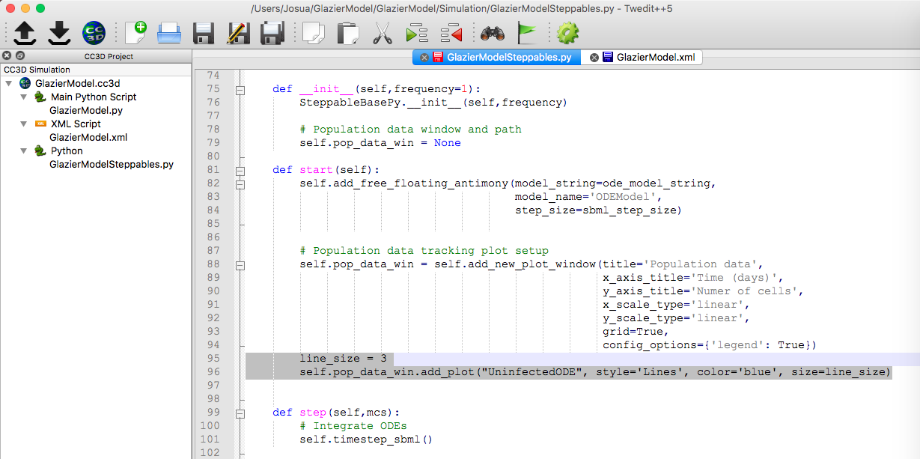
Adding Plots in CC3D: Add Data Series to Plot Window

Slide 56
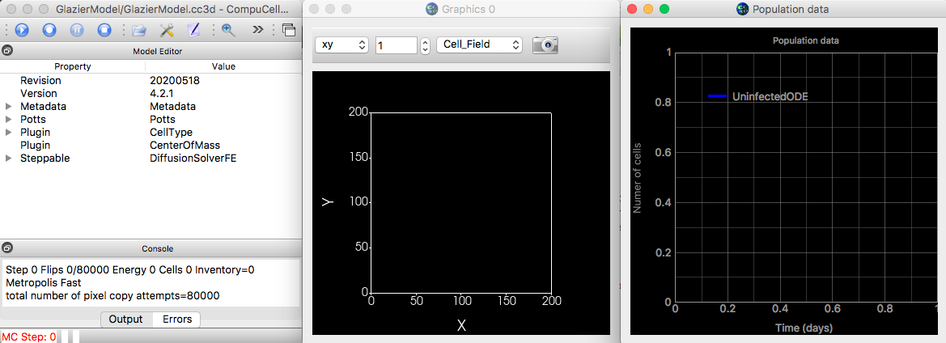
Run CC3D to check Plot Window
New plot window, but no data displayed in it. We need to add the data points next.

Slide 57
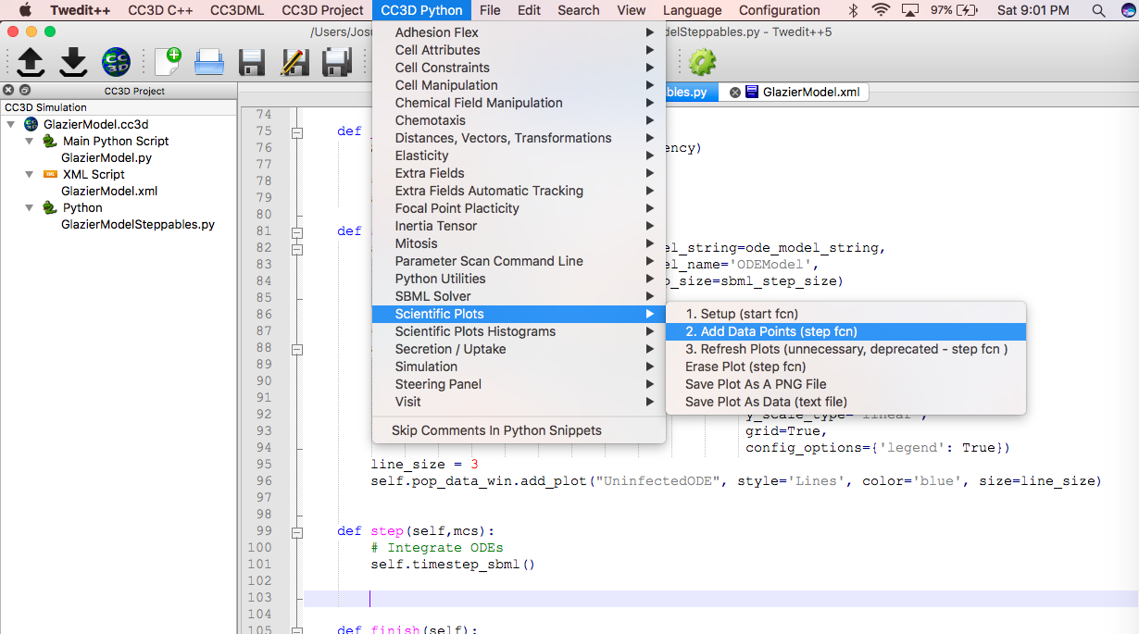
Adding Plots in CC3D: Adding Data Points to Data Series
3) After creating the plot window, we need to add data points to the empty plot by using Twedit++ code snippets
We add data points in the Steppable’s step function
CC3D Python -> Scientific Plots -> Add Data Points (step fcn)
Add after the self.timestep_sbml() command

Slide 58
Using Twedit++ to Add Data Points to a Plot Series
The code snippet will look like this:
The items being plotted in the code snippet are just placeholders arguments that need to be adapted to add data points to the data series we created
Self.pop_data_win.add_data_point(“UninfectedODE”, mcs *days_to_mcs, self.sbml.ODEModel[‘T’] )
We can defined the self.sbml.ODEModel[‘T’] outside of the function for convenience
self.plot_win.add_data_point("MVol", mcs, mcs**2)
self.plot_win.add_data_point("MSur", mcs, mcs)

Slide 59
Using Twedit++ to Add Data Points to a Plot Series
The code snippet will look like this:
The items being plotted in the code snippet are just placeholders arguments that need to be adapted to add data points to the data series we created
Self.pop_data_win.add_data_point(“UninfectedODE”, mcs *days_to_mcs, self.sbml.ODEModel[‘T’] )
We can defined the self.sbml.ODEModel[‘T’] outside of the function for convenience
self.plot_win.add_data_point("MVol", mcs, mcs**2)
self.plot_win.add_data_point("MSur", mcs, mcs)

Slide 60
Relationship Between Plot Window, Plot Series and Data Points
Note that both the WINDOW_HANDLE and the PLOT_NAME must match from when you created the plot window and plot series
self.plot_win = self.add_new_plot_window(title='Average Volume And Surface',
x_axis_title='MonteCarlo Step (MCS)',
y_axis_title='Variables',
x_scale_type='linear',
y_scale_type='linear',
grid=False)
self.plot_win.add_plot("MVol", style='Lines', color='red', size=5)
self.plot_win.add_plot("MSur", style='Dots', color='green', size=1)
self.plot_win.add_data_point("MVol", mcs, mcs**2) self.plot_win.add_data_point("MSur", mcs, mcs)

Slide 61
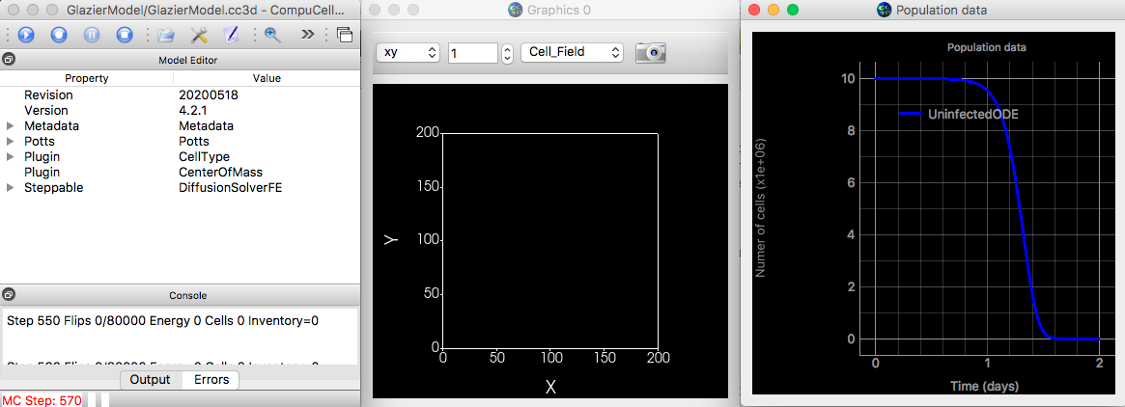
Run CC3D: Visualize Uninfected Cells in the ODE Model
Run CompuCell to display the number of uninfected cells in the Antimony model vs time

Slide 62
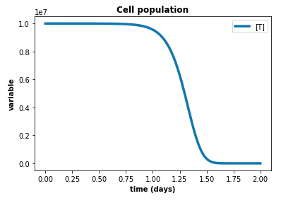
Run CC3D: Visualize Uninfected Cells in the ODE Model
Run CompuCell to display the number of uninfected cells in the Antimony model vs time

Slide 63
Exercise 1.6.1: Adding Additional Data Series to CC3D Plot Windows
Add the data series for the $I_{1}, I_{2},D,E_{L}$ and $E$cells in the Antimony model
Remember that the values of the model are given by
self.sbml.ODEModel[‘I1’]
self.sbml.ODEModel[‘I2’]
self.sbml.ODEModel[‘D’],
self.sbml.ODEModel[‘E’]
self.sbml.ODEModel[‘El’]
1) Add the five data series to the start function below the Uninfected data series (copy the code snippet and modify it)
2) Add data points to each series in the step function using the Twedit++ code snippet generator
CC3D Python –> Scientific Plots –> Add Data Points

Slide 64
Exercise 1.6.1: Adding Additional Data Series to CC3D Plot Windows

Slide 65
Exercise 1.6.1: Adding Additional Data Series to CC3D Plot Windows

Slide 66
Exercise 1.6.1: Adding Additional Data Series to CC3D Plot Windows

Slide 67
Exercise 1.6.1: Adding Additional Data Series to CC3D Plot Windows

Slide 68
Creating a Second Plot Window
We still need to display the time series for the Virus, the Cytokines and the Lymph Node APCs.
Follow same workflow to create a second plot window, the three data series in the window and to add data points to each series
Name the plot window in the _init_ function as self.med_diff_data = None

Slide 69
Creating a Second Plot Window
Create a second plot window: CC3D Python -> Scientific Plots -> Setup (start fcn)
Change inputs to the plot window
title = ‘Population Data’
x_axis_title = ‘Time (days)’
y_axis_title = ‘Number of Cells’
x_scale_type = ‘Linear’
y_scale_type = ‘Log’ (We use log scale because the viral curve is displayed as the log of the TCID
grid = True
config_options={'legend': True})

Slide 70
Creating a Second Plot Window
2) Add Data Series
Create data series: MedViralODE (line, red), MedCytLocalODE (line, blue), MedCytLymphODE (line, green)

Slide 71
Creating a Second Plot Window: Add Data Points
3) Add Data Points to this second plot window
To generate Twedit++ snippet: CC3D Python -> Scientific Plots -> Add Data Points (step fcn)
Specify data points:
We want to plot the Antimony variables corresponding to
Virus -> self.sbml.ODEModel[‘V’]
Cytokine -> self.sbml.ODEModel[‘C’]
Lymph Node APCs -> self.sbml.ODEModel[‘Cl’]
Since we are using a Log scale, we need to make sure to add data only when these values are bigger than 0.

Slide 72
Creating a Second Plot Window: Add Data Points

Slide 73
Run CC3D to Visualize Full Antimony Model Results

Slide 74
Run CC3D to Visualize Full Antimony Model Results
CC3D
Tellurium

Slide 75
Exporting Plot Data as CSV files from Plot Window
We could export the data generated in the CC3D plots for further post-processing.
Plot data can be exported as:
As images: PNG, SVG
As data: Matplotlib, CSV

Slide 76
Exporting Plot Data as CSV files from Plot Window

Slide 77
Exporting Plot Data as CSV files from Plot Window

Slide 78
Exporting Plot Data as CSV files from Plot Window

