Slide 1
CC3D Workshop 2.3: Implementing the Viral Infection Model in CC3D—Part 3: Adding Immune Cells
James A. Glazier
Dept. of Intelligent Systems Engineering
and Biocomplexity Institute
Indiana University
Bloomington, IN 47408
USA
Screensharing and microphones have been disabled for participants in the main session—they are available in breakout rooms
Please submit questions/concerns/suggestions via zoom chat
User support will be available in zoom breakout rooms
Workshop will be live-streamed, recorded and distributed
Please also join the workshop slack channel at https://join.slack.com/t/multiscalemod-ags3330/shared_invite/zt-g0up1lz7-z5XGFC73UZk1j3BPeW7RVA
Funding Sources: NIH U24 EB028887, NIH R01 GM122424, NIH R01 GM123032, NIH P41 GM109824, NSF 1720625 and nanoHUB
Note
Please download updated module code
https://drive.google.com/drive/folders/1xzAsdpc7LK3Yhjr-Yx0-KWhHzVUIoT15?usp=sharing
If you’re using nanoHUB, remember to upload all modules!

Slide 2
Topics
Destroying cells
Volume constraints and contact modeling
Compartmental modeling
Recruitment modeling
Exercises
Add immune cell count to plots
Effects of preferential attachment

Slide 3
Before we Begin…
We’re picking up the pace!
Please download updated module code
https://drive.google.com/drive/folders/1xzAsdpc7LK3Yhjr-Yx0-KWhHzVUIoT15?usp=sharing
If you’re using nanoHUB, remember to upload all modules!
For this module, you can begin from Module2_2.Version2/Loop

Slide 4
The Model… so far
Up to this point, we have
An epithelial sheet
Viral life cycle
Inflammatory signaling
$$\left\{\begin{aligned}&\frac{dT}{dt}=−βTV \\ &\frac{dI_{1}}{dt}=βTV−kI_{1} \\ &\frac{dI_{2}}{dt}=kI_{1}−dI_{2} \\ &\frac{dD}{dt}=dI_{2} \\ &\frac{dV}{dt}=pI_{2}−cV \\ &\frac{dC}{dt}=p_{C}\left(I_{1}+I_{2}\right)−c_{C}C\end{aligned}\right.$$

Slide 5
T-Cell Basics
T-Cell recruitment is complicated!
Biological Basics
Cells at an infection site signal for an organismal-level immune response
Elsewhere (e.g., lymph nodes, thymus), T-Cells proliferate, specialize, and migrate to a site of infection
T-Cells recognize infected cells and induce apoptosis through various surface interactions
Modeling Basics
Our infected cells release cytokines
The cytokines trigger a cascade of immune cell proliferation and recruitment back to our site of infection
At our site of infection, local immune cells move around on top of the epithelium, find infected cells and induce apoptosis through contact interactions

Slide 6
Model Components to Implement in this Module
New cell type: immune cells
Volume constraint
Contact modeling
These cells can move!
Multiscale scheme: Lymph node compartment
Diffusive cytokine is a signal to a far-away “lymph node”: the ODE model equations of immune cell proliferation and recruitment
Lymph node ODEs govern the seeding of immune cells in the spatial domain

Slide 7
ODE Model
$$\left\{\begin{aligned}&\frac{dT}{dt}=−βTV \\ &\frac{dI_{1}}{dt}=βTV−kI_{1} \\ &\frac{dI_{2}}{dt}=kI_{1}−dI_{2} \\ &\frac{dD}{dt}=dI_{2} \\ &\frac{dV}{dt}=pI_{2}−cV \\ &\frac{dC}{dt}=p_{C}\left(I_{1}+I_{2}\right)−c_{C}C−k_{C}C \\ &\frac{dC_{L}}{dt}=k_{C}C−c_{cl}C_{L} \\ &\frac{dE}{dt}=k_{e}E_{L}−d_{E}E \\ &\frac{dE_{L}}{dt}=p_{el}C_{L}+r_{el}C_{L}E_{L}\frac{K_{el}}{K_{el}+E_{L}}−k_{e}E_{L}\end{aligned}\right.$$
Total diffusive cytokine
in spatial domain
Cytokine transport to the lymph node
Local cytokine
Lymph node cytokine decay
Lymph node cytokine
Local immune cell recruitment
Local immune cells
Local immune cell decay
Lymph node immune cells
Lymph node immune cell decay
Lymph node immune cell production

Slide 8
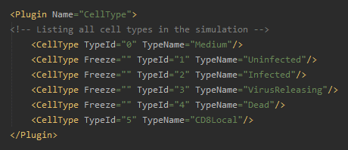
Creating the T Cell Type
In GlazierModel.xml
In plugin “CellType”
<CellType TypeId="5" TypeName="CD8Local"/>

Slide 9
Cell Adhesion Control
One parameter dictates strength of adhesion per type interface
lower coefficient = stronger adhesion
CC3DML: Contact plugin
Use Twedit generator to update
 | Medium | Type 1 | Type 2
Medium | n/a
Type 1 | 20 | 5
Type 2 | 25 | 10 | 15
Least adhesive: Type 2 – Medium
Most adhesive: Type 1 – Type 1

Slide 10
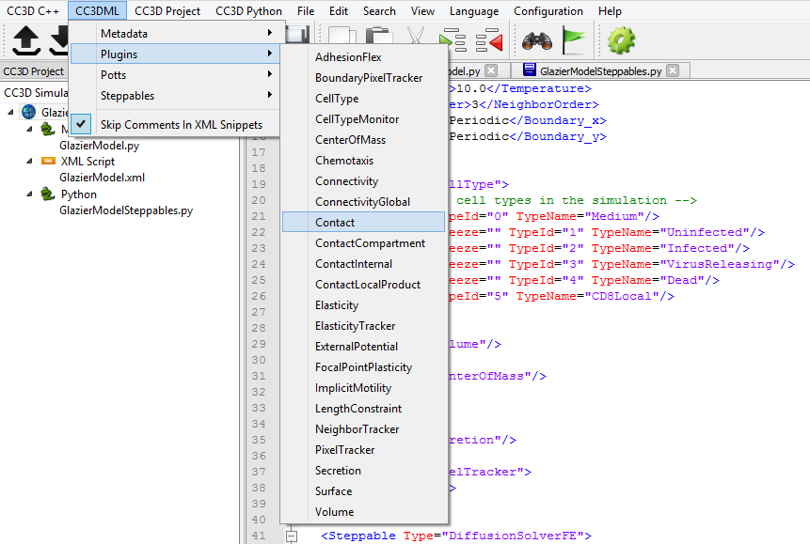
Implementing Adhesion Control
In GlazierModel.xml
Place cursor on an empty line
Use Twedit code-generator: CC3DML->Plugins->Contact
Simplest cast: no preferential attachment
Leave parameters as generated by Twedit

Slide 11
Cell Volume Control
Cells are compressible: need a volume constraint!
Two parameters dictate a volume constraint
Target volume: cell.targetVolume
Strength of constraint: cell.lambdaVolume
When creating a cell: both need set!
To kill a cell: cell.targetVolume = 0
Volume effective energy
$$ℋ_{v}=λ_{v}{\left(v−V\right)}^{2}$$
constraint strength
current cell volume
target cell volume

Slide 12
Implementing Cell Volume Control
In GlazierModel.xml
Add Volume plugin
<Plugin Name="Volume"/>

Slide 13
Implementing Cell Volume Control Parameter
In GlazierModelSteppables.py
Add model input for strength of volume constraint
volume_lm = 9

Slide 14
Adding the Lymph Node Compartment: Starting the ODE Model
Add model string
Variable: “lymph_node_model_string”
Model name: “LymphNodeModel”

Slide 15
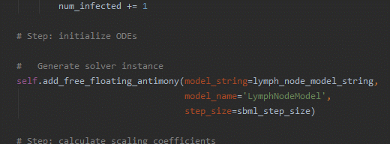
Adding the Lymph Node Compartment: Implementing the ODE Model
Add free-floating SBML solver to steppable
In steppable start(), after initial infection

Slide 16
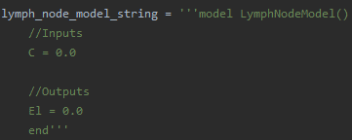
Adding the Lymph Node Compartment
Declare interface variables
Input: total local cytokine “C”
Output: lymph node immune cells “El”

Slide 17
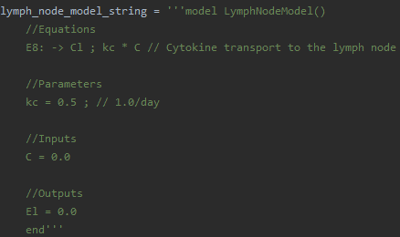
Adding transport of cytokine to the lymph node compartment
Copy lymph node cytokine production equation from ODE model (E8)
We’ll pass cytokine from the spatial domain, rather than simulate an ODE: Change “C -> Cl” to just “-> Cl”
Copy relevant parameter: kc

Slide 18
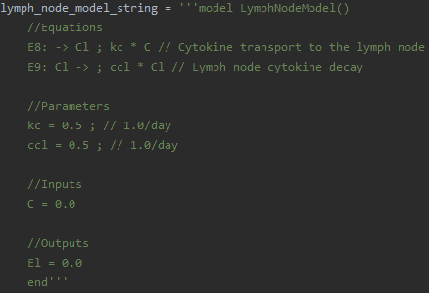
Adding Decay of Lymph Node Cytokine
Copy lymph node cytokine decay equation from ODE model (E9)
Copy relevant parameter: ccl

Slide 19
Passing local cytokine to the lymph node compartment
Add cytokine volume integral in steppable and pass to lymph node variable for local cytokine
cytokine_secretor.totalFieldIntegral()
Don’t forget to scale up from patch to organism!
In steppable step(), before integrating ODEs

Slide 20
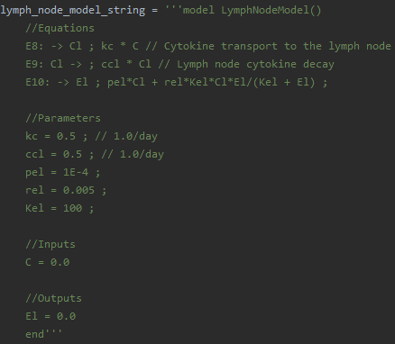
Local immune cell recruitment: add production to lymph node ODEs
Copy lymph node immune cell production equation from ODE model (E10)
Copy relevant parameters: pel, rel, Kel

Slide 21
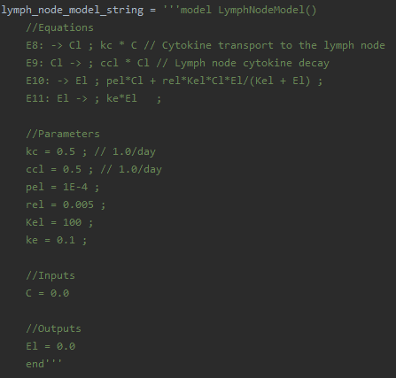
Local immune cell recruitment: add transport to lymph node ODEs
Copy immune cell transport equation from ODE model (E11)
We handle local immune cells in the spatial domain, rather than simulate an ODE: Change “El -> E” to just “El -> ”
Copy relevant parameter: ke

Slide 22
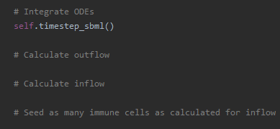
Local immune cell recruitment: updating the spatial model
Algorithm
Calculate outflow of immune cells
Calculate inflow of immune cells
Seed as many immune cells as calculated for inflow
After ODE integration: implement pseudo-code as comments

Slide 23
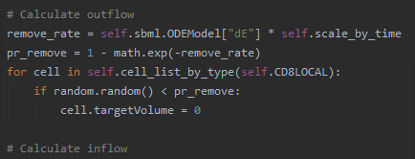
Implementing Outflow of Immune Cells
Outflow according to the ODEs
$$\frac{dE}{dt}=k_{e}E_{L}−d_{E}E$$
Outflow occurs using the discrete stochastic rule
$$\operatorname{Pr}\left(remove immune cell\right)=1−e^{−d_{E}∆t}$$

Slide 24
Calculating Immune Cell Inflow
Inflow according to the ODEs
$$\frac{dE}{dt}=k_{e}E_{L}−d_{E}E$$
Inflow occurs using the discrete stochastic rule
$$\operatorname{Pr}\left(add k immune cells\right)=1−e^{−k_{e}E_{L}∆t}\sum_{0≤n≤k}{\frac{{\left(k_{e}E_{L}∆t\right)}^{n}}{n!}}$$
Algorithm:
test for adding no cells
if not, test for adding one cell
…

Slide 25
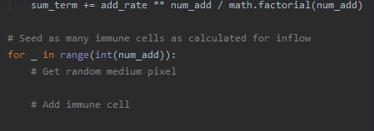
Overview: Immune Cell Seeding
For each immune cell that we need to add:
Randomly select a medium pixel
Create a cell and place it in medium pixel
Implement pseudo-code as comments and a generic loop

Slide 26
Looping over Randomly-Selected Medium Sites
We need to randomly select from a list of medium pixels
To get an iterator over medium pixels: track medium
In GlazierModel.xml
Add PixelTracker plugin
Enable medium tracking
In GlazierModelSteppables.py, add requirement to annotations

Slide 27
Randomly Selecting a Medium Pixel
Iterator for Pixel Tracker Data over all medium pixels: self.pixel_tracker_plugin.getMediumPixelSet()
Each Pixel Tracker Data has a pixel attribute: ptd.pixel
Each pixel has coordinate attributes ptd.pixel.x, ptd.pixel.y, ptd.pixel.z
Make a Python list of medium pixels
Generate a random index
Get the medium pixel at the random index

Slide 28
Get the Randomly Selected Seeding Coordinates
Declare coordinates for where a cell will be seeded
X-coordinate: x_seed = rand_pixel.x
Y-coordinate: y_seed = rand_pixel.y

Slide 29
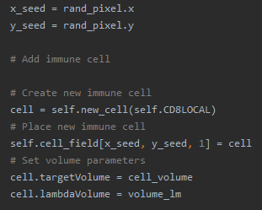
Creating and Seeding the New Immune Cell
Place a new cell at the seeding coordinates
Create a new immune cell: self.new_cell(self.CD8Local)
Place it at our seeding point
Set volume parameters

Slide 30
Exercise 2.3.1: Update population plot
Add local and lymph node immune cells to population data window
Update population data window with local and lymph node immune cell populations
Run a simulation
How do the spatial and ODE models compare?

Slide 31
Adding local and lymph node immune cells to plots
In steppable start(): add plots to population data window

Slide 32
Updating population data window with immune cell populations
In steppable step(), after recruitment: update population data plot window

Slide 33
Exercise 2.3.2: differential adhesion
Make immune cells stick to each other and run
Make immune cells not stick to each other and run
Reminder: lower contact coefficient = stronger adhesion
If killing infected cells by T Cells is local, how might this affect efficiency of immune response?
 | Medium | Type 1 | Type 2
Medium | n/a
Type 1 | 20 | 5
Type 2 | 25 | 10 | 15
Least adhesive: Type 2 – Medium
Most adhesive: Type 1 – Type 1

