Slide 1
CC3D Workshop 4.5: Releasing CompuCell3D Models on nanoHUB
Juliano F. Gianlupi
Dept. of Intelligent Systems Engineering
and Biocomplexity Institute
Indiana University
Bloomington, IN 47408
USA
Screensharing and microphones have been disabled for participants in the main session—they are available in breakout rooms
Please submit questions/concerns/suggestions via zoom chat
User support will be available in zoom breakout rooms
Workshop will be live-streamed, recorded and distributed
Make sure you save the zoom link after registering so you do not have to re-register
Please take the time now to be sure you have a working nanoHUB account and to download and install CompuCell3D to your desktop if you are planning to run it locally
Please also join the workshop slack channel at https://join.slack.com/t/multiscalemod-ags3330/shared_invite/zt-g0up1lz7-z5XGFC73UZk1j3BPeW7RVA
Funding Sources: NIH U24 EB028887, NIH R01 GM122424, NIH R01 GM123032, NIH P41 GM109824, NSF 1720625 and nanoHUB

Slide 2
What you’ll need
A nanoHUB account
A github account
Git bash (or some other way to interact with github on your machine)
A CompuCell3D model that you want to share
Being able to run a python script (a local python installation)

Slide 3
Step 1: Download the nanoHUB CC3D tool generator
Go to https://github.com/JulianoGianlupi/cc3d-nanoHub-tool-setuper
And either clone the repository or download it as a zip
If you downloaded it as a zip, unzip it

Slide 4
Step 2: Run the script
You need to be able to run a python script from the command terminal, in other words you need to be able to issue a command like “python script.py”
If you have anaconda installed, for instance, you can use anaconda prompt
If you have CC3D installed locally you can use python from there
The python script will take a three arguments
A short name for the tool, between 3 and 15 alphanumeric characters without spaces (choose this wisely)
Full path to where you wish the script to save the new files
Full path to where you have your model

Slide 5
Step 2: Run the script
The python script will take a three arguments
A short name for the tool, between 3 and 15 alphanumeric characters without spaces (choose this wisely) <short-tool-name>
Full path to where you wish the script to save the new files <full-path-to-repo>
Full path to where you have your model <full-path-to-model>
D:\>D:\CompuCell3D-py3-64bit\python36\python.exe D:\nanoHub\cc3d-nanoHub-tool-setuper\tool_maker.py testTool D:\test_nanohub D:\cc3d_ex_upload

Slide 6
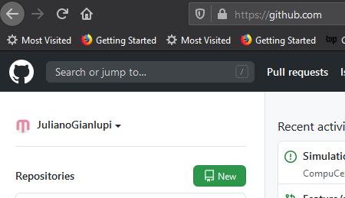
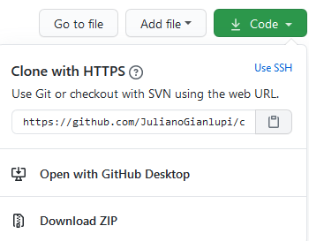
Step 3.1: Create a github repository
You need to create a new public repository on github
After you created your new repository grab the cloning link to it and have it in a text file

Slide 7
Step 3.2: Getting your simulation on github
Open gitbash on your local machine and navigate to <full-path-to-repo>
Now there are a few command that you’ll have to issue
git init
git add .
git commit -m "First commit "
git remote add origin <remote repository Link>
git remote –v
git push origin master
Go to your github repository and make sure the files are there

Slide 8
Step 3.3: Some files may need tweaking
There are two files that need execution permission but may loose it during this process
They are
<full-path-to-repo>/bin/<name>.sh
<full-path-to-repo>/middleware/invoke
So we need to issue
git update-index --chmod=+x bin/<name>.sh
git update-index --chmod=+x middleware/invoke
git commit -m "Changing file permissions“
git push

Slide 9
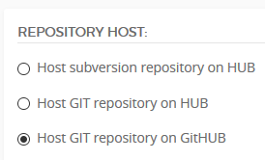
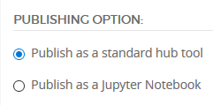
Step 4: onto nanoHUB
https://nanohub.org/tools/create
Fill that form, things to look out for
The first box, Tool Name, must be <short-tool-name>
You hosted the model on github
Publish as a standard hub tool

Slide 10
Step 5: waiting for nanoHUB
nanoHUB will install your tool in the following days
You’ll have to run it before making it public to make sure it works

