Slide 1
CC3D Workshop 2.1: Implementing the Viral Infection Model in CC3D—Part 2: Creating an Epithelial Sheet, Infection and Type Transitions
Josua Aponte Serrano
Dept. of Intelligent Systems Engineering
and Biocomplexity Institute
Indiana University
Bloomington, IN 47408
USA
Screensharing and microphones have been disabled for participants in the main session—they are available in breakout rooms
Please submit questions/concerns/suggestions via zoom chat
User support will be available in zoom breakout rooms
Workshop will be live-streamed, recorded and distributed
Please also join the workshop slack channel at https://join.slack.com/t/multiscalemod-ags3330/shared_invite/zt-g0up1lz7-z5XGFC73UZk1j3BPeW7RVA
Funding Sources: NIH U24 EB028887, NIH R01 GM122424, NIH R01 GM123032, NIH P41 GM109824, NSF 1720625 and nanoHUB

Slide 2
Topics
Creating an Epithelial Cell Layer
Cell Type Plugin in CC3DML
Determining cell volume
Creating Cells in Python Steppable
Downscaling ODE outputs
Translating rate laws to transition probabilities: Poisson distribution
Transition from Uninfected to Infected
Determining transition probability
Iterating over cells by type
Rolling dice (random number generator)
Changing cell types
Plotting and comparing ODE and Cellularized models
Transition from Infected to Virus Releasing
Exercise 2.1.1: Transition from Virus Releasing to Dead
Quantifying cell death mechanism
Creating dictionaries inside steppables

Slide 3
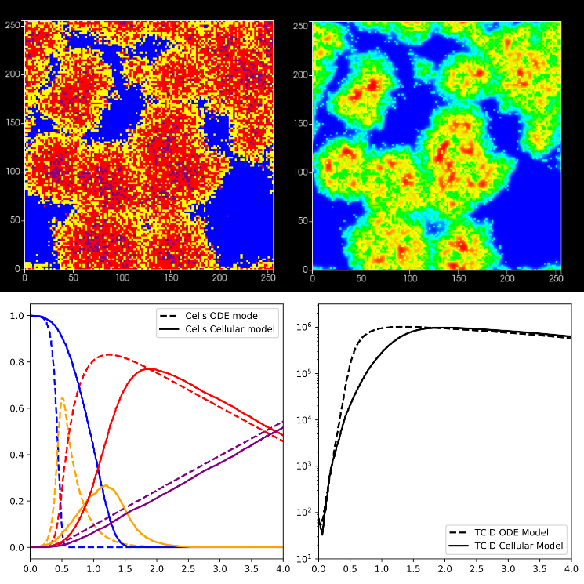
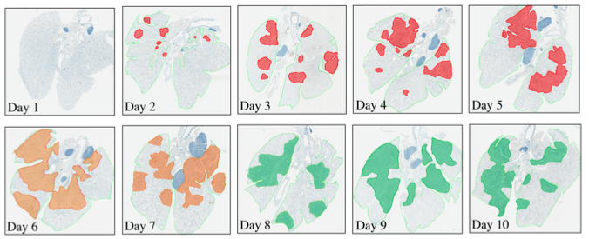
Spatializing ODE models in CC3D
ODE models are extensively to understand dynamics of wide ranges of biological systems (from ecosystems down to whole organism down to cell populations to intracellular pathways and responses)
ODE systems can be powerful predictive tools when fitted to experimental data
However, ODE do not include individual heterogeneity nor spatial resolution
For some disease, stochasticity associated with individual agents and the resulting spatiotemporal dynamics are important predictors of disease outcomes
Myers MA, Smith AP, Lane LC, Moquin DJ, Vogel P, Woolard S, Smith AM. Dynamically Linking Influenza Virus Infection with Lung Injury to Predict Disease Severity. bioRxiv. 2019 Jan 1:555276.

Slide 4
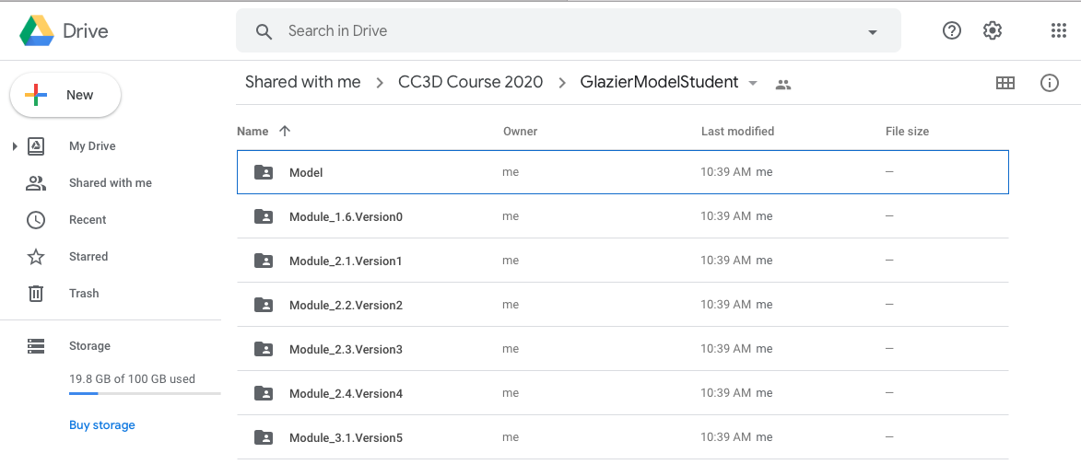
Download Simulation Scripts
Versions of the different projects we will be working during the following modules are available in Google Drive:
https://drive.google.com/drive/folders/1xzAsdpc7LK3Yhjr-Yx0-KWhHzVUIoT15?usp=sharing

Slide 5
Defining Cell Types in XML file
We defined cell types in the previous module (1.6) using Wizard
Cell types are displayed in XML with TypeID, TypeName and a flag that indicates whether the cell type is “frozen”
However, our code doesn’t create any cells in our cell-lattice domain

Slide 6
Refresher: Conversion Factors
In the previous module we established the conversions between CC3D time and spatial units (mcs and voxels) and real-world units (days, cell diameters).
Given the size of our simulation domain (200x200x2), we are now going to populate the domain with cells of the given size specified in our conversion factors
Since the cell diameter is 5 voxels, our cells will occupy 5x5 = 25 voxels

Slide 7
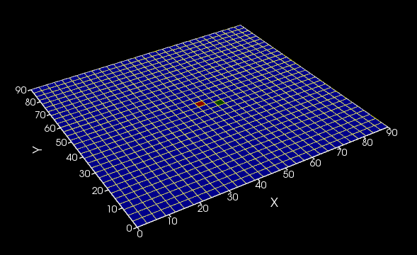
Creating Epithelial Cell Layer
We need to initialize a layer of susceptible epithelial cells
To generate a quasi-2D epithelium, we will create a layer of square epithelial cells (each occupying 25 voxels, 5x5) in the lower level of our simulation domain

Slide 8
Creating Epithelial Cell Layer
We will iterate through the voxels in the simulation domain in steps determined by the size of the cell, and assign cells to each location of the lattice

Slide 9
Creating Epithelial Cell Layer
We will iterate through the voxels in the simulation domain in steps determined by the size of the cell, and assign cells to each location of the lattice

Slide 10
Creating Epithelial Cell Layer
We will iterate through the voxels in the simulation domain in steps determined by the size of the cell, and assign cells to each location of the lattice

Slide 11
Creating Epithelial Cell Layer
We will iterate through the voxels in the simulation domain in steps determined by the size of the cell, and assign cells to each location of the lattice
1 | 1
1 | 1

Slide 12
Creating Epithelial Cell Layer
We will iterate through the voxels in the simulation domain in steps determined by the size of the cell, and assign cells to each location of the lattice
2 | 2
2 | 2
1 | 1
1 | 1

Slide 13
Creating Epithelial Cell Layer
We will iterate through the voxels in the simulation domain in steps determined by the size of the cell, and assign cells to each location of the lattice
3 | 3
3 | 3
2 | 2
2 | 2
1 | 1
1 | 1

Slide 14
Creating Epithelial Cell Layer
We will iterate through the voxels in the simulation domain in steps determined by the size of the cell, and assign cells to each location of the lattice
3 | 3
3 | 3
2 | 2
2 | 2
1 | 1 | 4 | 4
1 | 1 | 4 | 4

Slide 15
Creating Epithelial Cell Layer
We will iterate through the voxels in the simulation domain in steps determined by the size of the cell, and assign cells to each location of the lattice
3 | 3
3 | 3
2 | 2 | 5 | 5
2 | 2 | 5 | 5
1 | 1 | 4 | 4
1 | 1 | 4 | 4

Slide 16
Creating Epithelial Cell Layer
We will iterate through the voxels in the simulation domain in steps determined by the size of the cell, and assign cells to each location of the lattice
3 | 3 | 6 | 6
3 | 3 | 6 | 6
2 | 2 | 5 | 5
2 | 2 | 5 | 5
1 | 1 | 4 | 4
1 | 1 | 4 | 4

Slide 17
Creating Epithelial Cell Layer
We will iterate through the voxels in the simulation domain in steps determined by the size of the cell, and assign cells to each location of the lattice
3 | 3 | 6 | 6
3 | 3 | 6 | 6
2 | 2 | 5 | 5
2 | 2 | 5 | 5
1 | 1 | 4 | 4 | 7 | 7
1 | 1 | 4 | 4 | 7 | 7

Slide 18
Creating Epithelial Cell Layer
We will iterate through the voxels in the simulation domain in steps determined by the size of the cell, and assign cells to each location of the lattice
3 | 3 | 6 | 6
3 | 3 | 6 | 6
2 | 2 | 5 | 5 | 8 | 8
2 | 2 | 5 | 5 | 8 | 8
1 | 1 | 4 | 4 | 7 | 7
1 | 1 | 4 | 4 | 7 | 7

Slide 19
Creating Epithelial Cell Layer
We will iterate through the voxels in the simulation domain in steps determined by the size of the cell, and assign cells to each location of the lattice
3 | 3 | 6 | 6 | 9 | 9
3 | 3 | 6 | 6 | 9 | 9
2 | 2 | 5 | 5 | 8 | 8
2 | 2 | 5 | 5 | 8 | 8
1 | 1 | 4 | 4 | 7 | 7
1 | 1 | 4 | 4 | 7 | 7

Slide 20
Creating Cells in Python Steppables
In the start function, we create a loop to iterate through our entire domain in steps corresponding to the cell diameter (5 voxels)
Python loops allow iteration over list of objects.
For index in list:
do something
We need to iterate through a list of numbers corresponding to voxels in our simulation
We can generate these list using range(0,self.dim.x,cell_diameter)
self.dim.x corresponds to the size of the simulation in the x dimension (self.dim.y, self.dim.z are the other dimensions)
Theprefix self. Indicates that the attribute corresponds to entire class where is being used. In this case, is an attribute of the whole simulation (as opposed to an specific attribute of an individual object inside the simulation)
step_size indicate the spacing between number in our list.
In this case: range(0,self.dim.x,cell_diameter) = range(0,200,5) = [0,5,10,15,20,25,…,200]

Slide 21
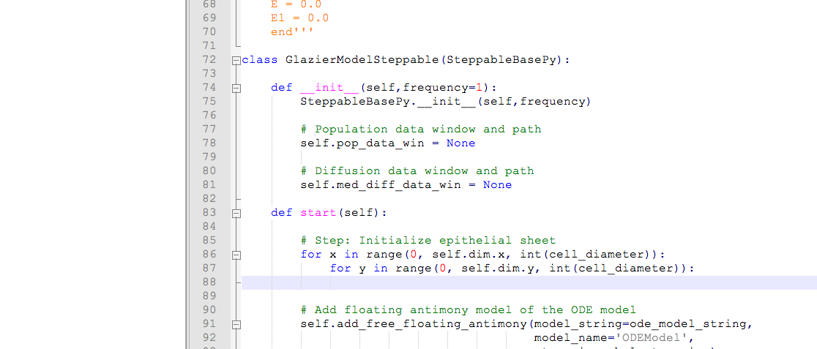
Creating Cells in Python Steppables
In the start function, we create a loop to iterate through our entire domain in steps corresponding to the cell diameter (5 voxels)
for range(0,self.dim.x,cell_diameter):
for range(0,self.dim.y,cell_diameter):
Create Cell

Slide 22
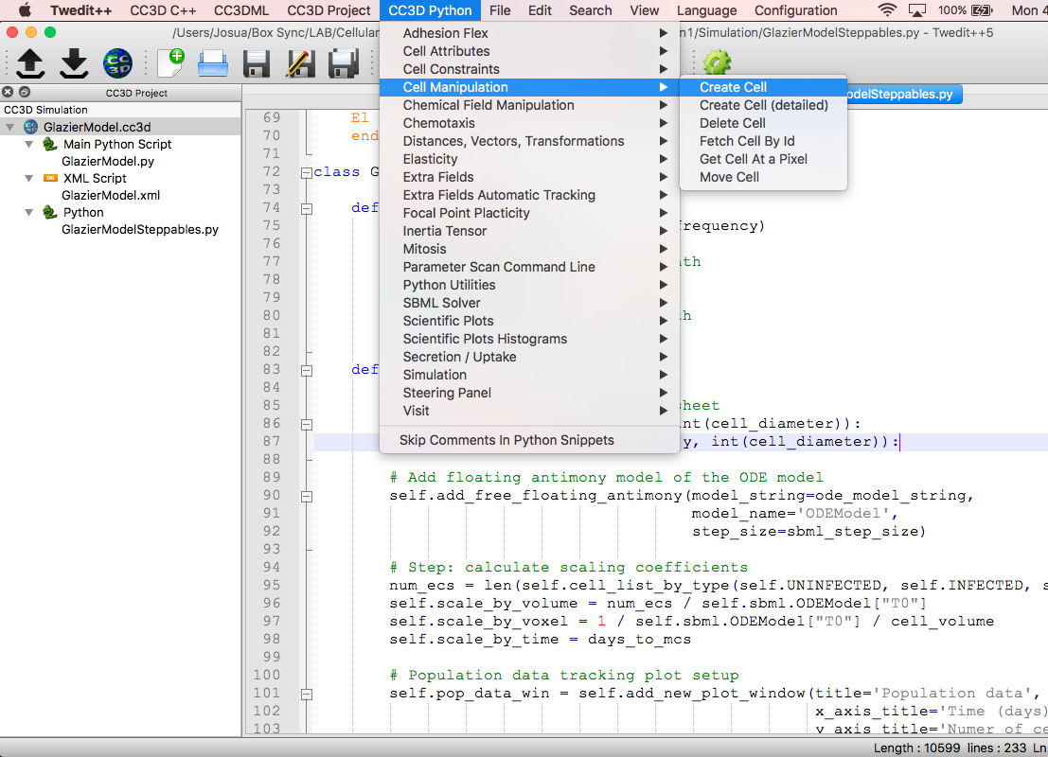
Creating Cells in Python Steppables
To create a new cell we access the code snippet in the pull down menu
File -> CC3D Python -> Cell Manipulation -> Create Cell

Slide 23
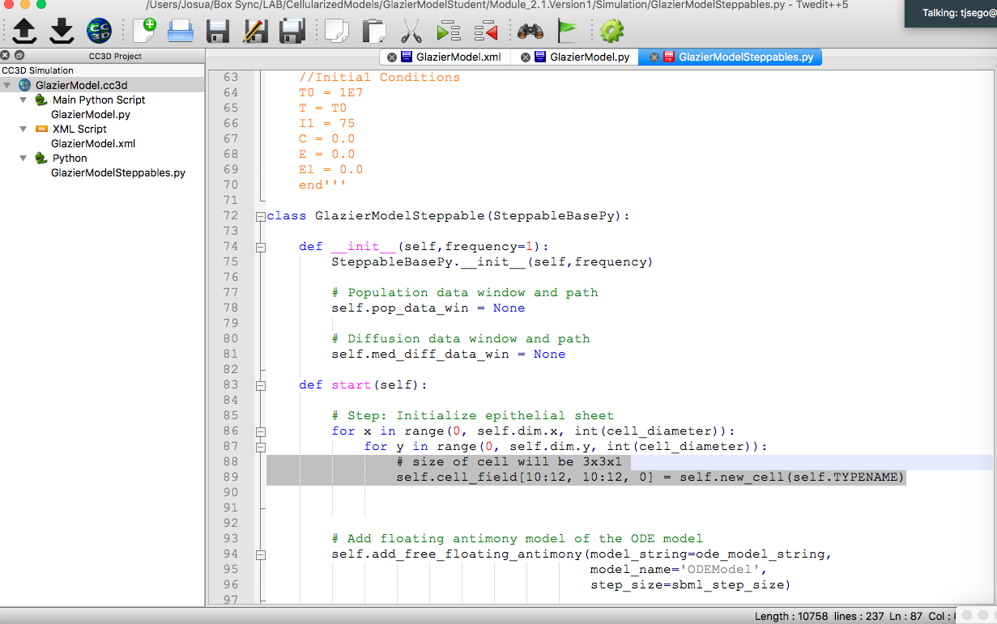
Creating Cells in Python Steppables
The default snippet creates a new cell “self.new_cell(self.TYPENAME)” at location “self.cell_field[10:12,10:12,0]”. We can now modify our snippet to create cells at each location in the simulation domain

Slide 24
Creating Cells in Python Steppables
The default snippet creates a new cell “self.new_cell(self.TYPENAME)” at location “self.cell_field[10:12,10:12,0]”. We can now modify our snippet to create cells at each location in the simulation domain

Slide 25
Creating Cells in Python Steppables
The default snippet creates a new cell at location specific location of the domain
self.cell_field[10:12,10:12,0] = self.new_cell(self.TYPENAME)
self.cell_field is a pointer to the cell occupying the space indicating inside the brackets
Inside the brackets 10:12 references the voxels located at 10 and 11 in both the x and y dimensions
self.new_cell creates a new cell of the type specified inside the parenthesis
We can now modify our snippet to create cells at each location in the simulation domain
First, we will split the code:
cell = self.new_cell(self.UNINFECTED) creates an uninfected cell and attaches it to the variable “cell”
Second, we determine the location at which the cell will be assigned. Since we are iterating over lists using the variables x and y, we can use them as variables for the positions in the simulation domain.
self.cell_field[x:x+cell_diameter,y:y+cell_diameter,0] x:x+cell_diameter references voxels in the positions x through x+cell_diameter (x+5) in the x dimension
Note that the z dimension has only one entry: 0, because we are generating cells of one voxel width in the z dimension
Third, we assigned the newly created cell to the space refernce in self.cell_field
self.cell_field[x:x+cell_diameter,y:y+cell_diameter,0] = cell

Slide 26
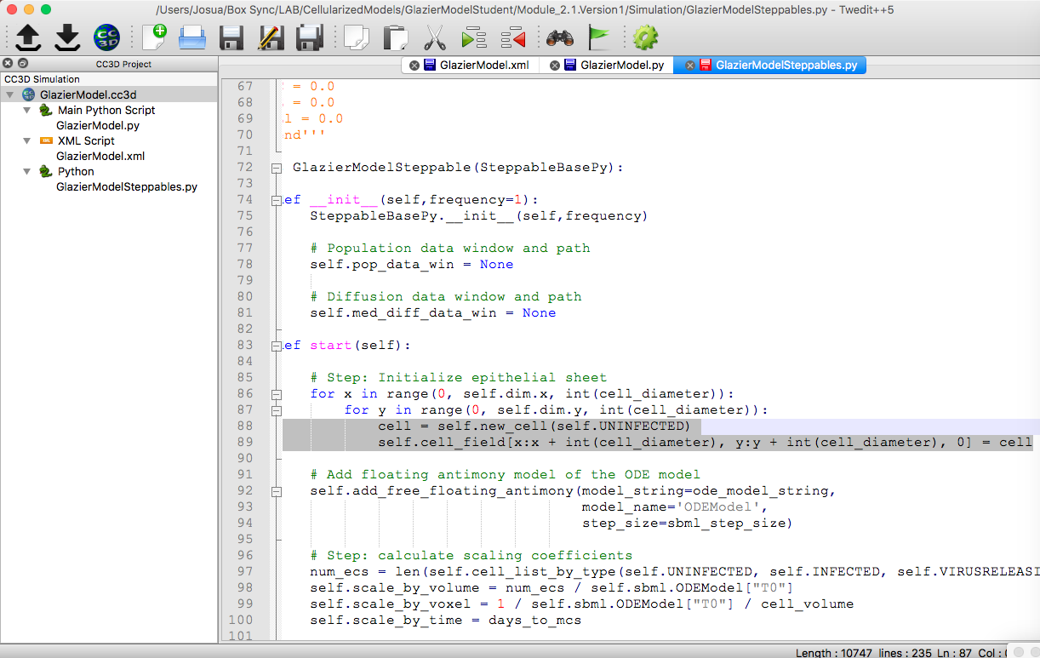
Creating Cells in Python Steppables

Slide 27
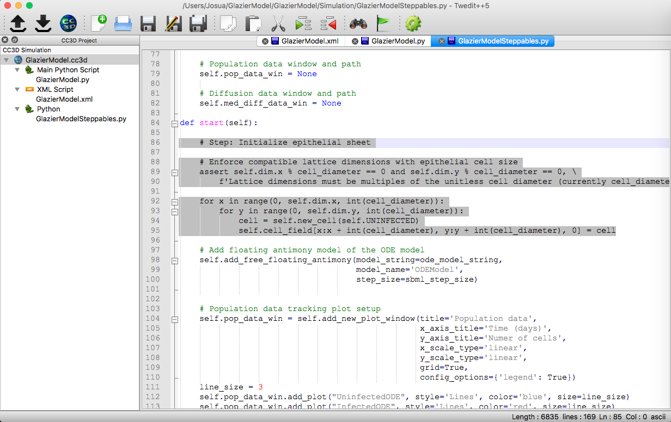
Making Sure All Cells are Complete
Explain your code! % == and self.dim.x
To make sure we fill the cell lattice with complete cells, we must check that the lattice size is an integer multiple of the cell size in voxels

Slide 28
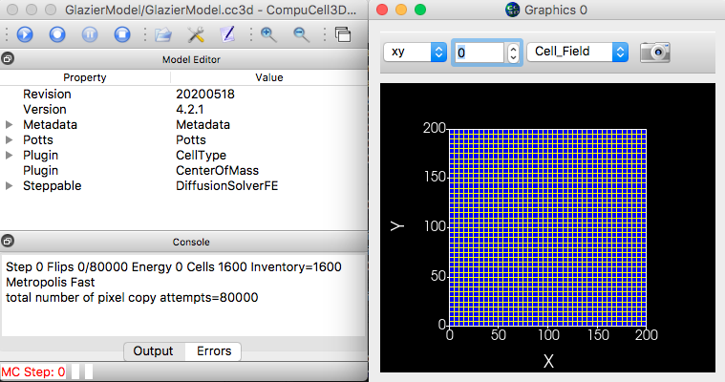
Displaying Cell Field
We can run CC3D now and display the cells in the simulation domain by choosing “Cell_Field” in the graphic window and showing level 0

Slide 29
Converting Between Antimony Model and CC3D Simulation Length, Time and Number of Cells
In the previous module (1.6), we loaded the Antimony Model to CompuCell and displayed results CC3D integrates the model.
In this module, we will use the rates and parameters of the Antimony Model to determine transition probabilities such that the cells of our cellular model transition between cell types at the same rate as the population of cells in the Antimony Model change.
To be able to compare the simulation (number of cells of each type per unit time, amount of extracellular virus, etc.) to the ODEs, we need to scaled down the outputs of the ODEs such that the numbers are comparable to the numbers in the cellular version
For example, in the ODE model the initial number of cells is T0 is 10E7.
Although in principle we could have the same number of cells in CC3D, simulations would run very slow. Instead, we simulate a smaller fraction of that population: around 10E3 cells.
We will therefore scaled down the outputs of the ODEs to be a fraction of the original number of cells, such that we can compared to our number of cells in CC3D
Parameter will also have to be rescaled to the simulation time units (mcs)

Slide 30
Rescaling Antimony Model for Simulation Domain
The three rescaling factors we need are:
self.scale_by_volume: rescale values by the initial number of epithelial cells in the simulation domain
self.scale_by_voxel: rescales values by the number of voxels each cell occupies
self.scale_by_time: rescales by the time we attributed to each mcs
Good Practice: we initialize the scaling factors in the _init_ function as None.
We declare the scaling factors as variables pertaining to the whole stoppable class

Slide 31
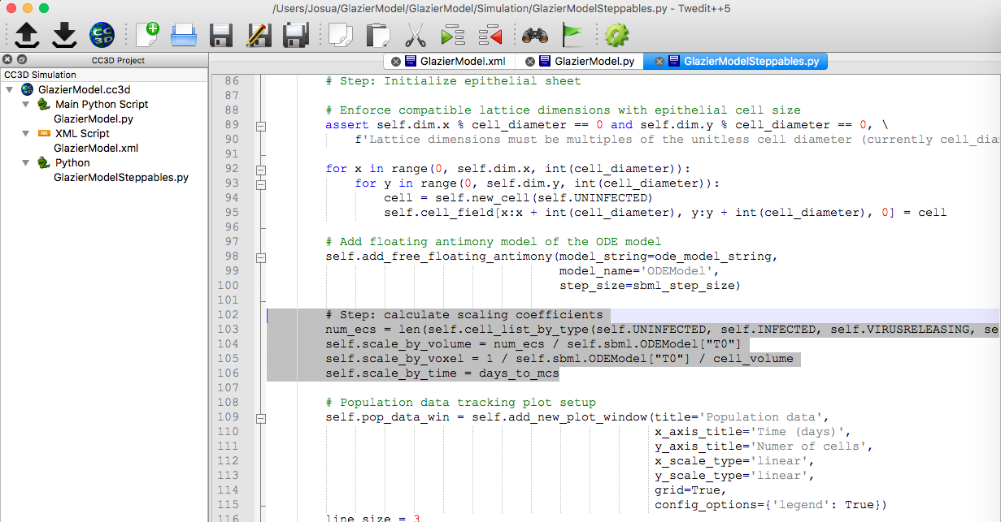
Rescaling Antimony Model to the size of the simulation domain
Values of the rescaling parameters:
self.scale_by_volume = original number of uninfected cells in the CC3D simulation/ original number of uninfected cells in the Antimony Model self.scale_by_voxel = 1 / (original number of uninfected cells in the Antimony Model * number of voxels per cell in CC3D) self.scale_by_time = days each mcs

Slide 32
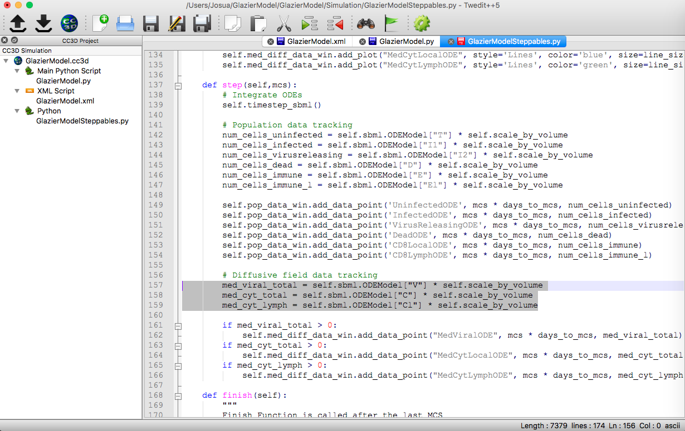
Rescaling ODE outputs for Simulation Domain
We need to rescale the outputs of the ODE so we can compare them to the outputs of the CompuCell simulation (Both the population data and the cytokines and virus)

Slide 33
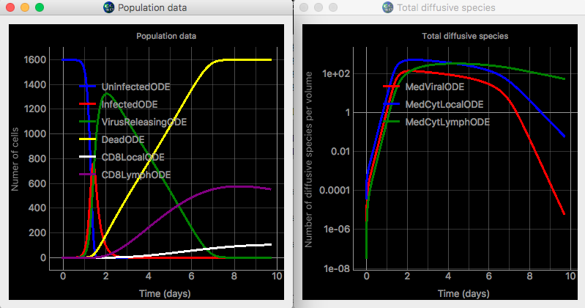
Rescaling ODE outputs for Simulation Domain
We need to rescale the outputs of the ODE so we can compare them to the outputs of the CompuCell simulation (Both the population data and the cytokines and virus)

Slide 34
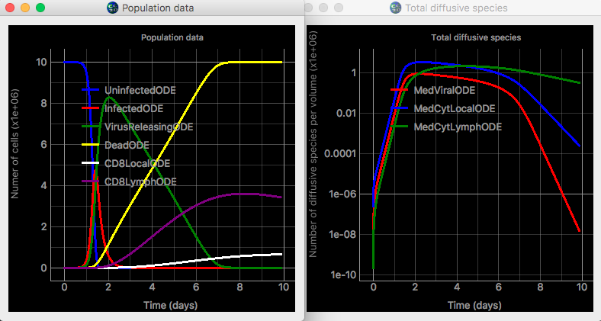
Rescaling ODE outputs for Simulation Domain
Before
Rescaling
After
Rescaling

Slide 35
Translating ODE rate to transition rules for individual agents
The rate equations on the Antimony model describe rate of change in population of cells (eg. how the number of uninfected cells is changing in time).
Now we need to translate this rate equations into rules of transition for individual cells. The general idea is that we will use the parameters of the Antimony model to calculate a transition probability for each individual cell, depending on the cell type they belong to.
We do this by assuming that the probability follows a Poisson distribution.
For an event of instantaneous probability per unit time tr, the probability of at least one occurrence of the event over a finite time $Δ t$ is given by the Poisson relation:
$$P\left(Δt\right)=1−e^{tr∗Δt}$$
This is just the rule for compounding interest!
Since we only care whether a transition in a cell happened at all (it can’t happen more than once) the Poisson relation is the correct one to use
We will calculate the probability of transition by calculating pr using the parameters from the Antimony model

Slide 36
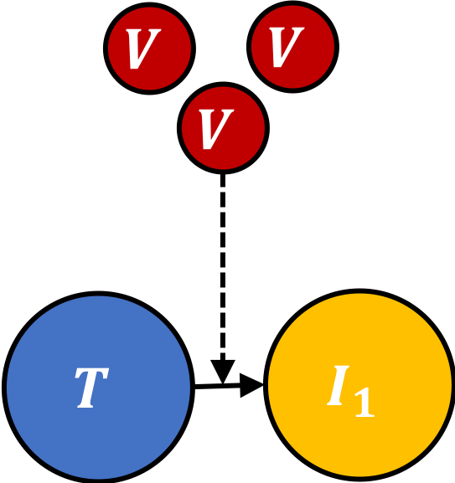
Transition Rule: Uninfected to Infected
The first transition that we will implement is the transition from Uninfected to Infected Using the rate equation for $T→I_{1}$ from the ODE we can determine that the the probability per unit time is:
$$T→I_{1};βVT$$
$$pr=βV$$
Where $β$is the infectivity parameter and $V$the amount of virus. The probability of each individual cell transitioning from Uninfected to Infected in a time step is
$$P\left(Uninfected→Infected\right)=1−e^{−pr∗Δt}$$
Next, We iterate over each of our individual cells, and use $P\left(Uninfected→Infected\right)$ to decide is the cells transitions from uninfected to infected.
When we use $V$ from the ODE our cellularized model is “slaved” to the ODE model, because the initial transition is determined by the amount of virus in the ODE model.
Keeping the cellular model slaved to the allow us to make sure that the quantities in the ODE and the cellular model are tracking closely
Later on, we will break this connection and let our cells get infected by the local concentration of virus in the simulation domain (no need to worry too much about it now).

Slide 37
Transition Rule: Uninfected to Infected General rule
The general rule to apply cell transitions:
Iterate through each cell of a given type.
Determine transition probability for each cell
Compare transition probability to a random number (roll a dice)
If condition is met, change the cell type of the cell

Slide 38
Transition Rule: Uninfected to Infected Iterating over cells of a given type
CC3D lists allow users to conveniently iterate through simulation objects (voxels, cells, etc.)
The cell list is a Python list that contains pointers to individual cells
self.cell_list contains pointers to all the cells in the simulation
self.cell_list_by_type(self.TYPENAME) contains pointer to cells of a given type.
For example, the list self.cell_list_by_type(self.UNINFECTED) contains pointers to all the uninfected cells in the simulation
Note that cells types are referenced as: self.TYPENAME all caps
To iterate through cells we just need to use a Python iterator on the list of interest
For example, we can iterate through all the cells: for cell in self.cell_list:
We can also iterate through all the uninfected cells: for cell in self.cell_list_by_type(self.UNINFECTED)

Slide 39
Transition Rule: Uninfected to Infected Iterating over cells of a given type
To iterate through cells of a given type, we can use snippet available in Twedit++ -> CC3D Python -> Visit -> All Cells of a Given Type

Slide 40
Transition Rule: Uninfected to Infected Iterating over cells of a given type
To iterate through cells of a given type, we can use snippet available in Twedit++ -> CC3D Python -> Visit -> All Cells of a Given Type

Slide 41
Transition Rule: Uninfected to Infected Iterating over Cell Types
We need to modify the default syntax of the snippet to tailored it to our specific needs. We want to iterate over the uninfected cells
for cell in self.cell_list_by_type(self.UNINFECTED):
Do something
We can now decide what to do to each individual cell inside the loop.

Slide 42
Transition Rule: Uninfected to Infected Iterating over Cell Types
We need to modify the default syntax of the snippet to tailored it to our specific needs. We want to iterate over the uninfected cells
for cell in self.cell_list_by_type(self.UNINFECTED):
Do something
We can now decide what to do to each individual cell inside the loop.

Slide 43
Transition Rule: Uninfected to Infected Iterating over Cell Types
We need to modify the default syntax of the snippet to tailored it to our specific needs. We want to iterate over the uninfected cells
for cell in self.cell_list_by_type(self.UNINFECTED):
Do something
We can now decide what to do to each individual cell inside the loop.

Slide 44
Transition Rule: Uninfected to Infected Determining Transition Event
We then calculate the transition probability.
$$P\left(Uninfected→Infected\right)=1−e^{−βV}$$
We defined a variable called infection_rate = beta * V
Both beta and V are determined from the ODE Model
We calculate the probability of infection pr_infect = 1 – math.exp(-infect_rate)

Slide 45
Transition Rule: Uninfected to Infected Determining Transition Event
To decide wether the infection event happens or not, we need to be able to roll a dice.
We roll a dice by using a random number generator.
numpy function np.random.random() returns a random number between 0 and 1
We then compare the random number to the transition probability
If the random number is less than the infection probability, the transition occurs
Otherwise, nothing happens and we move on to the next cell

Slide 46
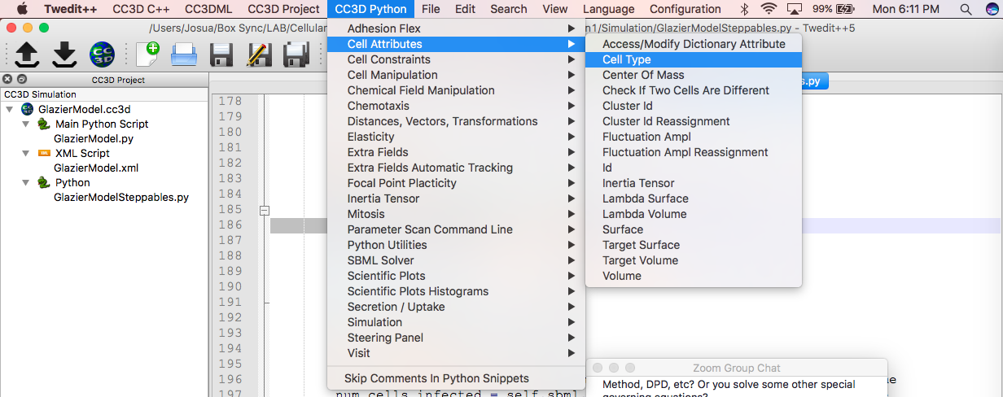
Transition Rule: Uninfected to Infected Determining Transition Event
If the transition occurs, we need to change the cell type of the cell we are iterating over.
Twedit++ has template snippet codes that allow users to manipulate different cell attributes
In this case we want to manipulate the cell’s type
CC3D Python -> Cell Attributes -> Cell Type

Slide 47
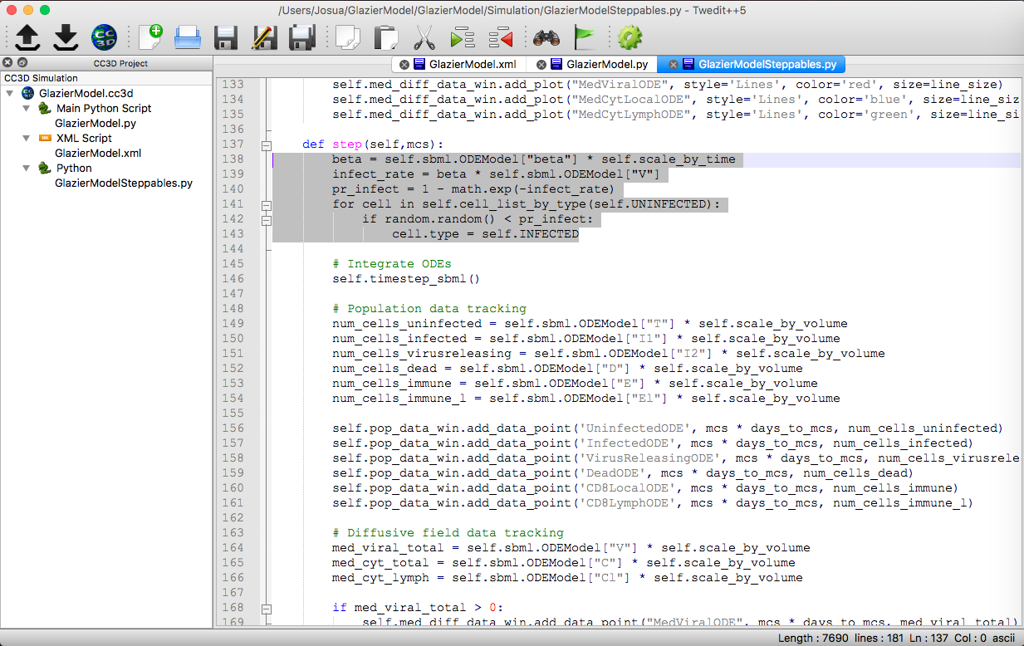
Transition Rule: Uninfected to Infected Changing Cell Type
We need to change the default snippet to change the cell type of the individual cell from UNINFECTED to INFECTED. Remember that cell types are always referenced in all caps!

Slide 48
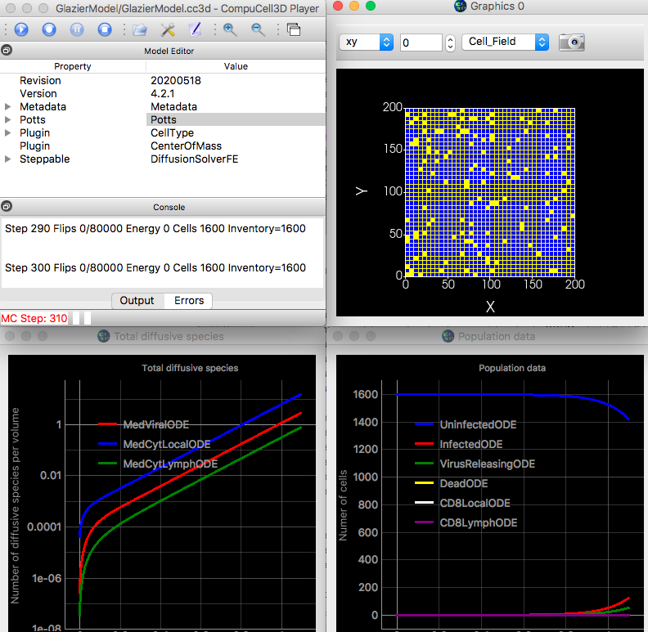
Transition Rule: Uninfected to Infected Run CC3D to see transitions
We need to change the default snippet to change the cell type of the individual cell to INFECTED.

Slide 49
Transition Rule: Uninfected to Infected Plotting Cell Number– Adding Data Series
To be able to compare the ODE results with the cellular simulation, we need to be able to plot them together (For details see Module 1.6)
Quick refresher to creating plot windows:
1) Create Plot Windows and Data Series in the start function
2) Add Data Points in the step function
Code snippets can be accessed in CC3D Python -> Scientific Plots
We want to add data series for the number of uninfected cells in the same plot window as the population data of the ODE model

Slide 50
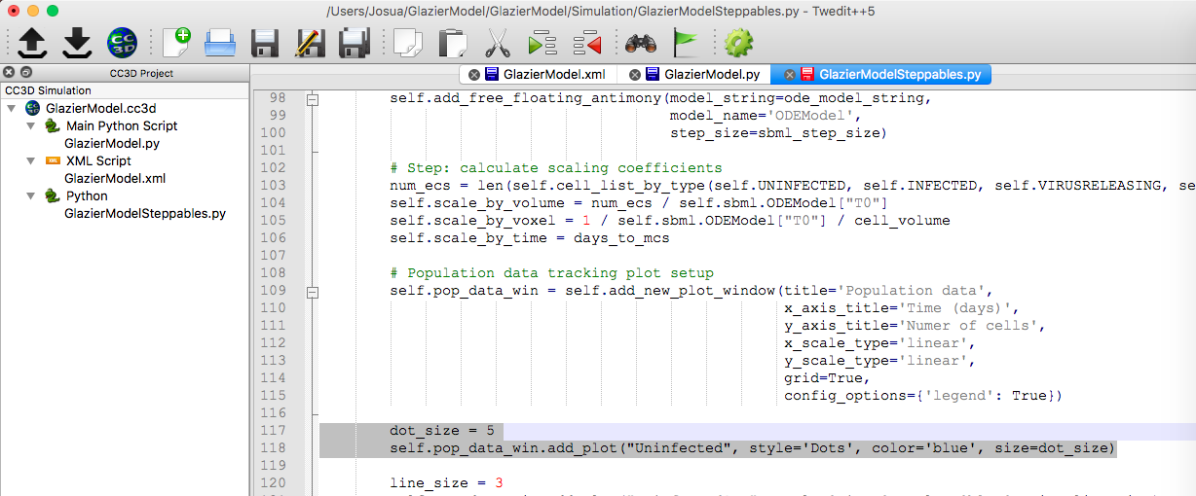
Transition Rule: Uninfected to Infected Adding Data Series
We will add data series called “Uninfected” to pop_data_win.
We will use “Dots” to distinguish CC3D data series from the ODE model from the cellularized model
We will define the dot_size outside of the function to make it available to other data series

Slide 51
Transition Rule: Uninfected to Infected Counting cells and adding Data Points
To add data points, we need to count the number of uninfected cells at each time step.
We can conveniently count the number of cells of a given type by measuring the length of the list_by_type:
len(self.cell_list_by_type(self.UNINFECTED))
We can then pass that number to the data series
We will do it by generating a variable num_cells_uninfected = len(self.cell_list_by_type(self.UNINFECTED))
We will pass this variable to the data series called ‘Uninfected’ using the add_data_point() method
num_cells_uninfected = len(self.cell_list_by_type(self.UNINFECTED)) self.pop_data_win.add_data_point('Uninfected', mcs * days_to_mcs, num_cells_uninfected)

Slide 52
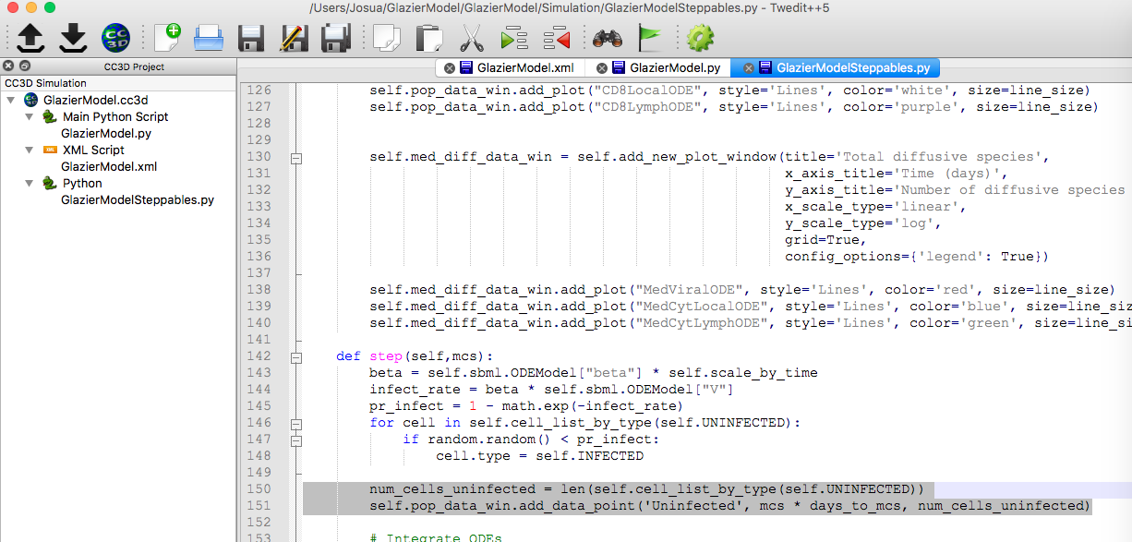
Transition Rule: Uninfected to Infected Counting cells and adding Data Points

Slide 53
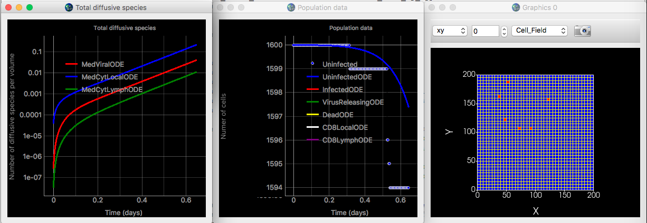
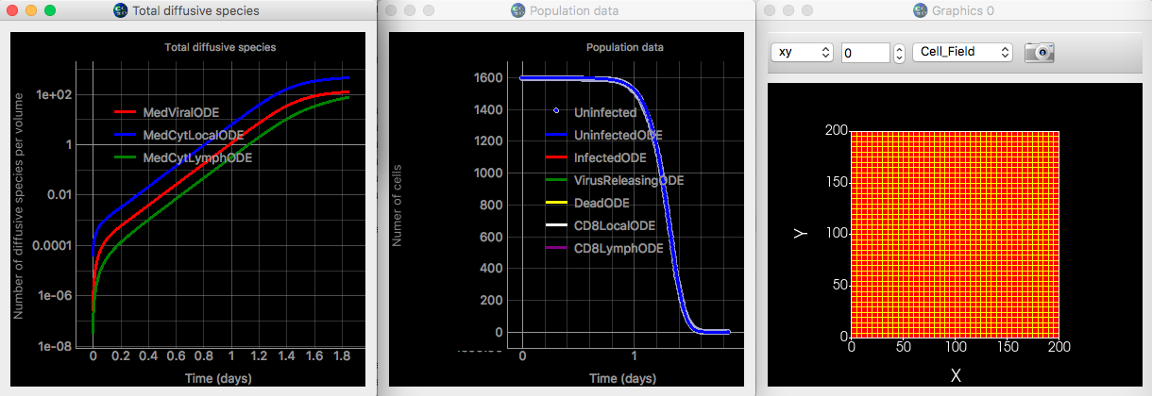
Transition Rule: Uninfected to Infected Counting cells and Adding Data Points

Slide 54
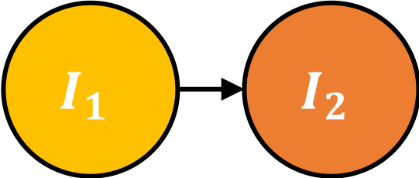
Transition Rule: Infected to Virus Releasing
Now, we will implement the transition from Infected to Virus Releasing. Using the rate equation for $I_{1}→I_{2}$ from the ODE we can determine that the the probability per unit time is:
$$T→I_{1};kI_{1}$$
$$pr=k$$
Where k is the eclipse phase parameter. The probability of each individual cell transitioning from Infected to Virus Releasing in a time step is
$$P\left(Infected→Virus Releasing\right)=1−e^{−k∗Δt}$$
Next, We iterate over each of infected cells, and use $P\left(Uninfected→Infected\right)$ to decide is the cells transitions to virus releasing.

Slide 55
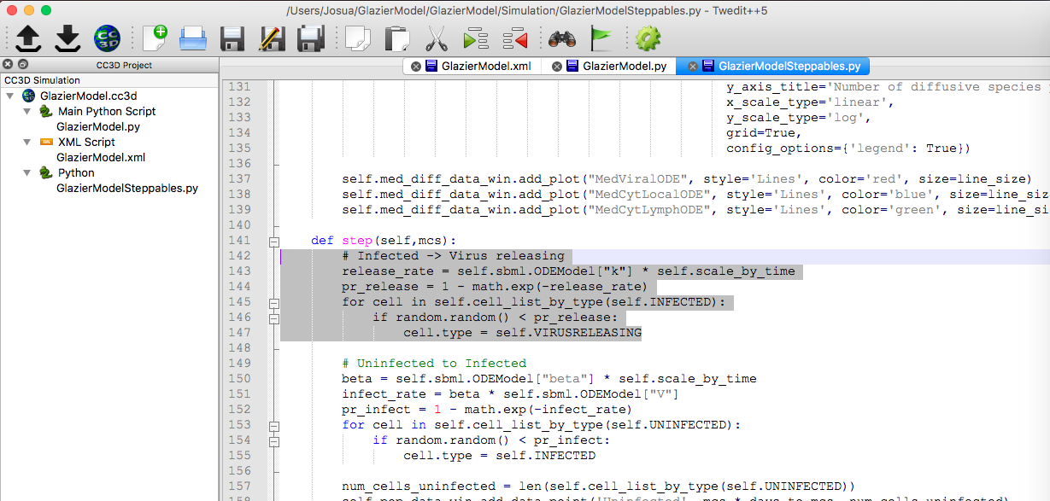
Transition Rule: Infected to Virus Releasing
Following the same workflow
Determine the probability of transitioning for individual cells
Iterate thru the list of INFECTED cells
Roll the dice and compare the random number to the transition probability
Change cell type if condition is met

Slide 56
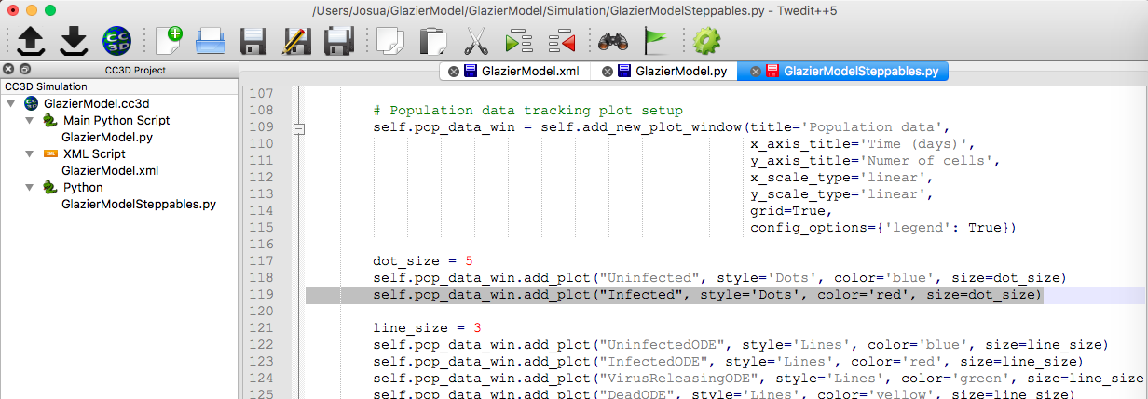
Transition Rule: Infected to Virus Releasing – Plotting Infected Cells
To compare ODE and cellular model, we need to overlay the plots of the number of Infected cells and in the ODE model and the CC3D model, following the worklow:
Add data series “Infected” to the pop_data_win in the start fcn
Count the number of infected cells: len(self.cell_list_by_type(self.INFECTED))
Add data points to the “Infected” data series

Slide 57
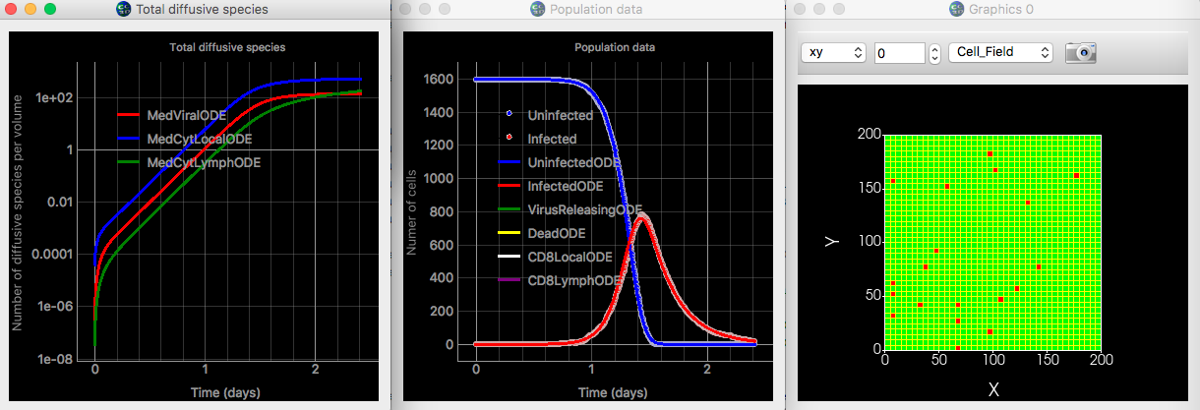
Transition Rule: Infected to Virus Releasing – Run CC3D to visualize plot
To compare ODE and cellular model, we need to overlay the plots of the number of Infected cells and in the ODE model and the CC3D model, following the worklow:
Add data series “Infected” to the pop_data_win in the start fcn
Count the number of infected cells: len(self.cell_list_by_type(self.INFECTED))
Add data points to the “Infected” data series

Slide 58
Exercise 2.1.1: Transition from Virus Releasing to Dead Cells
Establish the transition rule and code for Virus Releasing becoming Dead Cells.
Plot both Virus Releasing and Dead cells
The workflow is:
1) Determine transition probability using rate equation (step function):
death_rate = self.sbml.ODEModel["d"] * self.scale_by_time
death_probability = 1-math.exp(death_rate)
2) Iterate through list of Virus releasing cells
self.cell_list_by_type(self.VIRUSRELEASING)
3) Roll the dice and compare to death probability
np.random.random() < death_probability
4) Change cell type
cell_type = self.DEAD
5) Add data series (start function):
self.pop_data_win.add_plot("VirusReleasing", style='Dots', color='green’, size=dot_size)
6) Count number of virus releasing cells
num_cells_virusreleasing = len(self.cell_list_by_type(self.VIRUSRELEASING))
7) Add data points (step function)
self.pop_data_win.add_data_point('VirusReleasing', mcs * days_to_mcs, num_cells_virusreleasing)

Slide 59
Solution to Exercise 2.1.1

Slide 60
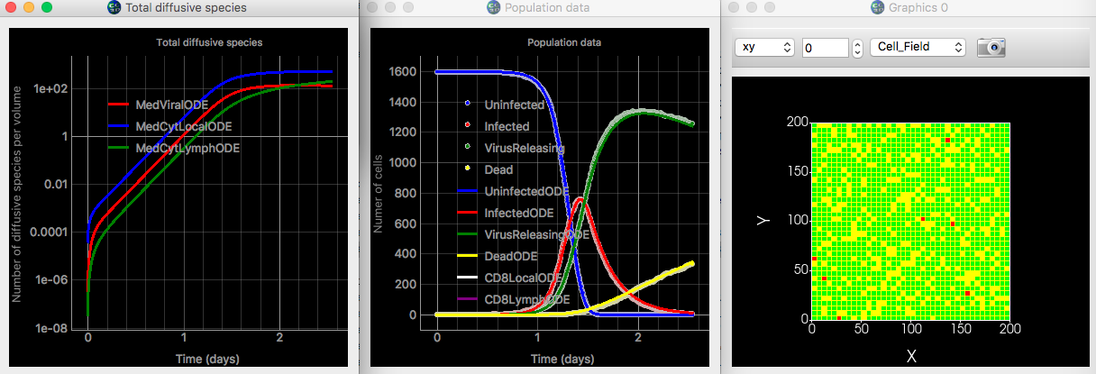
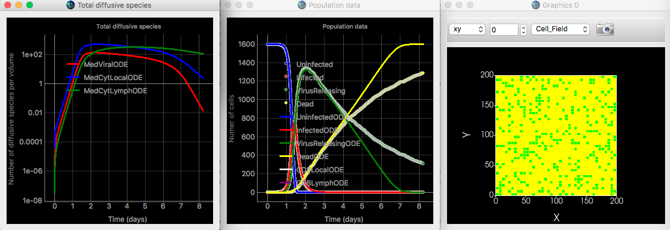
Comparing ODE and Cellular Results
Results track really well early on but differ later (after day 5)
Any ideas why?

Slide 61
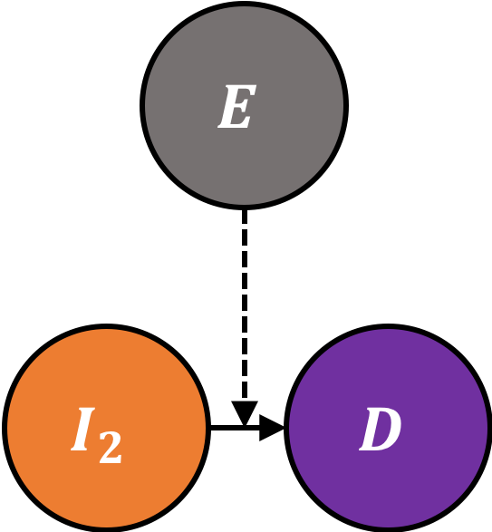
Quantifying Death by Mechanisms
To explain the difference between the cellular version and the ODE model we need to quantify the cell death by each mechanism
In the ODE Model, some cell death occurs because of the innate immune response others occur because of the adaptive immune response
We have added two additional variables in the Antimony Model to keep track of how many cells are dying by each mechanism
So far we have only included cell death by innate immune response

Slide 62
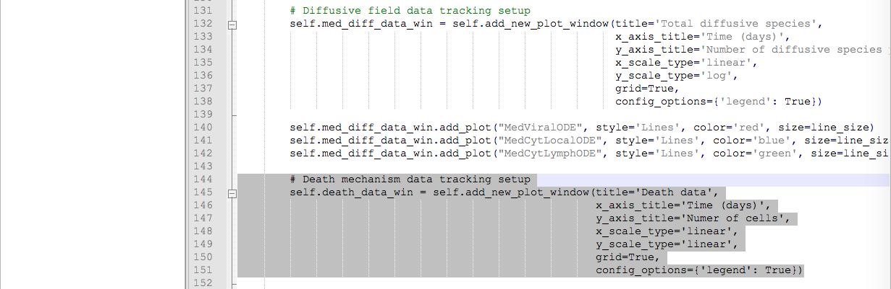
Quantifying Death by Mechanisms – Adding New Plot
We need to create a new plot window to display the amount of cell death by mechanism in the ODE model

Slide 63
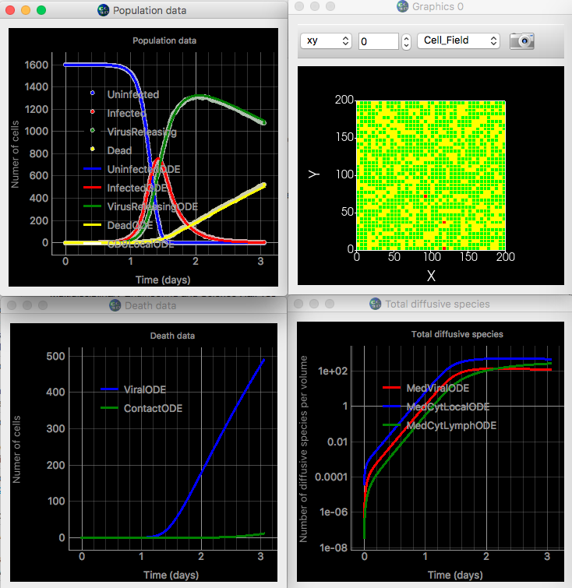
Quantifying Death by Mechanisms – Adding New Plot
We need to create a new plot window to display the amount of cell death by mechanism in the ODE model

Slide 64
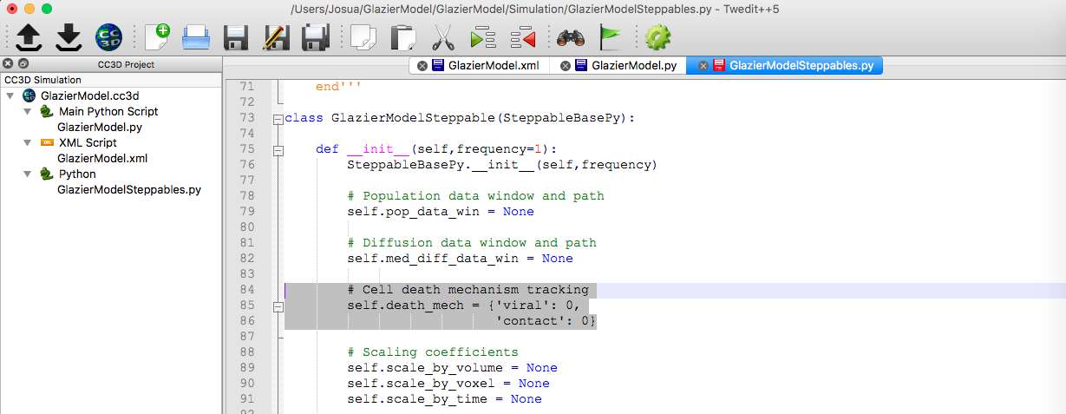
Quantifying Death Cell in Cellular Model – Creating Dictionary
Now we need to quantify the cell death in the cellular model.
We will create a self.death_mech dictionary in the _init_ function to keep track of the cell death. Keys are “viral” and “contact”
We will be counting the number of innate+viral deaths ‘viral’ and the number of deaths by contact ‘contact’
At the moment, we only have viral death, but in a later module we will add death by contact with immune cells

Slide 65
Quantifying Death Cell in Cellular Model – Counting Cell Death
Every time a cell dies because of the viral+innate mechanism we need to increase the count of the ‘viral’ deaths
Reference the dictionary entry as self.death_mech[‘viral’]
The python += operator increases the count by one
Increase the count inside the loop to determine cell transition from Virus

Slide 66
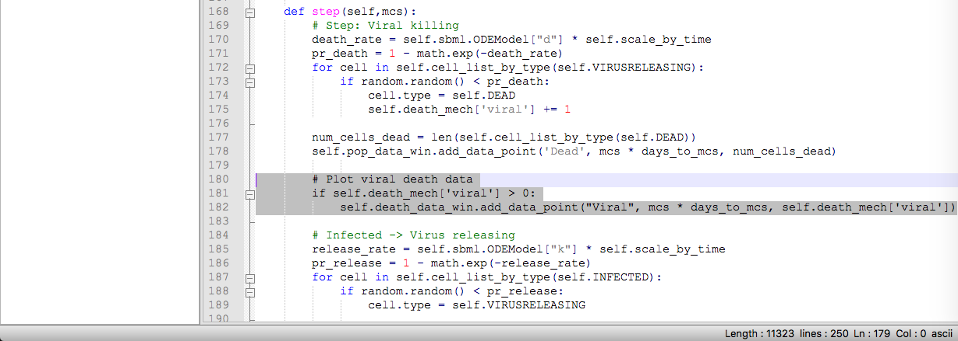
Quantifying Death Cell in Cellular Model – Plotting Cell Death
Now we can add the data series corresponding to the viral cell death in the cellular model to our death mechanism plot window

Slide 67
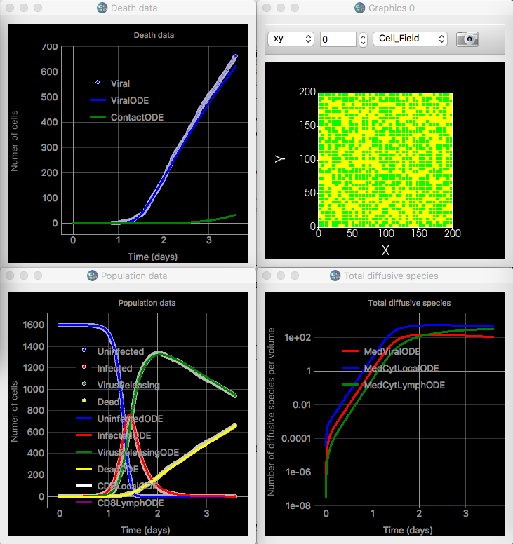
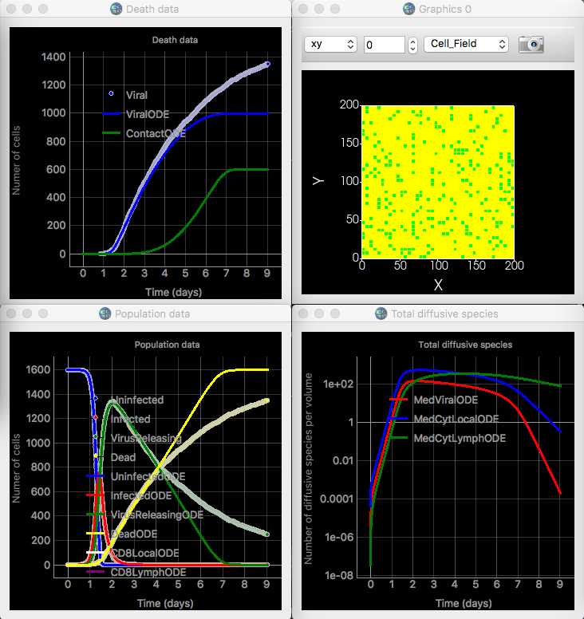
Quantifying Death Cell in Cellular Model – Plotting Cell Death

