Slide 1
CC3D Workshop 1.4: Exploring a COVID-19 Simulation
T.J. Sego
Dept. of Intelligent Systems Engineering
and Biocomplexity Institute
Indiana University
Bloomington, IN 47408
USA
Screensharing and microphones have been disabled for participants in the main session—they are available in breakout rooms
Please submit questions/concerns/suggestions via zoom chat
User support will be available in zoom breakout rooms
Workshop will be live-streamed, recorded and distributed
Please also join the workshop slack channel at https://join.slack.com/t/multiscalemod-ags3330/shared_invite/zt-g0up1lz7-z5XGFC73UZk1j3BPeW7RVA
Funding Sources: NIH U24 EB028887, NIH R01 GM122424, NIH R01 GM123032, NIH P41 GM109824, NSF 1720625 and nanoHUB

Slide 2
Topics
Review: loading simulations in Player and Twedit++
Exercises: Investigating with the complexity of viral infection by simple parameter variations

Slide 3
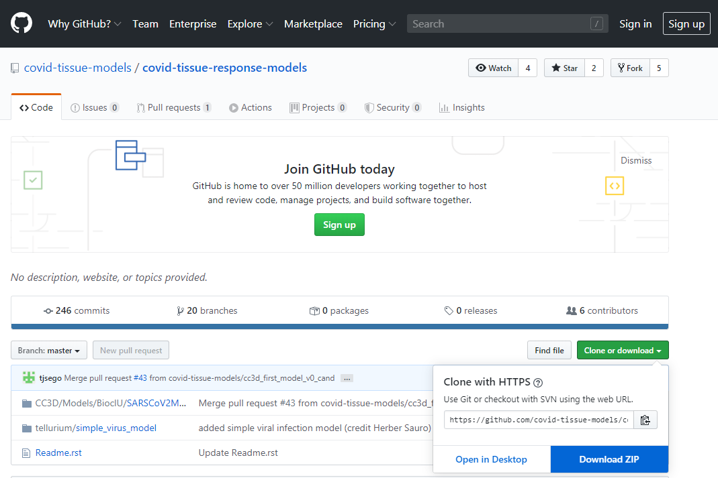
Downloading the model files
Simulation files are available in two locations
In GitHub repository: https://github.com/covid-tissue-models/covid-tissue-response-models
In Google Drive: https://drive.google.com/drive/folders/1TcBnwa0wpbuXW58fQWwttWZWlzaMBD8P?usp=sharing
For GitHub downloads, simulation files are located in
\covid-tissue-response-models-master\CC3D\Models\BiocIU\SARSCoV2MultiscaleVTM\Model

Slide 4
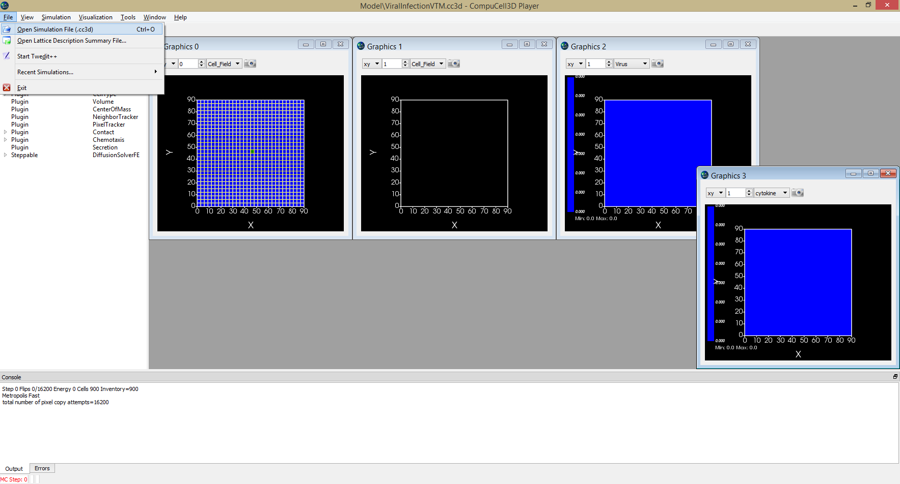
Loading and running a simulation in Player
In Player, File$→$Open Simulation File (.cc3d); select the CC3D File ViralInfectionVTM.cc3d

Slide 5
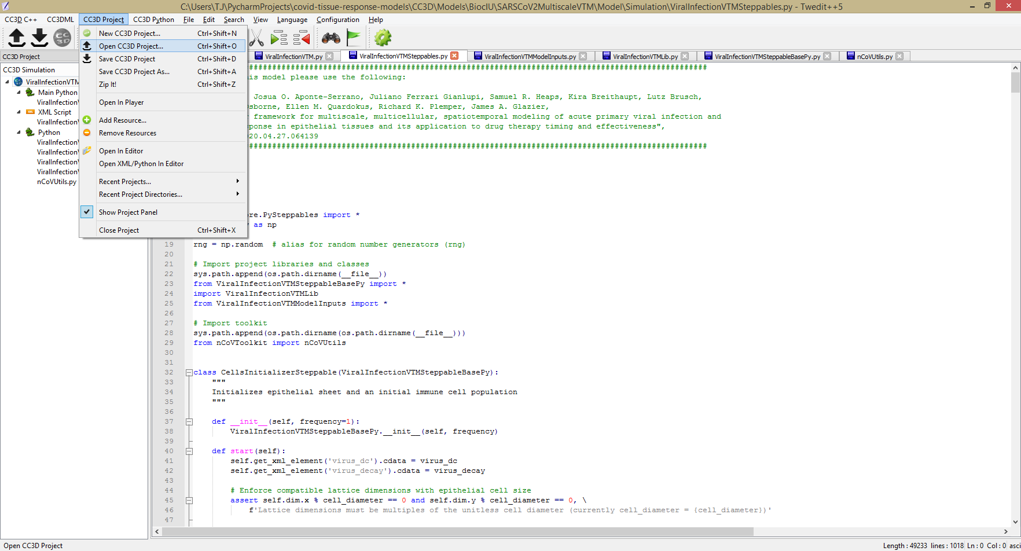
Loading a project in Twedit
In Twedit, CC3D Project$→$Open CC3D Project; select the CC3D File ViralInfectionVTM.cc3d
In CC3D Project Pane (left-hand side), double-click “ViralInfectionVTM.cc3d”

Slide 6
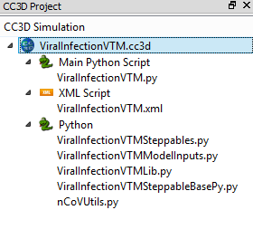
Overview of simulation structure
CC3DML Model Specification: ViralInfectionVTM.xml
Steppables (main Python model spec.): ViralInfectionVTMSteppables.py
Model inputs (parameters): ViralInfectionVTMModelInputs.py
Special steppable project definitions: ViralInfectionVTMSteppableBasePy.py
Libraries (ugly general functions): ViralInfectionVTMLib.py
Loading steppables into simulation: ViralInfectionVTM.py

Slide 7
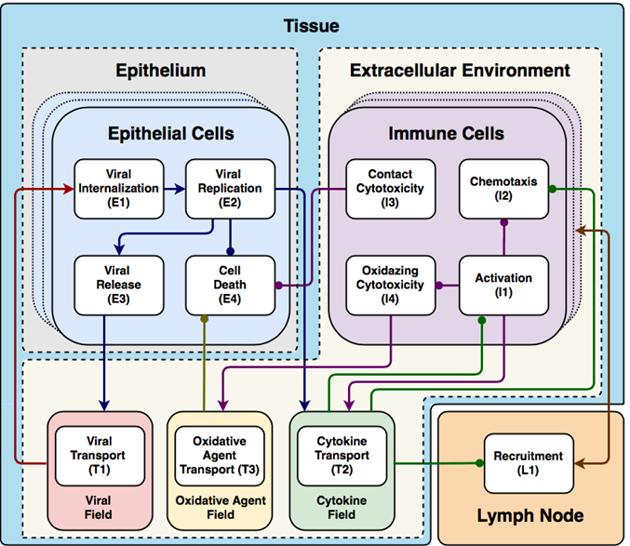
Overview of simulation Python specification
CellsInitializerSteppable: initializes epithelial sheet
ViralInternalizationSteppable: implements viral internalization model
ViralReplicationSteppable: implements viral replication and apoptosis models
ViralSecretionSteppable: implements viral release and internalization PDE terms
ImmuneCellKillingSteppable: implements contact and bystander effect killing model
ChemotaxisSteppable: implements chemotaxis by activated immune cell model
ImmuneCellSeedingSteppable: implements adding/removing immune cells
SimDataSteppable: performs graphics and data post-processing
CytokineProductionAbsorptionSteppable: implements cytokine uptake/secretion
ImmuneRecruitmentSteppable: implements immune recruitment model
oxidationAgentModelSteppable: implements oxidative agent secretion and killing

Slide 8
Parameters in ViralInfectionVTMModelInputs.py
Simulation step $∆t$ | 1200.0 s | Cytokine immune uptake rate | 3.5×10⁻⁵ pM/s | Virally-induced apoptosis Hill coefficient $h_{apo}$ | 2
Lattice width | 4.0 μm | Maximum cytokine infected cell secretion rate | 3.5×10⁻³ pM/s | Virally-induced apoptosis dissociation coefficient $V_{apo}$ | 100×10⁻¹⁴ mol
Scale factor for concentration | 1×10⁻¹⁴ mol | Infected cell cytokine secretion mid-point | 0.1 pM | Virally-induced apoptosis characteristic time constant $α_{apo}$ | 20 min
Cell diameter | 12.0 μm | Immune cell cytokine activation $EC50_{cyt, act}$ | 1 pM | Immune cell activation Hill coefficient $h_{act}$ | 2
Replication rate $r_{max}$ | 1/12×10⁻³ s⁻¹ | Immune cell equilibrium bound cytokine $EQ_{ck}$ | 134.4 pM | Immune cell activation dissociation coefficient $V_{act}$ | 64×10⁻¹⁴ mol
Translating rate $r_{t}$ | 1/18×10⁻³ s⁻¹ | Immune cell bound cytokine memory $ρ_{cyt}$ | 0.98 s⁻¹ | Immune response add immune cell coefficient $β_{add}$ | 1/1200 s⁻¹
Unpacking rate $r_{u}$ | 1/6×10⁻³ s⁻¹ | Immune cell activated time | 10 h | Immune response subtract immune cell coefficient $β_{sub}$ | 1/6000 cell⁻¹s⁻¹
Packaging rate $r_{p}$ | 1/6×10⁻³ s⁻¹ | Oxidation Agent diffusion coefficient $D_{oxi}$ | 0.64 μm²/s | Immune response delay coefficient $β_{delay}$ | 3000 s
Release rate $r_{s}$ | 1/6×10⁻³ s⁻¹ | Oxidation Agent diffusion length $λ_{oxi}$ | 36 μm | Immune response decay coefficient $β_{decay}$ | 1/12000 s⁻¹
Scale factor for number of mRNA per infected cell $mRNA_{avg}$ | 1000 cell⁻¹ | Oxidation Agent decay rate $γ_{oxi}$ | 1.32×10⁻⁵ s⁻¹ | Immune response cytokine transmission coefficient $α_{sig}$ | 0.5
Viral dissociation coefficient $r_{half}$ | 2000 | Immune cell oxidation agent secretion rate $σ_{oxi}$ | 3.5×10⁻³ pM/s | Immune response probability scaling coefficient $α_{immune}$ | 0.01
Viral diffusion coefficient $D_{vir}$ | 0.01 μm²/s | Immune cell $C_{cyt}$ threshold for Oxidation Agent release $τ_{oxi}^{sec}$ | 10 pM | Number of immune cell seeding samples $n_{seeding}$ | 10
Viral diffusion length $λ_{vir}$ | 36 μm | Tissue cell $C_{oxi}$threshold for death $τ_{oxi}^{death}$ | 1.5 pM | Initial target volume | 64 μm³
Viral decay rate $γ_{vir}$ | 7.71×10⁻⁶ s⁻¹ | Initial density of unbound cell surface receptors $R_{o}$ | 200 cell⁻¹ | Lambda volume $λ_{volume}$ | 9
Cytokine diffusion coefficient $D_{cyt}$ (IL-2 cytokine) | 0.16 μm²/s | Virus-receptor association affinity $k_{on}$ | 1.4×10⁴ M⁻¹s⁻¹ | Initial number of immune cells | 0
Cytokine diffusion length $λ_{cyt}$ (IL-2 cytokine) | 100 μm | Virus-receptor dissociation affinity $k_{off}$ | 1.4×10⁻⁴ s⁻¹ | Lambda chemotaxis $λ_{chemotaxis}$ | 1
Cytokine decay rate $γ_{cyt}$ (IL-2 cytokine) | 1.32×10⁻⁵ s⁻¹ | Infection threshold | 1 | Intrinsic Random Motility $ℋ^{∗}$ | 10
Maximum cytokine immune secretion rate | 3.5×10⁻⁴ pM/s | Uptake Hill coefficient $h_{upt}$ | 2 | Contact coefficients $J$ (all interfaces) | 10
Immune secretion midpoint | 1 pM | Uptake characteristic time constant $α_{upt}$ | 20 min

Slide 9
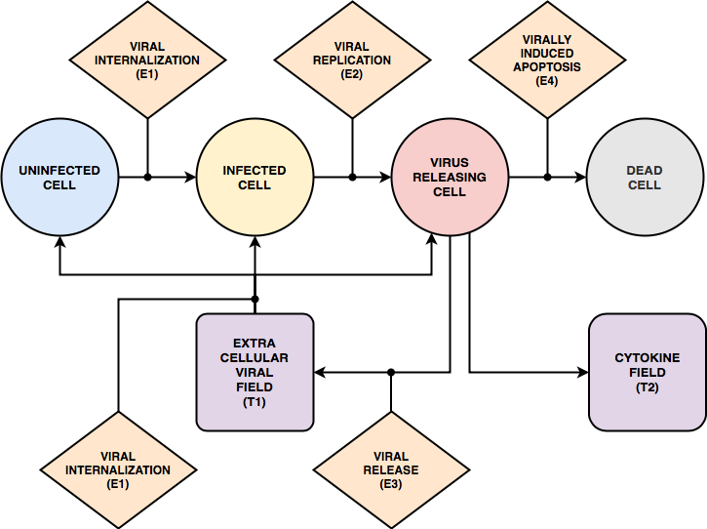
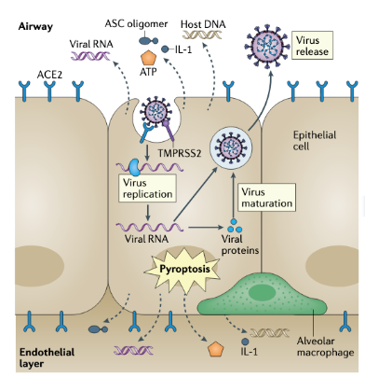
Exercise 1.4.1: Rate of Infection
Critical parameter: virus-receptor association affinity coefficient $k_{on}$
Increasing $k_{on}$ increases the rate of internalization
ViralInfectionModelInputs.py, ~Line 264 “kon”
$$\operatorname{Pr}\left(Uptake\left(σ\right)>0\right)=\frac{∆t}{α_{upt}}\frac{{\left(c_{vir}\left(σ\right)\right)}^{h_{upt}}}{{\left(c_{vir}\left(σ\right)\right)}^{h_{upt}}+{V_{upt}}^{h_{upt}}}$$
$$V_{upt}=\frac{R_{o}k_{off}}{2k_{on}v\left(σ\right)SR\left(σ\right)}$$
$$k_{on}V$$
Tay et. al., Nat Rev Immunol, 2020

Slide 10
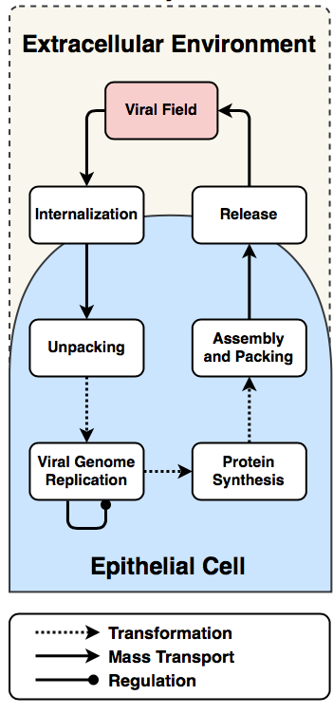
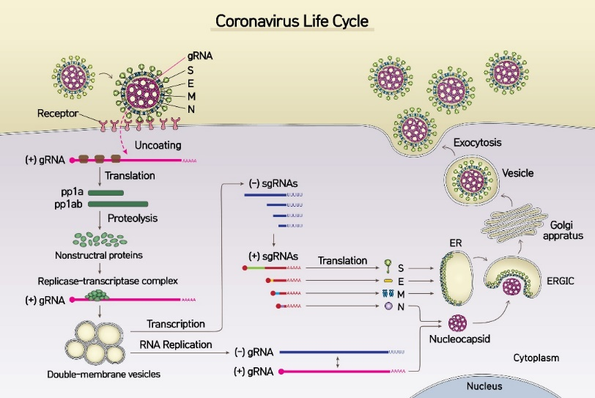
Exercise 1.4.2: Replication Rate
Critical parameter: replicating rate $r_{max}$
Increasing $r_{max}$ increases the rate of viral replication (exponential growth)
ViralInfectionModelInputs.py, ~Line 145 “replicating_rate”
$$\frac{dU}{dt}=Uptake −r_{u}U$$
$$\frac{dR}{dt}=r_{u}U +r_{max}R\frac{r_{half}}{R +r_{half}} −r_{t }R$$
$$\frac{dP}{dt}=r_{t}R−r_{p}P$$
$$\frac{dA}{dt}=r_{p}P−Release$$
https://phys.org/news/2020-04-coronavirus-sars-cov-.html
Accessed 6/10/2020

Slide 11
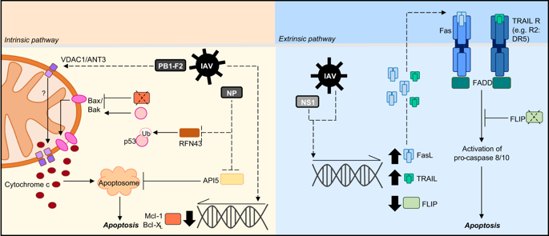
Exercise 1.4.3: Virally-induced Apoptosis
Critical parameter: apoptosis dissociation coefficient $V_{apo}$
Increasing $V_{apo}$ increases the internal virus required for virally-induced apoptosis
ViralInfectionModelInputs.py, ~Line 214 “diss_coeff_uptake_apo”
$$\operatorname{Pr}\left(τ\left(σ\right)→Dead|τ\left(σ\right)=Virus releasing\right)=\frac{Δt}{α_{apo}}\frac{{\left(A\left(σ\right)\right)}^{h_{apo}}}{{\left(A\left(σ\right)\right)}^{h_{apo}}+{V_{apo}}^{h_{apo}}}$$
$$\frac{V}{V_{apo}}$$
Atkin-Smith, Cell Death Dis, 2018

Slide 12
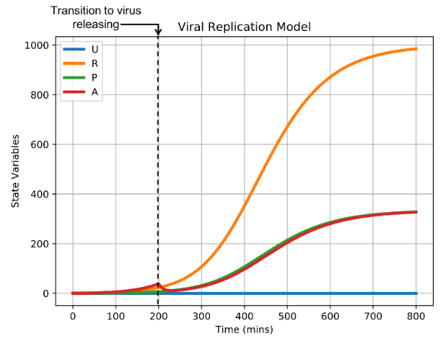
Exercise 1.4.4: Eclipse Phase
Critical parameter: infection threshold $A_{o}$ (assembled virus at which infected cells begin releasing virus)
Increasing $A_{o}$ lengthens eclipse phase
ViralInfectionModelInputs.py, ~Line 209 “cell_infection_threshold”
$$A−A_{o}$$

Slide 13
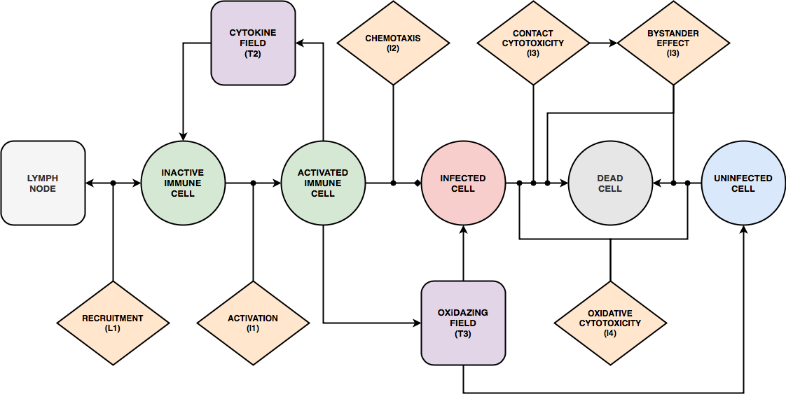
Exercise 1.4.5: Oxidative Killing
Critical parameter: oxidative agent death threshold $C_{o}$
Decreasing $C_{o}$ makes cells more sensitive and die
ViralInfectionModelInputs.py, ~Line 204 “oxi_death_thr”
$$C−C_{o}$$

Slide 14
Exercise 1.4.6: Oxidative Killing and Replicating Rate
$$C−C_{o}$$

Slide 15
Q&A
Please submit questions via Zoom chat

