Slide 1
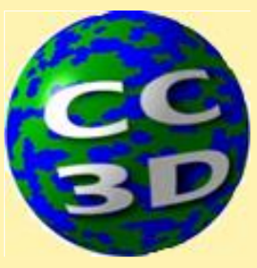
CompuCell3D Hackathon 5.0: Welcome and Organization of Hackathon
James A. Glazier
Dept. of Intelligent Systems Engineering
and Biocomplexity Institute
Indiana University
Bloomington, IN 47408
USA
The workshop will begin at 11:00AM EDT
Screensharing and microphones start disabled for participants in the main session—ask host for screenshare and mike when you need it
Sharing and microphones will be enabled in breakout rooms
Please submit questions/concerns/suggestions via zoom chat or slack
Workshop will be live-streamed, recorded and distributed
Make sure you save the zoom link after registering so you do not have to re-register
Please take the time now to be sure you have a working nanoHUB account and to download and install CompuCell3D to your desktop if you are planning to run it locally
Please also join the workshop slack channel at https://join.slack.com/t/multiscalemod-ags3330/shared_invite/zt-g0up1lz7-z5XGFC73UZk1j3BPeW7RVA
Funding Sources: NIH U24 EB028887, NIH R01 GM122424, NIH R01 GM123032, NIH P41 GM109824, NSF 1720625 and nanoHUB

Slide 2
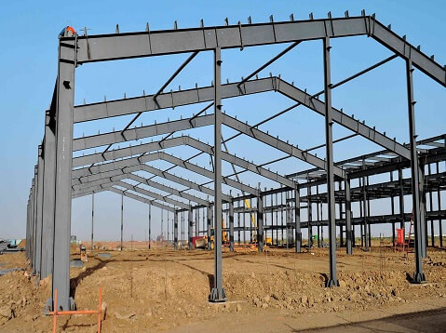
Hackathon Structure and Aims
Goals
Educational experience with model definition
This is the hardest part. Once you know WHAT to build - coding the model is relatively easy
Improve Familiarity with CompuCell3D
Social Learning
Peer-to-peer information transfer is important for modelers
Even if you’re building a model on your own - discuss it with other members in one of the groups
In the next three days, we’re going
to focus on building the frame
We’ll follow-up with more focused hackathons in the future to flesh out models

Slide 3
Resources
Writable google drive for you to upload materials
https://drive.google.com/drive/folders/1WbmezZZm1CxOoGdjZnxT88TAUVUtBHb0?usp=sharing
Viewable folder for Hackathon Resources
https://drive.google.com/drive/folders/1ckIYMHSUr9ypQN8dzRClJD5DKsfAYmn7?usp=sharing
An Article on the Process of Modeling “Workflow for Developing Mechanism-Based Computational Biology Models”
https://drive.google.com/file/d/1VPQE0TGfvUJrUghq0addoNb3zNPCl5m8/view?usp=sharing

Slide 4
Hackathon Day 1—Aims
New Projects
Identify Possible New Projects
Form Teams around Projects
Initial Clarification of Projects—What are the hypotheses to test? What data are available? What is feasible to model?
Try to define Conceptual Biological Model for development
Extend Existing Models
Choose a published ODE model and follow the workflow we used to build the Viral Infection and Immune response model, or continue with exercises we didn’t have time to complete during the workshop (e.g. adding INF-induced viral resistance or phagocytosis to the Viral Infection model)

Slide 5
Hackathon Day 1
11 AM to Noon (Self-) Organizing Teams
Teasers/Pitches from groups that you can join
Threaded discussion in #general-hackathon Slack channel
If you’re working individually describe your model here
Noon to 12:15 PM Quick Walk Through on Process of Model Definition
12:15 PM to 3:00 PM Setup and Initial Model-Building
Create Slack channels & breakout rooms for model definition & road-mapping exercise (see worksheet in student materials)
Thematically similar models will be placed together to support cross-pollination
CC3D Faculty members will pop in to help with model definition
Identify similar models & available data
Choose what biological components and processes to include and exclude etc.

Slide 6
Hackathon Day 1 Cont’d.
3:30 PM – 4:00 PM Quick Check in & Discussion with Full Group (Ask for Help, report changes in ideas)
Optional reorganization of teams
4:00 PM – 5:30 PM Work on Projects
5:30 PM – 6:00 PM Initial Reports & Discussion with Full Group—Plan Goals for Friday Night
Optional reorganization of teams
Friday Evening/Saturday Morning (Optional)
Work in groups - self-paced
Suggested Goal – Refine Conceptual Model, Identify Data and Validation, Complete XML Definitions, Define the domains, cell types, and geometries

Slide 7
Hackathon Day 2
11:00 AM to 11:30 AM Check-in with full group
Oral progress update (Ask for Help, changes in plans,…)
Faculty feedback & Cross Pollination
11:30 AM to 3PM Work on models
Help Appointments w/Faculty
Suggested Goal: ODE definitions
3:00 PM to 3:30 PM Quick Check in (Report, Ask other teams for help)
3:30 PM to 5:30 PM Work on Models
5:30 PM to 6:00 PM Quick Reports and Discussion—Plan Goals for Saturday Night
post in slack a written progress update for presentation tomorrow morning. This will inform CC3D faculty time appointments tomorrow
Saturday Evening/Sunday Morning (Optional)
Work in groups - self-paced
Suggested Goal – Initial CC3D models

Slide 8
Hackathon Day 3
11:00 AM – 11:30 AM Check-in with full group
Oral progress update
Faculty feedback & Cross Pollination
11:30 AM to 4:00 PM Work on Models
Help Appointments w/Faculty
Suggested Goal: Integration of model components & Definition of model metrics
Initial Runs of Model
4:00 PM to 5:00 PM Write up Initial Results
5:00 PM to 6:00 PM Present Results and Plan Future Steps
Each group submits final summary of model progress. Lay-out future steps
Plan next hackathon

