Slide 1
Workshop on Multi-scale Multi-cell Virtual-Tissue Modeling using CompuCell3D 4.0: Day 4 Welcome and The Principles of CC3D
Maciek Swat
USA
The workshop will begin at 11:00AM EDT
Screensharing and microphones have been disabled for participants in the main session—they are available in breakout rooms
Please submit questions/concerns/suggestions via zoom chat
User support will be available in zoom breakout rooms
Workshop will be live-streamed, recorded and distributed
Make sure you save the zoom link after registering so you do not have to re-register
Please take the time now to be sure you have a working nanoHUB account and to download and install CompuCell3D to your desktop if you are planning to run it locally
Please also join the workshop slack channel at https://join.slack.com/t/multiscalemod-ags3330/shared_invite/zt-g0up1lz7-z5XGFC73UZk1j3BPeW7RVA
Funding Sources: NIH U24 EB028887, NIH R01 GM122424, NIH R01 GM123032, NIH P41 GM109824, NSF 1720625 and nanoHUB

Slide 2
Course Outline
Day 1 Monday Aug. 3, 2020:
Getting Started with CC3D on nanoHUB and Desktop
Examples of Biomedical Problems you can address using Multicellular Virtual Tissue models
COVID Tissue Model, using Player and Twedit++
Building a Tellurium Model of virus and immune response
CV 19 Version 0 -- Running Antimony virus and immune response in CC3D, converting timescales, plots and saving data
Day 2 Tuesday Aug. 4, 2020:
CV 19 Version 1 -- Creating Epithelial Layer, Cell Type Transitions, Issue of Poisson Rules
CV 19 Version 2 -- Spatializing the virus, diffusion as an idea, diffusion solver, secretion and absorption, adding chemokine
CV 19 Version 3 -- Immune Cell Spatialization model, links, creating cells, saving data
CV 19 Version 4 -- Exercises on cell motility, chemotaxis and random motility and dependence on parameters
Day 3 Wednesday Aug. 5, 2020:
CV 19 Version 5 -- Contact killing -- contact area plug-in and links
CV 19 Version 6 -- Adding Tissue Recovery and Cell Division
CV 19 Version 7 -- Adding viral replication model in individual cells
CV 19 Version 8 -- Adding INF induced viral resistance, macrophages and phagocytosis
CompuCell3D Theory and Background
Day 4 Thursday Aug. 6, 2020:
Sample Models:
Delta Notch: Contact signaling between Antimony models and Simple Colonic Crypt
Cell Crawling: Compartmental Cells
Vasculature, Vascular and Avascular Tumor,
Colonic Crypt and 3D models
Cluster and Parameter Scan execution
Deploying CC3D simulation on NanoHub
CompuCell3D Modeling Best Practices
Turning unitary model into modules (optional)
Day 5-7 Friday Aug. 7-- Sunday Aug. 9, 2020: Hackathon BUILDING MODELS STUDENTS ARE INTERESTED IN

Slide 3
CC3D nanoHUB Links
NanoHUB is a shared, open, online computing platform for students, teachers and researchers. User can learn modeling, develop, run and share research models and learn from models developed by others. NanoHUB covers a range of applications from Artificial Intelligence, to electronics to biological modeling.
The CompuCell3D web page with info on nanoHUB is at: https://compucell3d.org/NanoHub
At nanoHUB, CC3D is at: https://nanohub.org/tools/cc3dbase4x

Slide 4
CC3D Desktop App
Current CompuCell3D (CC3D) version is 4.2.3, released 31 July 2020. (though any 4.2.x version should be OK.)
CC3D uses Python 3.6.
Executable version are available for Windows, Mac and Linux at:
https://compucell3d.org/SrcBin
Source code is also available if you would like to compile on your own:
https://compucell3d.org/SourceCode

Slide 5
Where to Find Resources
CompuCell3D:
Web Site: https://compucell3d.org/
Download source and compiled code: https://compucell3d.org/SrcBin
Online Help and Manual: https://pythonscriptingmanual.readthedocs.io/en/4.1.1/
Other Help Files: https://compucell3d.org/Manuals
Class files at the Compucell3d website: https://compucell3d.org/CC3D_2020_class_files (see also the slack channel)
Quick Reference Guides:
CompuCell3D Online Quick Start: https://cc3dquickreferenceguide.readthedocs.io/en/latest/ https://compucell3d.org/CC3D_2020_class_files?action=AttachFile&do=get&target=cc3d_quick_reference_guide.pdf
Python Quick Reference Guide: https://compucell3d.org/CC3D_2020_class_files?action=AttachFile&do=get&target=python_cheat_sheet_py3.pdf
Tellurium and libRoadRunner Quick Reference Guide: https://compucell3d.org/CC3D_2020_class_files?action=AttachFile&do=get&target=TellRoadCheatSheet.pdf

Slide 6
Slack
Main Slack channel:
https://app.slack.com/client/T017HE055JN/C017HE05KPC
Slack help for Windows:
https://multiscalemod-ags3330.slack.com/archives/C01879HFYL8
Slack help for Mac:
https://multiscalemod-ags3330.slack.com/archives/C017PKPSYAG
Slack help for Unix:
https://multiscalemod-ags3330.slack.com/archives/C01879J0ULQ
Questions-for-the-organizers:
https://multiscalemod-ags3330.slack.com/archives/C017G3PT4AZ

Slide 7
People
Prof. James A Glazier, IUB, jaglazier@gmail.com
Dr. Gilberto L Thomas, Univer. Federal do Rio Grande do Sul, Brazil, glt@if.ufrgs.br
Dr. Bobby Madamanchi, Purdue University, akmadamanchi@gmail.com
Dr. Andy Somogyi, IUB, somogyie@indiana.edu
Dr. TJ Sego, IUB, tjsego@gmail.com
Dr. Jim Sluka, IUB, jsluka@iu.edu
Dr. Javier Toledo, IUB, toledom@iu.edu
Mr. Joshua Aponte-Serrano, IUB, joaponte@iu.edu
Mr. Juliano Ferrari Gianlupi, IUB, jferrari@iu.edu
IUB: Indiana University, Bloomington, Indiana USA

Slide 8
Summary of previous Day’s Results
James A. Glazier
Dept. of Intelligent Systems Engineering
and Biocomplexity Institute
Indiana University
Bloomington, IN 47408
USA
Day 3:
CV 19 Version 5 -- Contact killing -- contact area plug-in and links
CV 19 Version 6 -- Adding Tissue Recovery and Cell Division
CV 19 Version 7 -- Adding viral replication model in individual cells
CV 19 Version 8 -- Adding INF induced viral resistance, macrophages and phagocytosis
CompuCell3D Theory and Background

Slide 9
Implementing Cell Growth
CellGrowth1.cc3d
Start with a single cell, positive contact energy and a volume constraint that varies over time. Keep increasing target volume
<CompuCell3D Revision="20200731" Version="4.2.3"> <Potts> <Dimensions x="256" y="256" z="1"/> <Steps>100000</Steps> <Temperature>10.0</Temperature> <NeighborOrder>1</NeighborOrder> </Potts> <Plugin Name="CellType"> <CellType TypeId="0" TypeName="Medium"/> <CellType TypeId="1" TypeName="Tumor"/> <CellType TypeId="2" TypeName="TumorProliferating"/> <CellType TypeId="3" TypeName="Necrotic"/> </Plugin> <Plugin Name="Volume"/> <Plugin Name="CenterOfMass"/> <Plugin Name="Contact"> <Energy Type1="Medium" Type2="Medium">10.0</Energy> <Energy Type1="Medium" Type2="Tumor">10.0</Energy> <Energy Type1="Medium" Type2="TumorProliferating">10.0</Energy> <Energy Type1="Medium" Type2="Necrotic">10.0</Energy> <Energy Type1="Tumor" Type2="Tumor">10.0</Energy> <Energy Type1="Tumor" Type2="TumorProliferating">10.0</Energy> <Energy Type1="Tumor" Type2="Necrotic">10.0</Energy> <Energy Type1="TumorProliferating" Type2="TumorProliferating">10.0</Energy> <Energy Type1="TumorProliferating" Type2="Necrotic">10.0</Energy> <Energy Type1="Necrotic" Type2="Necrotic">10.0</Energy> <NeighborOrder>4</NeighborOrder> </Plugin> </CompuCell3D>
from cc3d.core.PySteppables import * class CellGrowth1Steppable(SteppableBasePy): def __init__(self, frequency=1): SteppableBasePy.__init__(self, frequency) def start(self): cell = self.new_cell(self.TUMORPROLIFERATING) self.cell_field[100:102, 100:102, 0] = cell cell.targetVolume = 25 cell.lambdaVolume = 5.0 def step(self, mcs): for cell in self.cell_list: if cell.type in [self.TUMORPROLIFERATING]: cell.targetVolume += 0.2

Slide 10
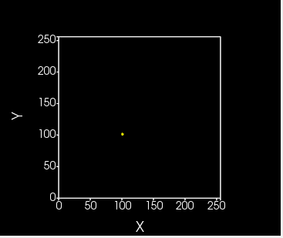
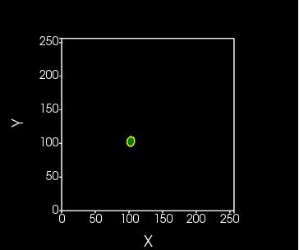
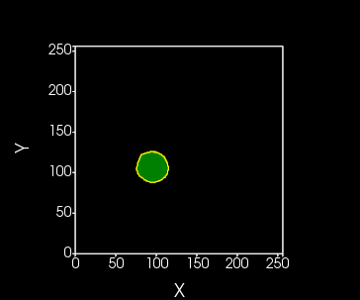
Implementing Cell Growth
Cell is gradually adjusting its volume in such a way that it is always close to target volume

Slide 11
Mitosis
CellGrowth2.cc3d
Once cell starts growing it makes sense to divide the cell once it reaches doubling volume
self.parent_cell
Before mitosis we have single object that represents cell
self.child_cell
self.parent_cell represents CC3D cell object that exist before mitosis takes place
self.child_cell represents new CC3D cell object that gets created during mitosis
In biology we talk about two daughter cells. However in simulation it is very convenient to use parent, child terminology so that we can copy cell properties from cell that existed before mitosis to newly created cell object

Slide 12
Code Highlights - CellGrowth2.cc3d
class CellGrowth2Steppable(SteppableBasePy): def __init__(self, frequency=1): SteppableBasePy.__init__(self, frequency) def start(self): cell = self.new_cell(self.TUMORPROLIFERATING) self.cell_field[100:102, 100:102, 0] = cell cell.targetVolume = 25 cell.lambdaVolume = 5.0 def step(self, mcs): for cell in self.cell_list: if cell.type in [self.TUMORPROLIFERATING]: cell.targetVolume += 0.2
class MitosisSteppable(MitosisSteppableBase): def __init__(self, frequency=1): MitosisSteppableBase.__init__(self, frequency) def step(self, mcs): cells_to_divide = [] for cell in self.cell_list: if cell.volume > 50: cells_to_divide.append(cell) for cell in cells_to_divide: self.divide_cell_random_orientation(cell) def update_attributes(self): # reducing parent target volume self.parent_cell.targetVolume /= 2.0 self.clone_parent_2_child() if self.parent_cell.type == self.TUMORPROLIFERATING: self.child_cell.type = self.TUMOR else: self.child_cell.type = self.TUMORPROLIFERATING
from cc3d import CompuCellSetup from CellGrowth2Steppables import CellGrowth2Steppable from CellGrowth2Steppables import MitosisSteppable CompuCellSetup.register_steppable(steppable=CellGrowth2Steppable(frequency=1)) CompuCellSetup.register_steppable(steppable=MitosisSteppable(frequency=1)) CompuCellSetup.run()

Slide 13
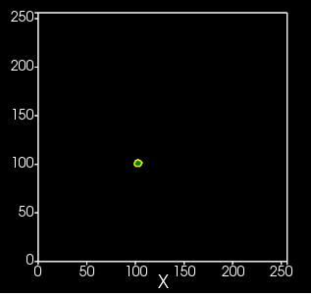
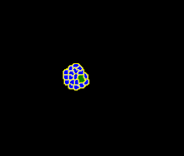
Mitosis - continued
After 2500 MCS
Why do we observe a single cell of type TumorProliferating and a lot of cells of type Tumor?
Based on the code, can you spot which cells grow and (thus divide)?
Can you modify the code so that cells of all types grow and divide?

Slide 14
Mitosis code explained
self.parent_cell
Before mitosis we have single object that represents cell
self.child_cell
class MitosisSteppable(MitosisSteppableBase): def __init__(self, frequency=1): MitosisSteppableBase.__init__(self, frequency) def step(self, mcs): cells_to_divide = [] for cell in self.cell_list: if cell.volume > 50: cells_to_divide.append(cell) for cell in cells_to_divide: self.divide_cell_random_orientation(cell) def update_attributes(self): # reducing parent target volume self.parent_cell.targetVolume /= 2.0 self.clone_parent_2_child() if self.parent_cell.type == self.TUMORPROLIFERATING: self.child_cell.type = self.TUMOR else: self.child_cell.type = self.TUMORPROLIFERATING
update_attributes function gets called immediately after new cell is created here
update_attributes function is a right place to initialize properties of the newly created cell and adjust properties of self.parent_cell

Slide 15
Contact inhibition of proliferation
ContactInhibitionOfProliferation.cc3d
When We can build a simple model where we make cell growth rate pressure dependent. When pressure inside the cell - defined as targetVolume – volume, grows the cell growth rate gets smaller
class CellGrowthSteppable(SteppableBasePy): def __init__(self, frequency=1): SteppableBasePy.__init__(self, frequency) def start(self): cell = self.new_cell(self.TUMORPROLIFERATING) self.cell_field[100:102, 100:102, 0] = cell cell.targetVolume = 25 cell.lambdaVolume = 5.0 def step(self, mcs): for cell in self.cell_list: if cell.type in [self.TUMORPROLIFERATING, self.TUMOR]: delta = max(0.0, 0.2 - 0.05*(cell.targetVolume - cell.volume)) cell.targetVolume += delta
Simple implementation of contact inhibition of proliferation

Slide 16
Code highlights - ContactInhibitionOfProliferation.cc3d
class MitosisReadyPlotterSteppable(SteppableBasePy): def __init__(self, frequency=1): SteppableBasePy.__init__(self, frequency) self.create_scalar_field_cell_level_py("MitosisReadyCells") def step(self, mcs): field = self.field.MitosisReadyCells field.clear() for cell in self.cell_list: if cell.volume > 50: field[cell] = 100 print('adding cell ', cell.id) else: field[cell] = 1
from cc3d import CompuCellSetup from ContactInhibitionOfProliferationSteppables import CellGrowthSteppable from ContactInhibitionOfProliferationSteppables import MitosisSteppable from ContactInhibitionOfProliferationSteppables import MitosisReadyPlotterSteppable CompuCellSetup.register_steppable(steppable=CellGrowthSteppable(frequency=1)) # it is essential to register plotter before Mitosis otherwise we will never see which cell was ready for mitosis CompuCellSetup.register_steppable(steppable=MitosisReadyPlotterSteppable(frequency=1)) CompuCellSetup.register_steppable(steppable=MitosisSteppable(frequency=1)) CompuCellSetup.run()

Slide 17
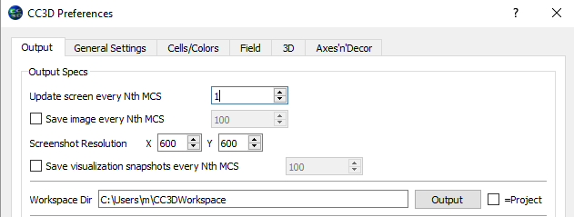
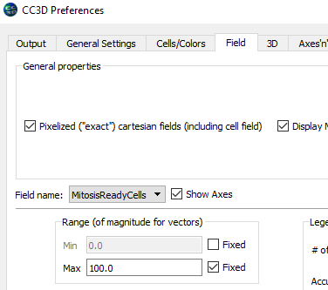
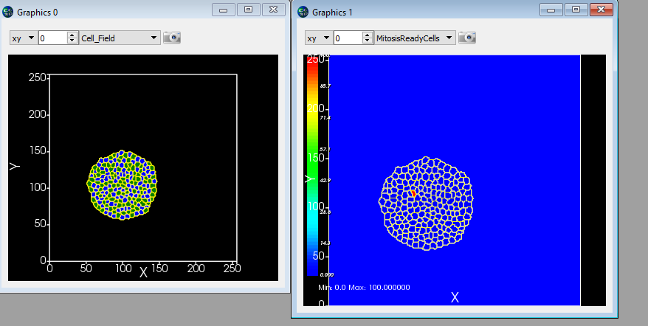
MitosisReadyPlotter – Player Settings
To observe mitosis ready plotter output set screen update frequency to 1 once there is enough cells to see the effect
Set fixed value of 100 for MitosisReadyCell field
Cell about to divide

Slide 18
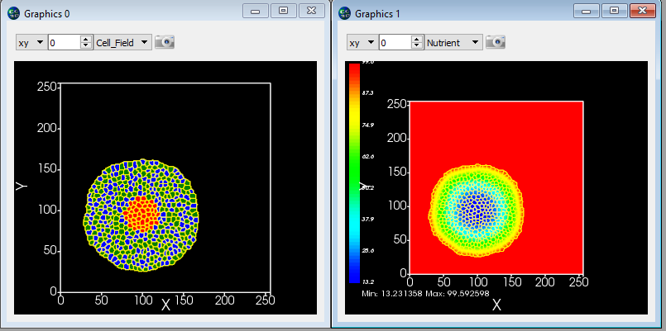
Putting it all together – Avascular Tumor Simulation
AvascularTumor.cc3d
So far we have learned the following CC3D concepts and techniques:
How to use contact energy and volume constraint to control cell shape
How to grow cells
How to divide cells
How to add diffusive field
How to change cell type
Let’s combine those techniques together and build a simplified simulation of avascular tumor.
We will use 3 cell types ,Tumor, TumorProliferating and Necrotic
We will make cell growth depend on level of nutrients and on cell pressure (contact inhibition of proliferation)
Cells turn necrotic once the level of nutrients falls below critical threshold. Necrotic cells do not grow or divide
Tumor or TumorProliferating cells
Necrotic cells

Slide 19
Code highlights - AvascularTumor.cc3d
from cc3d.core.PySteppables import * def ir(x): return int(round(x)) class AvascularTumorSteppable(SteppableBasePy): def start(self): cell = self.new_cell(self.TUMORPROLIFERATING) self.cell_field[100:102, 100:102, 0] = cell cell.targetVolume = 25 cell.lambdaVolume = 5.0 def step(self, mcs): nutrient_field = self.field.Nutrient for cell in self.cell_list: x_com = ir(cell.xCOM) y_com = ir(cell.yCOM) z_com = ir(cell.zCOM) nutrient_level = nutrient_field[x_com, y_com, z_com] if cell.type in [self.TUMORPROLIFERATING, self.TUMOR]: nutrient_based_growth_component = min(0.2, 0.01 * nutrient_level) delta = max(0.0, nutrient_based_growth_component - 0.05 * (cell.targetVolume - cell.volume)) cell.targetVolume += delta if len(self.cell_list) > 200:
for cell in self.cell_list: x_com = ir(cell.xCOM) y_com = ir(cell.yCOM) z_com = ir(cell.zCOM) nutrient_level = nutrient_field[x_com, y_com, z_com] if nutrient_level < 20: cell.type = self.NECROTIC
Convenience function to round COM coordinate to nearest integer
Nutrient-based contribution to growth rate
Pressure dependent growth rate
Tumor-> necrotic transition

Slide 20
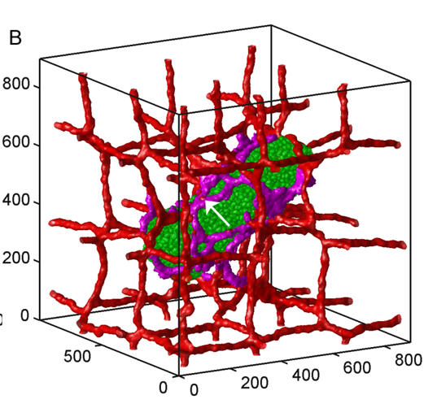
Building 3D Vascular Tumor simulation
While we are not going to go through this exercise in this introductory session it is worth mentioning that building
The simulation presented below does not take that much more coding that we have already done so far.
from .TumorVasc3DSteppables import VolumeParamSteppable from .TumorVasc3DSteppables import MitosisSteppable import cc3d.CompuCellSetup as CompuCellSetup vol_steppable = VolumeParamSteppable(frequency=1) vol_steppable.set_params(1, 5, 1) CompuCellSetup.register_steppable(steppable=vol_steppable) doublingVolumeDict = {1: 54, 2: 54, 4: 80, 6: 80} mitosis_steppable = MitosisSteppable(frequency=1) mitosis_steppable.set_params(doublingVolumeDict=doublingVolumeDict) CompuCellSetup.register_steppable(steppable=mitosis_steppable) CompuCellSetup.run()
The simulation uses the same mechanisms that we have covered so far

Slide 21
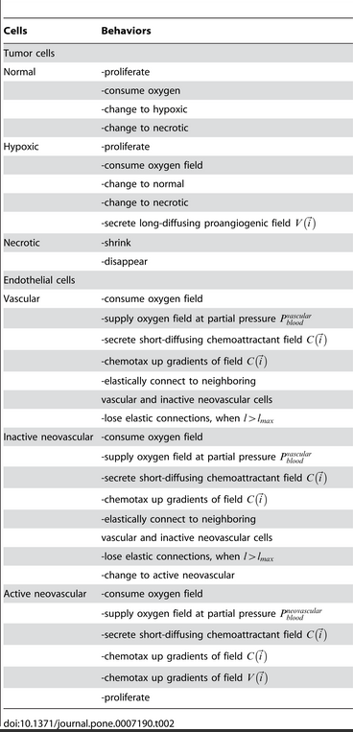
Key concepts of the simulation
<CompuCell3D> <Potts> <Dimensions x="180" y="180" z="180"/> <Steps>100000</Steps> <Flip2DimRatio>1</Flip2DimRatio> <Boundary_x>Periodic</Boundary_x> <Boundary_y>Periodic</Boundary_y> <Boundary_z>Periodic</Boundary_z> <CellMotility> <MotilityParameters CellType="InactiveNeovascular" Motility="0"/> <MotilityParameters CellType="Vascular" Motility="0"/> <MotilityParameters CellType="ActiveNeovascular" Motility="0"/> <MotilityParameters CellType="Vascular" Motility="0"/> <MotilityParameters CellType="Normal" Motility="100"/> <MotilityParameters CellType="Hypoxic" Motility="100"/> <MotilityParameters CellType="Necrotic" Motility="`100"/> </CellMotility> <NeighborOrder>3</NeighborOrder> </Potts>
<Plugin Name="CellType"> <CellType TypeName="Medium" TypeId="0"/> <CellType TypeName="Normal" TypeId="1"/> <CellType TypeName="Hypoxic" TypeId="2"/> <CellType TypeName="Necrotic" TypeId="3"/> <CellType TypeName="ActiveNeovascular" TypeId="4"/> <CellType TypeName="Vascular" TypeId="5"/> <CellType TypeName="InactiveNeovascular" TypeId="6"/> </Plugin>

Slide 22
<Plugin Name="NeighborTracker"/> <Plugin Name="Chemotaxis"> <Algorithm>merks</Algorithm> <ChemicalField Source="FlexibleDiffusionSolverFE" Name="VEGF1"> <ChemotaxisByType Type="ActiveNeovascular" Lambda="85" ChemotactTowards="Medium,Normal,Hypoxic"/> </ChemicalField> ... <Plugin Name="CenterOfMass"/> <Plugin Name="Contact"> <Energy Type1="Medium" Type2="Medium">0</Energy> <Energy Type1="Normal" Type2="Medium">8</Energy> <Energy Type1="Normal" Type2="Normal">6</Energy> ... <Plugin Name="Volume"/> <Plugin Name="Surface"/> <Plugin Name="FocalPointPlasticity"> <Parameters Type1="ActiveNeovascular" Type2="ActiveNeovascular"> <Lambda>10</Lambda> <ActivationEnergy>-100</ActivationEnergy> <TargetDistance>3</TargetDistance> <MaxDistance>20</MaxDistance> <MaxNumberOfJunctions NeighborOrder="1">2</MaxNumberOfJunctions> </Parameters> ... <Steppable Type="PIFInitializer"> <PIFName>Simulation/TumorVasc3D.txt</PIFName> </Steppable> <Steppable Type="FlexibleDiffusionSolverFE"> ... <Steppable Type="KernelDiffusionSolver"> ...

Slide 23
def step(self, mcs): field_neo_vasc = self.field.VEGF2 field_malig = self.field.Oxygen for cell in self.cellList: # Inactive neovascular differentiation if cell.type == 6: total_area = 0 x = int(round(cell.xCM / max(float(cell.volume), 0.001))) y = int(round(cell.yCM / max(float(cell.volume), 0.001))) z = int(round(cell.zCM / max(float(cell.volume), 0.001))) concentration = field_neo_vasc[x, y, z] if concentration > 0.5: neighbor_list = self.get_cell_neighbor_data_list(cell) for neighbor, common_surface_area in neighbor_list: if neighbor: if neighbor.type in [5, 6, 7]: total_area += common_surface_area print(cell.type, total_area) if total_area < 70: # Growth rate equation cell.targetVolume += 0.06 * concentration / (0.5 + concentration) cell.targetSurface += 0.15 * concentration / (0.5 + concentration) ## Active neovascular growth if cell.type == 4: total_area = 0 x = int(round(cell.xCM / max(float(cell.volume), 0.00000001))) y = int(round(cell.yCM / max(float(cell.volume), 0.00000001))) z = int(round(cell.zCM / max(float(cell.volume), 0.00000001))) concentration = field_neo_vasc[x, y, z] if concentration > 0.5: neighbor_list = self.get_cell_neighbor_data_list(cell) for neighbor, common_surface_area in neighbor_list: if neighbor: if neighbor.type in [5, 6, 7]: total_area += common_surface_area if total_area < 50: # Growth rate equation cell.targetVolume += 0.06 * concentration / (0.5 + concentration) cell.targetSurface += 0.15 * concentration / (0.5 + concentration)
# Malignat and Hypoxic Cells growth if cell.type == 1 or cell.type == 2: x = int(round(cell.xCM / max(float(cell.volume), 0.001))) y = int(round(cell.yCM / max(float(cell.volume), 0.001))) z = int(round(cell.zCM / max(float(cell.volume), 0.001))) concentration2 = field_malig[x, y, z] # switch to Hypoxic cell type if concentration2 < self.nutrient_thresh and mcs > 100: cell.type = 2 # switch to Necrotic cell type if concentration2 < self.necrotic_thresh and mcs > 100: cell.type = 3 # set growth rate equation if mcs > 100: cell.targetVolume += 0.04 * concentration2 / (10 + concentration2) cell.targetSurface += 0.12 * concentration2 / (10 + concentration2) # Hypoxic Cells if cell.type == 2: x = int(round(cell.xCM / max(float(cell.volume), 0.001))) y = int(round(cell.yCM / max(float(cell.volume), 0.001))) z = int(round(cell.zCM / max(float(cell.volume), 0.001))) concentration3 = field_malig[x, y, z] # switch to Necrotic cell type if concentration3 < self.necrotic_thresh and mcs > 100: cell.type = 3 # switch to Normal cell type if concentration3 > self.nutrient_thresh: cell.type = 1 # Necrotic Cells if cell.type == 3: # set growth rate equation cell.targetVolume -= 0.5 cell.lambdaSurface = 0

