Slide 1
CC3D Workshop 1.3: Tissue-Level COVID-19 Simulation
T.J. Sego
Dept. of Intelligent Systems Engineering
and Biocomplexity Institute
Indiana University
Bloomington, IN 47408
USA
Screensharing and microphones have been disabled for participants in the main session—they are available in breakout rooms
Please submit questions/concerns/suggestions via zoom chat
Workshop will be live-streamed, recorded and distributed
Please also join the workshop slack channel at https://join.slack.com/t/multiscalemod-ags3330/shared_invite/zt-g0up1lz7-z5XGFC73UZk1j3BPeW7RVA
Funding Sources: NIH U24 EB028887, NIH R01 GM122424, NIH R01 GM123032, NIH P41 GM109824, NSF 1720625 and nanoHUB

Slide 2
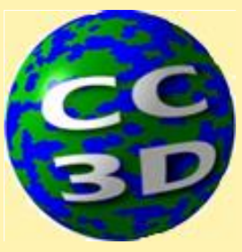
Topics
Background: About SARS-CoV-2, COVID-19 and computational modeling
Conceptualizing a Viral Infection Model: Overview of the current BIOC model
Complexity of Viral Infection and Immune Response: Overview of key results
Demo: running the nanoHUB tool varying parameters via dialogue box

Slide 3
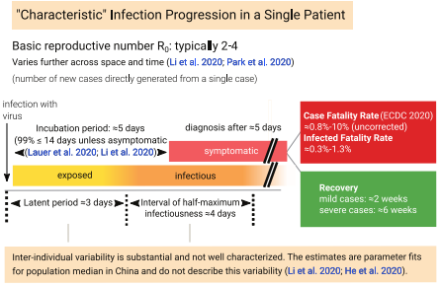
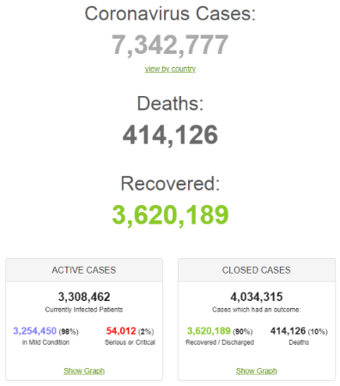
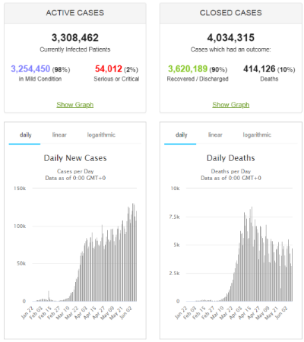
Sobering Times
Infectious before symptomatic
Outcomes are highly variable by patient and location
Causes of death include refractory ARDS, septic shock, sudden cardiac arrest, hemorrhagic shock, acute myocardial infarction
Data is sparse but grows by the day
Bar-On et al., eLife, 2020.
https://www.worldometers.info/coronavirus/
Accessed 6/10/2020
Wang et al., Critical Care, 2020.

Slide 4
Motivating Questions of COVID-19 Modeling
So many questions:
Why do some people get sick, others not?
Why is COVID-19 different from the flu?
Why is there a delayed adverse response (recovery/relapse) in some individuals?
What causes pneumonia, cytokine storms or other adverse effects?
Why are there such strong age-related effects?
What causes the differences in response to infection by the same virus in different tissues?
Could we triage patients better?
How could use of antiviral therapies be optimized?
How could use of anti-inflammatory therapies be optimized?
Can we predict systems-level effects from molecular-level perturbations?

Slide 5
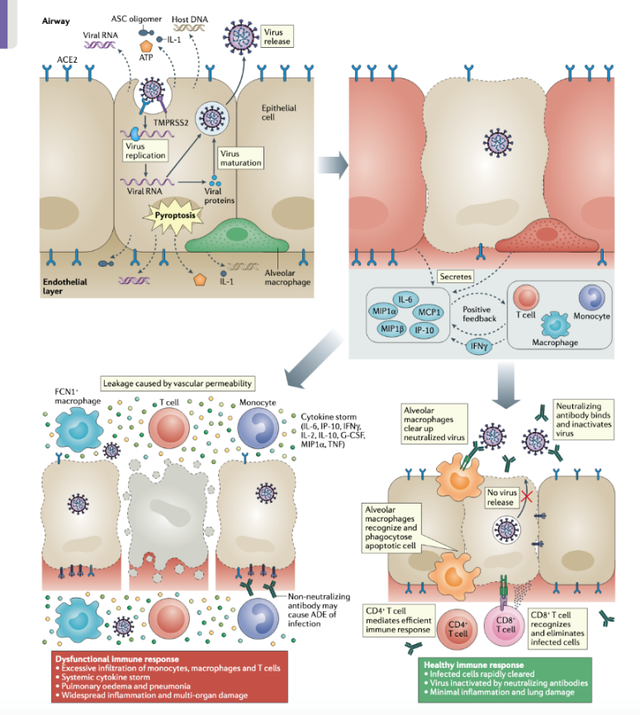
Biological Components of SARS-CoV-2 Infection
Epithelial target tissue (nasal, throat, bronchial, alveolar)
Extracellular environment
Virus entry, replication, spread and removal
Immune cells (lots of them) and their recruitment and actions
Immune signals (lots of them)
Tissue damage and recovery
Lymph nodes/systemic immune system
Immune signaling
Immune-cell proliferation
Whole body transport (blood, lymph, air)
Other non-target or secondary target organs (blood, heart, kidneys,…)
Innate and adaptive immune responses
Tay et. al., Nat Rev Immunol, 2020

Slide 6
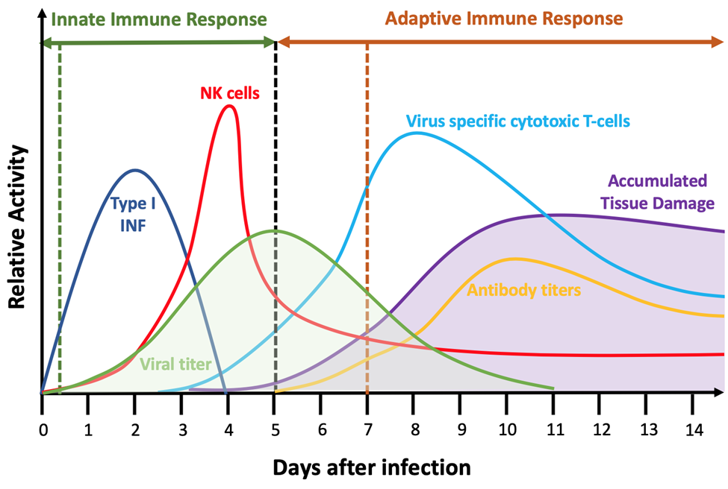
Immune Response Components
Immune cell scavenging/phagocytosis of virus (peaks at 1 day, reduced after 2 days)
IFN response, viral resistance and other non-cell-mediated responses (starts early, most important early)
Systemic Cytokine signaling (starts around day 2 and goes on and is relayed and amplified by immune cells)
Recruitment of NK cells (starts pretty fast and peaks as shown on diagram)
Dendritic cells $→$ Lymph node (day 4-6)
Return of CD8+ and related immune cells to the tissue (days 7-14)
B cells and antibodies (day 10 onward)
Complications from infection like pneumonia (typically start around day 7 with beginning of adaptive immune response and positive feedback on cytokines)

Slide 7
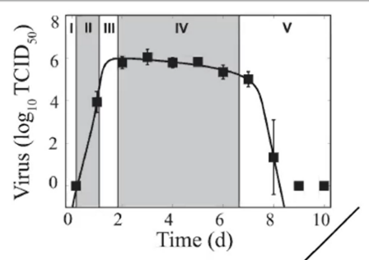
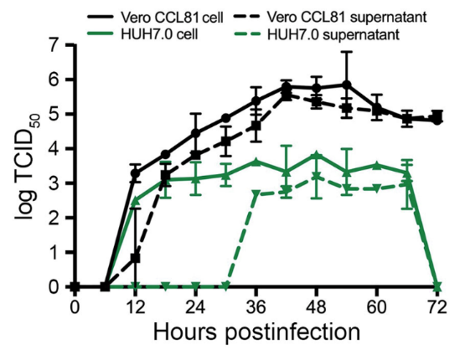
Viral Replication and Concentrations
Eclipse Phase (6 h – slightly longer) before any cells start releasing virus
Rapid exponential growth to maximum viral concentration (over 2 days for influenza)
Saturation and mild decline (days 2-7 days for influenza)
Rapid Viral Clearance (at 7-9 days for influenza)
Influenza in mice.
Smith et at. (2018) Curr Opin Sys Biol
SARS-CoV-2 in cultured kidney and liver cells.
https://wwwnc.cdc.gov/eid/article/26/6/20-0516_article

Slide 8
Tissue Damage and Recovery
Tissue damage (starts around day 1 or 2 and gets worse variably depending on course of disease)
Cell cytotoxicity due to virus
Cell apoptosis due to antiviral signaling
Contact cell killing by immune cells
Indirect cell killing by bystander effect
Indirect cell killing by immune-cell-secreted oxidative species
Cell proliferation and tissue recovery (starts around day 10)

Slide 9
Biological Components of a Viral Infection and Their Conceptual Mappings
Epithelial target cells
Viral replication
Immune cells
Lymph nodes/systemic immune system

Slide 10
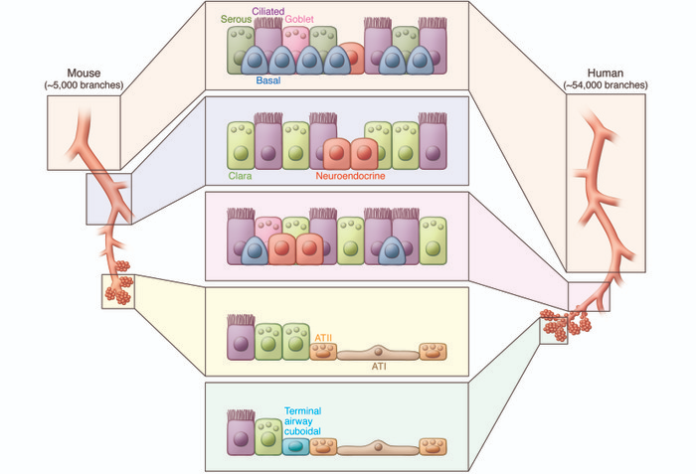
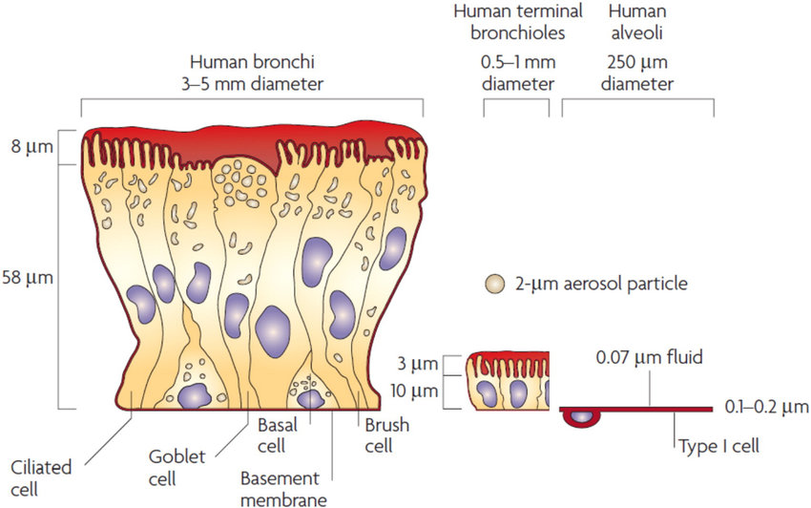
Lung Epithelia
Key biological concepts:
Quasi-2D epithelium (semi-stratified in some places, simple in others)
Varies in cell type and geometry by position
Cells vary in their ability to be infected

Slide 11
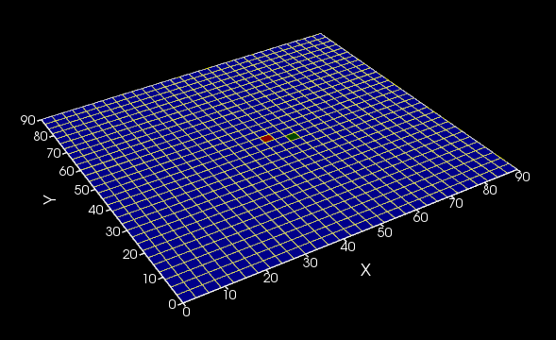
Lung Epithelia
Key biological concepts:
Quasi-2D epithelium (semi-stratified in some places, simple in others)
Varies in cell type and geometry by position
Cells vary in their ability to be infected
Base model retains idea of simple epithelium, but omits complexity
Flat sheet of single cell type

Slide 12
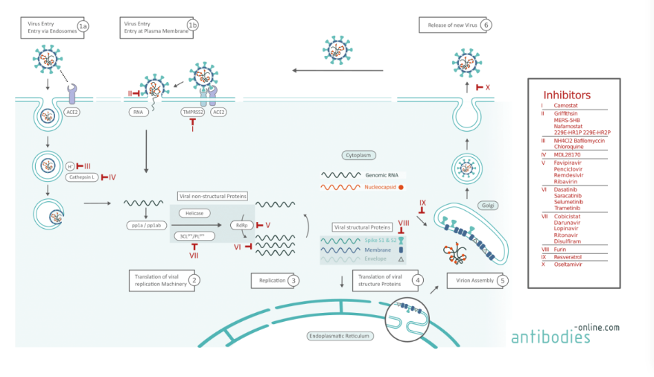
Viral Replication
Key biological concepts:
Virus replication has many steps
Critical mechanisms include RNA replication (leads to exponential amplification)
Release by exocytosis
See eclipse phase, followed by exponential growth, followed by saturation
https://www.antibodies-online.com/resources/18/5410/sars-cov-2-life-cycle-stages-and-inhibition-targets/
Accessed 6/10/2020

Slide 13
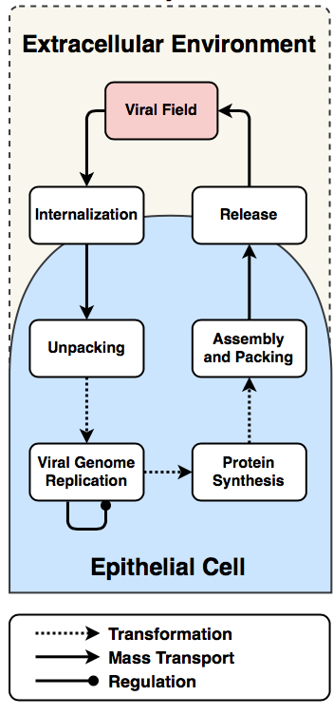
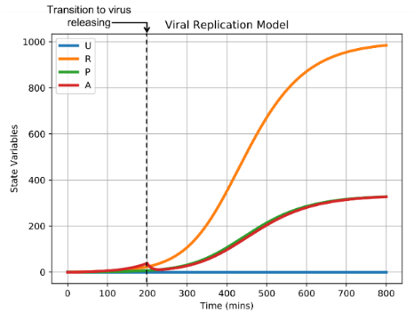
Viral Replication
Key biological concepts:
Virus replication has many steps
Critical mechanisms include RNA replication (leads to exponential amplification)
Release by exocytosis
See eclipse phase, followed by exponential growth, followed by saturation
$$\frac{dU}{dt}=Uptake −r_{u}U$$
$$\frac{dR}{dt}=r_{u}U +r_{max}R\frac{r_{half}}{R +r_{half}} −r_{t }R$$
$$\frac{dP}{dt}=r_{t}R−r_{p}P$$
$$\frac{dA}{dt}=r_{p}P−Release$$
https://www.antibodies-online.com/resources/18/5410/sars-cov-2-life-cycle-stages-and-inhibition-targets/
Accessed 6/10/2020
Base model retains exponential amplification of RNA
and 3-phases of growth,
omits complexity of entry and protein synthesis

Slide 14
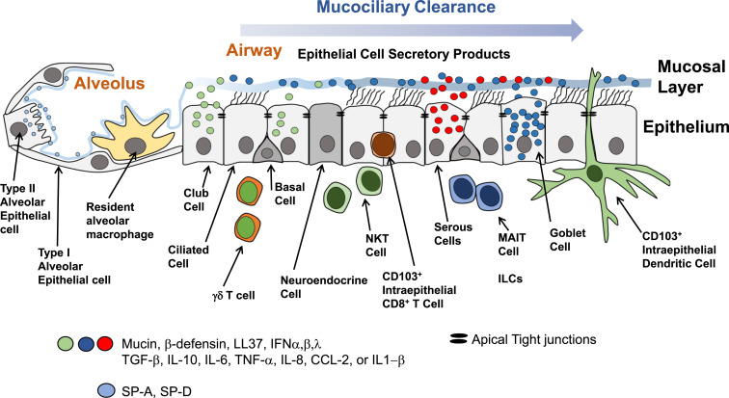
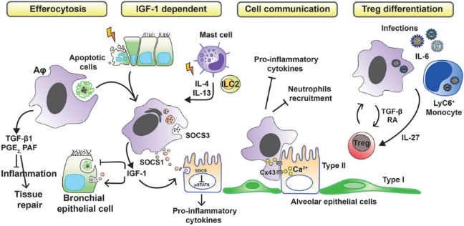
Immune Response in Tissue
Many cell types and signals playing roles in
Phagocytosis
IFN-induced viral resistance
Killing of infected cells by contact, bystander effect, secreted oxidative chemicals
Complex time series of cell and signaling activity
Antigen presentation and transport in the lymph nodes
Relaying and amplification of cytokine signals
Complex pattern of entry of cells into tissue and spatial localization
SARS-1 and SARS-CoV-2 both deplete resident T-cells and macrophages
SARS can infect T-cells and macrophages
Innate and Adaptive phases
Non-specific antibodies may be important in early control
Specific Antibodies late in infection
Complex mixture of pro and anti-inflammatory signals

Slide 15
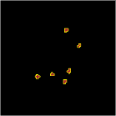
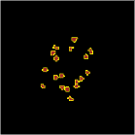
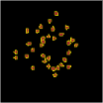
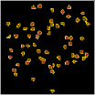
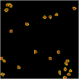
Immune Response in Tissue
Many cell types and signals playing roles in
Phagocytosis
IFN-induced viral resistance
Killing of infected cells by contact, bystander effect, secreted oxidative chemicals
Complex time series of cell and signaling activity
Antigen presentation and transport in the lymph nodes
Relaying and amplification of cytokine signals
Complex pattern of entry of cells into tissue and spatial localization
SARS-1 and SARS-CoV-2 both deplete resident T-cells and macrophages
SARS can infect T-cells and macrophages
Innate and Adaptive phases
Non-specific antibodies may be important in early control
Specific Antibodies late in infection
Complex mixture of pro and anti-inflammatory signals
Immune
Model includes one cytokine and one immune cell type (T-cell like)
Cells conceived of acting above the epithelial sheet
Activation of immune cells by cytokine
Direct killing, bystander killing and secreted oxidative chemicals

Slide 16
Systemic Immune Response
Key biological concepts:
Complex mixture of pro and anti-inflammatory signals
Local signaling recruits circulating immune cells
Long-range signaling upregulates immune cell production
Migration of APCs to lymph nodes takes days
Production of antigen-specific CD8+ and other T-cells takes days
Production of B-cells and antibodies takes weeks
Immune system retains memory of antigen exposure

Slide 17
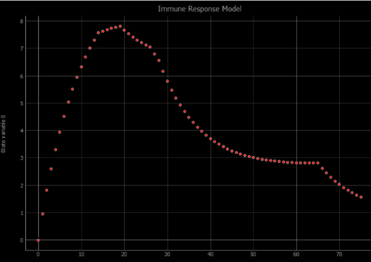
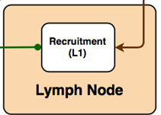
Systemic Immune Response
$$\frac{dS}{dt}=β_{add}−β_{sub}N_{immune}+\frac{α_{sig}}{β_{delay}}δ−β_{decay}S$$
Key biological concepts:
Complex mixture of pro and anti-inflammatory signals
Local signaling recruits circulating immune cells
Long-range signaling upregulates immune cell production
Migration of APCs to lymph nodes takes days
Production of antigen-specific CD8+ and other T-cells takes days
Production of B-cells and antibodies takes weeks
Immune system retains memory of antigen exposure
Model concepts:
Long-range signaling from local tissue determines net pro- or anti-inflammatory state
Lymph node supplies immune cells to tissue for pro-inflammatory state, removes immune cells from tissue for anti-inflammatory state
Immune cells supplied to tissue with variable delay

Slide 18
Tissue Damage and Recovery
Key biological concepts:
Intrinsic Cell death due to viral production
Extrinsic Cell Death due to viral production
Immune-cell killing
Cytokine-induced damage
Recovery after injury by proliferation of resident stem-like cells

Slide 19
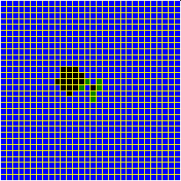
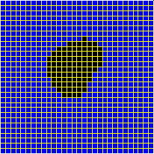
Tissue Damage and Recovery
Damage
Uninfected
Infected
Dead
Time
Key biological concepts:
Intrinsic Cell death due to viral production
Extrinsic Cell Death due to viral production
Immune-cell killing
Cytokine-induced damage
Recovery after injury by proliferation of resident stem-like cells
Model concepts:
Cell death due to viral production
Immune cell death as previously described
No tissue recovery

Slide 20
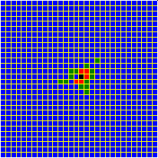
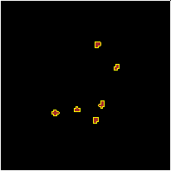
Multiscale Infection and Response
Systemic
Basic mechanisms of infection and immune response range from subcellular to systemic
Viral replication can occur in each cell
Recruitment signaling can occur by all cells
Subcellular
Cellular
Uninfected
Infected
Virus releasing
Dead
Immune

Slide 21
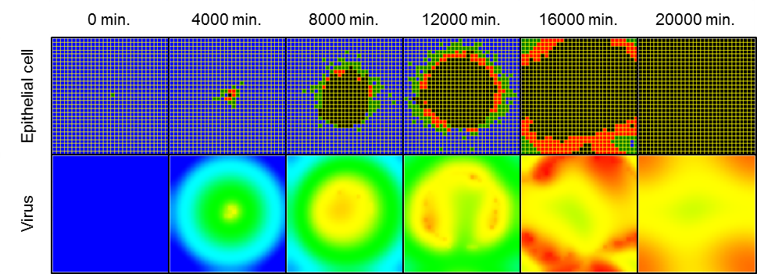
Modeling Viral Infection in CC3D
A modular framework for multiscale multicellular spatial modeling of viral infection, immune response and drug therapy timing and efficacy in epithelial tissues
T.J. Sego, Josua O. Aponte-Serrano, Juliano Ferrari Gianlupi, Samuel R. Heaps, Kira Breithaupt, Lutz Brusch, James M. Osborne, Ellen M. Quardokus, Richard K. Plemper, James A. Glazier
doi: https://doi.org/10.1101/2020.04.27.064139
Submitted to PLoS Comp. Bio.

Slide 22
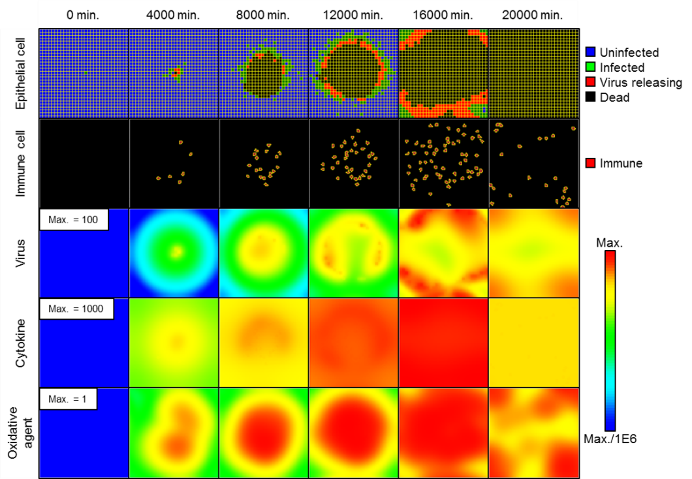
Start Modest: Look at Spread of Infection in a Small Patch of Epithelial Tissue
Focus on infection in a small patch of susceptible tissue
Assume primary infection
no pre-existing adaptive immune response
no specific antibodies, memory T-cells or targeted B cells
Assume acute infection
consider a short time where the immune system either clears the virus, the virus spreads over the entire tissue patch, or something in between

Slide 23
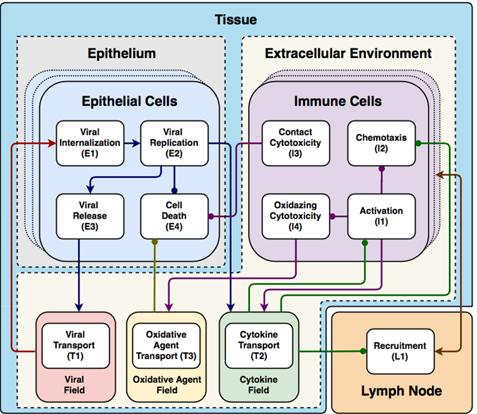
Overview of Model Components
Two cell classes
Epithelial cell: the susceptible cells
Immune cell: the infection fighters
Three diffusive fields
(Extracellular) Viral Field: extracellular virus transport
Cytokine Field: local and global signaling
Oxidative Agent Field: epithelial cell killing by immune cells
Lymph node
Compartmental model
Regulates local immune cell population

Slide 24
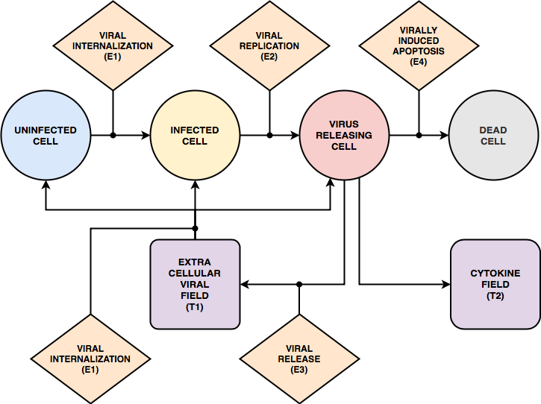
Epithelial Cell Types
One epithelial biological cell type realized as 4 simulation cell types
Type | Internalize Virus | Replicate Virus | Release Virus | Release Cytokines | Die from Virus | Die from Oxidative Agent | Bystander Death
Uninfected | X |  |  |  |  | X | X
Infected | X | X |  | X |  | X | X
Virus Releasing | X | X | X | X | X | X | X
Dead

Slide 25
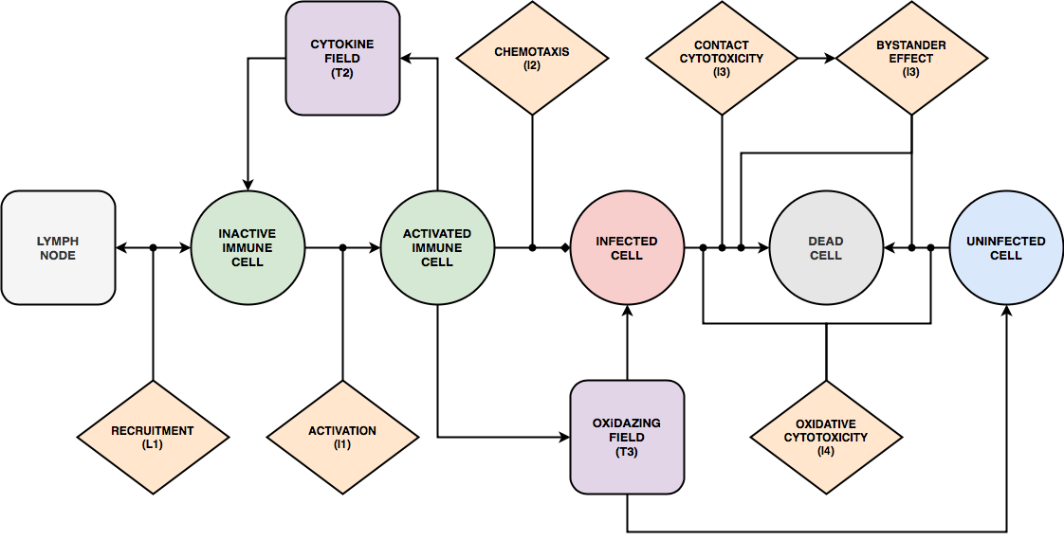
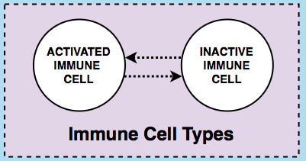
Immune Cell Types
One generic immune cell type realized as 2 simulation cell types
Type | Random Motility | Chemotax to Cytokine | Contact Kill | Release Cytokines | Activate in Response to Cytokine | Secrete Oxidative Chemical | Inactivate with time
Inactive | X |  | X |  | X
Activated | X | X | X | X |  | X | X

Slide 26
Phases of Basic Viral Replication
Viral Internalization: how virus gets into a cell
Virus is taken from the environment and transferred into a cell
Binding to receptors determines rate of internalization vs extracellular viral concentration
Each cell has a finite number of available receptors
Viral Replication: how virus replicates inside a cell
Four basic stages of replication: Unpacking, Genome Replication, Protein Synthesis, and Assembly and Packing
Exponential amplification phase: Genome Replication
Viral Release: how virus is released into the environment
Virus is taken from the cell and transferred into the environment
Rate of release is proportional to internal amount of Assembly and Packing

Slide 27
Overview of Immune Recruitment
A single variable 𝑆 represents net inflammatory state (pro-inflammatory or anti-inflammatory) and controls immune cell recruitment
$S>0$ add immune cells to tissue
$S<0$ remove immune cells from tissue
Signaling from the spatial domain due to infection affects $S$
$S$ increases by the cytokine level in the tissue with a delay
$S$ decreases when immune cells added

Slide 28
Overview of Cell Death Mechanisms
Epithelial cells can die by 4 different stochastic mechanisms
Virally-induced Apoptosis: from high internal virus
Contact Cytotoxicity: from contact with immune cells
Bystander Effect: from contact with cell killed by contact cytotoxicity
Oxidizing Cytotoxicity: from high exposure to levels of Oxidative Agent Field

Slide 29
Overview of Simulation Details
Quasi-2D simulation configuration
Lower level: fixed monolayer of uninfected epithelial cells
Upper level: motile immune cells
All fields: initially zero everywhere
Center epithelial cell: seeded with internal virus
Simulation time: ~14 days (20 minutes per step)
Uninfected
Infected
Virus releasing
Dead
Immune
Max.
Max./1E6

Slide 30
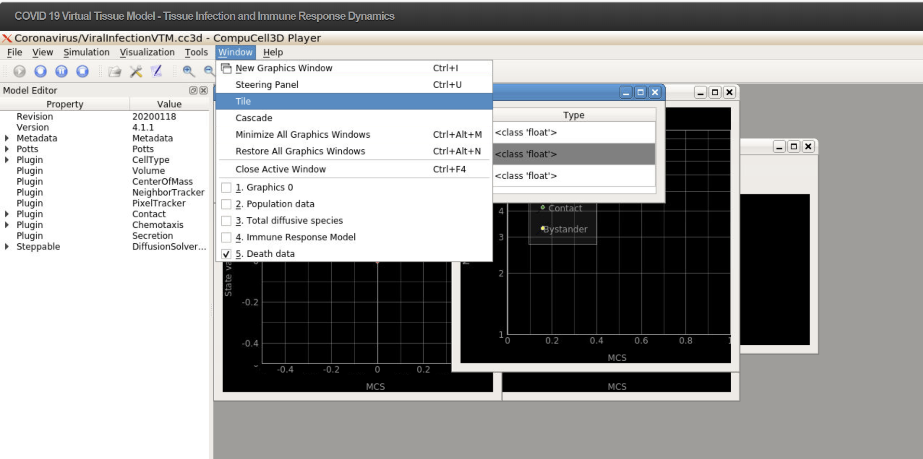
Exercise 1.3.1—Run Viral Infection Model on nanoHUB
nanoHUB tool:
https://nanohub.org/tools/cc3dcovid19
Explore configuring the simulation display and starting, pausing and stopping the simulation
Use the Tile function in the “Window” pulldown menu to arrange your screen
You can add additional windows to view the immune cells or the chemical or viral fields by clicking on the icon in the menu bar

Slide 31
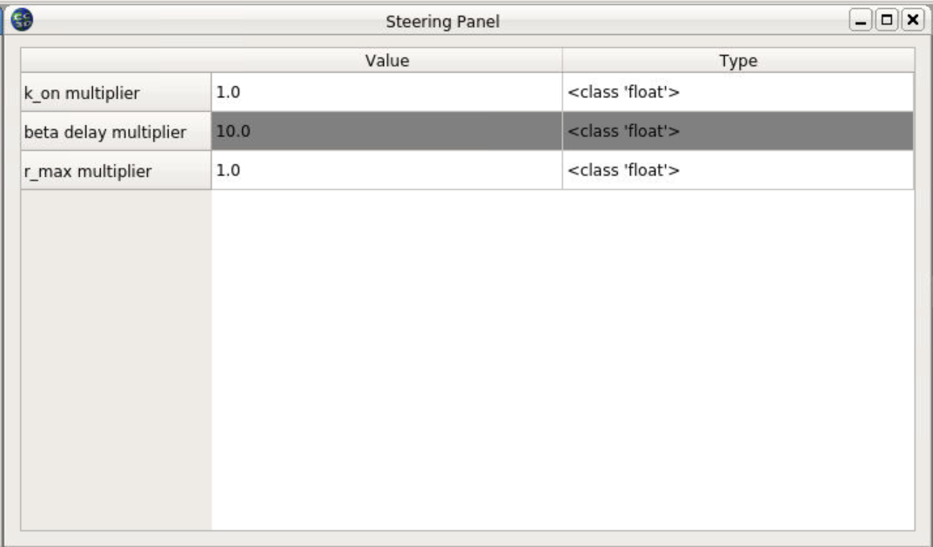
Exercise 1.3.1—Run Viral Infection Model on nanoHUB
nanoHUB tool:
https://nanohub.org/tools/cc3dcovid19
The simulation version on nanoHUB allows you to change three key parameters using a dialogue box “Steering Panel”
k_on multiplier changes the affinity between viral receptor and virus. Larger multipliers make the virus more infective. Smaller values correspond to antibody therapies or interferon-induced antiviral resistance to infection.
1) Try running for a k_on multiplier of 100 and see how the result differs from that for k_on multiplier of 1
r_max multiplier changes the rate at which the virus reproduces in the cell. Larger values lead to faster reproduction. Smaller values correspond to antiviral treatment or interferon-induced antiviral resistance
2) Try running for a few minutes till 100 MCS (2000 minutes or 1.4 days) and then switch the r_max multiplier of 0.1 to simulate a highly effective antiviral treatment given a day and a half after exposure. What happens? How does the result depend on the time after exposure at which the treatment is given
beta_delay multiplier changes the speed and amplitude of immune response. Larger values lead to slower and weaker immune responses. Larger values correspond to an immunosuppressed individual or anti-inflammatory treatment smaller values would correspond to a chronic inflammatory state or activating therapy (like IL-2, IL-6 or IL-7)
Try changing these at home to explore more!

Slide 32
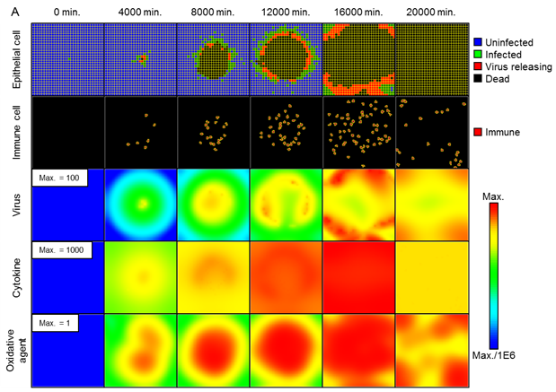
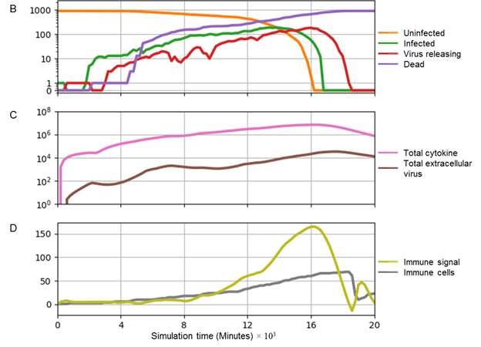
Baseline Parameter Set
Just at the “boundary” of balance between infection and control
All cells infected and die
Immune cells kill many infected cells

Slide 33
Epithelial
Immune
Uninfected
Infected
Virus releasing
Dead
Immune
Virus
Cytokine
Oxidative Agent

Slide 34
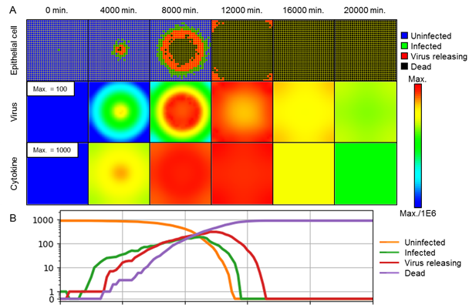
Reference Case: Immune Response
Disabling immune response: classic Fisher-type spread of infection
Enabling immune response: widespread infection is slowed but not stopped
Baseline parameters

Slide 35
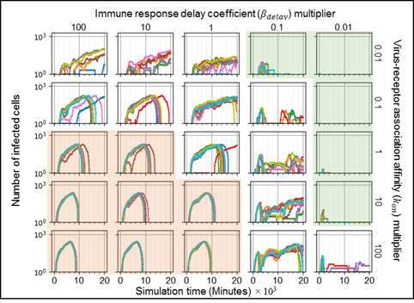
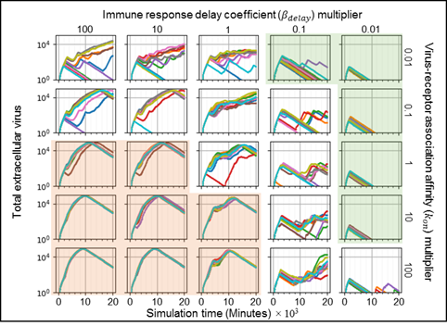
Parameter Sensitivity for Immune Response and Viral Internalization
Parameter variations: immune response delay and viral internalization rate
Regions of certain outcomes, with variability in between
Green: at end of simulation, no infected or virus releasing cells, and some uninfected cells
Red: at end of simulation, no uninfected cells
Stronger Immune Response
Baseline
parameter set
Faster Viral Internalization
Number of Infected Cells
Extracellular Virus

Slide 36
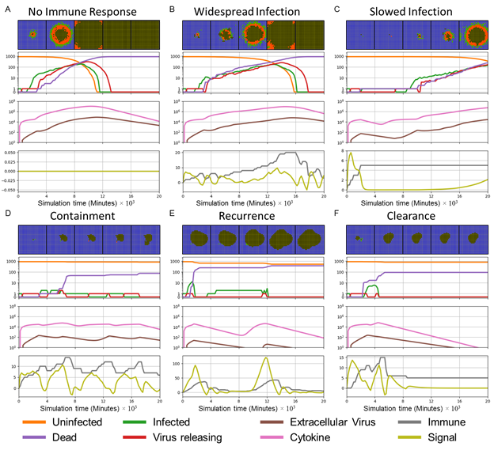
Classes of Infection Dynamics
Parameter sweep showed consistent emergent behaviors of infection
Five classes of infection dynamics
Widespread infection (B)
Slowed infection (C)
Containment (D)
Recurrence (E)
Clearance (F)

Slide 37
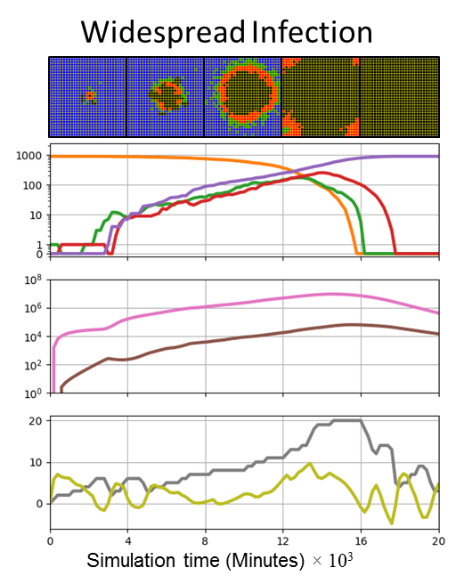
Classes of Infection Dynamics
Widespread infection
weak immune response and large rate of infection propagation
no uninfected epithelial cells survive at the end of the simulation
Stronger Immune Response
Faster Viral Internalization
Number of Infected Cells

Slide 38
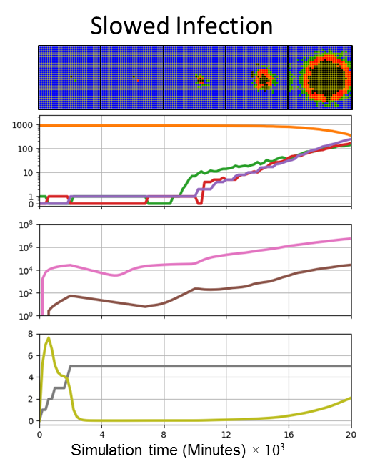
Classes of Infection Dynamics
Slowed infection
moderate immune response and moderate rate of infection propagation
both uninfected and infected epithelial cells and some extracellular virus remain at the end of the simulation
Stronger Immune Response
Faster Viral Internalization
Number of Infected Cells

Slide 39
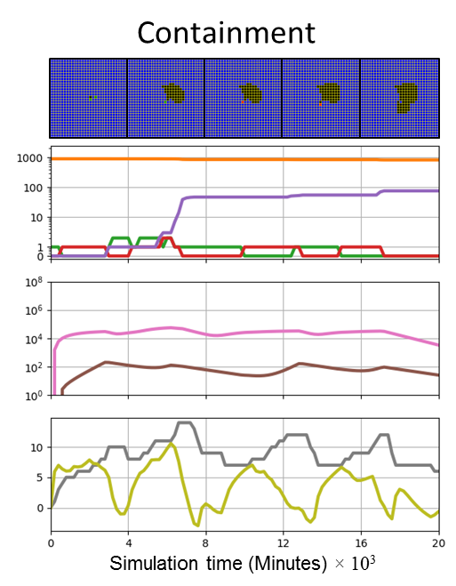
Classes of Infection Dynamics
Containment
strong immune response and low to moderate rate of infection propagation
no infected or virus releasing cells remain, while uninfected cells survive and some extracellular virus remains in the extracellular environment at the end of the simulation
Stronger Immune Response
Faster Viral Internalization
Number of Infected Cells

Slide 40
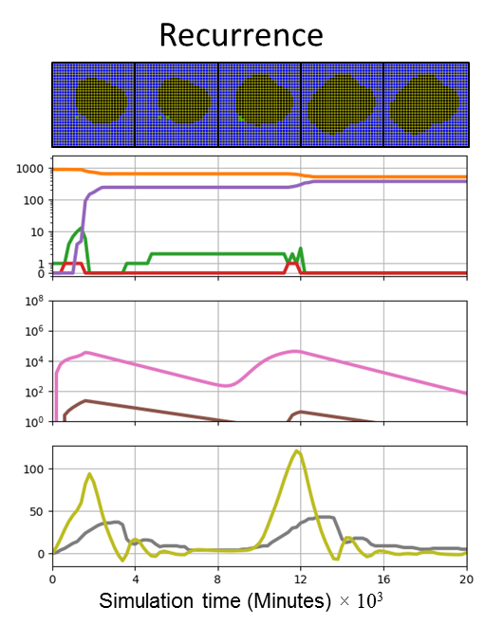
Classes of Infection Dynamics
Recurrence
strong immune response and fast infection propagation
all infected and virus-releasing epithelial cells die but remaining extracellular virus infects epithelial cells later on, restarting the spread of infection
Stronger Immune Response
Faster Viral Internalization
Number of Infected Cells

Slide 41
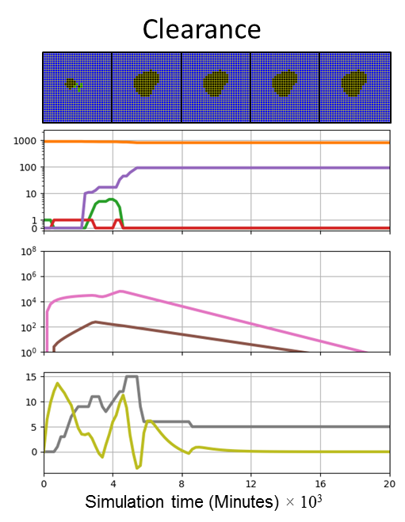
Classes of Infection Dynamics
Clearance
strong immune response and slow infection propagation
the number of infected and virus-releasing epithelial cells goes to zero without recurrence and the extracellular virus drops below a threshold (1/900 per cell) by the end of the simulation
Stronger Immune Response
Faster Viral Internalization
Number of Infected Cells

Slide 42
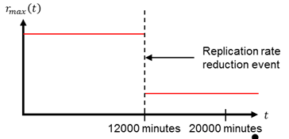
Simulate Therapy with RNA-Synthesis Blocker
Drugs like Remdesivir inhibit RNA synthesis, the one exponential step in viral replication
Issues:
Effectiveness decreases rapidly as the time of first treatment increases
Tradeoff between potency (drug efficacy x dose) vs effectiveness [want to use lowest effective dose to minimize side effects)
Easy to model and simulate
Treatment corresponds to reducing replication rate in viral replication model
Treatment can be applied at various times after initial infection in simulation
Example simulated therapy. $r_{max}$ is the replication rate of all cells in simulation time.
$$\frac{dU}{dt}=Uptake −r_{u}U$$
$$\frac{dR}{dt}=r_{u}U +r_{max}R\frac{r_{half}}{R +r_{half}} −r_{t }R$$
$$\frac{dP}{dt}=r_{t}R−r_{p}P$$
$$\frac{dA}{dt}=r_{p}P−Release$$
From the Viral Replication module
$U$: Unpacking, $R$: Genome Replication, $P$: Protein Synthesis, and $A$: Assembly and Packing

Slide 43
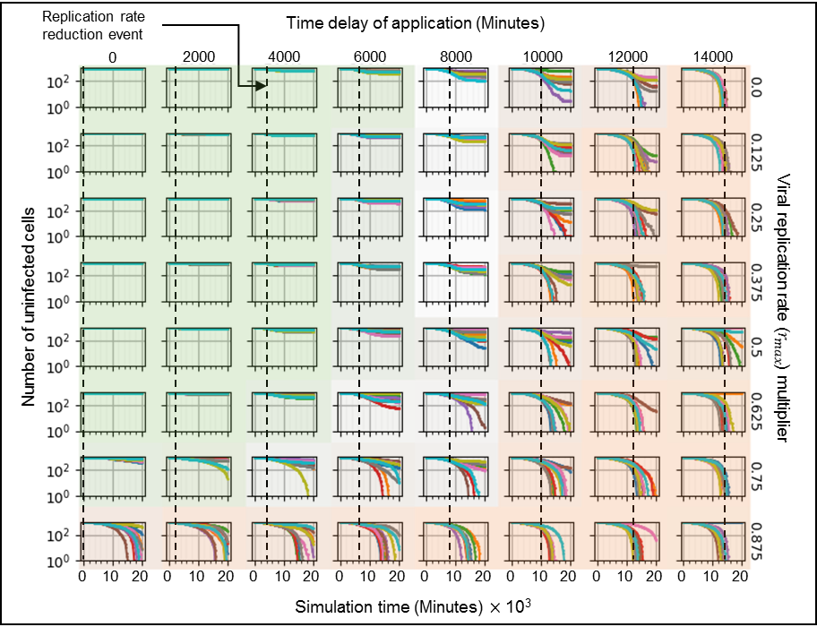
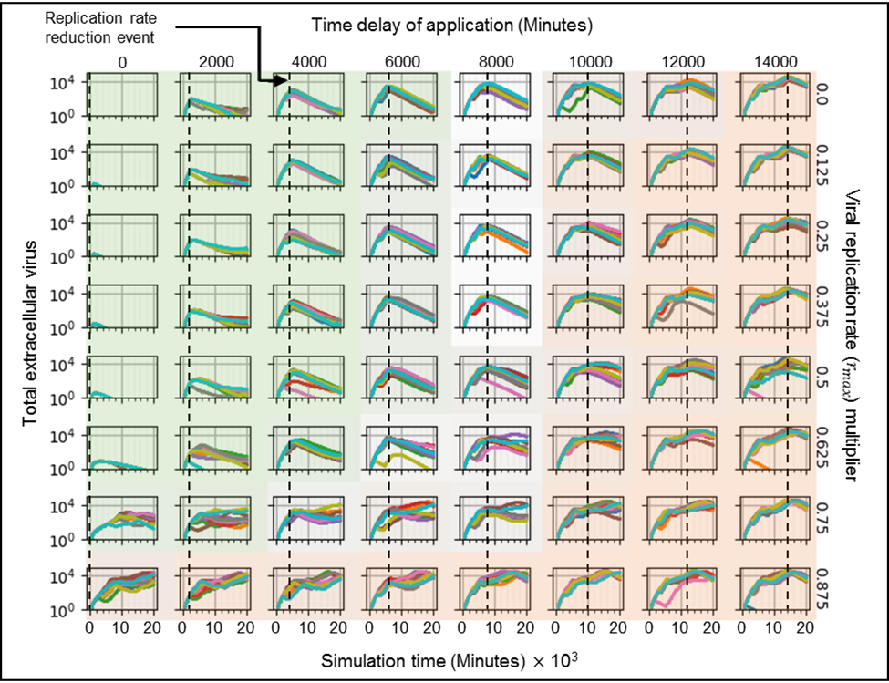
Time vs Potency Tradeoffs for an RNA-Synthesis Blocker
Later Treatment
Higher Potency
Green: virus controlled and most cells left uninfected
Red: most cells infected, virus not controlled

Slide 44
Time vs Potency Tradeoffs for an RNA-Synthesis Blocker
Later Treatment
Higher Potency
High stochasticity between regions of certain outcomes

Slide 45
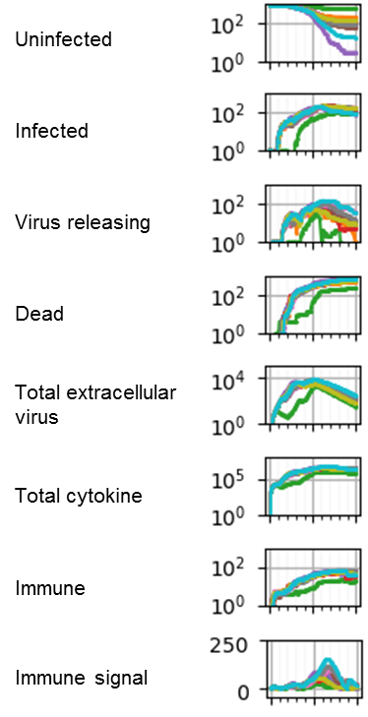
Exploring Stochasticity of Outcomes
Positive outcome: delayed infection from early stochastic events
Intermediate vs. Negative outcomes: spatial effects

Slide 46
Summary of Findings
Simulating viral infection
Parameter space has deterministic regions with fuzzy boundaries
Stochasticity of cell-based events matters!
Spatial distribution of infection matters!
Simulating drug therapy
Early treatment is better (no surprise)
Even very low dose treatment earlier is better than high dose treatment later (maybe more surprising)
A few replicas treated with high potency at late times still show good outcomes because of stochastic cases with slower viral build up

Slide 47
Q&A
Please submit questions via Zoom chat

