Slide 1
CC3D Workshop 4.6: Best Practices and Parameters
James Sluka
Dept. of Intelligent Systems Engineering
and the Biocomplexity Institute
Indiana University
Bloomington, IN 47408
USA
The workshop will begin at 11:00AM EDT
Screensharing and microphones have been disabled for participants in the main session—they are available in breakout rooms
Please submit questions/concerns/suggestions via zoom chat
User support will be available in zoom breakout rooms
Workshop will be live-streamed, recorded and distributed
Make sure you save the zoom link after registering so you do not have to re-register
Please take the time now to be sure you have a working nanoHUB account and to download and install CompuCell3D to your desktop if you are planning to run it locally
Please also join the workshop slack channel at https://join.slack.com/t/multiscalemod-ags3330/shared_invite/zt-g0up1lz7-z5XGFC73UZk1j3BPeW7RVA
Funding Sources: NIH U24 EB028887, NIH R01 GM122424, NIH R01 GM123032, NIH P41 GM109824, NSF 1720625 and nanoHUB

Slide 2
Best Practices
Project file versioning and tracking
Biological Description
Parameters
Biological Parameters
Computational Parameters
Units and citations

Slide 3
Best Practices: Project file versioning and tracking
Programmers prefer a versioning system such as GitHub our SourceForge
CompuCell3D uses SourceForge: https://sourceforge.net/projects/cc3d/files/4.2.2/windows/
Advantages:
Programmers often already use one of these tools
Robust versioning
Reliable retention of previous versions
Excellent ability to share with a team
Disadvantages
Non-programmers usually have not used these tools
Significant learning curve
Requires internet access if files are used live

Slide 4
Best Practices: Project file versioning and tracking
Using on online file storage system such as Google Drive or Dropbox.
Advantages:
Easy
Keeps a reasonable set of backups and previous file versions
Disadvantages
Can be a challenge to use these files as if they are on the users local computer hard drive.
Requires internet access if files are used live
Cost may be an issue

Slide 5
Best Practices: Project file versioning and tracking
Non-programmers tend to not keep old version or backups (beyond whatever file backups their system generates automatically)
Advantages:
Easy
Disadvantages
Little protection from file loss
Little ability to trace project evolution
Easy to develop broken code without being able to backup to a previous working version

Slide 6
Best Practices: Project file versioning and tracking
A reasonable, low cost approach for non-programmers is to keep the projects file on the local hard drive and create frequent zip files that are a snapshot of the projects folders.
Advantages:
Fairly easy (CC3D has a built in zip functionality for the files in a project)
Disadvantages
Must remember to actually make the copies.

Slide 7
Best Practices: Biological Description
Modelers should keep a working document that describes the biology being modelled and how it is modelled. The biological description should include:
A description of the overall domain and goals of the modeling effort.
A list of biological physical entities such as cell types, diffusing molecules, extracellular matrix, etc.
A list of biological processes such as diffusion, cell death and division, phenotypic changes.
Optimally, the above would include citations and links to the concepts in bio-ontologies.

Slide 8
Best Practices: Parameters
The COVID-19 model makes extensive use of parameters and conversions in a parameter file.
A CC3D project demonstrating the use of a parameter file (Python) is in CC3D_parameters_example.zip

Slide 9
Best Practices: Parameters
Tracking parameters within a computational modeling project can be challenging.
The worst case is that biological parameters (e.g., cell volumes or a diffusion coefficient), units, and model implementation parameters (e.g., width of model in pixels) are scattered about in the code.
Modelers should track and organize parameters and to clearly label the conversion between biological and modeling parameters.
In addition, the units and reference or citation for biological parameters should be tracked from the beginning of a project.

Slide 10
Best Practices: Parameters, simple approach
Include the parameters (preferably with comments) at the top of the steppables file.
# Python Steppables File
from cc3d.core.PySteppables import *
# Conversion Factors
s_to_mcs = 5.0 * 60.0 # s/mcs
days_to_mcs = s_to_mcs / 60.0 / 60.0 / 24.0 # days/mcs
# =============================
# CompuCell Parameters
# cell
cell_diameter = 5.0
cell_volume = cell_diameter ** 2
# virus diffusion
virus_dc = 1.875
You can use the variables, without prefix, in any place within this python file.

Slide 11
Best Practices: Parameters, a better approach
Create a parameters file in Python and include it in the CC3D project. The python file can include:
Parameters broken up into biological and computational domains
Units for parameters
References for parameters
Equations that convert from biological units to model units (e.g., microns per pixel).
Ontological links for objects (cells, tissue, …) and processes
Lung epithelial cell = http://purl.obolibrary.org/obo/CL_0000082
epithelial cell proliferation = http://purl.obolibrary.org/obo/GO_0050673

Slide 12
Best Practices: Parameters, a better approach
The Covid-19 model uses a parameter file as part of the project.
The Parameter file is ViralInfectionVTMModelInputs.py:
Importing the parameters into a module ViralInfectionVTMSteppables.py:
Usage:
# To use, assign the name of the code variable as a key, and a
# string description as value
# e.g., __param_desc__['my_var'] = 'My variable'
# my_var = 1
# The generated csv will read, "my_var, 1, My variable'
__param_desc__ = {}
# Conversion Factors
__param_desc__['s_to_mcs'] = 'Simulation step'
s_to_mcs = 1200.0 # s/mcs
Create a parameter description dictionary
# Import project libraries and classes
sys.path.append(os.path.dirname(__file__))
from ViralInfectionVTMSteppableBasePy import *
import ViralInfectionVTMLib
from ViralInfectionVTMModelInputs import *
Note that no package name was used
uptake_amount = s_to_mcs / rate_coeff_uptake_pr * uptake_probability

Slide 13
Best Practices: Parameters, a better approach
Demo with cell sorting in a “python only” model (no xml)
Python only since it is easier to change many of the most basic CC3D parameters (like model dimensions) in python versus the XML version.
Project name: CC3D_parameters_example

Slide 14
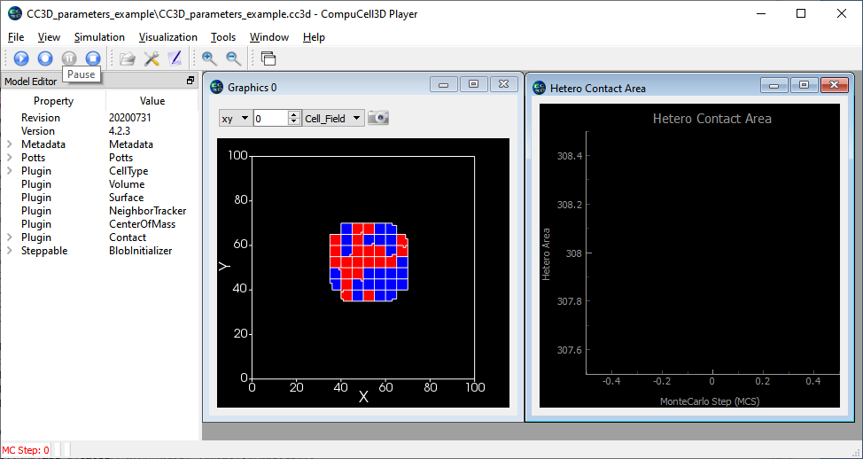
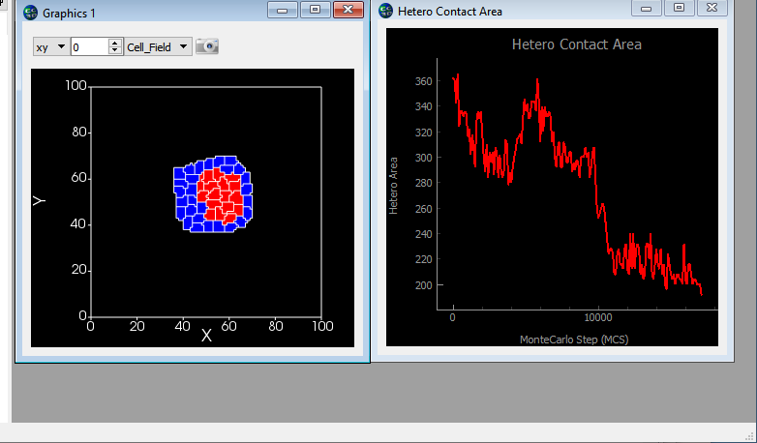
Best Practices: Parameters, cell sorting demo
You can download this model from https://compucell3d.org/CC3D_2020_class_files?action=AttachFile&do=get&target=CC3D_parameters_example.zip
Total contact area between cells of different types (excluding medium)
I will use a model of my own. If you would like to load a suitable file to try this on you can use a Python only demo like C:\CompuCell3D-py3-64bit\Demos\CompuCellPythonTutorial\PythonOnlySimulationsExamples\cellsort-2D-player-new-syntax)
Notes:
https://compucell3d.org/CC3D_2020_class_files?action=AttachFile&do=get&target=CC3D_parameters_example.zip

Slide 15
Best Practices: Add python file for parameters to the CC3D Project
Right-click
Notes:
Have students try this on a CC3D project of their own choosing

Slide 16
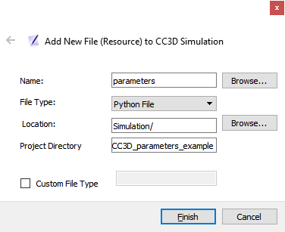
Best Practices: Add python file for parameters
Call the file “parameters” (for example)
Might be better to name <project name>_parameters
File type is “python”

Slide 17
Best Practices: Add python file for parameters
You should now have an empty file, double click on it in the file list to open in Twedit++

Slide 18
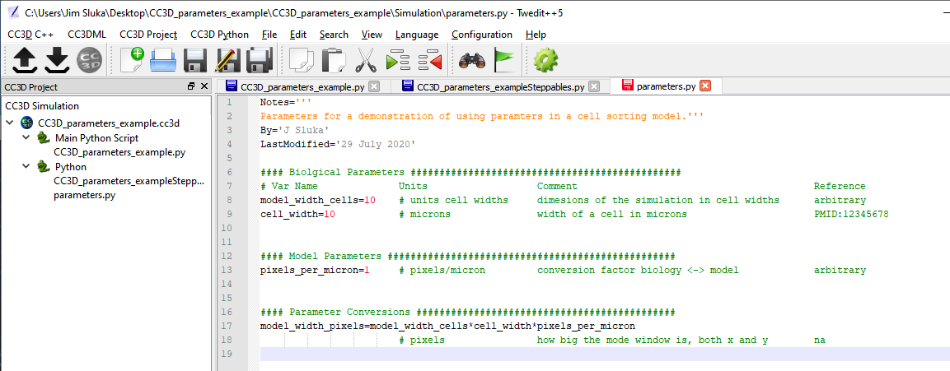
Best Practices: Add your parameters
Define biological and model values, add references, units, etc. This is python so you can assign values, comment, do calculations, etc.
Convenient to separate into Biological, Model and Conversions (between biological values and model values) sections.

Slide 19
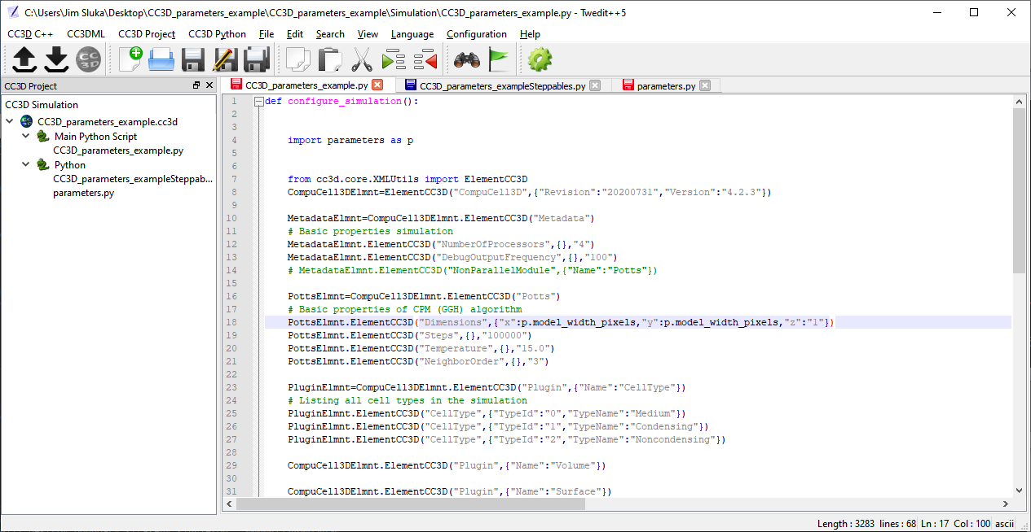
Best Practices: Use the parameters
Import the parameters file into any of your python modules that need access to them.
“model_width_pixels” a parameter in the parameter file

Slide 20
Best Practices: Converting from biological values to model values in the parameter file
#### Biological Parameters ###############################################
# Var Name Units Comment Reference
model_width_cells = 20 # units cell widths dimensions of the simulation in cell widths arbitrary
cell_width_microns= 10 # microns width of a cell in microns PMID:12345678
#### Model Parameters ##################################################
pixels_per_micron = 1.0 # pixels/micron conversion factor biology <-> model arbitrary
max_mcs= 1000000 # mcs maximum number of mcs
#### Parameter Conversions #############################################
model_width_pixels = int(model_width_cells*cell_width_microns*pixels_per_micron)
# pixels how big the mode window is, both x and y na
cell_width_pixels = int(cell_width_microns*pixels_per_micron)
# pixels how wide an indvidual cell is na
initial_cell_field_radius = int(0.3 * model_width_pixels)
# pixels intial width of the blob of cells na
# 2D
cell_targetVolume = (cell_width_pixels)**2

Slide 21
Best Practices: Tricky ones- J values (adhesions) and lambda volume and surface
Adhesion Values (j):
Lambda Volume (λ_{vol}):
Lambda Surface (λ_{surf}):
The cell sorting model was calibrated with D_{ref} of 5
$$j=\frac{j_{ref}D_{ref}}{D_{actual}}$$
Where j is the scaled value to use, j_{ref} is the value at a reference cell width of d_{ref} and d_{actual} is the cell width actually being used.
Where λ_{vol} is the scaled value to use, λ_{vol,ref} is the value at a reference cell volume of V_{ref} and V_{actual} is the cell volume actually being used.
$$λ_{vol}=\frac{λ_{vol,ref}V_{ref}}{V_{actual}}$$
Where λ_{surf} is the scaled value to use, λ_{surf,ref} is the value at a reference cell width of D_{ref} and D_{actual} is the cell width actually being used.
$$λ_{surf}=\frac{λ_{surf,ref}D_{ref}}{D_{actual}}$$

Slide 22
Best Practices: One way to collect things
Notes='''
Parameters for a demonstration of using parameters in a cell sorting model.'''
By='J Sluka'
LastModified='29 July 2020'
Notes2='''Note that since this file is part of the project any CC3D run output directory will include the parameter file used for that particular run.'''
#### Biolgical Parameters ###############################################
# Var Name Units Comment Reference
model_width_cells = 20 # units cell widths dimesions of the simulation in cell widths arbitrary
cell_width_microns= 10 # microns width of a cell in microns PMID:12345678
#### Model Parameters ##################################################
pixels_per_micron = 1.0 # pixels/micron conversion factor biology <-> model arbitrary
max_mcs= 1000000 # mcs maximum number of mcs
#### Parameter Conversions #############################################
model_width_pixels = int(model_width_cells*cell_width_microns*pixels_per_micron)
# pixels how big the mode window is, both x and y na
cell_width_pixels = int(cell_width_microns*pixels_per_micron)
# pixels how wide an indvidual cell is na
initial_cell_field_radius = int(0.3 * model_width_pixels)
# pixels intial width of the blob of cells na
# 2D
cell_targetVolume = (cell_width_pixels)**2
cell_targetSurface= 4.*cell_width_pixels
lambda_volume = 3*25/cell_targetVolume
# potts energy lambda_volume for both kinds of cells, the refer lambda is 3, and the
# reference volume 25 (2D)
lambda_surface = 2*5/cell_width_pixels
# potts energy lambda_surface for both kinds of cells, the refer lambda is 2, and the
# reference surface 5 (2D) (actually just using the cell width)
# adhesion values
j_MM = 0.*5/cell_width_pixels # reference j is 0, reference width is 5
j_MC = 16.*5/cell_width_pixels # reference j is 16, reference width is 5
j_MN = 16.*5/cell_width_pixels # reference j is 16, reference width is 5
j_CC = 2.*5/cell_width_pixels # reference j is 2, reference width is 5
j_CN = 11.*5/cell_width_pixels # reference j is 11, reference width is 5
j_NN = 16.*5/cell_width_pixels # reference j is 16, reference width is 5
Or perhaps a dictionary of dictionaries, which would allow accessing parameter values, units, notes, references etc. (Which the simple text format above can’t do.)
p.p(ParamName(key))

Slide 23
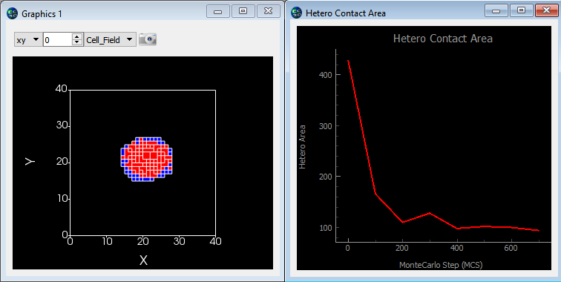
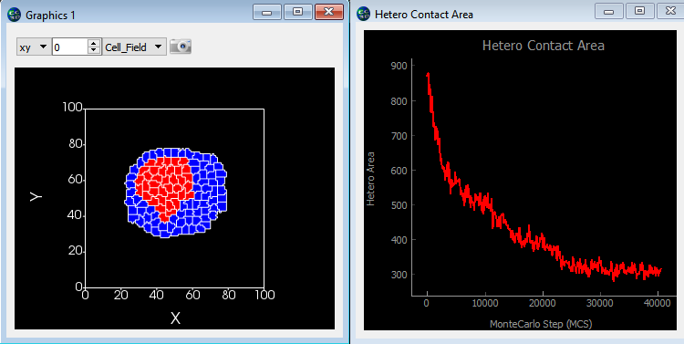
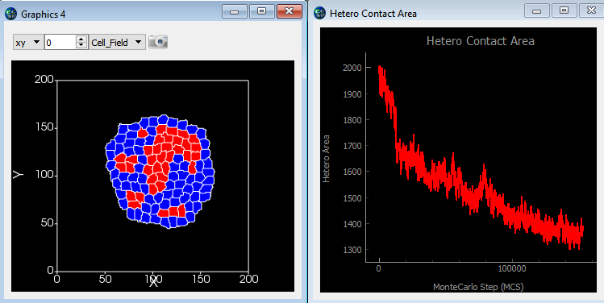
Best Practices: Demonstration of changing the model resolution by changing one parameter
pixels_per_micron = 0.2 (micron/pix=5) 700 mcs
pixels_per_micron = 0.5 (micron/pix=2) 4000 mcs
pixels_per_micron = 1 (micron/pix=1) 120,000 mcs
All 3 simulations have the same number of cells but the cells are different sizes.

Slide 24
Best Practices: Caveats on rescaling models
There is a complex interaction between the parameters in a Potts model. Adhesions, cell volumes and surfaces, pixels per cell, etc. interact in complex ways.
Often, rescaling models is most useful for simply creating a low resolution model that runs fast and allows much more rapid code development and debugging.
A more complex use of a variable scale model is to establish that the model’s precisions (e.g., pixels/micron) does not have a large effect on the model’s output.

Slide 25
Best Practices: A more complex way using a Python dictionary of dictionaries
# Define Parameters as a dictionary of dictionaries
p={}
p.update({'pixels_per_micron':{'value': '1','unit':'pixel/um','reference':'not applicable'}})
p.update({'cell_width': {'value':'10','unit':'um', 'reference':'PMID:12345678‘ }})
CODE DEMO:
print (p,"\n")
for key1 in p: # print the header
print('{: <20}'.format('Name'),end="")
for key2 in p[key1]:
#print(key2,end="\t")
print('{: <20}'.format(key2),end="")
break
print("\n-------------------------------------------------------------------------------------")
for key1 in p: # print the key & values
print('{: <20}'.format(key1),end="")
for key2 in p[key1]:
print('{: <20}'.format(p[key1][key2]),end="")
print()
OUTPUT:
{'pixels_per_micron': {'value': '1', 'unit': 'pixel/um', 'reference': 'not applicable'},
'cell_width': {'value': '10', 'unit': 'um', 'reference': 'PMID:12345678'}}
Name value unit reference
-------------------------------------------------------------------------------------
pixels_per_micron 1 pixel/um not applicable
cell_width 10 um PMID:12345678
USAGE in CC3D Python:
import parameters as p
cellWidth = p.p['cell_width']['value']

Slide 26
Best Practices: Conclusion
Establishing a consistent process for tracking code versions (including considering the need to share with collaborators) is a key part of a serious model development project.
Tracking parameters, units, references, goals, etc. within the CC3D project will both reduce the chances of errors (such as inconsistent units) and make it easier to prepare a paper describing the model.

Slide 27
Module 4.6: Best Practices: Exercise 4.6.1
Add a parameter file to the CC3D project you have been working on. (Hint: right click in Twedit++’s left hand window where the file list is) (if you don’t have a project you can use a Python only demo like C:\CompuCell3D-py3-64bit\Demos\CompuCellPythonTutorial\PythonOnlySimulationsExamples\cellsort-2D-player-new-syntax)
Write a brief description of your model’s goals. This is a python file so use comments, text variables (triple quotes for multiline text variables)
Define a few parameters in the file, including a parameter that depends on other parameters (model width is a good one for this)
Import the parameters file into the proper CC3D python modules
Implement the parameters in the modules
Test your new mode including changes in the parameter file

