Slide 1
CC3D Workshop 1.5B: Building an ODE Viral Infection Model in Tellurium—Part II
James A. Glazier
Dept. of Intelligent Systems Engineering
and Biocomplexity Institute
Indiana University
Bloomington, IN 47408
USA
Screensharing and microphones have been disabled for participants in the main session—they are available in breakout rooms
Please submit questions/concerns/suggestions via zoom chat
User support will be available in zoom breakout rooms
Workshop will be live-streamed, recorded and distributed
Please also join the workshop slack channel at https://join.slack.com/t/multiscalemod-ags3330/shared_invite/zt-g0up1lz7-z5XGFC73UZk1j3BPeW7RVA
Funding Sources: NIH U24 EB028887, NIH R01 GM122424, NIH R01 GM123032, NIH P41 GM109824, NSF 1720625 and nanoHUB

Slide 2
Module 1.5B Topics
Review of 1.5A
Principles of Modeling
Limiting Cases
First Order Kinetics, Mass Action
Saturation, Michaelis-Menten Kinetics, Hill Equations
Modeling Viral Infection
Innate Immune Clearance
Adaptive Immune Clearance

Slide 3
Workshop Resources
All class files are available in a shared google drive https://drive.google.com/drive/folders/18b5lTDBQrAe765wddu_eMw3PgLYTEvKz?usp=sharing
They will also be posted on slack (and pinned): https://multiscalemod-ags3330.slack.com
All resources are also posted in www.compucell3d.org/workshop20

Slide 4
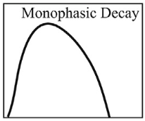
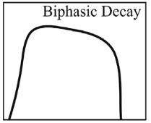
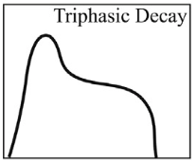
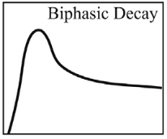
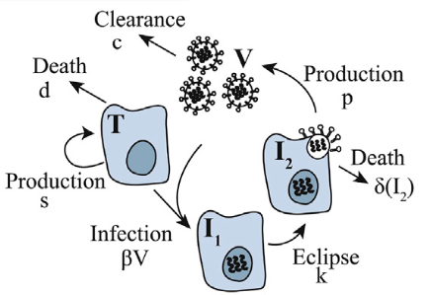
Last Time: Dynamics of Viral Infection
For many viruses and hosts, viral kinetics are relatively similar:
virus increases exponentially, reaches a peak, and declines exponentially in a monophasic, biphasic, or triphasic manner until clearance (acute) or a steady state (chronic)
Mathematical models have been used to evaluate viral infection dynamics and host immune responses, including ordinary differential equation (ODE) models and spatially-resolved agent-based models (ABM)
The most widely used is the standard viral dynamic ODE model
More complicated models might be needed to reproduce different viral curves
Smith AM. Validated models of immune response to virus infection.

Slide 5
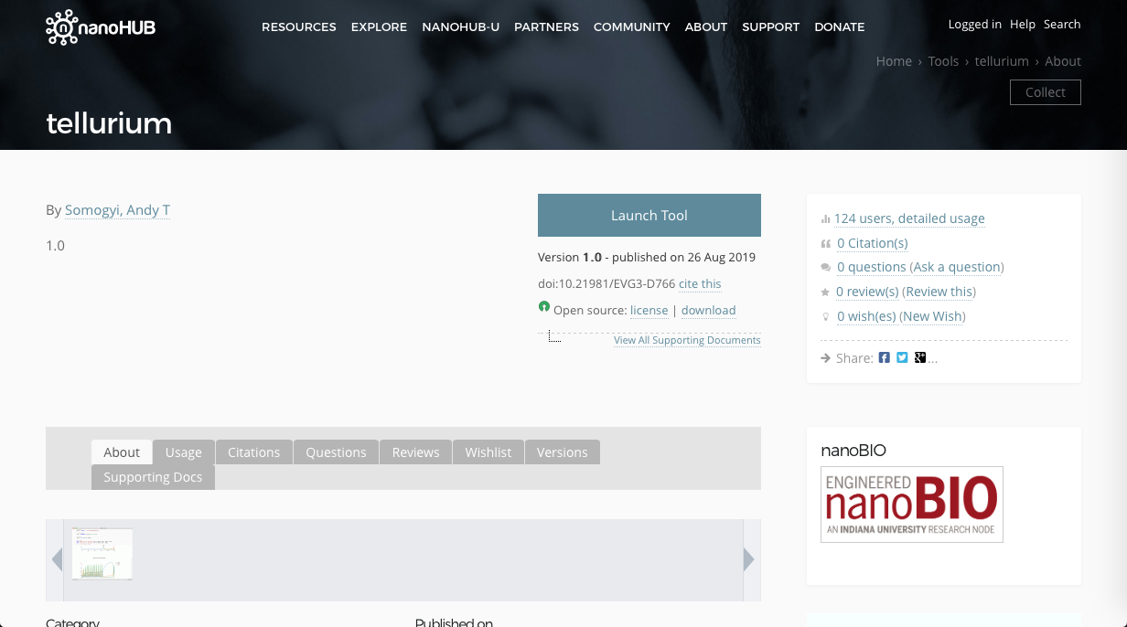
Reminder: Launch Tellurium on nanoHUB
Launch Tool

Slide 6
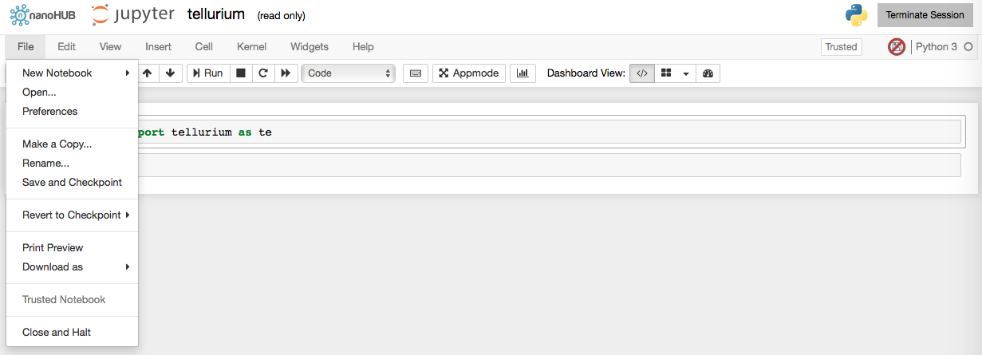
Reminder: Upload Notebook for Class Exercises to Tellurium nanoHUB
You should have your notebook available from yesterday using the Open command
If not, reload it

Slide 7
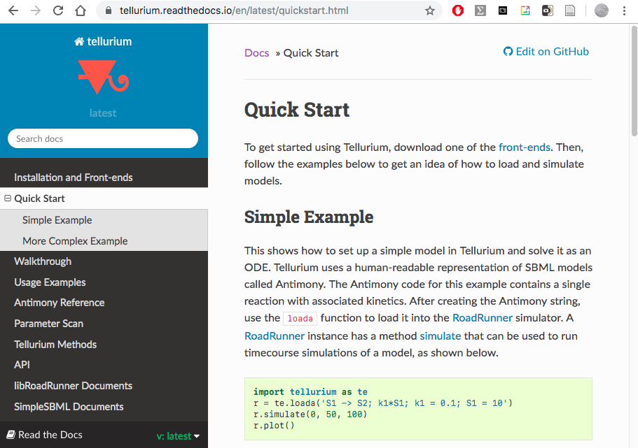
Reminder: Help and References for Tellurium
https://tellurium.readthedocs.io/
Cheat Sheet: https://compucell3d.org/CC3D_2020_class_files?action=AttachFile&do=view&target=TellRoadCheatSheet.pdf
Have documentation open in a separate window

Slide 8
Reminder: Model and Simulation Definition Structure in Tellurium
$$T\underset{→}{βTV}I_{1}$$
Mathematical model defined in the Antimony language as an Antimony String
Python commands to simulate the model and display results
Note that all your simulations will have a mixture of these two languages

Slide 9
Reminder: Specifying Rate Equations in Antimony
For $T\underset{→}{βTV}I1$
The rate equations are:
$$\frac{dT}{dt}=−βTV, \frac{dI_{1}}{dt}=βTV$$
In Antimony:
E1 names the rate equation (and creates a variable to access its value)
T → I1 specifies the transition
beta*T*V specifies the transition rate
A more complex model would include more rate equations
$$T\underset{→}{βTV}I_{1}$$

Slide 10
Reminder: Accessing Simulations Results
Now execute the model by hitting “Shift-Enter” or “Control-Enter” for each cell
The object s now contains the time series of the simulation
Simulations variables can be accessed using the following syntax:
simulation_object[variable]
$$T\underset{→}{βTV}I_{1}$$

Slide 11
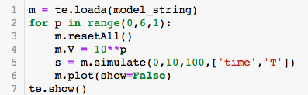
Reminder: Selecting Output Columns Tellurium
We can conveniently choose to output only selected variables in the ODE by listing the variable we want to display in the simulate function at the end of the call
Remember that ‘Time’ is a reserved word for the simulation time
To store all variables in s:
s=m.simulate(0,10,100)
To store only variables time, T and I1 in s:
s=m.simulate(0,10,100,[‘Time’,’T’,’I1’])
If we don’t explicitly ask for time, it will not be saved

Slide 12
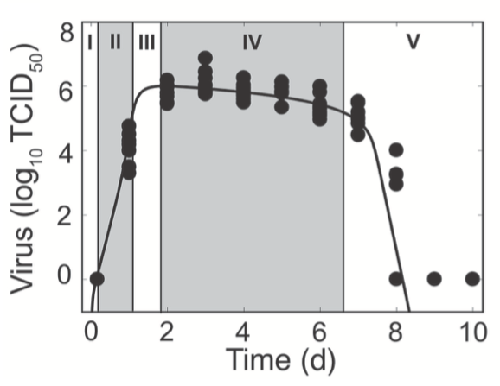
Key Rates and Times in the Viral Load Curve
Get times and rates and values
1) Eclipse Phase: 6 hours
2) Exponential growth: ten-fold over 1/6 day for 1 day
3) Saturation: 10E6 at day 1
4) Slow decrease: 10 fold over 5 days (from 10E6 at day 2 to 10E5 at day 7)
5) Fast decrease: 10E5 over 2 days (from 10E5 at day 7 to 10E0 at day 8) or 10-fold over 2/5 of a day for 2 days
Phase | Rate
Eclipse Phase | 6 hours
Exponential Growth Phase | 10-fold over 4 hours
Saturation Phase | 10E6 at day 1
Slow Clearance Phase | 10-fold over 5 days
Rapid Clearance Phase | 10E5 over 2 days
Smith AM. Influenza Virus Infection Model With Density Dependence Supports Biphasic Viral Decay

Slide 13
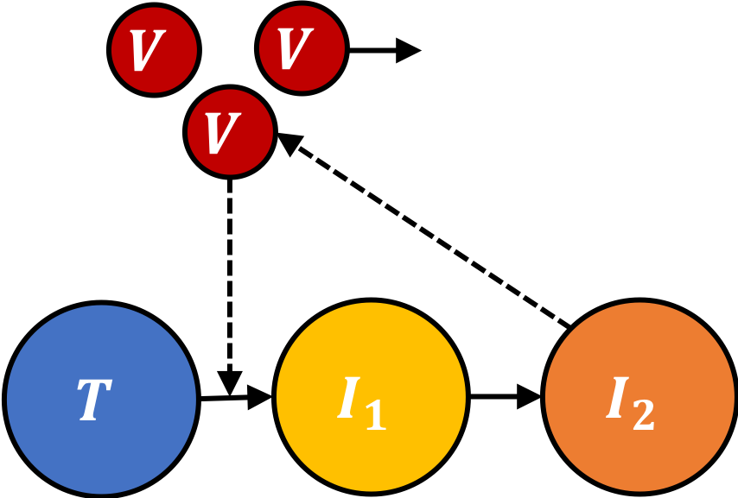
Base Model of Viral Infection in a Tissue
Including infection of uninfected cells (T) by virus ($V$) to produce early infected cells ($I1$) , transition from early ($I1$) to late (virus releasing) cells ($I2$) and production and release of the virus by the virus releasing cells, we obtain:
$$\frac{dT}{dt}=−βTV, \frac{dI_{1}}{dt}=βTV−kI_{1}$$
$$\frac{dI_{2}}{dt}=kI_{1}, \frac{dV}{dt}=pI_{2}$$
$$T\underset{→}{βVT}I_{1}$$
$$I_{1}\underset{→}{kI_{1}}I_{2}$$
$$\underset{→}{pI_{2}}V$$
$$β={6.2×10}^{−5}per cell/TCID$$
$$k=4.0 per day$$
$$p=1.0\frac{TCID}{cell day}$$

Slide 14
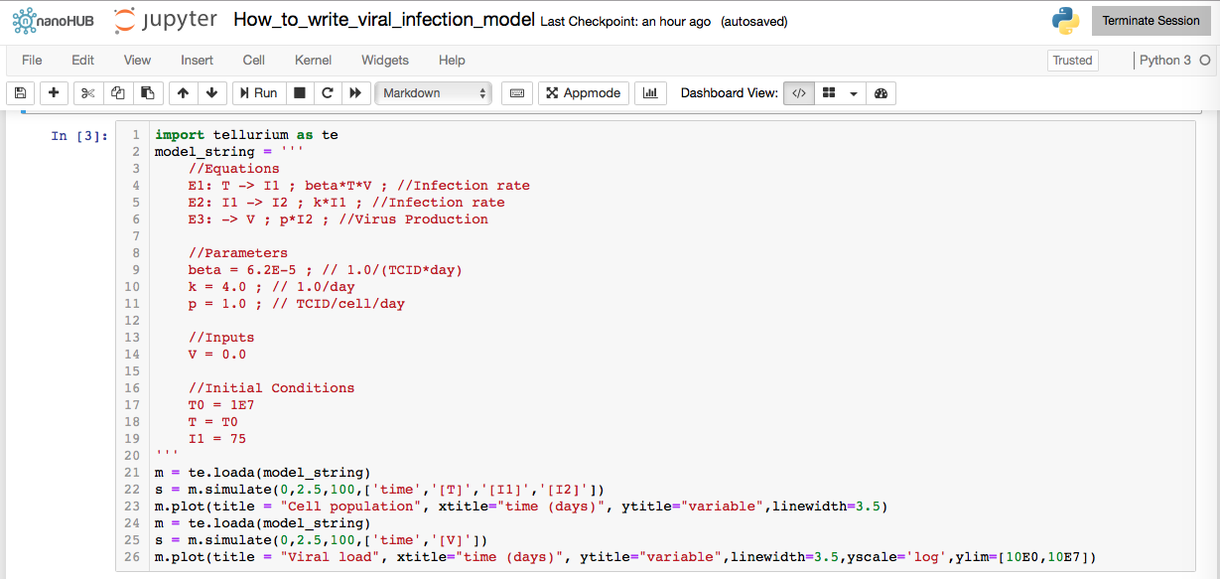
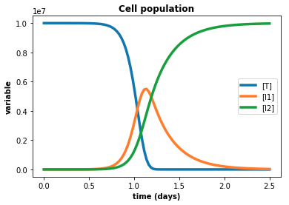
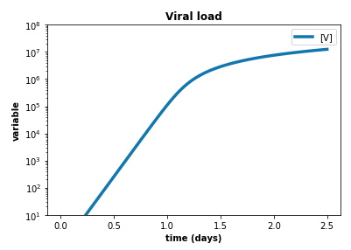
Simulating the Base Model of Viral Infection
Phase | Rate
Eclipse Phase | 6 hours
Exponential Growth Phase | 10-fold over 4 hours
Saturation Phase | 10E6 at day 1
Slow Clearance Phase | 10-fold over 5 days
Rapid Clearance Phase | 10E5 over 2 days
$$T\underset{→}{βVT}I_{1}$$
$$I_{1}\underset{→}{kI_{1}}I_{2}$$
$$\underset{→}{pI_{2}}V$$

Slide 15
Exercise 1.5.3: Exponential Growth of the Virus
Explore how the parameters ($β$, $k$ and $p$) change the exponential growth phase of the viral curve.
Perform parameter sweeps and overlay the viral curve plots
1) Parameter sweep of the infectivity $β$
2) Parameter sweep of the eclipse phase $k$
3) Parameter sweep of the viral release by late infected cells $p$
4) Try changing the infection rule to $T+V\underset{→}{βTV}I1$

Slide 16
Viral Decay and Removal
$$T\underset{→}{βVT}I_{1}$$
$$I_{1}\underset{→}{kI_{1}}I_{2}$$
$\underset{→}{pI_{2}}V$ $\underset{→}{cV}$
Extracellular virus has a lifespan during which it can infect cells and after which it degrades and its not longer infectious. It is also removed by phagocytosis by macrophages and neutrophils
We next add a virus decay term that is proportional to the amount of extracellular virus and the clearance rate $c$ which is the reciprocal of the lifetime of the virus in the tissue (which is about 2.5 hours) so $c ≈9.4 per$day
Adding the decay term will allow us to reproduce the viral load curves that the amount of extracellular virus reaches a plateau.
$$\frac{dV}{dt}=pI_{2}−cV$$
$p=1.0$ TCID/epithelial cell/day
$$c=9.4 \text{/}\text{day}$$

Slide 17
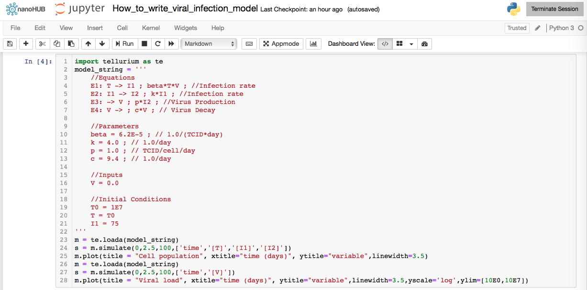
Viral Decay in Simulation
Changes to model from previous run
Will assume that the typical lifetime of virus in the tissue is $2.5$ hours which is $\sim 1/10$of a day (from experimental studies)
So the rate of clearance is the reciprocal
$c=9.4$per day (from Amber Smith)
$$T\underset{→}{βVT}I_{1}$$
$$I_{1}\underset{→}{kI_{1}}I_{2}$$
$\underset{→}{pI_{2}}V$ $\underset{→}{cV}$
Exercise—Run it!

Slide 18
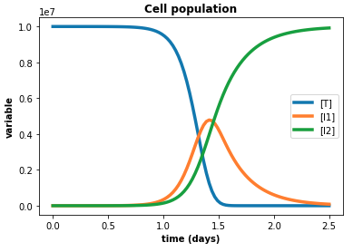
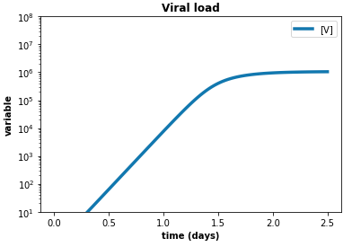
Viral Decay in Simulation
Phase | Rate
Eclipse Phase | 6 hours
Exponential Growth Phase | 10-fold over 4 hours
Saturation Phase | 10E6 at day 1
Slow Clearance Phase | 10-fold over 5 days
Rapid Clearance Phase | 10E5 over 2 days
$$T\underset{→}{βVT}I_{1}$$
$$I_{1}\underset{→}{kI_{1}}I_{2}$$
$\underset{→}{pI_{2}}V$ $\underset{→}{cV}$

Slide 19
Exercise 1.5.4: Saturation of the Viral Load
Explore how the parameters ($β$, $k,$ $p$ and $c$) change saturation of the viral curve.
Perform parameter sweeps and overlay the viral curve plots
1) Parameter sweep of the infectivity $β$
2) Parameter sweep of the eclipse phase $k$
3) Parameter sweep of the viral release by late infected cells $p$
4) Parameter sweep of the viral decay $c$

Slide 20
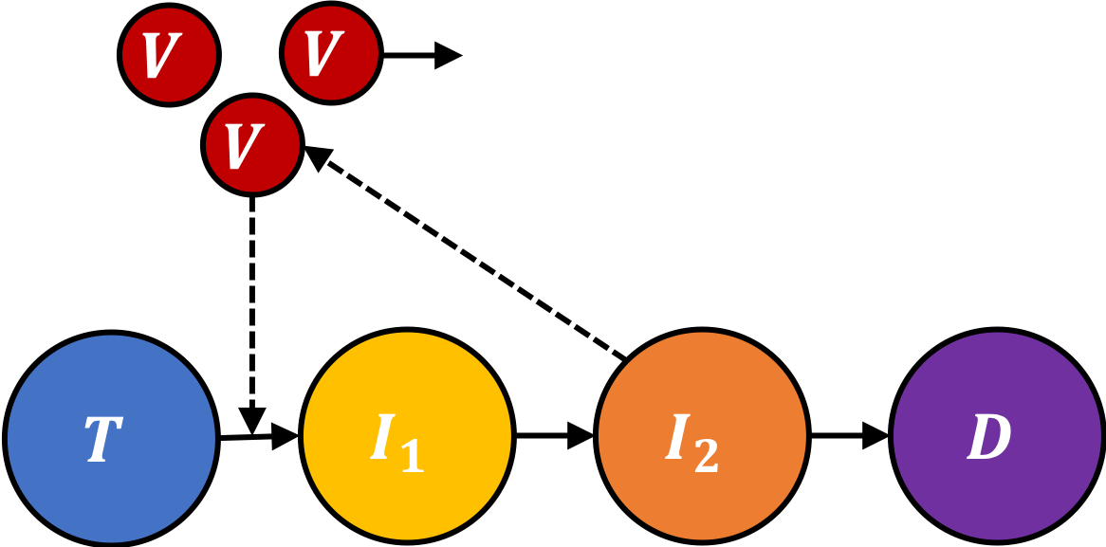
Infected Cell Death due to Viral Infection and Innate Immune Response
Infected cells have an average lifespan before they die from viral infection (from complex cell death pathways) or innate immune response (e.g. killing by NK cells)
We can approximate the death rate in our population to be first-order in the number of late infected cells ($I_{2}$) and the death rate ($d$). We will assume the lifetime of the late infected cells is about 4 days, which gives a rate of death of $d= 0.24$/day for SARS-CoV-2 the lifetime is about 2 days so $d ≈0.5$ /day
$$\frac{dI_{2}}{dt}=kI_{1}−dI_{2}, \frac{dD}{dt}=dI_{2}$$
Now we can model the slow decay in the viral curve
$$T\underset{→}{βVT}I_{1}$$
$I_{1}\underset{→}{kI_{1}}I_{2}$ $\underset{→}{dI_{2}}D$
$$\underset{→}{pI_{2}}V\underset{→}{cV}$$
The infected cell lifetime for influenza is probably shorter (12 hours) in which case $d = 2$ /day. You can try this and see what the difference is

Slide 21
Infected Cell Death due to Viral Infection and Innate Immune Response
Will assume that the typical lifetime of infected virus releasing cells is about 4 days. So the rate of clearance is the reciprocal $d=0.24$per day
The infected cell lifetime for influenza is probably shorter (12 hours) in which case $d = 2$ /day. You can try this and see what the difference is
$$T\underset{→}{βVT}I_{1}$$
$I_{1}\underset{→}{kI_{1}}I_{2}$ $\underset{→}{dI_{2}}D$
$$\underset{→}{pI_{2}}V\underset{→}{cV}$$
Exercise—Run it!

Slide 22
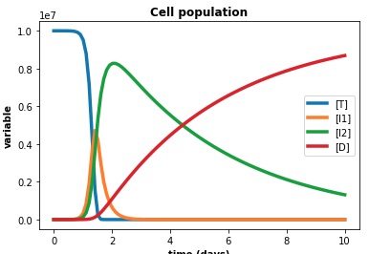
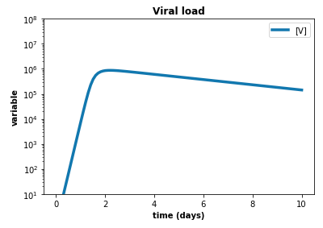
Infected Cell Death due to Viral Infection and Innate Immune Response
Phase | Rate
Eclipse Phase | 6 hours
Exponential Growth Phase | 10-fold over 4 hours
Saturation Phase | 10E6 at day 1
Slow Clearance Phase | 10-fold over 5 days
Rapid Clearance Phase | 10E5 over 2 days
$$T\underset{→}{βVT}I_{1}$$
$I_{1}\underset{→}{kI_{1}}I_{2}$ $\underset{→}{dI_{2}}D$
$$\underset{→}{pI_{2}}V\underset{→}{cV}$$

Slide 23
Principles of Modeling—Phenomenological Rate Laws
Yesterday we wrote a lot of phenomenological rate laws for transitions: from uninfected to infected, early to late infected, rate of viral release,…
No detailed experimental data on the form or values of any of these rate laws, but the simple model reproduces the experimental viral load pretty well
In chemical reactions, we have physics-based and empirical rules which let us determine the form of rate laws. These principles don’t apply for populations, but the forms are the same. Why?
How do we know what phenomenological rate laws to start with when we have no empirical information?
$$T\underset{→}{βVT}I_{1}$$
$I_{1}\underset{→}{kI_{1}}I_{2}$ $\underset{→}{dI_{2}}D$
$$\underset{→}{pI_{2}}V\underset{→}{cV}$$

Slide 24
Principles of Modeling—Phenomenological Rate Laws, Limiting Cases
How do we know what phenomenological rate laws to start with when we have no empirical information?
Often looking at Limiting Cases (what happens when one or more components of a reaction are very large, very small, or zero) can get us a long way
(The next step will be to think about “rate limitation”)
$$T\underset{→}{βVT}I_{1}$$
$I_{1}\underset{→}{kI_{1}}I_{2}$ $\underset{→}{dI_{2}}D$
$$\underset{→}{pI_{2}}V\underset{→}{cV}$$
Value
parameter

Slide 25
Phenomenological Rate Laws, Limiting Cases, Lower Bounds
Always start by thinking about what happens when the amount of a species is 0 and when it is $>0$ but very small
If we have no $I_{1}$ early infected cells, clearly the rate at which early infected cells become late infected cells $I_{1}→I_{2}$ must be zero
Similarly, if we have no virus, the rate of infection at which $T→I_{1}$ must be zero
And if we have no uninfected cells, the rate the rate of infection at which $T→I_{1}$ must also be zero
It also makes sense that for small amounts of a species, increasing the amount of that species also increases the rate (monotonicity with non-zero slope at 0)
If the slope of the rate law at zero is zero, then things are a little more complicated (Hill equations)
These two rules, by themselves give us the first approximation for a phenomenological rate law
$$T\underset{→}{βVT}I_{1}$$
$I_{1}\underset{→}{kI_{1}}I_{2}$ $\underset{→}{dI_{2}}D$
$$\underset{→}{pI_{2}}V\underset{→}{cV}$$

Slide 26
Phenomenological Rate Laws, Single Species, First Order Kinetics
1) When the amount of a species is 0, the rate must be zero
2) For small amounts of a species, increasing the amount of that species also increases the rate (monotonicity with non-zero slope at 0)
These two rules, by themselves give us the first approximation for a phenomenological rate law
Suppose the rate law for a single species is some arbitrary function of $x, f(x)$
Since $x$ is small, Taylor expand $f(x)$ around $x=0$
$$f\left(x\right)=f\left(0\right)+xf^{′}\left(0\right)+\frac{1}{2}x^{2}f^{′′}\left(0\right)+\frac{1}{6}x^{3}f^{′′′}\left(0\right)+…$$
Rule 1 says that $f\left(0\right)=0$ or rate wouldn’t be 0 for $x=0$
$$f\left(x\right)=xf^{′}\left(0\right)+\frac{1}{2}x^{2}f^{′′}\left(0\right)+\frac{1}{6}x^{3}f^{′′′}\left(0\right)+…$$
Rule 2) says that $f^{′}\left(0\right)>0$
If $x$ is small enough, $xf^{′}\left(0\right)≫higher order terms$, so
$$f\left(x\right)≈xf^{′}\left(0\right)$$
i.e. the rate is linear in $x$, as we have used 4 times (this law is called “First order” kinetics in chemistry
$$T\underset{→}{βVT}I_{1}$$
$I_{1}\underset{→}{kI_{1}}I_{2}$ $\underset{→}{dI_{2}}D$
$$\underset{→}{pI_{2}}V\underset{→}{cV}$$

Slide 27
Phenomenological Rate Laws, Multiple Species, “Mass Action”
1) When the amount of a species is 0, the rate must be zero
2) For small amounts of a species, increasing the amount of that species also increases the rate (monotonicity with non-zero slope at 0)
Suppose the rate law for two species $x$ and $y$ is some arbitrary function of $f(x,y)$
Taylor expand $f(x,y)$ around $x=0$
$$f\left(x,y\right)=f\left(0,0\right)+x\frac{∂f}{∂x}\left(0,0\right)+y\frac{∂f}{∂y}\left(0,0\right)+\frac{1}{2}\left[x^{2}\frac{∂^{2}f}{∂x^{2}}\left(0,0\right)+2xy\frac{∂^{2}f}{∂x∂y}\left(0,0\right)+y^{2}\frac{∂^{2}f}{∂y^{2}}\left(0,0\right)\right]+𝒪\left(x^{3}\right)+…$$
Rule 1 says that $f\left(0\right)=$ $\frac{∂f}{∂x}\left(0,0\right)=$ $\frac{∂f}{∂y}\left(0,0\right)=0$ otherwise the rate wouldn’t go to zero independently when either $x$ or $y$ was 0
$$f\left(x,y\right)=\frac{1}{2}\left[x^{2}\frac{∂^{2}f}{∂x^{2}}\left(0,0\right)+2xy\frac{∂^{2}f}{∂x∂y}\left(0,0\right)+y^{2}\frac{∂^{2}f}{∂y^{2}}\left(0,0\right)\right]+𝒪\left(x^{3}\right)+…$$
$$T\underset{→}{βVT}I_{1}$$
$I_{1}\underset{→}{kI_{1}}I_{2}$ $\underset{→}{dI_{2}}D$
$$\underset{→}{pI_{2}}V\underset{→}{cV}$$

Slide 28
Phenomenological Rate Laws, “Mass Action”
1) When the amount of a species is 0, the rate must be zero
2) For small amounts of a species, increasing the amount of that species also increases the rate (monotonicity with non-zero slope at 0)
Rule 1 also says that $\frac{∂^{2}f}{∂x^{2}}\left(0,0\right)=\frac{∂^{2}f}{∂y^{2}}\left(0,0\right)=0,$otherwise the rate wouldn’t go to zero independently when either $x$ or $y$ was 0, so
$$f\left(x,y\right)=\frac{1}{2}\left[2xy\frac{∂^{2}f}{∂x∂y}\left(0,0\right)\right]+𝒪\left(x^{3}\right)+…$$
$$f\left(x,y\right)≈xy\frac{∂^{2}f}{∂x∂y}\left(0,0\right)$$
i.e. the rate is bilinear in $x$ and $y$, as we have used in the rate law for infection
This law is called “Mass Action” kinetics in chemistry
$$T\underset{→}{βVT}I_{1}$$
$I_{1}\underset{→}{kI_{1}}I_{2}$ $\underset{→}{dI_{2}}D$
$$\underset{→}{pI_{2}}V\underset{→}{cV}$$

Slide 29
Phenomenological Rate Laws, Upper Bounds, Saturation
Next think about what happens when the amount of a species is large, does the rate go to infinity or stay bounded? Does it keep increasing or does it decrease again?
For the conversion between cell types, the rates for each cell are independent, so there is no reason for the rate law to deviate from linearity
However, in other cases, especially when there are two components like the infection case, we expect to see saturation
Let’s consider the case of infection, we certainly expect the rate of infection to increase monotonically as the amount of virus per cell increases, however,
If we have a huge amount of virus per cell, the rate of infection per cell can’t be infinitely fast, because the virus takes time to bind to the surface receptors and be internalized
In this case, the time the virus takes to internalize is a rate limiting step and we would expect the rate to increase more slowly than linearly with the amount of virus per cell when the amount of virus per cell is very large
Value
parameter
$$Slope(0)$$
$$Value\left(∞\right)$$
Value
Half Maximum
parameter
Processes taking a finite time are a common cause of saturation and rate limitation

Slide 30
Phenomenological Rate Laws, Saturation
$$f\left(x\right)=v\frac{Kx}{K+x}$$
$v$ is the maximum rate and $K$ is the saturation constant
We can rewrite for clarity
$$f\left(x\right)=v\frac{x}{1+\frac{x}{K}}$$
Showing that if $x≪K$the rate increases linearly in $x$ with slope $v$ and if $x≫K$the rate is $v$, independent of $x$
$$Slope(0)$$
$$Value\left(∞\right)$$
Value
Half Maximum
parameter

Slide 31
Phenomenological Rate Laws, Saturation
$$f\left(x\right)=v\frac{x}{1+\frac{x}{K}}$$
$v$ is the maximum rate and $K$ is the half maximal saturation constant
Alternative possibilities include increasing exponential
$$f\left(x\right)=v\left(1−e^{−\frac{x}{K}}\right)$$
If $f\left(x\right)$ is a decreasing function of $x$ and is nonzero at 0 and zero at large $x$, the corresponding form is
$$f\left(x\right)=v\frac{1}{1+\frac{x}{K}}$$
Alternative possibilities include decreasing exponential
$$f\left(x\right)=ve^{−\frac{x}{K}}$$
In the case of multiple species which have different rate limiting effects, the number of possible basic structures can be fairly large, including $f\left(x,y\right)=v\frac{x}{1+\frac{x}{K_{1}}}$ $\frac{y}{1+\frac{y}{K_{2}}}$ and $\frac{xy}{1+\frac{x}{K_{1}}+\frac{y}{K_{2}}}$
$$Slope(0)$$
$$Value\left(∞\right)$$
Value
Half Maximum
parameter
$$Slope(0)$$
Value
Half Maximum
parameter

Slide 32
Phenomenological Rate Laws, Saturation
In another example, which we will see in a minute, the time a CD8+ effector T cell takes to kill an infected cell is about 40 minutes
If we have only a few T cells (we will denote the number by $E$) and a lot of infected cells ($I2$), then the rate at which the T cells can kill the infected cells should be independent of the number of $I2$ at 30/T-cell/day
On the other had, if we have few infected cells and few T cells, we would expect that the rate of killing will increase linearly in the number of T cells (since each one is killing independently)
The simplest form for a rate law depending on a species $x$ which is 0 when $x= 0$, linear for small $x$, monotonically increasing and reaches a maximum value for large $x$ is
$$f\left(x\right)=v\frac{Kx}{K+x}$$
Where v is the maximum rate and $K$ is the saturation constant (Michaelis constant)
Always write rate laws so that the saturation terms range from 0 to 1 as a function of $x$
$$Slope(0)$$
$$Value\left(∞\right)$$
Value
Half Maximum
parameter

Slide 33
Phenomenological Rate Laws, Saturation, T-cell Killing
In another example, which we will return to in a minute, the time a CD8+ effector T cell takes to kill an infected cell is about 40 minutes
If we have only a few T cells (we will denote the number by $E$) and a lot of infected cells ($I_{2}$), then the rate at which the T cells can kill the infected cells should be independent of the number of $I_{2}$ at 30/T-cell/day
$$f\left(x\right)=v\frac{x}{1+\frac{x}{K}}$$
$v$ is the maximum rate and $K$ is the saturation constant
In this case, $x$ is the number of infected cells, $I_{2}$, so we would expect $v=30$/T-cell/day and $K$ to be the number of T cells, $E$, so
$$f\left(I_{2},E\right)≈30\frac{I_{2}}{1+\frac{I_{2}}{E}}$$
Would be a reasonable first guess at a rate law
$$T\underset{→}{βVT}I_{1}$$
$I_{1}\underset{→}{kI_{1}}I_{2}$ $\underset{→}{dI_{2}}D$
$$\underset{→}{pI_{2}}V\underset{→}{cV}$$

Slide 34
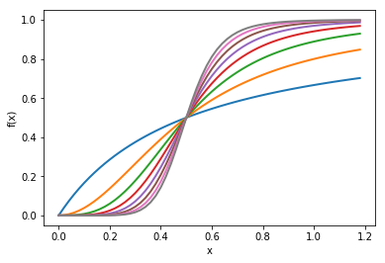
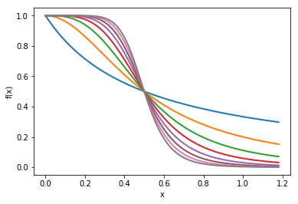
Phenomenological Rate Laws, Hill Equation
If the slope of the rate law for small x is 0 and the rate is bounded at large x and monotonically increasing, then the most common phenomenological rate law is the Hill equation
$$f_{n }\left(x\right)≡v\frac{{\frac{x}{K}}^{n}}{{0.5}^{n}+{\frac{x}{K}}^{n}}$$
$v$ is the maximum rate and $K$ is the half maximal value or saturation constant (or Hill constant) and n is the Hill exponent
If $g\left(S\right)$ is a decreasing function of $S$ and is nonzero at 0 and zero at large $x$, the corresponding form is
$$g_{n }\left(S\right)≡v\frac{1}{{0.5}^{n}+{\frac{S}{K}}^{n}}$$
Again, in the case of multiple species which have different rate limiting effects, the number of possible basic structures can be fairly large
$$n=9$$
$$f\left(x\right)$$
$$n=1$$
$$0.5$$
$$x$$
$$n=9$$
$$g\left(S\right)$$
$$n=1$$
$$K$$
$$S$$

Slide 35
Principles of Modeling: Summary Limiting Cases: Values and Slopes
When thinking about rate laws, or about results ALWAYS ask:
At the lower limit of the parameter (0 or appropriate lower bound):
Is the value 0, nonzero, infinite?
Is the slope negative infinite, negative finite, 0, positive finite?
At the upper limit of the parameter ($∞$ or appropriate upper bound):
Is the value 0, nonzero, infinite?
Is the slope negative finite, 0, positive finite, positive infinite?
Are there other places the value is constrained? E.g., a Hill function is constrained at $K$
Is the value 0, nonzero, infinite?
Is the slope negative finite, 0, positive finite?
For More information see Herbert Sauro’s Textbook, “Systems Biology, Introduction to Pathway Modeling”
Value
parameter
Behavior at 0
or appropriate lower limit
Value
parameter
Behavior at $∞$
or appropriate upper limit

Slide 36
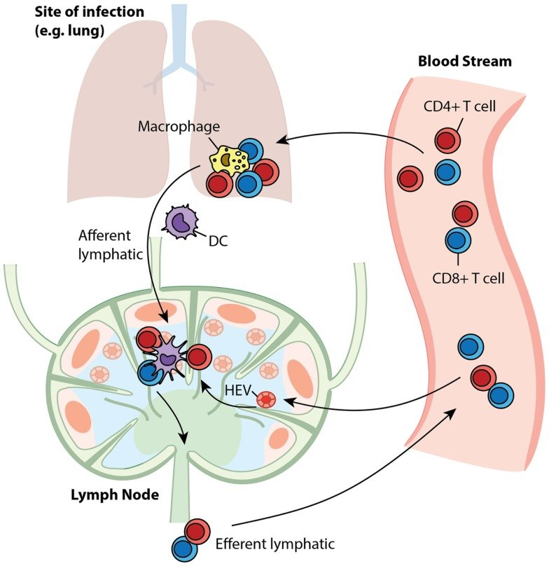
Biology of the Adaptive Immune Response
So far, our model reproduces the first four stages of the standard viral curve.
To be able to reproduce the rapid clearance we need to incorporate adaptive immune response
When cells get infected they release pro-inflammatory cytokines that signal the immune system that they are infected. The tissue also generates antigen presenting cells (APCs)
Cytokines and APCs are transported to the lymph node where they regulate replication of several kinds of adaptive immune cells. APCs take several days to get to the lymph nodes
After the adaptive immune cells proliferate, the CD8+ Effector T-cells travel through the lymphatic and circulatory system back to the infection site
Effector T-cells kill the infected cells in the infected tissue that they contact
Adding the adaptive immune response will allow us to reproduce the biphasic clearance in the viral load curve
https://www.frontiersin.org/articles/10.3389/fimmu.2014.00057/full

Slide 37
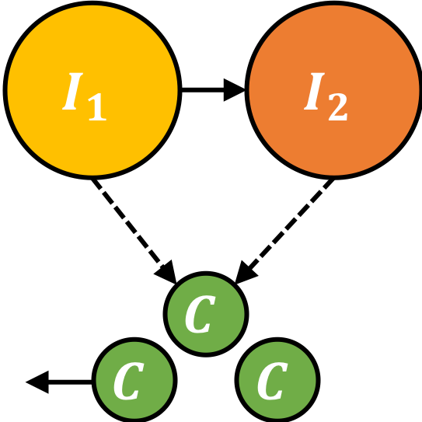
Cytokine Production and Decay
$$I_{1}\underset{→}{kI_{1}}I_{2}$$
$$\underset{→}{p_{c}(I_{1}+I_{2})}C\underset{→}{c_{C}C}$$
Let’s start with cytokine production
We’ll make cytokine ($C$) production proportional to the number of infected cells $\left(I_{1}+I_{2}\right)$, no initial cytokine $C=C_{0}=0$
As with the Virus ($V$), we will assume that cells produce cytokine at a constant rate $p_{c}$
We will also assume that cytokines degrade in the extracellular environment at a rate proportional to a decay constant ($c_{c}$). We will assume the cytokine has a lifetime of $12$ hours (1/2 day) do $c_{C}= 2.0$/day
The cytokine is a placeholder for a complex of species, so the absolute concentration doesn’t matter and we will set $p_{c}=1.0 per cell per day$
$$\frac{dC}{dt}=p_{c}\left(I_{1}+I_{2}\right) −c_{c}C$$
$p_{c}=1.0 per cell per day$
$c_{c}=2.0$ $per day$

Slide 38
Cytokine Production and Decay
$$T\underset{→}{βVT}I_{1}$$
$I_{1}\underset{→}{kI_{1}}I_{2}$ $\underset{→}{dI_{2}}D$
$$\underset{→}{pI_{2}}V\underset{→}{cV}$$
$$\underset{→}{p_{c}(I_{1}+I_{2})}C\underset{→}{c_{C}C}$$
$C=C_{0}=0$
$p_{c}=1.0 per cell per day$
$c_{c}=2.0$ $per day$
Exercise—Run it!

Slide 39
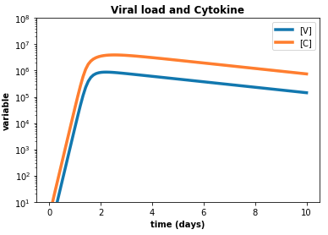
Cytokine Production and Decay
$$T\underset{→}{βVT}I_{1}$$
$I_{1}\underset{→}{kI_{1}}I_{2}$ $\underset{→}{dI_{2}}D$
$$\underset{→}{pI_{2}}V\underset{→}{cV}$$
$$\underset{→}{p_{c}(I_{1}+I_{2})}C\underset{→}{c_{C}C}$$

Slide 40
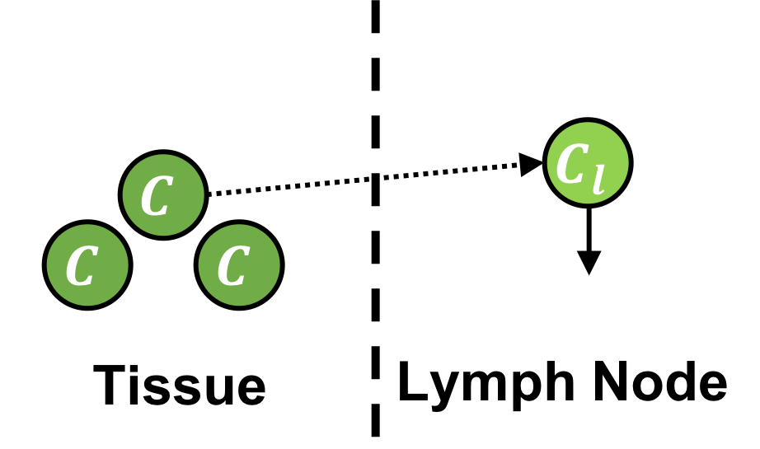
APC Transport to the Lymph Node
Cytokines released by infected cells induce antigen presenting cells which migrate to the lymph node through the lymph
Specialized immune cells (e.g. dendritic cells) also transport viral proteins from the infection site
To model transport of APCs to the lymph node, we say that the cytokine in tissue ($C$) leads to APCs in the lymph node ($C_{L}$).
The rate of APC transport to the lymph node is proportional to transport rate ($k_{c}$) that is the reciprocal of the time it takes the APC to travel to a nearby lymph node (about 2 days).
Cytokine and APCs are eliminated in the lymph node at a rate proportional to the decay rate $(c_{cl}$), lifetime about 2 days
$$\frac{dC}{dt}=p_{c}\left(I_{1}+I_{2}\right) −c_{c}C −k_{c}C$$
$$\frac{dC_{L}}{dt}=k_{c}C−c_{cl}C_{L}$$
$$C\underset{→}{k_{C}C}C_{L}\underset{→}{c_{cl}C_{L}}$$
$k_{c}=0.5$ /day
$c_{cl}=0.5$/day

Slide 41
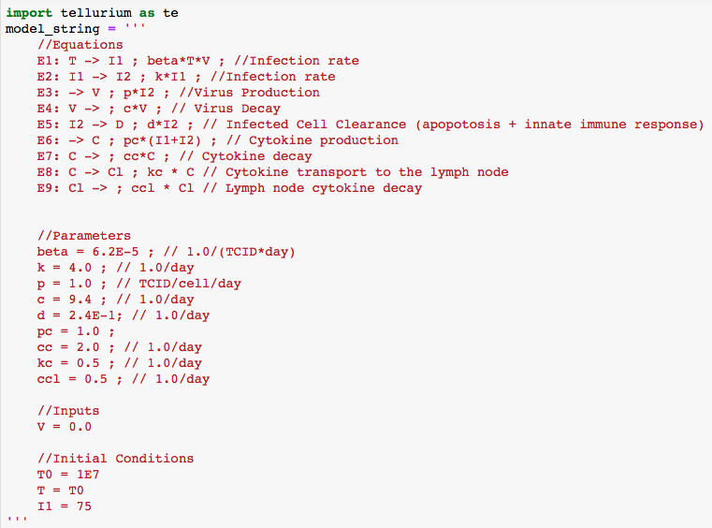
APC Transport to the Lymph Node
$$T\underset{→}{βVT}I_{1}$$
$I_{1}\underset{→}{kI_{1}}I_{2}$ $\underset{→}{dI_{2}}D$
$$\underset{→}{pI_{2}}V\underset{→}{cV}$$
$$\underset{→}{p_{c}(I_{1}+I_{2})}C\underset{→}{c_{C}C}$$
$$C\underset{→}{k_{C}C}C_{L}\underset{→}{c_{cl}C_{L}}$$
$k_{c}=0.5$ /day
$c_{cl}=0.5$/day
Our naming is unfortunate here, should really have said APCs rather than cytokines in lymph node
Exercise—Run it!

Slide 42
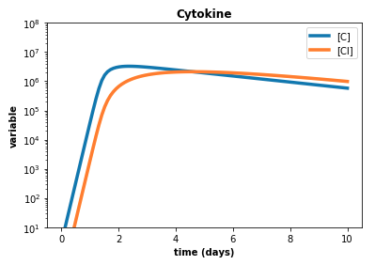
APC Transport to the Lymph Node
$$T\underset{→}{βVT}I_{1}$$
$I_{1}\underset{→}{kI_{1}}I_{2}$ $\underset{→}{dI_{2}}D$
$$\underset{→}{pI_{2}}V\underset{→}{cV}$$
$$\underset{→}{p_{c}(I_{1}+I_{2})}C\underset{→}{c_{C}C}$$
$$C\underset{→}{k_{C}C}C_{L}\underset{→}{c_{cl}C_{L}}$$
$k_{c}=0.5$ /day
$c_{cl}=0.5$/day
What happens when you change the time the APCs take to get to the lymph node?

Slide 43
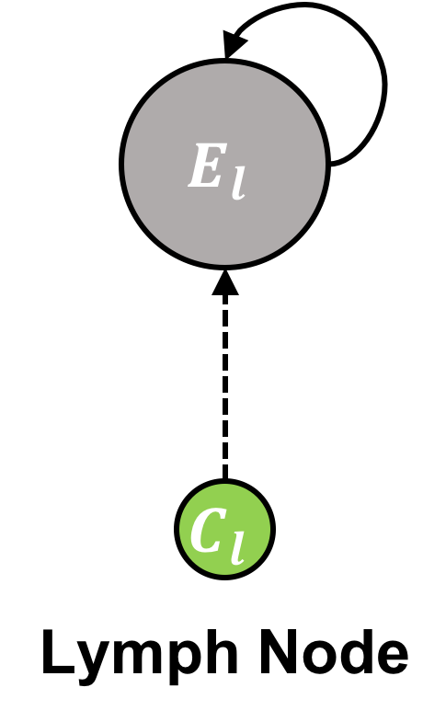
Effector T-cell Proliferation in the Lymph Node
$$\underset{→}{p_{el}C_{L}+r_{el}C_{L}E_{L}\frac{K_{el}}{K_{el}+E_{L}}}E_{L}$$
Cytokines and antigen presentation induce proliferation of effector immune cells (T-cells and B-cells) in the lymph node.
To model this, our lymph APCs ($C_{L}$) must induce proliferation of effector T-cells in the lymph node ($E_{L}$)
We assume that the lymph node APCs ($C_{L}$) both initiate conversion of inactive T cells to proliferating T cells at a rate $p_{el}=1×{10}^{−4}$ immune cells per APC per day and promote the proliferation of effector T-cells ($E_{L}$) rate $r_{el}=1.0$ per APC per day (these are guesses….)
We also assume that the replication rate of lymph node T-effector cells saturates as the number of T-effector cells increases with a typical number of $K_{el}=1× {10}^{3}$ cells
The cell cycle time for the immune cells is about a day so
$$r_{el}≈1 per day$$
$$E_{L}$$
$p_{el}=1×{10}^{−4}$ immune cells per APC per day
$r_{el}=1.0$ per APC per day
$K_{el}=1× {10}^{3}$cells

Slide 44
Effector T-cell Proliferation in the Lymph Node
$$\underset{→}{p_{el}C_{L}+r_{el}C_{L}E_{L}\frac{K_{el}}{K_{el}+E_{L}}}E_{L}$$
Cytokines and antigen presentation induce proliferation of effector immune cells (T-cells and B-cells) in the lymph node.
The specific functional form of the rate of proliferation of effector T-cells depends on our understanding of biological mechanisms and the experimental measurements of T-cell population.
$$\frac{dE_{L}}{dt}=p_{el}C_{L}+r_{el}C_{L}E_{L}\frac{K_{el}}{K_{el}+E_{L}}$$
$$E_{L}$$
$p_{el}=1×{10}^{−4}$ immune cells per APC per day
$r_{el}=1.0$ per APC per day
$K_{el}=1× {10}^{3}$cells
We could definitely consider different forms for the saturation term, in particular, we might expect that the rate of proliferation saturates as the number of APCs increases

Slide 45
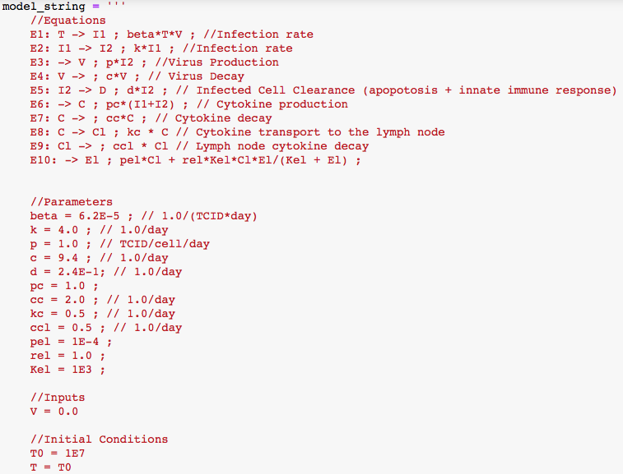
Effector T-cell Proliferation in the Lymph Node
$$T\underset{→}{βVT}I_{1}$$
$$I_{1}\underset{→}{kI_{1}}I_{2}\underset{→}{dI_{2}}D$$
$$\underset{→}{pI_{2}}V\underset{→}{cV}$$
$$\underset{→}{p_{c}(I_{1}+I_{2})}C\underset{→}{c_{C}C}$$
$$C\underset{→}{k_{C}C}C_{L}\underset{→}{c_{cl}C_{L}}$$
$$\underset{→}{p_{el}C_{L}+r_{el}C_{L}E_{L}\frac{K_{el}}{K_{el}+E_{L}}}E_{L}$$
$p_{el}=1×{10}^{−4}$ immune cells per APC per day
$r_{el}=1.0$ per APC per day
$K_{el}=1× {10}^{3}$cells
Exercise—Run it!

Slide 46
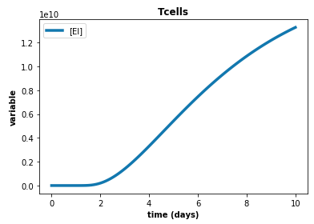
Effector T-cell Proliferation in the Lymph Node
$$T\underset{→}{βVT}I_{1}$$
$$I_{1}\underset{→}{kI_{1}}I_{2}\underset{→}{dI_{2}}D$$
$$\underset{→}{pI_{2}}V\underset{→}{cV}$$
$$\underset{→}{p_{c}(I_{1}+I_{2})}C\underset{→}{c_{C}C}$$
$$C\underset{→}{k_{C}C}C_{L}\underset{→}{c_{cl}C_{L}}$$
$$\underset{→}{p_{el}C_{L}+r_{el}C_{L}E_{L}\frac{K_{el}}{K_{el}+E_{L}}}E_{L}$$

Slide 47
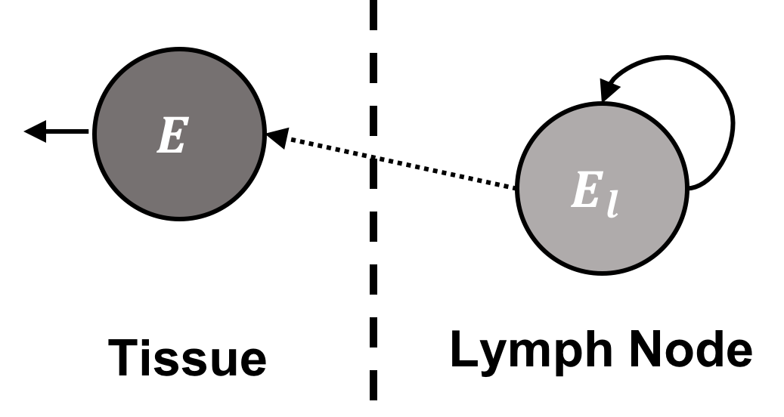
Transport T-cell to the Infection Site
Next, effector T-cells need to travel from the lymph node to the infection site.
We distinguish between effector T-cells in the lymph node ($E_{L}$) and the
We assume that the rate of transport of immune cells to the infection site ($E$) is directly proportional to the number of effector T-cells in the lymph node ($E_{L}$) and the transport rate ($k_{e}$).
Once in the tissue, effector immune cells have a lifespan determined by the exfiltration parameter ($c_{e}$)
Here we assume the cells take 2 days to reach the tissue and have a mean survival time of about a day
$$\frac{dE_{L}}{dt}=p_{el}C_{L}+r_{el}C_{L}E_{L}\frac{K_{el}}{K_{el}+E_{L}}−k_{e}E_{L}$$
$$\frac{dE}{dt}=k_{e}E_{L}−d_{e}E$$
$$E_{L}$$
$${\underset{→}{p_{el}C_{L}+r_{el}C_{L}E_{L}\frac{K_{el}}{K_{el}+E_{L}}}E}_{L}\underset{→}{k_{e}E_{L}}E\underset{→}{d_{e}E}E$$
$k_{e}=0.5 /day$
$d_{e}=1.0$ /day

Slide 48
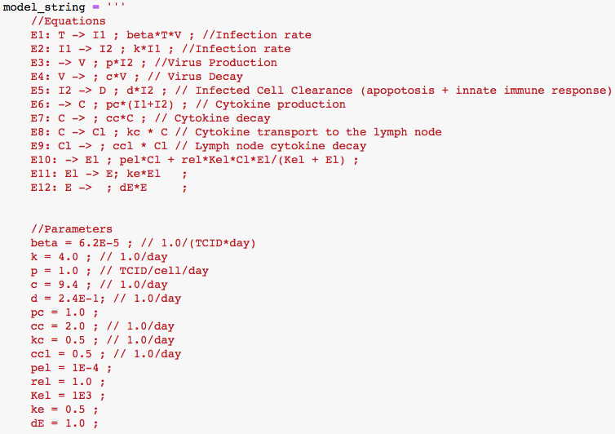
Transport T-cells to the Infection Site
$$T\underset{→}{βVT}I_{1}$$
$$I_{1}\underset{→}{kI_{1}}I_{2}\underset{→}{dI_{2}}D$$
$$\underset{→}{pI_{2}}V\underset{→}{cV}$$
$$\underset{→}{p_{c}(I_{1}+I_{2})}C\underset{→}{c_{C}C}$$
$$C\underset{→}{k_{C}C}C_{L}\underset{→}{c_{cl}C_{L}}$$
$${\underset{→}{p_{el}C_{L}+r_{el}C_{L}E_{L}\frac{K_{el}}{K_{el}+E_{L}}}E}_{L}\underset{→}{k_{e}E_{L}}E\underset{→}{c_{e}E}E$$
$k_{e}=0.5 /day$
$d_{e}=1.0$ /day
Exercise—Run it!

Slide 49
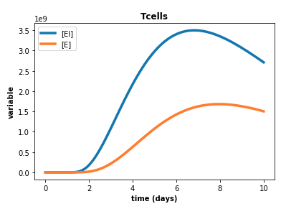
Transport T-cells to the Infection Site
$$T\underset{→}{βVT}I_{1}$$
$$I_{1}\underset{→}{kI_{1}}I_{2}\underset{→}{dI_{2}}D$$
$$\underset{→}{pI_{2}}V\underset{→}{cV}$$
$$\underset{→}{p_{c}(I_{1}+I_{2})}C\underset{→}{c_{C}C}$$
$$C\underset{→}{k_{C}C}C_{L}\underset{→}{c_{cl}C_{L}}$$
$${\underset{→}{p_{el}C_{L}+r_{el}C_{L}E_{L}\frac{K_{el}}{K_{el}+E_{L}}}E}_{L}\underset{→}{k_{e}E_{L}}E\underset{→}{c_{e}E}E$$

Slide 50
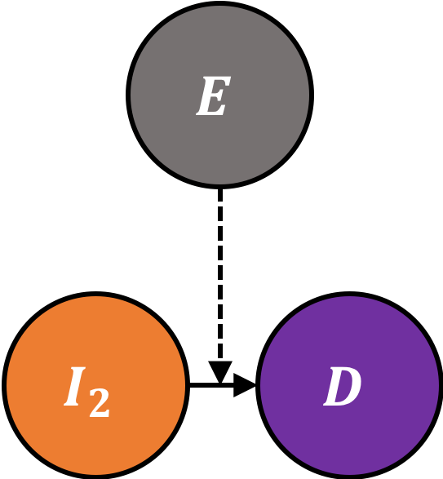
T-cell-Mediated Cytotoxicity
We model the adaptive immune response as T-cell-mediated cytotoxicity
T-cells induce infected-cell death by recognizing pathogen-associated proteins in the infected cell surface, which means that T-cells most find their target cells in the tissue.
The rate of T-cell killing is a function of how easy is for effector T-cells in the tissue ($E$) to encounter their target cells ($I_{2}$)
We model this limiting factor by including a saturating term in the rate of cell killing that depends on both the number of infected cells ($I_{2}$) and the number of effector immune cells ($E$)
$$I_{2}\underset{→}{d_{ei2}EI_{2}\frac{K_{ei2}}{K_{ei2}+E+I_{2}}}D$$

Slide 51
T-cell-Mediated Cytotoxicity
We model the adaptive immune response as T-cell-mediated cytotoxicity
In the tissue T-cells take about 40 minutes to kill infected cells once they contact them. If there are few T cells per infected cell, the rate of killing is then about 30 / T cell / day
If there are very few infected cells, the T cells take time to find them (which is determined by the threshold $K_{ei2}$).
We chose $K_{ei2}{ d}_{ei2}$to give a sensible result for the levels of $E$, but did not base them on experimtal data.
If we had an experimental data set for the number of T cells in the tissue (they are available) we could constrain $K_{ei2}$ and $d_{ei2}$
$$\frac{dI_{2}}{dt}=−d_{ei2}EI_{2}\frac{K_{ei2}}{K_{ei2}+E+I_{2}}$$
$$\frac{dD}{dt}=d_{ei2}EI_{2}\frac{K_{ei2}}{K_{ei2}+E+I_{2}}$$
$$I_{2}\underset{→}{d_{ei2}EI_{2}\frac{K_{ei2}}{K_{ei2}+E+I_{2}}}D$$
$${{ d}_{ei2}=0.01, K}_{ei2}=500$$
We could definitely consider different forms for the saturation term

Slide 52
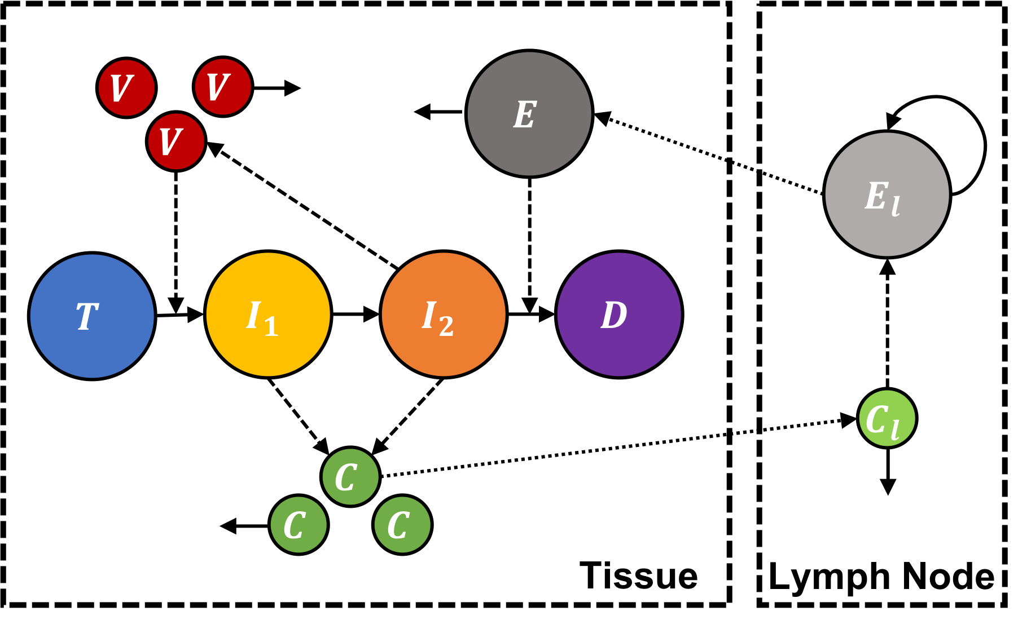
Full Model with Viral Infection and Adaptive Immune Response
$$T\underset{→}{βVT}I_{1}$$
$$I_{1}\underset{→}{kI_{1}}I_{2}\underset{→}{dI_{2}+d_{ei2}EI_{2}\frac{K_{ei2}}{K_{ei2}+E+I_{2}}}D$$
$$\underset{→}{pI_{2}}V\underset{→}{cV}$$
$$\underset{→}{p_{c}(I_{1}+I_{2})}C\underset{→}{c_{C}C}$$
$$C\underset{→}{k_{C}C}C_{L}\underset{→}{c_{cl}C_{L}}$$
$${\underset{→}{p_{el}C_{L}+r_{el}C_{L}E_{L}\frac{K_{el}}{K_{el}+E_{L}}}E}_{L}\underset{→}{k_{e}E_{L}}E\underset{→}{c_{e}E}E$$

Slide 53
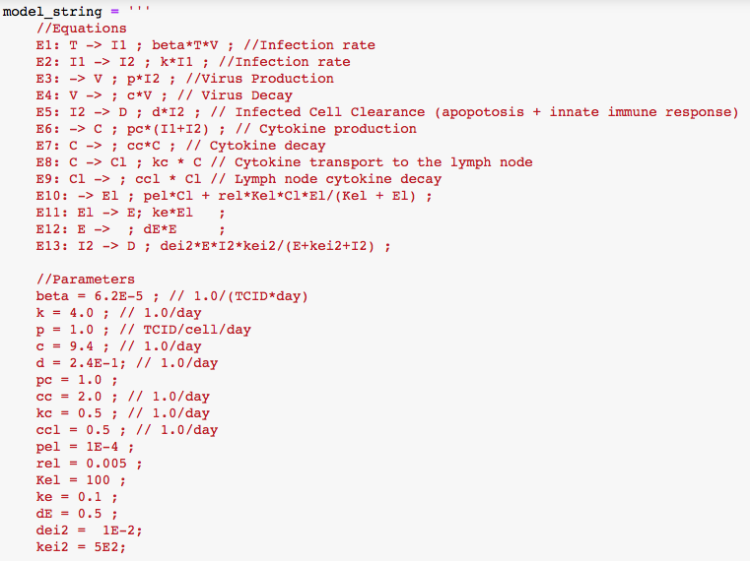
Simulating Everything Together
$$T\underset{→}{βVT}I_{1}$$
$$I_{1}\underset{→}{kI_{1}}I_{2}\underset{→}{dI_{2}+d_{ei2}EI_{2}\frac{K_{ei2}}{K_{ei2}+E+I_{2}}}D$$
$$\underset{→}{pI_{2}}V\underset{→}{cV}$$
$$\underset{→}{p_{c}(I_{1}+I_{2})}C\underset{→}{c_{C}C}$$
$$C\underset{→}{k_{C}C}C_{L}\underset{→}{c_{cl}C_{L}}$$
$${\underset{→}{p_{el}C_{L}+r_{el}C_{L}E_{L}\frac{K_{el}}{K_{el}+E_{L}}}E}_{L}\underset{→}{k_{e}E_{L}}E\underset{→}{c_{e}E}E$$
$${ d}_{ei2}=0.01$$
$$K_{ei2}=500$$
Exercise—Run it!

Slide 54
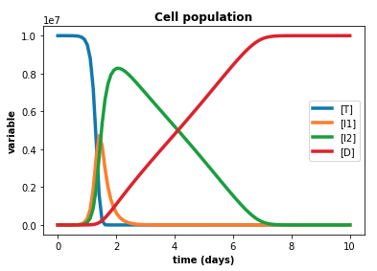
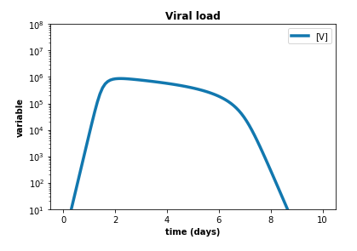
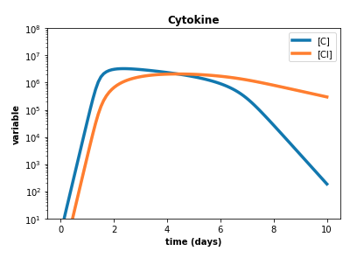
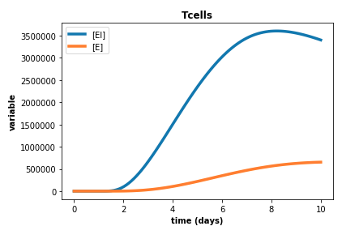
Full Model Results

Slide 55
Comparing Simulated and Experimental Viral Load Curves
Phase | Rate
Eclipse Phase | 6 hours
Exponential Growth Phase | 10-fold over 4 hours
Saturation Phase | 10E6 at day 1
Slow Clearance Phase | 10-fold over 5 days
Rapid Clearance Phase | 10E5 over 2 days

Slide 56
Exercise 1.5.5: Rapid Adaptive Immune Clearance of the Virus
Explore how the immune parameters ($k_{e}$, $d_{ei2},$ $K_{ei2}$) change the timing and rate of the rapid clearance of the viral load
Perform parameter sweeps and overlay the viral curve plots
1) Parameter sweep of the transport of effector T-cells to tissue $k_{e}$
2) Parameter sweep of the rate of killing by effector T-cells $d_{ei2}$
3) Parameter sweep of saturation of killing by effector T-cells $k_{ei2}$
Try combinations of these parameters to compensate for each other
4) Try using the model in which the virus is used up on infection $T+V\underset{→}{βVT}I_{1}$
$$T\underset{→}{βVT}I_{1}$$
$$I_{1}\underset{→}{kI_{1}}I_{2}\underset{→}{dI_{2}+d_{ei2}EI_{2}\frac{K_{ei2}}{K_{ei2}+E+I_{2}}}D$$
$$\underset{→}{pI_{2}}V\underset{→}{cV}$$
$$\underset{→}{p_{c}(I_{1}+I_{2})}C\underset{→}{c_{C}C}$$
$$C\underset{→}{k_{C}C}C_{L}\underset{→}{c_{cl}C_{L}}$$
$${\underset{→}{p_{el}C_{L}+r_{el}C_{L}E_{L}\frac{K_{el}}{K_{el}+E_{L}}}E}_{L}\underset{→}{k_{e}E_{L}}E\underset{→}{c_{e}E}E$$

Slide 57
Exercise 1.5.6: Changing Model Structure and Assumptions
1) Assume that effector T-cells can also recognize and kill early infected cells ($I_{1}$)
a) Modify the ODEs
b) Modify the Antimony Model
c) Simulate the new model and compare to the previous model
2) Assume that the replication of effector T-cells in the lymph node is independent of the APCs in the lymph node
a) Modify the ODEs
b) Modify the Antimony Model
c) Simulate the new model and compare to the previous model

Slide 58
Exercise/Homework 1.5.7: Changing Model Structure and Assumptions
Try changing the form of the saturation terms
Try to recalibrate the model for a different virus
See if you can find experimental data on the number of CD8+ T cells in the tissue as a function of time. Does our simulation agree with these data? If not, what would you have to change?

Slide 59
Next Module
Now that we have a reasonable model for viral infection and clearance that replicates the experimental viral load curves for influenza we will begin to convert it into spatial form in CC3D and compare the results to see what, if any, is the significance of the spatial structure of infection

