Slide 1
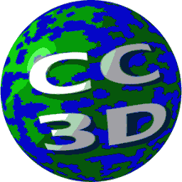
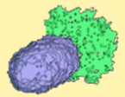
Cell Crawling
CC3D Demo
Gilberto L. Thomas
Instituto de Física – UFRGS -Brasil
15th CC3D Workshop - Biocomplexity Institute Indiana Univertity Bloomington
August 03 – 06, 2020

Slide 2
Topics:
How cells crawl
Compartmental Cells
Contact energy in compartmental cells
Exercises

Slide 3
Contents:
Introduction to the problem: Motivation
Main goals
Biological cell: movie
The computational model
The code
Creating initial cell
Tracking trajectories
Data saving

Slide 4
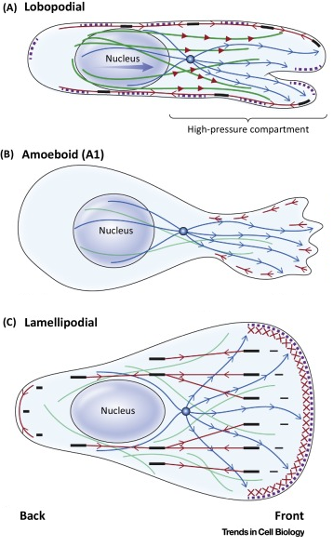
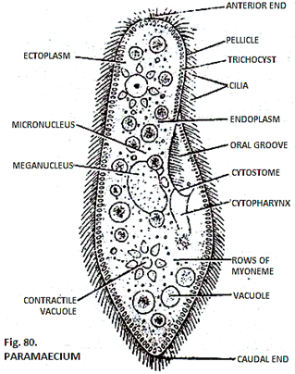
Motivation:
Cells crawling and migration is ubiquitous
in many biological processes:
embryonic development,
wound healing,
inflammatory response,
many pathologies, etc…
Internal mechanisms
Different types of movement
External mechanisms
Cilia

Slide 5
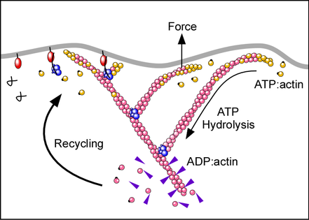
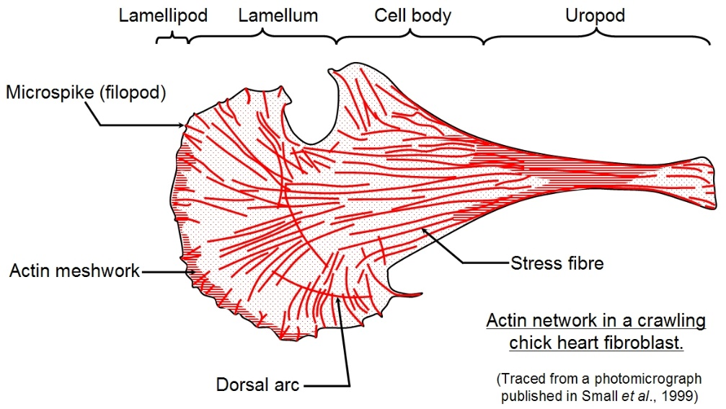
Here is how it looks like:
Maiuri, Cell 2015
Lai et al., EMBO J. 27, 2008,982–992

Slide 6
The simulation
Upload and Run the simulation in nanohub.

Slide 7
Main Goals:
To reproduce a single cell random movement;
To obtain the cell trajectory (to plot it);
To obtain data for later to characterize the movement, e.g, to calculate the cell’s:
mean square displacement (MSD);
movement persistence time (P);
average velocity autocorrelation function (AVACF);
polarization direction...

Slide 8
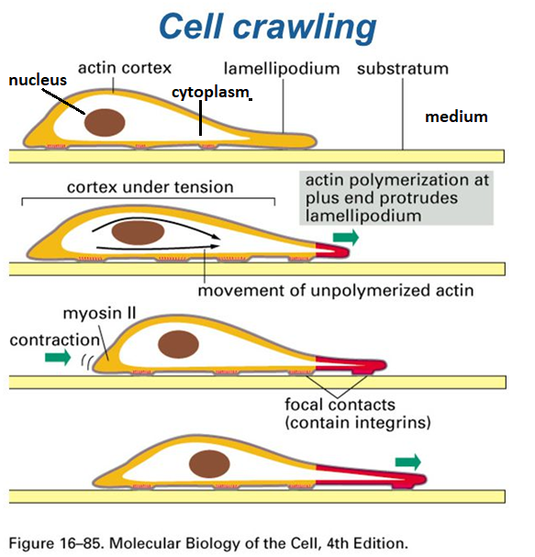
The Cell Movement Model: Abercrombie(Expl Cell Res. 67,1971)
Biological components (basic):
Medium
Substratum
The Cell: 3 well distinct parts:
Nucleus
Cytoplasm
Lamellipodium
Actin cortex
Focal contacts

Slide 9
The Computational Model: the design
Simulated components:
0 – Medium
The Cell: 3 compartments
Nucleus
Cytoplasm
Lamellipodium (Front)
4 – Substratum
Actin cortex
→ density fields (actin polymers – F-Actin
No focal contacts
Schematic representation of the simulated cell.

Slide 10
The computational model: Physics
GGH/CPM, as described previously:
$$E_{interface}=\sum_{\vec{r}}{\sum_{\vec{v}\left(\vec{r}\right)}{J\left(σ\left(\vec{r}\right),C\left(\vec{r}\right);σ\left(\vec{v}\right),C\left(\vec{v}\right)\right)}},$$
$$E_{target volume}=\sum_{C=1}^{3}{λ_{C} {\left(V_{C}−V_{C}^{target}\right)}^{2}},$$
$$E=E_{interface}+E_{target volume}+E_{F−actin},$$
$${∆E}_{F−actin}=λ_{F−actin}\left[F\left(\vec{v}\right)−F\left(\vec{r}\right)\right] δ\left(C\left(\vec{r}\right)−3\right) δ\left(σ\left(\vec{v}\right)−medium\right)\text{,}$$
$$\frac{∂F\left(\vec{r},t\right)}{∂t}= D_{F}∇^{2}F\left(\vec{r},t\right) +k_{source}δ \left(C\left(x,y,1\right)−3\right)−k_{decay} F\left(\vec{r},t\right),$$

Slide 11
The Computational Model: The Dynamics
1) The actin field in lattice sites occupied by lamellipodium (green) favors the overwriting of medium lattice sites (black) by lamellipodium lattice sites, increasing the volume of the lamellipodium compartment and extending it to the left (white to red).
Polarization axis
2) The volume constraint on the lamellipodium compartment then favors the overwriting of lamellipodium lattice sites by cytoplasm lattice sites (blue), decreasing lamellipodium compartment volume and increasing cytoplasm compartment volume (white to red).
These 3 steps create a polarization axis, which imposes a net migration of the cell in the direction of the lamellipodium compartment.
3) Finally, the volume constraint on the cytoplasm compartment favors overwriting of cytoplasm compartment lattice sites by medium lattice sites ( white to red).

Slide 12
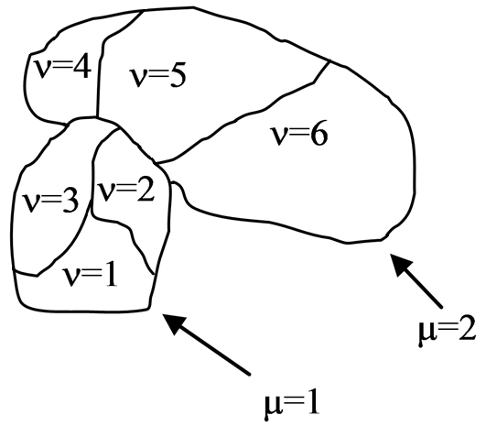
The Computational Model: structure
So, our simulated cells need to have structure!
Compartmental cells
CC3D additional plugin: ContactInternal plugin

Slide 13
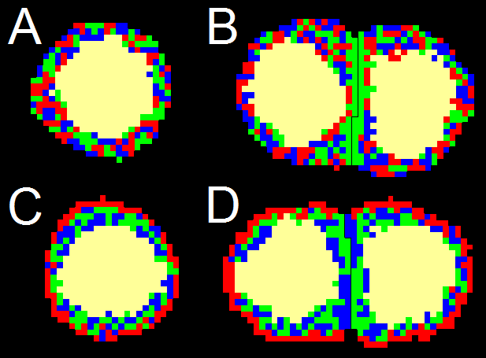
With compartmental cells plugin → Cell Polarization
cytoplasm
cadherins
ephrins
Ephs
integrins

Slide 14
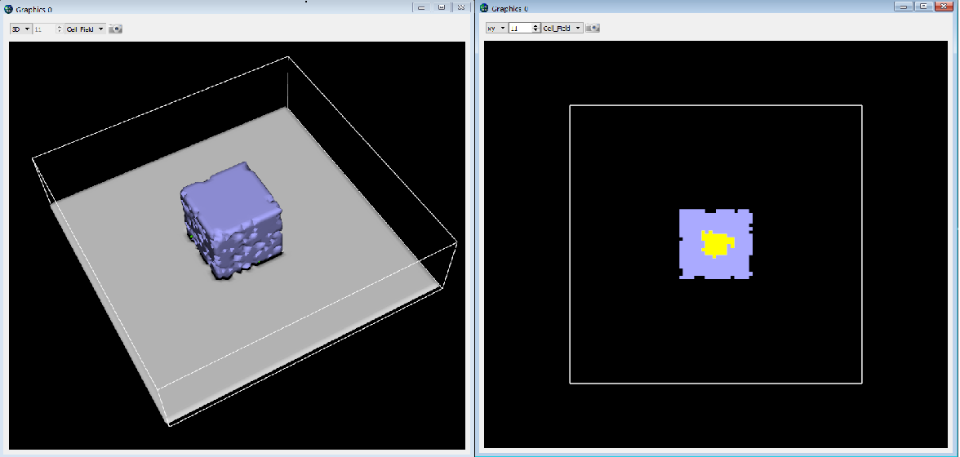
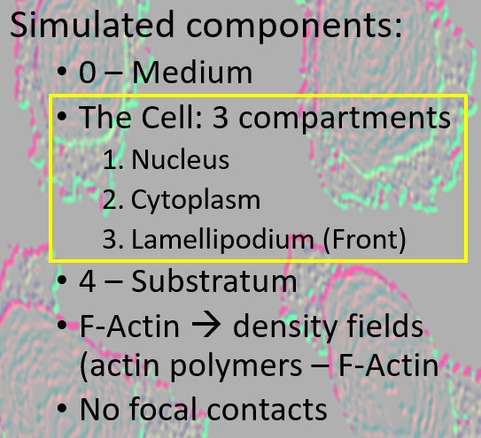
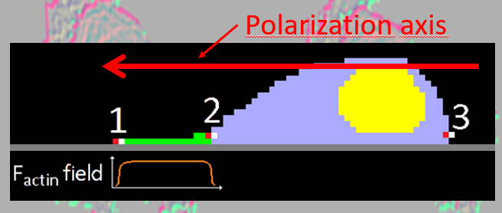
The Code: Main Goal 1. Cell movement
Remembering …
According with the simplest biological approach, our simulation initial state should be like
And the proposed dynamics …
Let’s see how to build this initial state in Twedit++, but first…

Slide 15
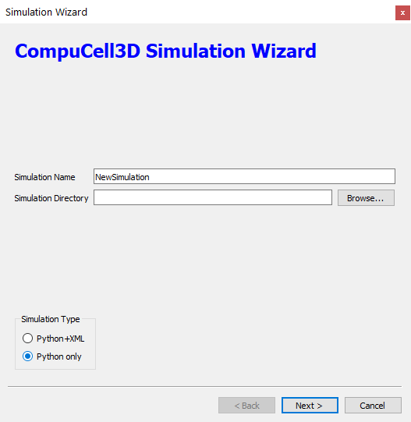
Simulation files:
Now, to Twedit++…

Slide 16
The Code: Main Goal 1. Cell movement
First, we create the design the simulation: components, dimensions, parameters, etc… .
Let’s follow the code to understand how this is done. → Twedit++
Then we create the cell initial state.
The python file contains the steppable calling section:
→ Let’s see the steppable file on Twedit++...

Slide 17
The Code: Main Goal 1. Cell movement
Here is the simulation: open player
Show the movie

Slide 18
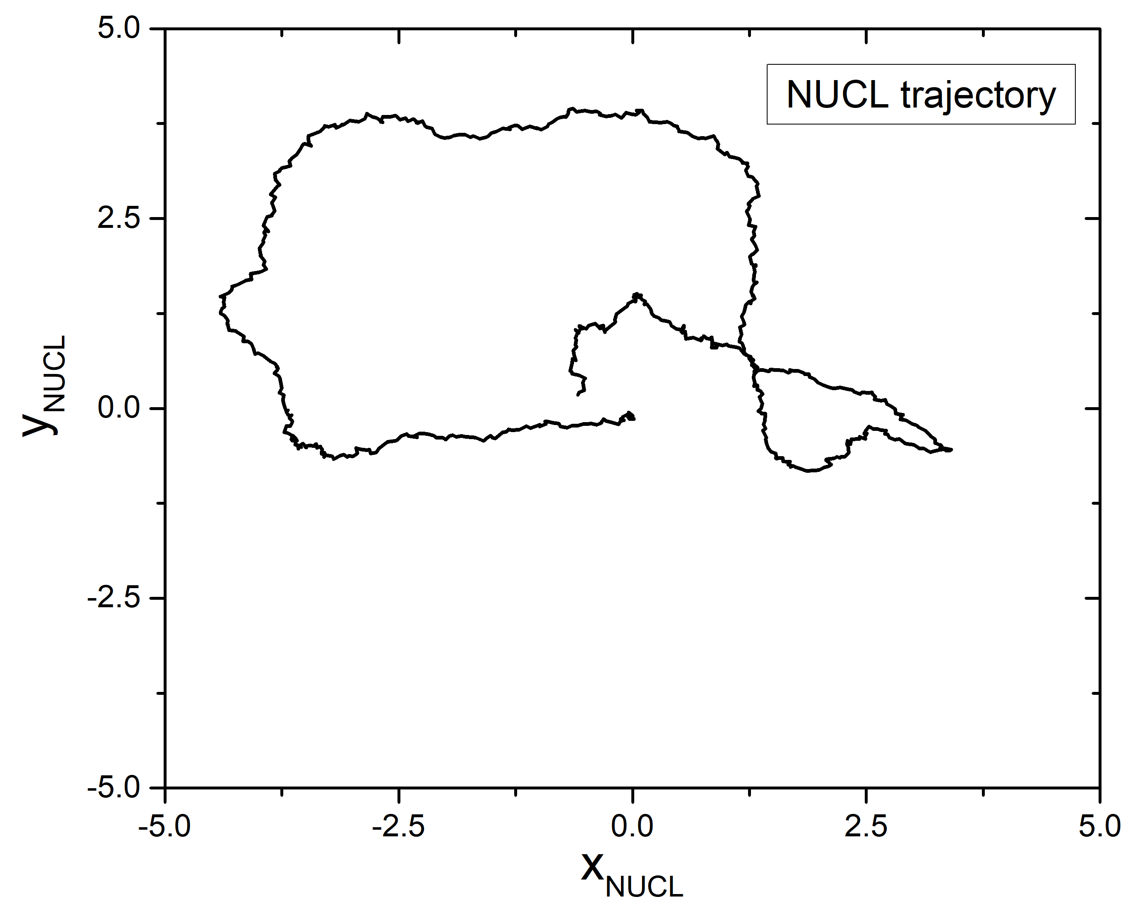
The Code: Main Goal 2. Cell trajectory
In general, cell tracking experiments follow the cell’s nuclei colored with some fluorescent chemical:
So, to achieve this goal with our computational model, we must track the position of the centers-of-mass of the cell and of its compartments. Doing that, we get:

Slide 19
The Code: Main Goal 2. Cell trajectory – centers-of-mass
To see the trajectory on-the-fly we need:
to know the center-of-mass position of the nucleus (NUCL) compartment
to open a GRAPH (or plot) window to plot this trajectory
This is achieved in the steppable Calc:
→ Let’s go back to the steppable file on Twedit++

Slide 20
The Code: Main Goal 3. Movement characterization
To characterize the cell movement, we need to calculate, from the cell trajectory, the mean square displacement (MSD):
$$〈{\left|∆\vec{r}\right|}^{2}〉=\left\langle \left. \frac{1}{T−Δt}\int_{0}^{T−Δt}{dt {\left(\vec{r}\left(t+∆t\right)−\vec{r}\left(t\right)\right)}^{2} }\right\rangle \right.$$
… meaning we have to know the entire trajectory to calculate it!
So, this calculation has to be done AFTER the simulation ends, with the data it stores in the class Calc of the steppable file.
→ Let’s go back to the steppable file on Twedit++..

Slide 21
The Code: Main Goal 3. Movement characterization
Output file names are:

Slide 22
Simulations → different cell phenotypes

Slide 23
Exercises:
Edit the .py file and
4.3.1 – change lambCHEM
4.3.2 – change front fraction phiF
4.3.3 - create a second cell at the position indicated in lines 194-195.

Slide 24
THE END

